Slide 1

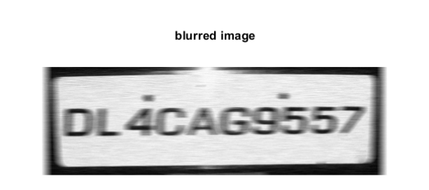
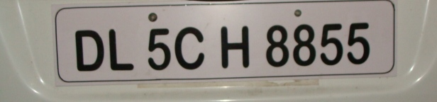
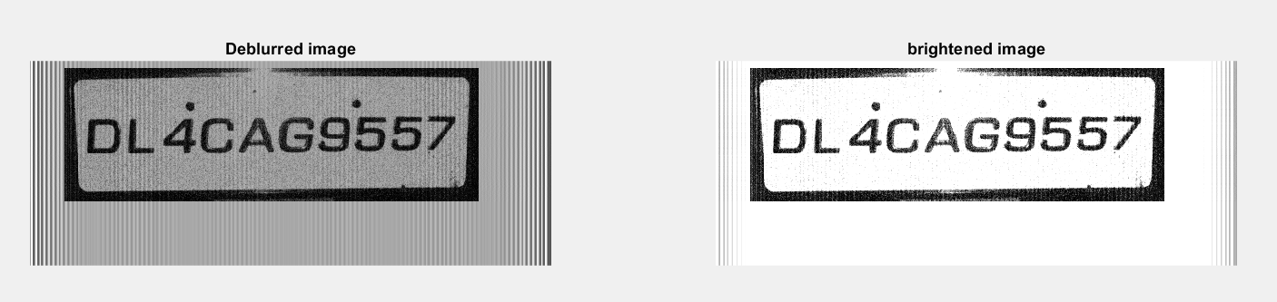

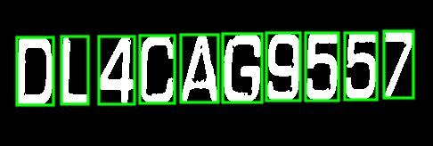

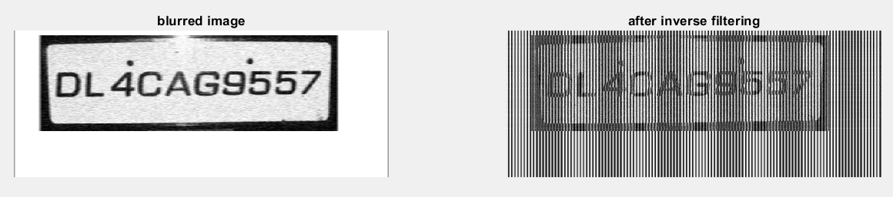
License Plate Character Recognition
Julia Przekaza and Cameron Spiess
Computer Science, Digital Image Processing
Dr. Meenalosini Vimal Cruz
May 2019
Introduction
Blurred Image with Noise
Implementation
Conclusion and Resources
Project Goals:
In this project, we will take a noisy and blurry image of a license plate and then apply some filters to it so that the Character Recognition MATLAB program will be able to read the plate.
bc=imread('image1noise.tif');
bg=im2uint8(rgb2gray(bc));
subplot(1,2,1),imshow(bg),title('original image');
%takes a sub image square of the image
b=bg(25:260,50:650);
subplot(1,2,2),imshow(b),title('sub image');
%creating the transform
m2=zeros(236,601);
m2(1,1:5)=m;
mf=fft2(m2);
bmi=ifft2(fft2(bm)./mf);
subplot(1,2,3),fftshow(bmi,'abs'),title('after inverse filtering');
%inverse filtering with constrained division
d=0.02;
mf=fft2(m2);
mf(find(abs(mf)<d))=1;
bmi=ifft2(fft2(bm)./mf);
bmi1=mat2gray(abs(bmi));
figure, subplot(1,2,1),imshow(bmi1),title('Deblurred image');
%multiply with 2 to increase the brightness
final=bmi1*2;
subplot(1,2,2),imshow(final),title('brightened image');
Conclusion:
In this project, we succeeded in reading the license plate characters from the image after we removed the blurring and noise that was on the original image.
Program:
clc
close all;
Clear;
load imgfildata;
[file,path]=uigetfile({'*.jpg;*.bmp;*.png;*.tif'},'Choose an image');
s=[path,file];
img=imread(s);
np=number_plate(img);
disp(np);
Command Window Results:
1
This is obviously wrong. We had to perform some filtering operations on the image to allow the program to read the license plate successfully.
Program:
clc
close all;
Clear;
load imgfildata;
[file,path]=uigetfile({'*.jpg;*.bmp;*.png;*.tif'},'Choose an image');
s=[path,file];
img=imread(s);
np=number_plate(img);
disp(np);
Command Window Results:
DL4CAG9557
The Character Recognition Algorithm takes an input image of the license plate and after filtering it compares each region with templates and returns string of number plate characters. This program detects the license plate numbers using the Image Correlation Method.
Character Recognition Program:
clc
close all;
Clear;
load imgfildata;
[file,path]=uigetfile({'*.jpg;*.bmp;*.png;*.tif'},'Choose an image');
s=[path,file];
img=imread(s);
np=number_plate(img);
disp(np);
Command Window Results:
DL5CH8855
Resources:
Kumar, Nishant. “Licence Plate Recognition - File Exchange - MATLAB Central.” Licence Plate Recognition - File Exchange, MATLAB Central, Jan. 2016
www.mathworks.com/matlabcentral/fileexchange
/54456-licence-plate-recognition.

