Slide 1

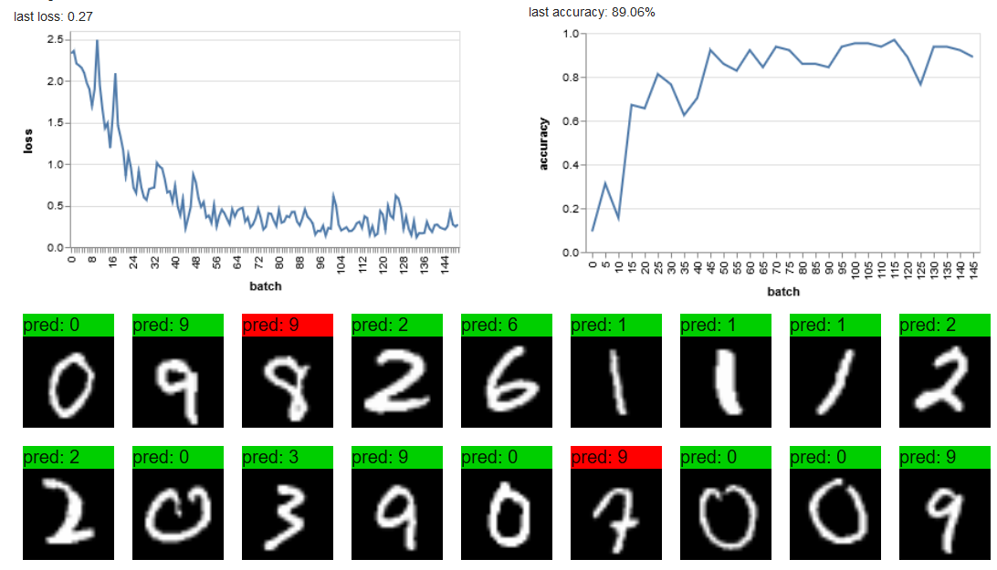
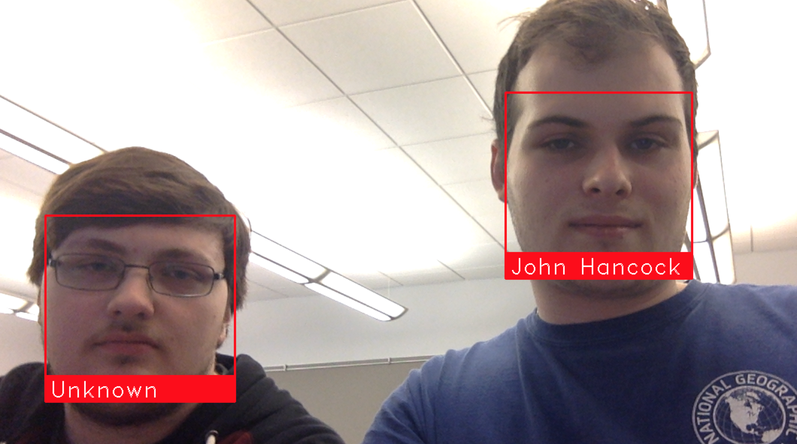

Object Detection in Computer Vision
Acknowledgements
John Hancock and Nick Saling
Dr. Meenalosini Vimal Cruz
Object detection overview
Methods
Recognizing Handwritten Characters using TensorFlow.js
Object detection is the process of finding instances of real-world objects such as faces, bicycles, and buildings in images or videos. Object detection algorithms typically use extracted features and learning algorithms to recognize instances of an object category. It is commonly used in applications such as image retrieval, security, surveillance, and advanced driver assistance systems (ADAS).
K-Means Clustering attempts to group individuals in a population together by similarity, but not driven by a specific purpose.. K-Means clustering is often called an unsupervised learning, as you don’t have prescribed labels in the data and no class values denoting a priori grouping of the data instances are given.
Utilizes a Convolutional Neural Network to recognize handwritten characters from the MNIST database. First applies several layers of filters to find patterns in the images, then defines an optimizer and loss function before training the network and testing its accuracy.
TensorFlow
Facial Recognition using Python facial recognition api
TensorFlow an open source software library, originally developed by the Google Brain team within Google’s AI organization.
Facial recognition using supervised k-means clustering in Python.
References
https://www.datacamp.com/community/tutorials/object-detection-guide
https://www.mathworks.com/discovery/object-detection.html
https://thesai.org/Downloads/Volume8No9/Paper_14-Face_Extraction_from_Image_based_on_K_Means.pdf
https://js.tensorflow.org/
http://yann.lecun.com/exdb/mnist/
https://www.tensorflow.org/
http://bigdata-madesimple.com/possibly-the-simplest-way-to-explain-k-means-algorithm/
https://www.tensorflow.org/tutorials/layers
TensorFlow.js is an open-source library that can used to define, train, and run machine learning models entirely in the browser, using Javascript and WebGL.

