Slide 1

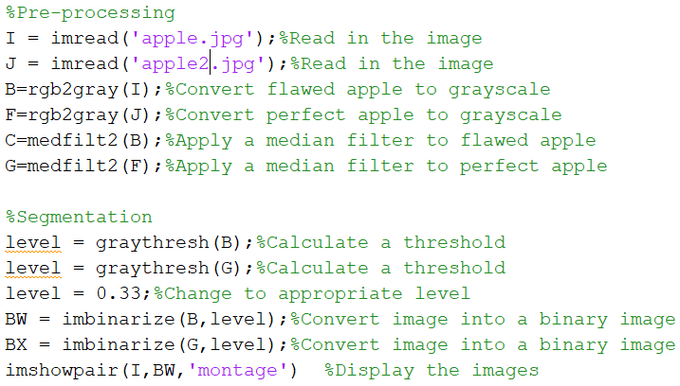
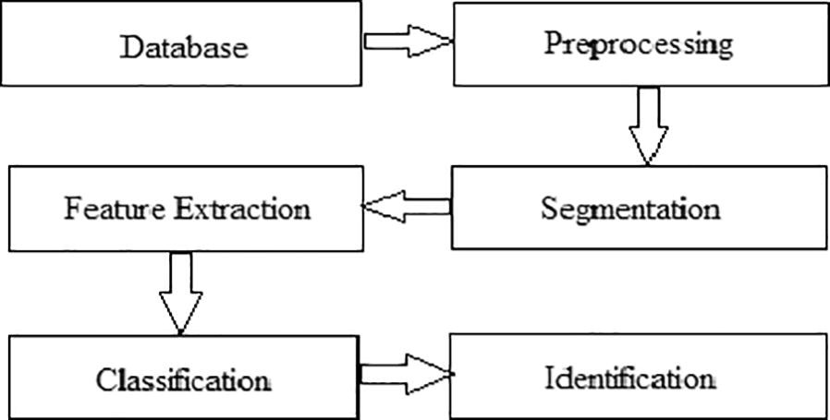
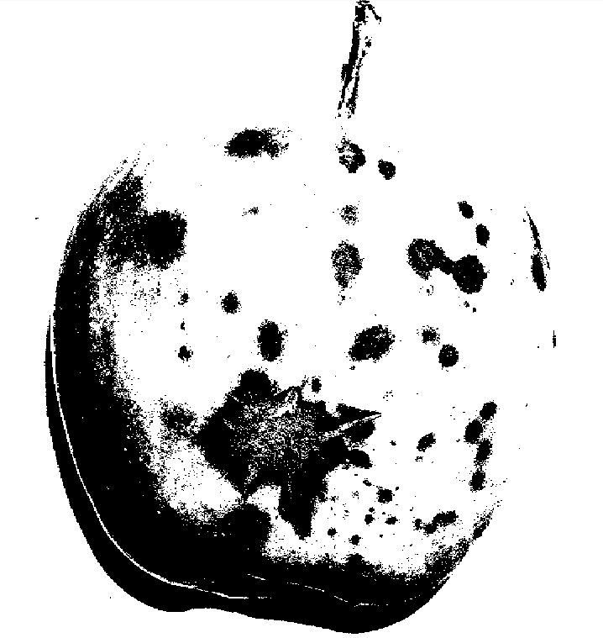
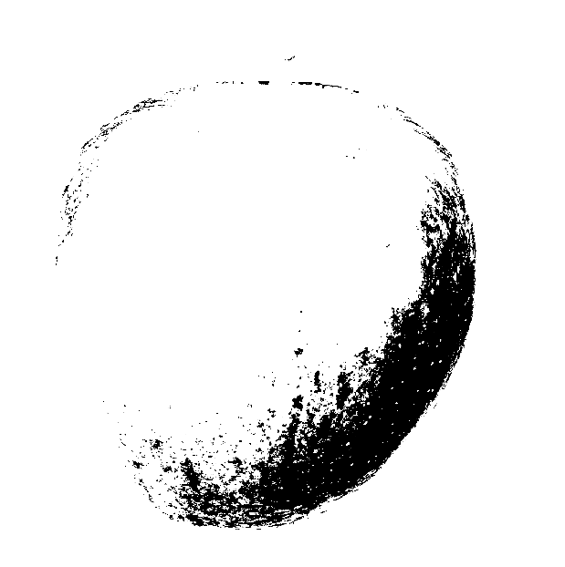
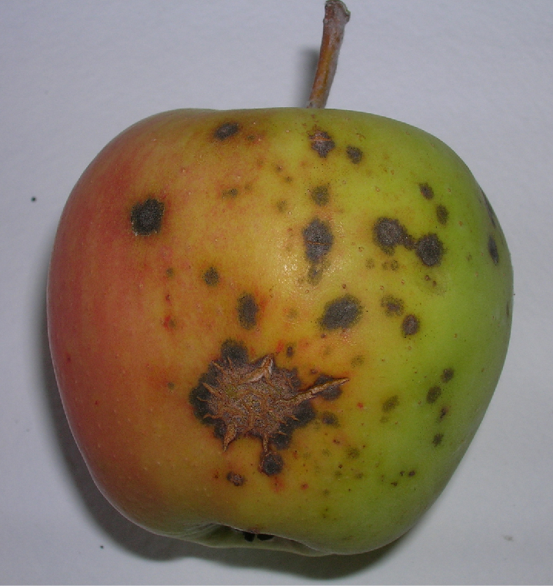
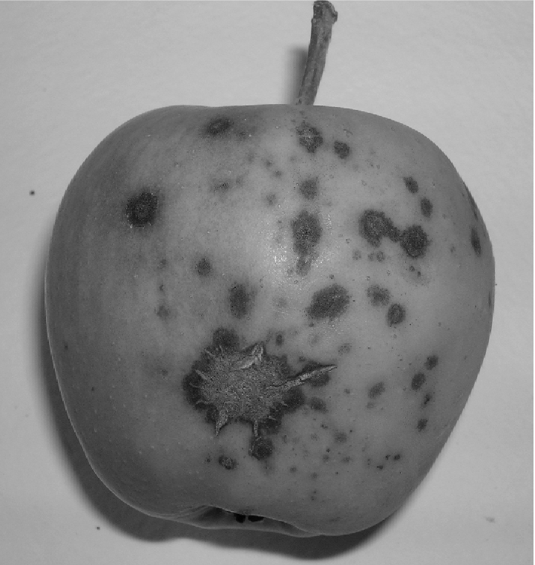
Food Inspection Using Image Processing
Kevin Chernoff & Cyril Farrar
ISCS-380-Digital Image Processing, Keene State College
Acknowledgements
Dr. Meenalosini Vimal Cruz
Introduction
Segmentation
Feature Extraction
Before reaching the shelves of grocery stores, fruits and vegetables must be evaluated and inspected for defects. This job can be completed by humans but it is time-consuming, expensive and not consistent. The solution to this problem is computer vision. The quality of produce, specifically apples can be determined by color, texture, size, shape, and defects. To inspect for these features, the image will first need to be preprocessed. This involves reducing noise in the image. The next step is segmentation. The basic purpose of segmentation is to separate the background from the object in the image and to separate the image into separate sections. Then the image will need to go through feature extraction to make it easier to determine what is important in the image. Lastly, this leads to classification and identification.
Once the image is preprocessed it is ready for segmentation. The main purpose of this is to separate the image into different sections for evaluating the significant areas. The most commonly used forms of segmentation for processing images of food are thresholding and clustering. A segmentation process commonly used on produce is called Otsu’s Method. This creates a gray level histogram from the grayscale image. The profits of this are that the threshold value and processing of the grayscale image can be completed without past information of the Image. The main overhead of Otsu’s method is the long computational time when there is a high number of clusters.
Feature extraction is the next step in processing any image. In simpler terms, this is the easiest way for a computer to understand an image. In this process, extracted features form feature vectors are used to classify and recognize the input. The feature vectors are used to classify the object precisely and the shape. This is all done to speed up the rate of feature recognition through the extraction of features. In the food industry, these features give the explicit data that can be used for quality checks
Flaw Detection
Fruit disease causes losses in yield and quality. The common disease of apples is rot and blotch. To manage the increased expectation inspection requirements, computer vision systems provide automated, and cost-effective solutions. These solutions work much faster than any human can, and is reliable 93% of the time.
Code
Results
The images show the result after thresholding using Otsu’s method. It is now obvious for a computer to see where the scabs and flaws are on the apple which can be seen in figure 1. One of the challenges of inspecting apples is the glare that reflects off of the shiny skin and the fact that some apples have multiple colors making it harder to perform segmentation. Figure 2 does not have any imperfections but the different colors and lighting make it harder to determine if there are flaws. In conclusion, digital image processing is an extremely helpful tool and is increasing in popularity by the day. The potential of this technology is nowhere near its peak and can be applied in numerous applications.
Preprocessing
Every picture is susceptible to noise. This makes it harder to perform segmentation and determine if there are flaws on the produce being inspected. To resolve this issue the image is preprocessed. When preprocessing images of apples and other foods, the most effective way to reduce noise is by converting the image to grayscale and applying a median filter.
Bhargava, A., & Bansal, A. (2018, June 05). Fruits and vegetables quality evaluation using computer vision: A review. Retrieved March/April, 2019, from https://www.sciencedirect.com/science/article/pii/S131915781830209X#b0835
Graythresh. (n.d.). Retrieved April 15, 2019, from https://www.mathworks.com/help/images/ref/graythresh.html
Mohana, Prabhakar, & Kumar, P. (2013). Surface Defect Detection and Grading of Apples. 58- 64. Retrieved April 4, 2019, from https://pdfs.semanticscholar.org/21ff/c45009c3016d465b6a16244199ba5f703e62.pdf.
Puchalski, C., Gorzelany, J., Zaguła, G., & Brusewitz, G. (2008). IMAGE ANALYSIS FOR APPLE DEFECT DETECTION. 197-205. Retrieved April 15, 2019, from http://citeseerx.ist.psu.edu/viewdoc/download?doi=10.1.1.501.781&rep=rep1&type=pdf
References
Figure 1, flawed apple after preprocessing and thresholding
Figure 2, unflawed apple after preprocessing and thresholding

