Slide 1

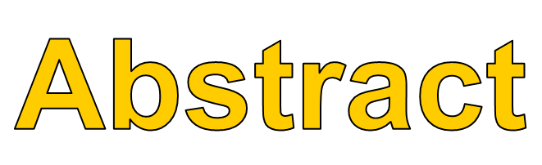
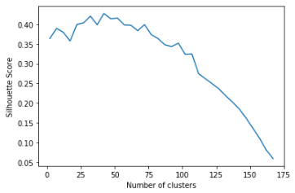
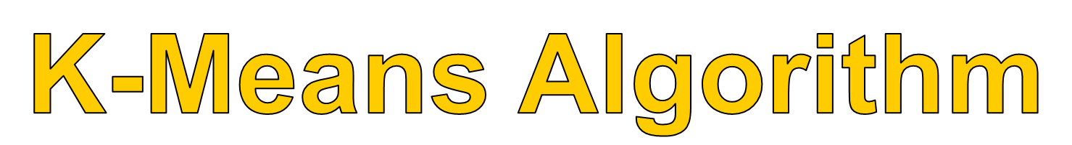
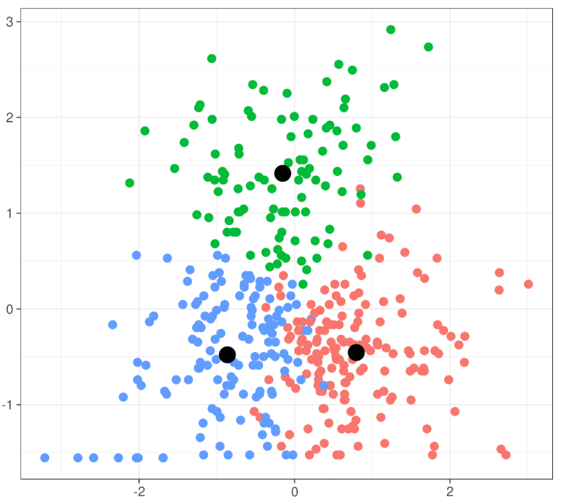
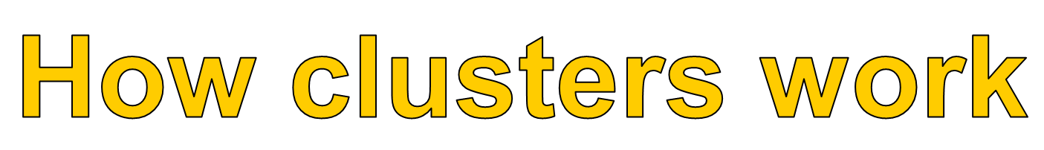
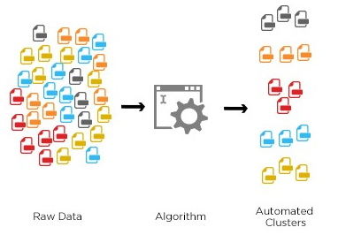
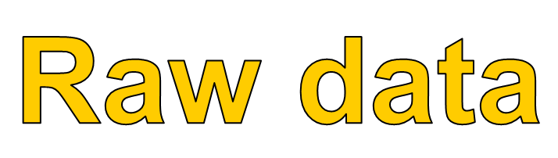
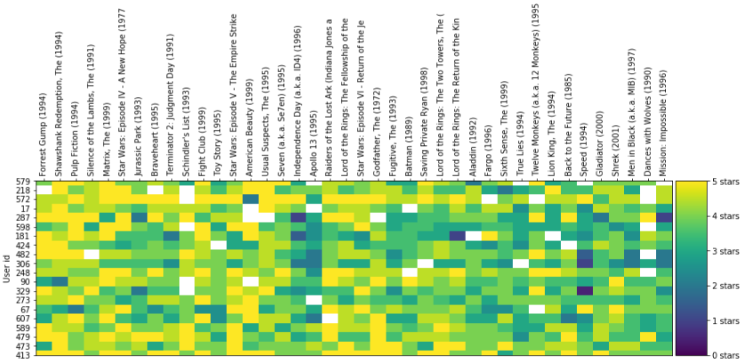

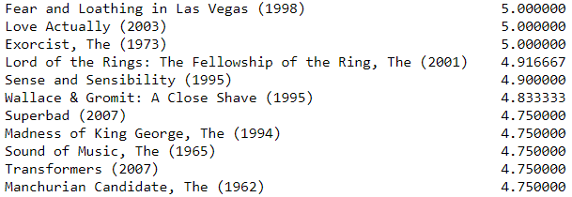
Movie Recommender
Acknowledgements: https://grouplens.org/datasets/movielens/
Author: Quinlan Wood
Have you every noticed that when you watch a video on Netflix or YouTube that soon after you will begin to see suggestion similar to what you recently watched? This is a type of market segmentation in which these streaming sites log all the recent movies and episode that you have been watching. Then by comparing you with other users with similar tastes they can suggest options that they think you would enjoy, but what if you recently watched variety of videos that you did not enjoy? This would result in your suggested videos being related to topics you did not enjoy. Therefore, I intend to create a market segmentation algorithm that will not only consider the recently watch videos of users, but it will also give higher priority to the rating the user gives the video. With more data being fed into the algorithm it will be able to more accurately give users suggestions that will be tailored to their liking.
When creating a K-Means model on the fields that must be given is a number of clusters. This tells the model how many groups to make from the data. In order to choose the best possible number of clusters I have compared the silhouette scores of the possible cluster values (higher is better) by running this test a number of times I have found that on average 25 clusters gives the best results for my model.
A popular clustering algorithm
Centroid based
  Each datapoint will be assigned a cluster based on it distance from that clusters centroid
Will automatically generate different sets of clusters on the value of k provided
Two inputs needed
  Number of clusters
  Number of training example
The K-Means algorithm takes the following steps to calculate the clusters:
  Choose initial centroid values
  Assign each data point to a cluster depending upon the distance between it and the centroids
  The algorithm will then update the centroids and repeat steps 1 and 2
  It will repeat steps 1 – 3 until the clusters in the previous iteration match the current clusters

