Slide 1

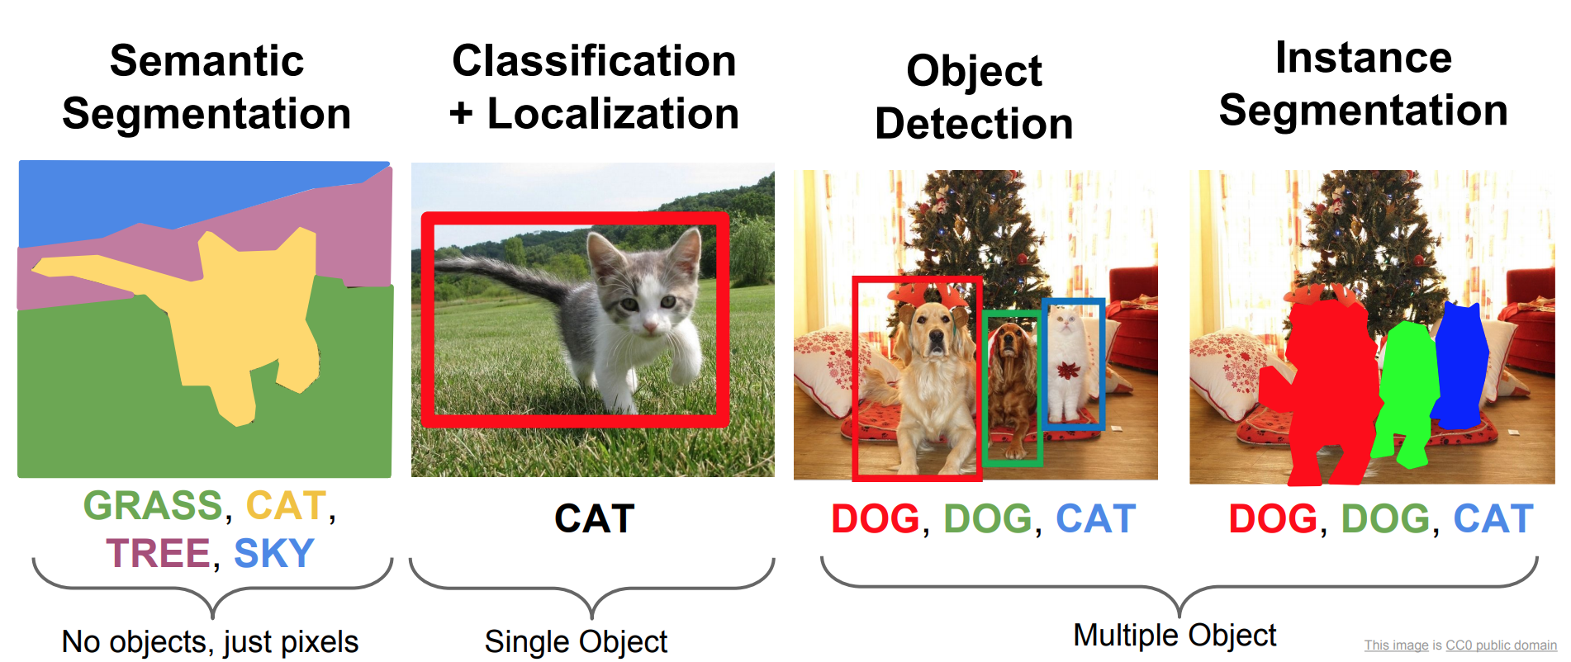
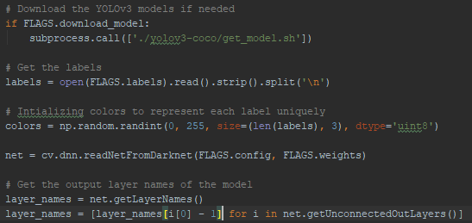
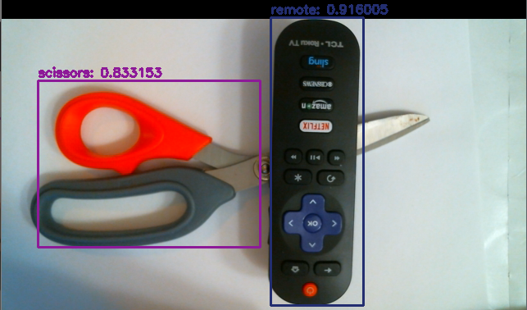
Machine Learning and Object Detection
Acknowledgements
Kolton Sumner
CS480 Machine Learning - Fall 2019
Dr. Meenalosini Vimal Cruz
Abstract
Implementation
Discussion
At the forefront of new technology in the 21st century is Machine Learning. As we progress forward technology is making its way into more and more aspects of our lives. It now does not seem like science fiction for cars to be able to drive themselves with the power of machine learning and object detection. Driverless cars will be just the beginning of the endless applications for object detection and machine learning to combine. In our research, we explored different object detection algorithms utilizing image processing and machine learning to analyze and classify general objects to get an idea of what is now possible.
The model program used for this project is designed based on Tensorflows implementation of neural networks, which handle the machine learning aspect of the project. Tensorflow is a very popular machine learning module in Python. To handle the image processing OpenCV was used. In order to train the model a large dataset was required. A large dataset was necessary to be able to accurately identify a variety of objects in different lighting, backgrounds, color variations and basic shapes. For examples not all apples are red but the model should still know that a green apple is considered an apple as well. The YOLO dataset from Darknet was used to satisfy this requirement.
As technology continues to advance and compute power continues to become cheaper and more efficient machine learning and object detection will become more common place. Object detection is an extremely powerful technology that will certainly effect our day to day lives in the near future. Industries have begun to adopt the idea of incorporating object detection into their systems. Some companies have started researching how machine learning and object detection could be used to automate quality control meanwhile others are looking into how machine learning and object detection can improve their products. For example some cameras are now doing object detection looking for faces and other features to determine where the cameras focus should be set. As time goes on object detection will become more and more common.
Depicting difference in classification and object detection.
Introduction
Python to create the neural network for object detection.
Object detection has become a very powerful way of extracting information from images or videos. Object detection is often confused with image classification, however, the two are very different. With image classification the image as a whole is given a single label or class. Conversely, object detection views the image as parts. This means that will object detection you can extract much more information from an image. For example if there were an image of a face and it was processed with image classification it would just tell you it was a face but, if it were processed with an object detection algorithm you could extract data like the locations of facial features, hair color and much more.
Results
Once the object detection model had been trained on the YOLO dataset it was extremely effective. With a clear image the model was able to detect objects that were included in the dataset with over 90% confidence consistently. The model was even able to process live video from a webcam utilizing Tensorflows GPU integration for higher processing power to maintain a frame rate of about 20 FPS.
Model even works effectively with obstructed views of objects.
References
Agarwal, Rahul. “Object Detection Using Deep Learning Approaches: An End to End Theoretical Perspective.” Medium, Towards Data Science, 30 Apr. 2019, towardsdatascience.com/object-detection-using-deep-learning-approaches-an-end-to-end-theoretical-perspective-4ca27eee8a9a.
“Makers of MATLAB and Simulink.” MathWorks, www.mathworks.com/.
“OpenCV Documentation Index.” OpenCV Documentation Index, docs.opencv.org/.
Redmon, Joseph. “YOLO: Real-Time Object Detection.” YOLO: Real-Time Object Detection, pjreddie.com/darknet/yolo/.

