Slide 1
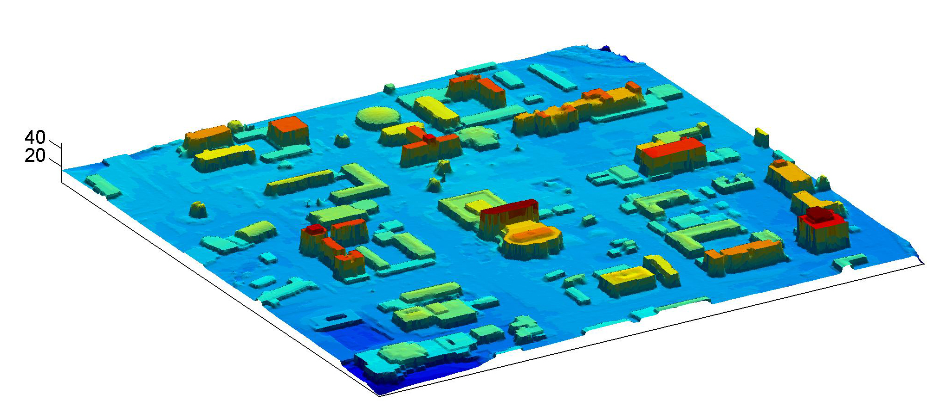
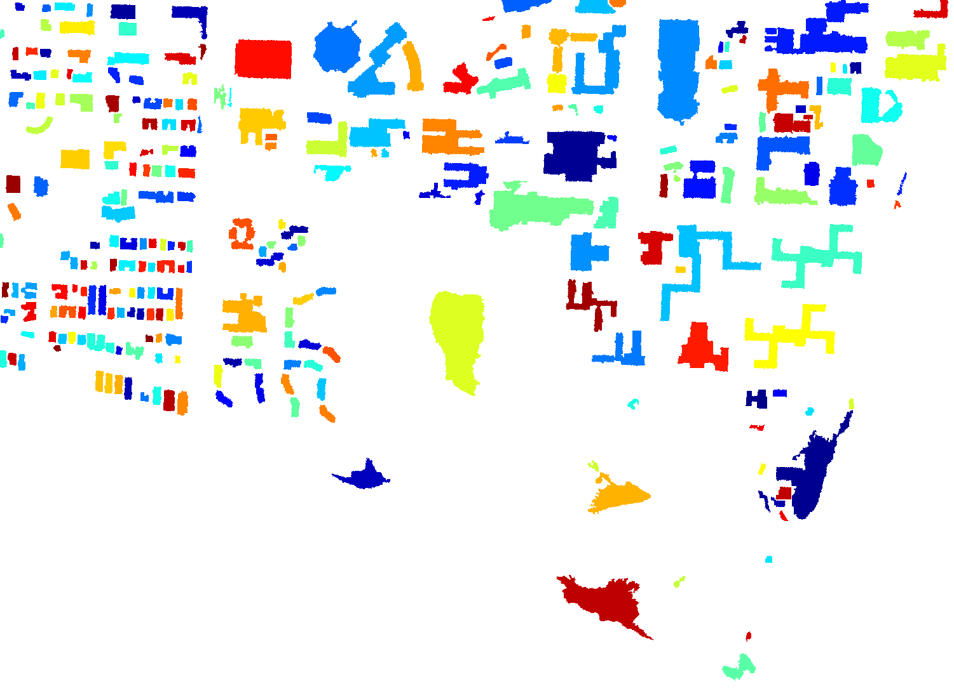
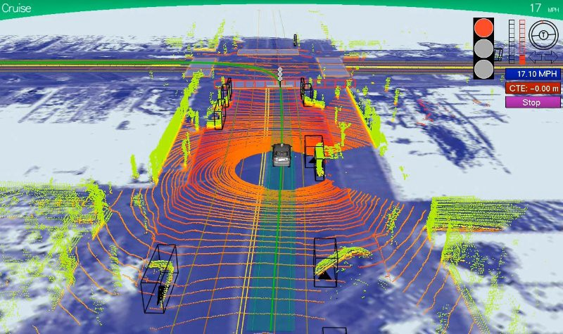
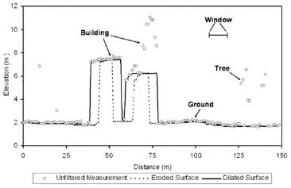
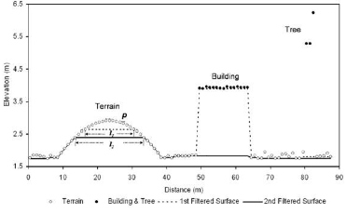
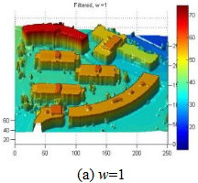
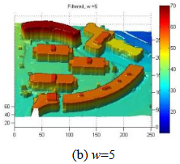
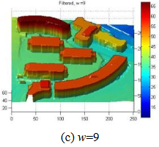
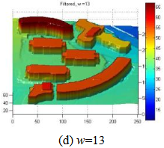
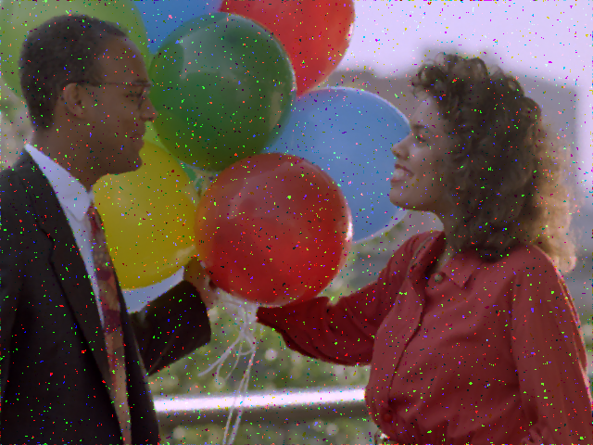
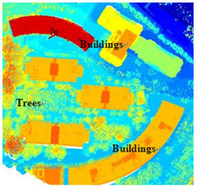
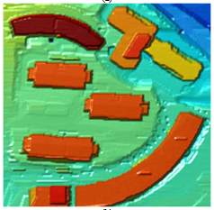
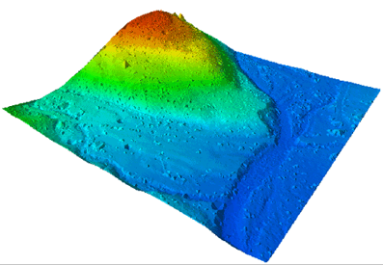
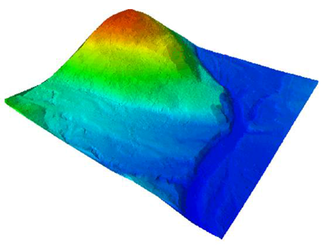
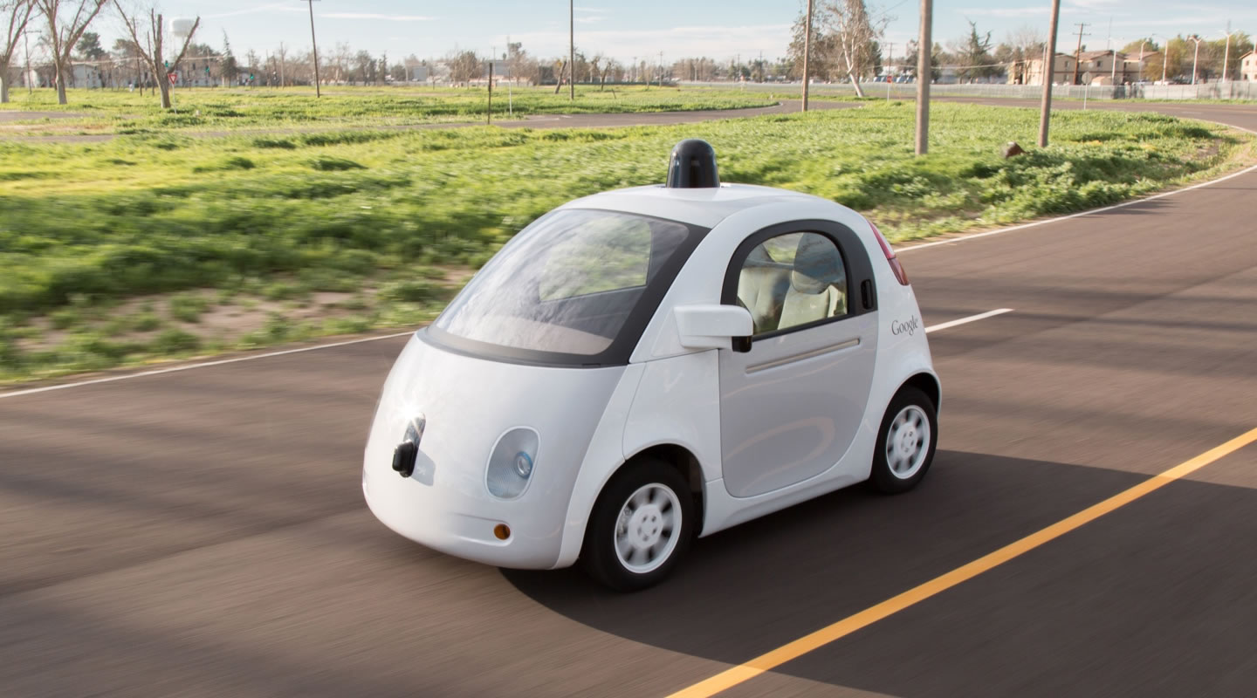
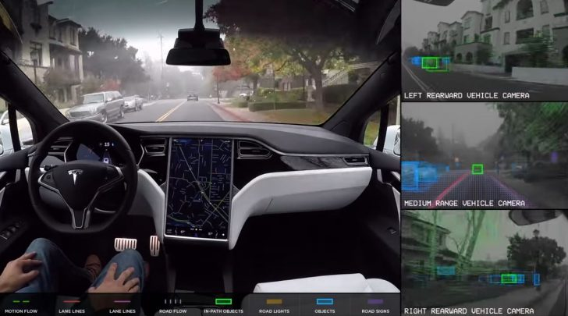
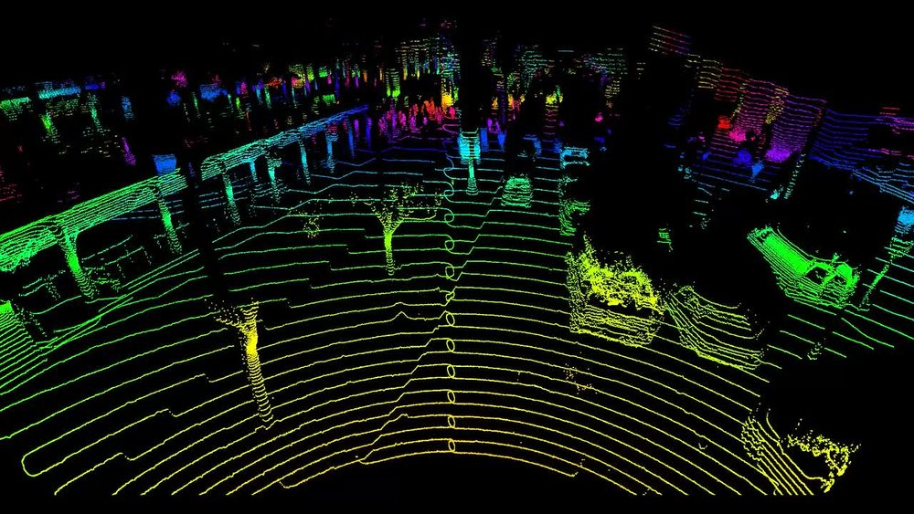
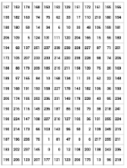
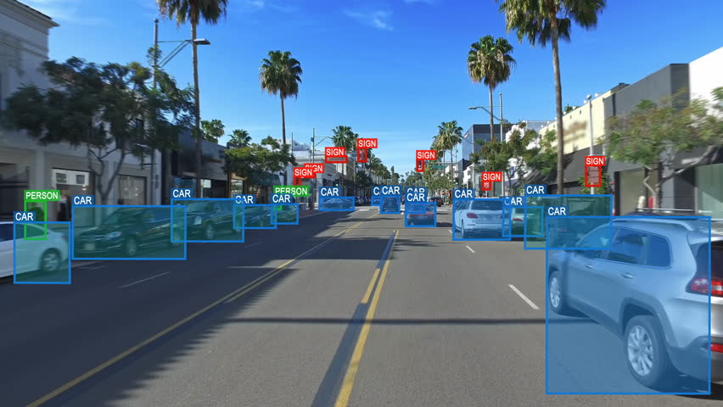

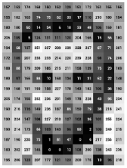
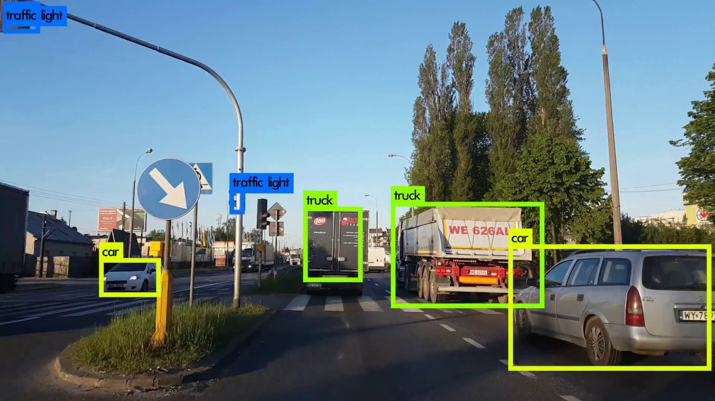
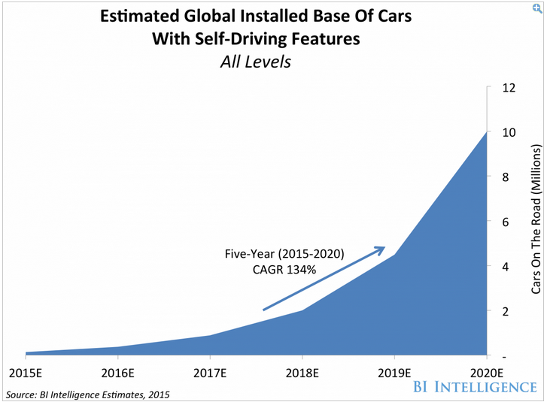

Image Processing Techniques and LIDAR in Self Driving Cars
Created by: Daniel Acabbo and Steven Soto
ISCS-399-Digital Image Processing, Keene State College
What is LIDAR?
LIDAR (LIE-dar) – is short for Light Detection and Ranging. It is a type of sensor that is currently at the heart of many autonomous car designs and is believed to be critical to several world-wide mapping efforts.
In its current stages, LIDAR is a very expensive system in the prices ranges of $75,000 for some models. Image processing techniques and algorithms are going to be huge when it comes to the discussion of bringing this technology to the wholesale market, due to its potential to read and interpret the LIDAR system’s data. More advanced algorithms could lead to cheaper LIDAR models being produced.
Objective
To show different Image Processing Techniques and Filters that assist with LIDAR systems in Self Driving Cars
Processing with Morphological Filtering
Morphology is the broad set of image processing operations that process images based on shapes. There are two fundamental morphological operations, dilation and erosion.
Figure(s) below represent data taken from a LIDAR system. The first figure is the opening operation, before a filter was applied. The second figure is the same information but after the morphological filter was applied. As a result, the objects (i.e. trees) with size smaller than the widow size were removed by erosion and other objects were shaped by dilation.
Further Processing with Segmentation
Segmentation is used to locate objects and boundaries such as lines or curves in images. This is an important pre-processing step in any image-based application.
Noise Removal
Digital Images, including the ones taken from the sensors on a self-driving car, are prone to various types of noise. Noise is the result of errors in the image acquisition process that result in pixel values that do not reflect the true intensities of the scene.
Figure 1 shows a very noisy image, and Figure 2, is the result of an attempt at noise removal using a 3x3 Median Filter.
LIDAR images are also not going to be perfect. Its not always going to be a bright, sunny day outside. There will be days that are rainy, foggy, and snowy. In a way, these are real life versions of noise. The LIDAR sensors can pick up everything around it, but can’t always interpret what it means, and could lead to devastating repercussions.
This is a raw data input from LIDAR. On the left, the image still contains a lot of ‘noise’ or things that we don’t want in the image. After a filter has been applied to the first image, the resulting right image, is a much smoother and more detailed representation of the land in front of a car. The heights, in different colors, are much more prevalent and defined in the second photo.
From (a) w = 1, to (a) w = 13, you can see the distinct effect of morphological filtering. Unwanted objects were removed while the wanted objects such as the ground an buildings were preserved. Generation of these images do take time, which is why they must be pre-rendered and stored in the car’s informational database, prior to driving.
Image from LIDAR system
On The Road Now
In today’s current market, there are cars on the road who are employing this technology. Among those leaders are Tesla and Google (Waymo), both of whose car’s are using both LIDAR based systems and additional image pre-processing techniques.
Figure 1
Figure 2
PRE
POST
Edge Detection
Edges contain some of the most useful information in an image. It is incredibly helpful in object analysis, recognition, and classification. An edge region is the visible region, which has different intensity values comparing neighboring pixel values.
Object Detection is a very necessary in self-driving cars. You need to be able to specify different objects, so they are avoided.
Summary & The Future
Self-driving cars are no longer a futuristic idea. Companies like BMW, Tesla and Google are already on their ways to
releasing self-driving cars.
LIDAR systems are still too expensive to completely ‘drive’ the car. We still need image processing techniques that
can assist LIDAR in properly detecting objects.
Without proper processing of LIDAR images and images taken from sensors, the system can misinterpret
Information. Tesla recently has had an incident where a driver was killed due to the sensors not being able to
pick up another car in very foggy weather.
Companies are going to continue to develop and refine this technology and its predicted that within 2 years, 10 million cars can self-drive
Acknowledgements: We are thankful to Dr. Meenalosini Vimal Cruz and the Keene State College Computer Science Department. This class is an experimental course currently being offered at Keene State College
Sources: Listed on separate page

