Slide 1
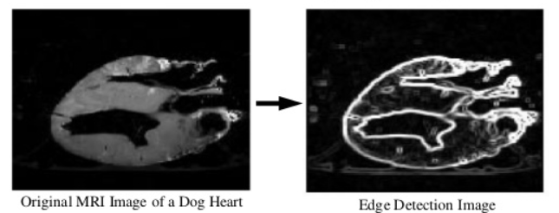
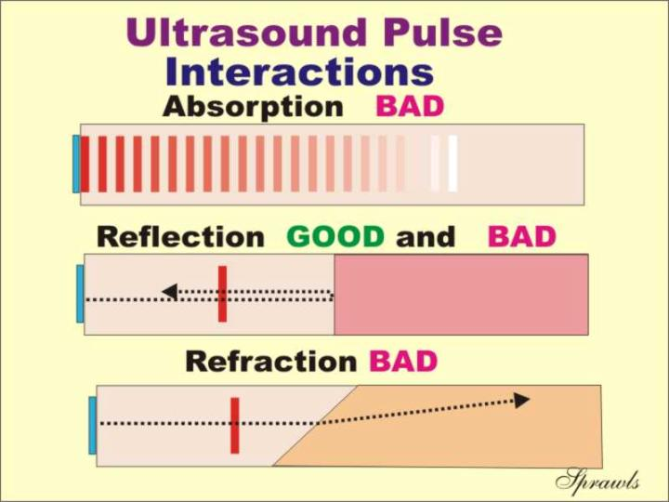
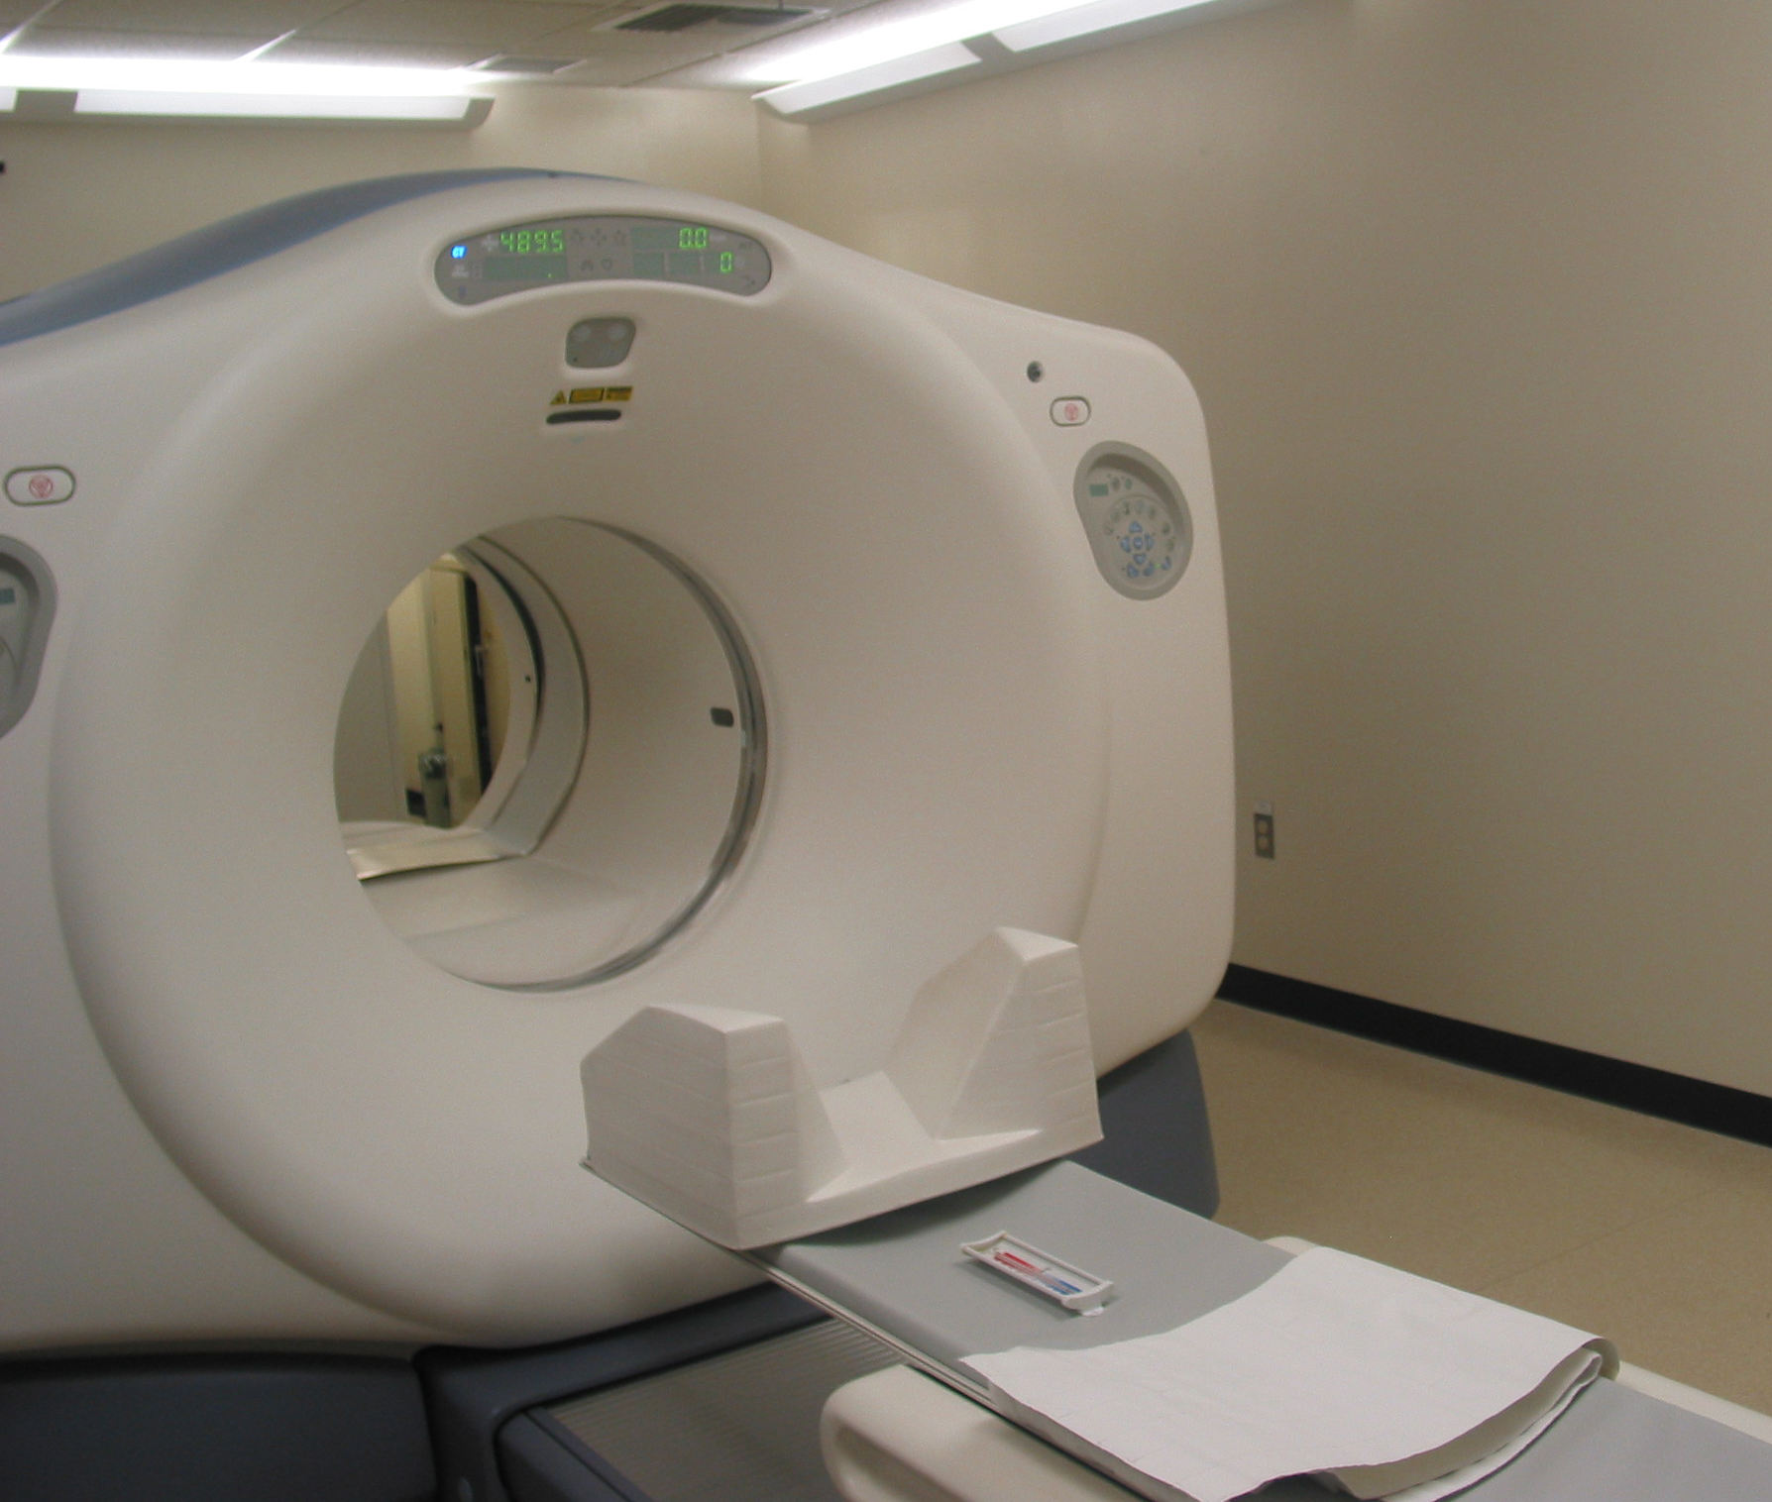

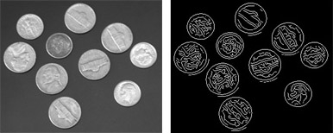
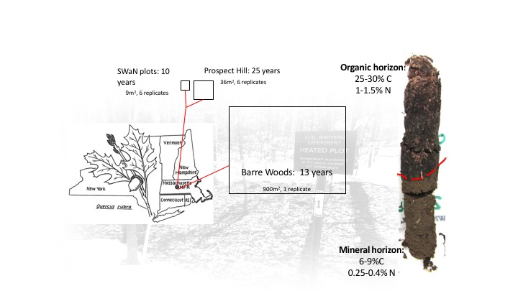
Medical Image Processing
Christian Jacobs, Dylan Rychlik
ISCS 399 Digital Image Processing – Keene State College
What is medical image processing?
MRI Scans
Practical Application
Future Applications
Medical image processing has many areas of study, in particular we will be examining MRI scans that are then run through image processing program in order to better define key areas of the photo and identify certain aspects of a body’s anatomy.
Other area include:
PET scans
X-rays
CT scans
This technology is very valuable in both clinical analysis and treatment. By scanning the body we can identify behavior and develop plans to resolve an issue, and by then later scanning we are able to check if issues are being resolved.
MRI is an acronym for magnetic resonance imaging. The scanner uses radio waves and very strong magnetic fields in order to generate images of the body.
When the area cannot be properly examined with traditional technologies. Such as cartilage, joints, muscles, ligaments, and tendons
MRIs are a very popular technology for sports related injuries because of this increased granularity
Different filters can be used to manipulate images and understand certain features of MRI scan to be used for medical purposes. In the left image, it show the original image of the MRI scan. The right image, using edge detection highlight certain areas of the image and helps a doctor determine a prognosis using the filtering technique. Other variations of edge detection with different filterings can be used to determine check the area from MRI scan.
The MRI scan and filtering can used to detect many things such as, cancer, broken bone, autism, Alzheimer's disease, and among others. It efficient way for doctors to get an idea of the issues a patent and come a sufficient prognosis. As technologies develops, it seems this might become a mainstream technique to help Doctors.
Detecting Alzheimer’s Disease
Using image processing doctors have been able to detect early signs of Alzheimer's in elderly by using MRI and image processing in conjunction. Alzheimer's disease is a brain disease and irreversible and gets rid of memory and thinking skills to the point that it starts affecting daily life and is the most common cause of dementia in the elderly. Different techniques can be used to detect it such as K-means clustering, wavelet transform, watershed algorithm and also a customized algorithm tailored for the specific case.
When to use an MRI?
What is it like inside an MRI?
Automating Workflow
Edge detection
Image processing is becoming a larger part of the healthcare field every day. By automating various processes allows user error to be taken out of the equation. For instance ultrasound results currently rely directly on the operator's skill.
Because of the strong magnetic fields the machine generates it is very important to have no metal on your body when entering the machine. While entering the machine you will be required to hold as still as possible and greeted with a loud oscillating sound
Edge detection algorithms identify boundaries of objects within an image. They primarily work by detecting brightness of edges. Edge detection is not only limited to the medical field though. These programs are also used in image segmentation, computer vision, and machine vision.
Examples of edge detection
Scanning a Heart
Fig 3. MRI scan of a dog’s heart before and after processing
When looking at the example shown above it is very easy to see how effective and valuable image processing is in the medical field. Once again MRIs are able to scan tissue with a high level of granularity when compared to other scanning technologies (such as PET, CT, and X rays) and any abnormalities are also very easily highlighted and any deviant anatomy is easily identifiable to a medical practitioner
Fig 4. Representation of ultrasound interactions based on angle
Smart Flow Imaging
Fig 2. Image of an MRI machine in Boston Children's Hospital
With smart flow technologies many of the image capturing techniques are angle independent and even reduce the number of operations needed to be preformed by a particular technician.
Fig 1. Image of coins before and after being fed through an edge detection algorithm

