Slide 1

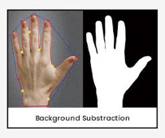
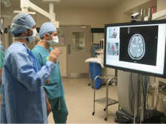
Hand Gesture Recognition
Acknowledgements
Breaden Huot, Devon Plourde
Digital Image processing- Spring 2019
Keene State College
Dr. Meenalosini Vimal Cruz
Overview
Gesture Recognition
Conclusion
To explore MatLab further than we were able to in class by looking in depth at a specific topic. We wish to show different image processing techniques that aid in the detection and classification of hand gestures.
Steps For Recognition
Hand Gesture Recognition may not seem as important as something like facial recognition, but there are still many useful applications for it. Things such as a hand gesture to text/speak application could be implemented in modern cell phones. Others could be applications in the medical field such as passing information through hand gestures to robots performing the surgery. This could allow for surgeries to be conducted remotely from across the world.
For gesture recognition, Principal Component Analysis (PCA) is used to theoretically simplify the image. It reduces the dimensionality of the image and still keeps most of the data associated with it, making it much easier to then match the picture of the hand to a template image found in a database. If the PCA does not find a match it will say it is not a match, otherwise it will return the command/name assigned with the gesture in the database.
Hand Recognition
First a conversion from RGB to YCbCR is done. This is necessary for the Y, CB, and CR values to be utilized in Skin Color Segmentation which checks for parts of the picture that are skin color. This distinguishes between the portion that is and is not a hand. Finally, OTSU thresholding is applied to separate the hands from the rest of the picture. The technique assigns a thresholding value to either the background or foreground and separates the two based on that value.
References
-Hand Gesture Using PCA by: Mandeep Kaur Ahuja and Dr. Amardeep Singh
-Hand Gesture Recognition using PCA and histogram projection by: Krishnakant C. Mule & Anilkumar N. Holambe

