Slide 1
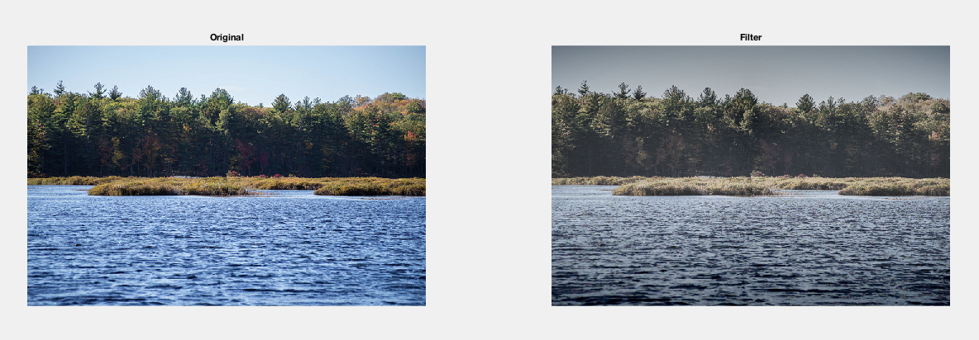
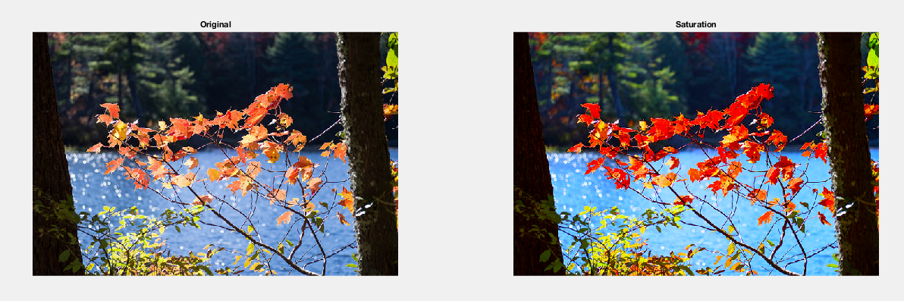
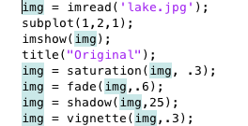
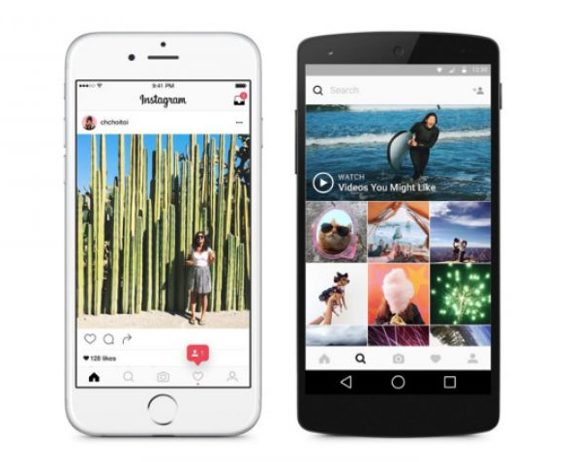
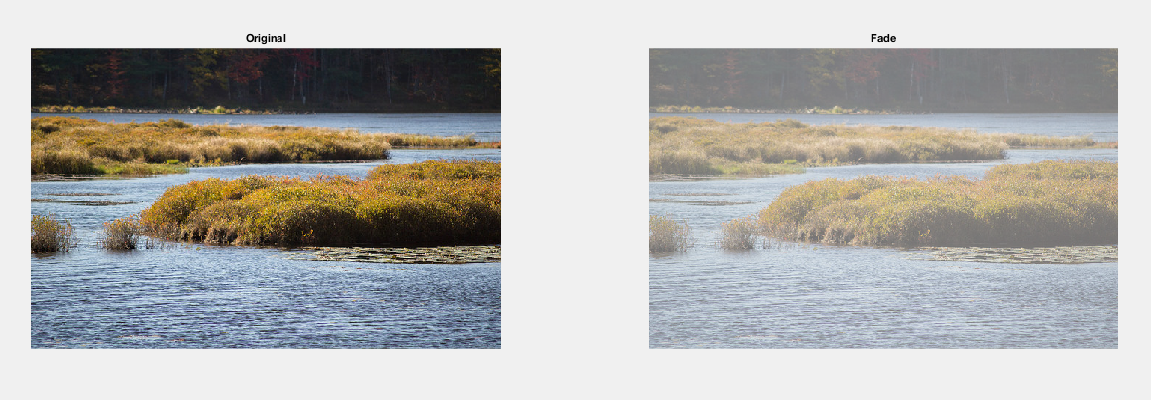
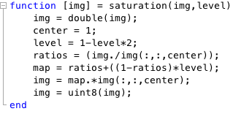

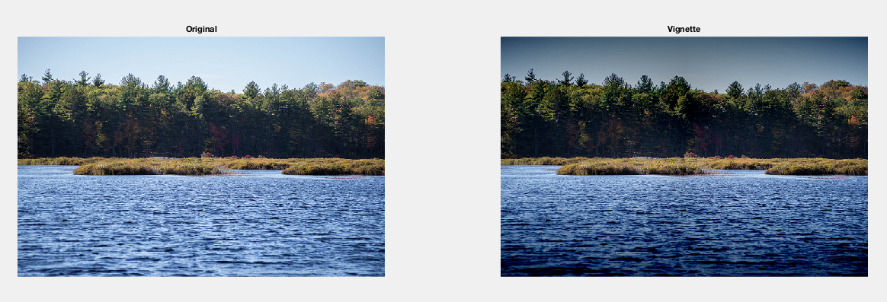
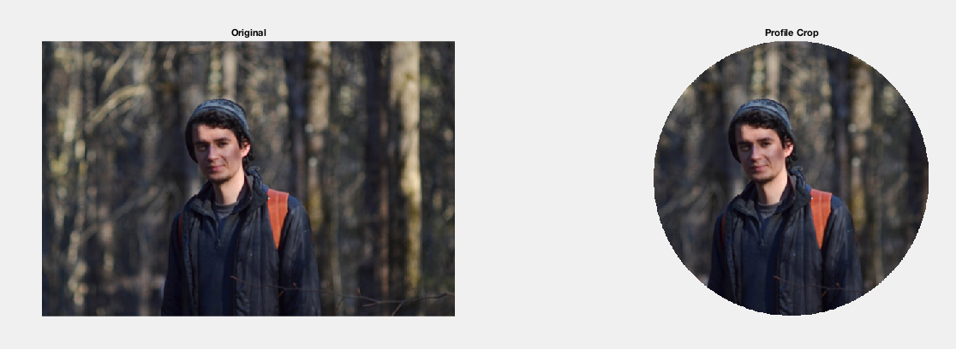
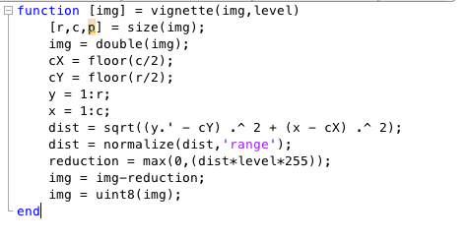
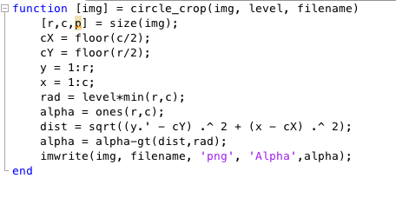
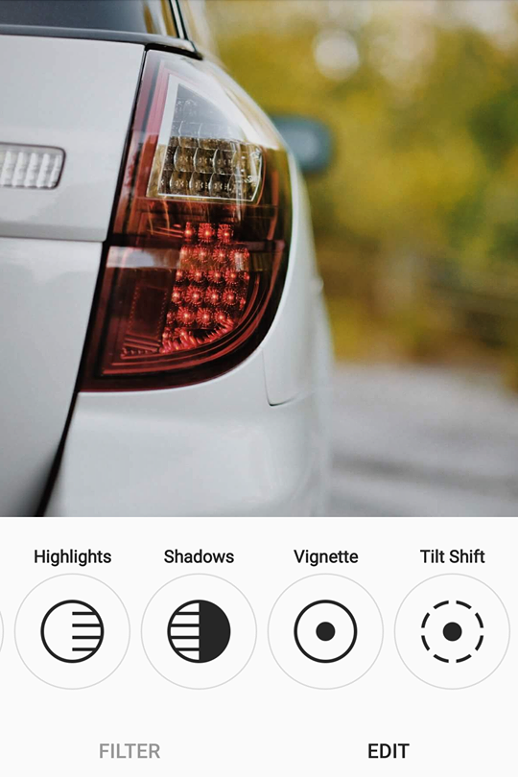
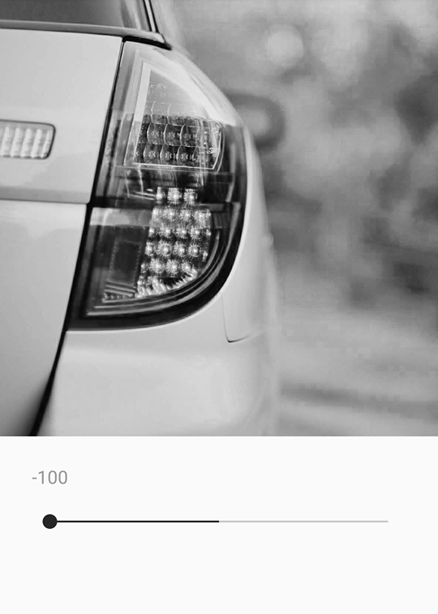
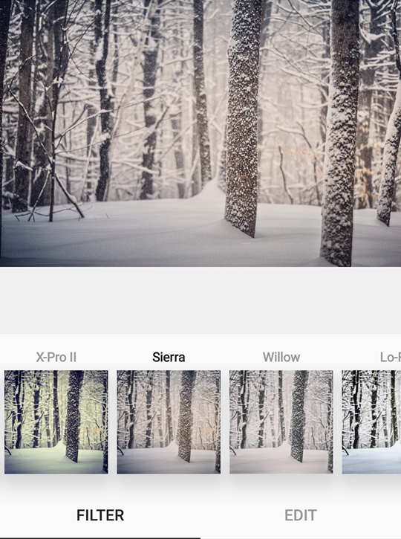
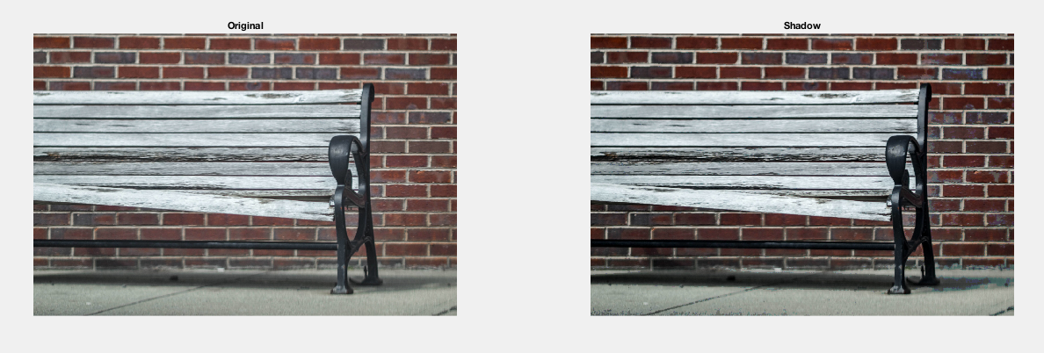
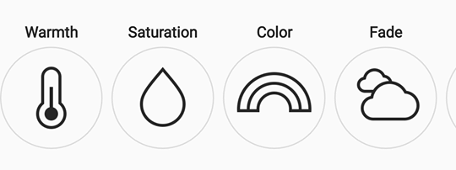
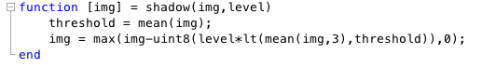
DIGITAL IMAGE PROCESSING & INSTAGRAM
Kole Nunley & Jonah Walker
ISCS399 Digital Image Processing – Dr. Meenalosini Vimal Cruz
What is Instagram?
Fade & Shadow in MatLab
Saturation & Vignette in MatLab
Filter & Profile Crop in Matlab
We will be covering the image manipulation tools found in the mobile app “Instagram”. This app initially began as a simple photo sharing application with little to no capabilities in terms of image manipulation. They had simple, preset filters. More recently they added a more comprehensive set of tools, which we will cover in this poster.
Fade
Saturation
Filter
Fade is most simple of the manipulation techniques we examined. The process involves nudging each pixel color value towards a certain gray value. The user may adjust how close the colors get to the fixed gray value. Eventually the image becomes a solid gray surface.
Saturation requires intricate care of each pixel color value. It works by first calculating the ratio of each blue and green pixel color with respect to the red pixel color. This ratio is then stretched to increase the relative difference between colors and saturating the image.
A variety of filters can be created by applying different permutations of the individual manipulation techniques. The above filter is the result of a light reduction in saturation, a heavy fade, moderate shadow increase, and a mild vignette. Note the order of manipulation can impact the end result.
Above are visual examples of the Instagram app on both Android and iPhone
Filters and Editing in Instagram
Vignette
Instagram has a myriad of built in “filters” or image manipulation presets. Some of these include the following;
Structure
Shadows/Highlights
Lux
Tilt Shift
Saturation
Profile Crop
Shadowing
Shadow is slightly more complex than fade. First, the mean value between the three color values of each pixel is compared against a threshold. The threshold is the mean color value of the entire image. If the pixel color mean is below the threshold, each color value is reduced by a user-set level.
Vignette is a simple procedure in which each pixel color value is reduced relative to the pixel’s distance to the center of the image. Thus, pixels near the edge appear black and pixels near the center appear to maintain their original color.
Image dimension and shape manipulation is common on Instagram and other online platforms. A profile-style crop works by removing pixels beyond a set radial distance from the image center.
Pictured above: Instagram photo editor tool examples

