Slide 1

Lecture 1
Introduction to Big Data

Slide 2
Table of Contents
What is Big Data?
Why Big Data?
Data Storage and Analysis
Characteristics of Big Data
Structure of Big Data
Applications of Big Data
History of Hadoop
RDBMS and MapReduce
Hadoop Ecosystems

Slide 3
What is Big Data?
IDC estimates that by 2020, digital universe would grow upto 44 zettabytes.
Walmart handles more than 1 million customers transactions every hour.
Facebook handles 40 billion photos from its user base.
Decoding the human genome originally took 10 years to process; now it can be achieved in one week.
Big Data is the big thing in the IT World.
The first organizations to embrace it were online and startup firms. Firms like Google, eBay, LinkedIn, and Facebook were built around big data from the beginning.

Slide 4
Why Big Data?
There are some things that are so big that they have implications for everyone, whether we want it or not. (Eg. Photos we are taking on daily basis.)
The basic idea behind the phrase ‘Big Data’ is that everything we do is increasingly leaving a digital trace which we can analyze and use.
Big Data therefore refers to our ability to make use of ever increasing volumes of data.
More data usually means better algorithms.

Slide 5
Data Storage and Analysis
Although the storage capacities of hard drives have increased massively over the years ,access speeds- the rate at which data can be read from drives have not kept up.
Parallel processing comes in picture.
File system that manage the storage across a network of machines are called distributed file systems.
Two issues:
Hardware failure – Data replication
Combining the data from multiple disk and generating meaning out of it.
Notes:
1. This is where parallel processing comes in picture. If we are reading 1-terabyte of data we would be able to do that in 2 and a half hours . Working in parallel, we could read that data in 2 minutes.

Slide 6
Four Characteristics of Big Data
Volume
Velocity
Veracity
Variety
Notes:
Volume (Large amount of Data) - Typical PC has gigabytes of storage, Facebook ingests 500 terabytes of new data every day.
Velocity (Speed of Data) – High Frequency stock trading algorithms reflect market changes within microseconds.
Variety (Different type of Data) – It can include geospatial data, 3D data, audio files, unstructured texts, log files and social media.
Veracity(Trustworthiness of Data)- Twitter Hashtags, Abbreviations, Typos – Reliability and accuracy of contents

Slide 7
Structure of Big Data
Structured:
Most traditional data sources.
Semi Structured:
Unstructured:
Video data, Audio Data
Notes:
Structured Data : It is organized into entities that have a defined format such as XML documents or database tables that have some predefined schema.
Semi-structured Data : Although it may have a schema, but it only act as a guide to the structure of data. Eg : Spreadsheet
Unstructured Data : Doesnot have any particular internal strcutures. Eg: Images

Slide 8
Applications of Big Data
Smarter Healthcare
Homeland Security
Traffic Control
Manufacturing
Multi-channel sales
Telecom
Trading Analytics
Search Quality

Slide 9
History of Hadoop
Created by Doug Cutting.
Open source apache project.
Initially there was a project developed called GFS (Google File system), which was then combined with Mapreduce to be called as Hadoop and was adopted by Apache.

Slide 10
RDBMS and MapReduce
 | Traditional RDBMS | MapReduce
Data Size | Gigabytes | Petabytes
Access | Interactive and Batch | Batch
Updates | Read and write many times | Write once, read many times
Transactions | Schema on write | Schema on read

Slide 11
Hadoop tries to co-locate the data with the compute nodes, so data access is fast because it is local.
Processing in Hadoop operates only at the higher level, the programmer thinks in terms of data model, while the data flow remains implicit.
Distributed processing frameworks like MapReduce spare the programmer from having to think about failure, since the implementations detects failed tasks and reschedules replacements on machines that are healthy.

Slide 12
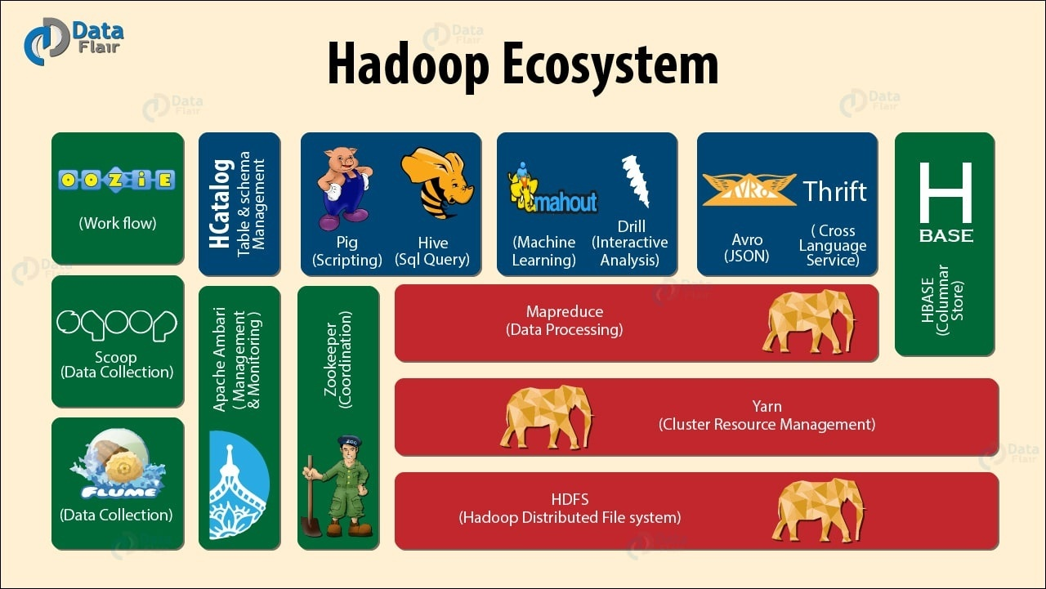

Slide 13
Any Questions??
Thank you!

