Slide 1

Lecture 2
HDFS(Hadoop Distributed File Systems)

Slide 2
HDFS
HDFS stands for Hadoop Distributed Filesystem.
Filesystem that manages the storage across a network of machines are called distributed filesystems.
It is a filesystem designed for storing very large files with streaming data access running on clusters of commodity hardware.

Slide 3
Features of HDFS
1. Very Large Files
2. Streaming Data Access
3. Commodity Hardware
4. Low Latency Data Access
5. Multiple Writers, arbitrary file modifications
Notes:
Files that are hundreds of megabytes, gigabytes, petabytes and terabytes of data.
2. Data processing pattern is write once and read many times pattern.
It doesn’t require expensive, highly reliable hardware. HDFS knows how to handle failures.
Applications that require low latency access to data will not work well with HDFS
Files in HDFS are written by a single writer. Writers always write at the end of file , in append only fashion.

Slide 4
HDFS Concepts(Blocks)
HDFS block size is 128 MB by default.
Like in a filesystem for single disk, files in HDFS are broken into block sized chunks which are stored as independent units.
A file in HDFS which is smaller than a single block does not occupy a full block’s worth of underlying storage. For eg 1 MB file won’t use up entire 128 MB.
Notes:
Usually a disk has a block size which is the minimum amount of data that it can read or write. Blocks are typically a few kilobytes in size whereas disk blocks are normally 512 bytes.
HDFS too has the concept of block level.

Slide 5
HDFS Concepts (Blocks)
Benefits :
A file can be larger than any disk in the network.
Simplifies the storage subsystem.
Fit well with replication for providing fault tolerance and availability.
Command to list blocks in filesystem :
hdfs fsck / -files –blocks
Will list the blocks that makes up each filesystem.
Notes:
Since there is no limitation that the blocks of a file to be stored in a single disk, we can store such big of a file that can take up all the disk of the cluster.
Simplifies storage management( because blocks are of fixed size, it is easy to calculate how many can be stored on a given disk) and eliminating metadata concerns (file metadata such as permissions information does not need to be stored in blocks, so other systems can maintain separately.)
Each block is replicated to a small number physically separate machine. If a copy is unavailable it can be read from another location.

Slide 6
HDFS Concepts(Namenodes & DataNodes)
Master (Namenode) – worker (Datanode) pattern.
Namenode manages the filesystem tree and metadata for all the files and directories in the tree.
Datanodes are where the blocks of given files are located.
Notes:
1. Metadata is stored persistently on local disk in form of two files : namespace image and edit log.

Slide 7
HDFS Concept(Block Caching)
For frequently accessed files, the blocks are explicitly cached in the datanode’s memory in an off-heap block cache.
For eg, a small lookup table used in a join can be a good candidate for caching.
Applications instructs the namenode which files to cache by adding a cache directory or cache pools.

Slide 8
HDFS Concepts(HDFS Federation)
HDFS federation included in 2.x series, allows a cluster to scale up by adding namenodes, each of which manages a portion of filesystem namespace.
Each namenode manages a namespace volume , like one namenode can handle /user and other can handle /share.
Namenodes are independent of each other and unavailability of one does not impact the other.
Datanodes register with each namenode in the cluster.
Notes:
On a large cluster, with many small files , memory becomes the limiting factor for scaling.

Slide 9
Namenode Failures(Need to check)
Namenode Failure(Single Point of Failure)
Two ways:
Back up the files that make up the persistent state of the filesystem metadata. We can write it to local disk as well as NFS mount.
Secondary namenode, It periodically merges the namespace image with the edit logs. But in this case data loss is certain.
Setting up a new namenode can take about 30 minutes.

Slide 10
HDFS Concepts(High Availability)
Hadoop 2 added support for pair of namenodes in active-standby mode.
In case of failure, standby takes over without a significant interruption.
Changes wrt previous architecture:
Namenode uses highly available shared storage to share the edit log. Continuous process.
Datanodes must send block reports to both namenodes because the block mappings are stored in namenode’s memory.
Notes:
Transition from active to standby namenode is managed by a new entity in the system called failover controller. Default implementations uses zookeeper to ensure that only one namenode is active.

Slide 11
Hadoop Commands
Copy From Local:
hadoop fs –copyFromLocal input/docs/abc.txt hdfs://localhost/user/tom/abc.txt
Copy to Local :
Hadoop fs –copyToLocal input/docs/abc.txt abc.txt
Make and List
hadoop fs –mkdir
Hadoop fs –ls

Slide 12
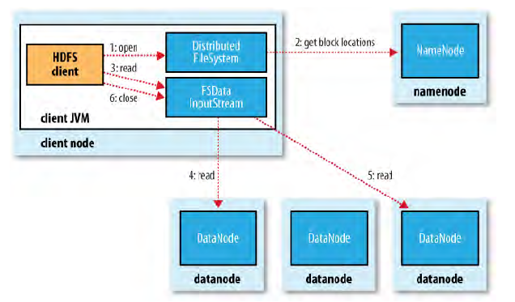
Anotamy of File Read:

Slide 13
File Read Explained:
1. Client calls for open() on DistributedFileSystem.
2. DFS calls the name the namenode using Remote procedure calls to determine locations of first few blocks. Namenode returns the address of each datanodes that have the copy of the block.
Datanodes are sorted according to data locality and then DFS returns an FSDataInputStream to the client to read data from.
3. Client then calls read() on the stream. DFSInputStream will then connect to the first datanode, read entire data and close the connection and then reconnect to the next best datanode.
Notes:
If it encounters while reading from datanode, it will try the next closest one for that block.
It also verifies checksums for data transferred to the datanode.

Slide 14
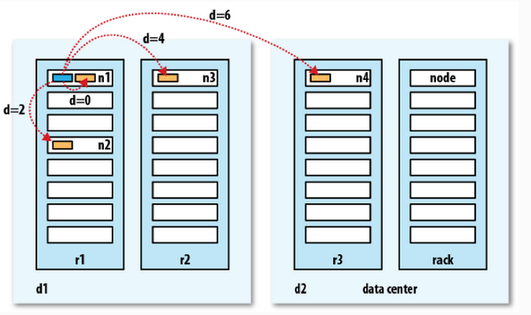
Network Topology (Bandwidth is a scarce commodity)
Notes:
Processed on same node.
Different nodes on same rack.
Nodes on different racks in same data center.
Nodes in different data centers.

Slide 15
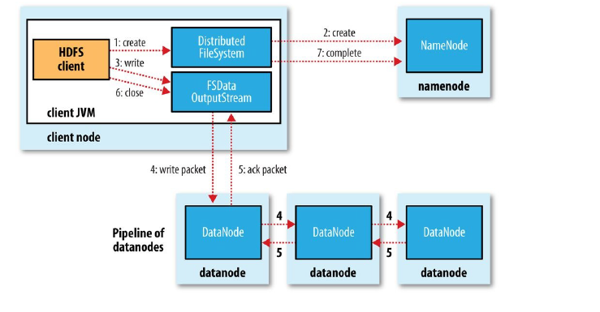
Anatomy of File Write

Slide 16
Anatomy of File Write Explained
1. User calls create() on DFS.
2. DFS makes RPC call to namenode. Namenode performs various checks like file doesnot already exists, user has necessary permission etc.
3. DFStream splits it into packets called Data queue. DFStream also maintains internal queue of packets that are waiting to be acknowledged called ack queue.
4. Once data is written , it calls close operation on it.
Notes:
Data Queue is responsible for asking namenode on which datanodes the blocks needs to be stored. If the replication factor is 3, it will send the first copy to first datanode then second and so on.

Slide 17
Next Lecture
Installation of HDP Environment
PreRequisite – Download Hortonworks Image
Running basic Hadoop commands

Slide 18
THANK YOU!

