Slide 1
Lecture 4
MapReduce

Slide 2
MapReduce Introduction
Hadoop provides a reliable storage system and analysis system.
Storage is provided by HDFS and analysis done by MapReduce.
MapReduce is programming model for processing.

Slide 3
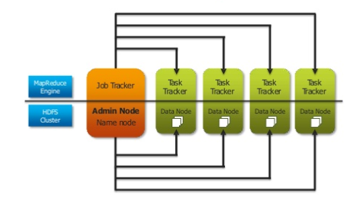
MapReduce Concepts(Hadoop 1.0)
Notes:
JobTracker : It is responsible for accepting jobs from clients, dividing those jobs into tasks and assigning those tasks to be executed by worked nodes.
Task Tracker : It is a process that manages the execution of the tasks currently assigned to that node. Each TaskTracker has a fixed number of slots for executing tasks (two maps and two reduces by default.)

Slide 4
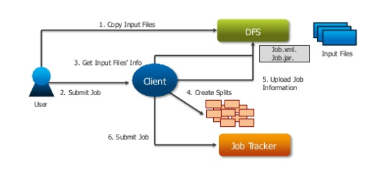
MapReduce Stage 1

Slide 5
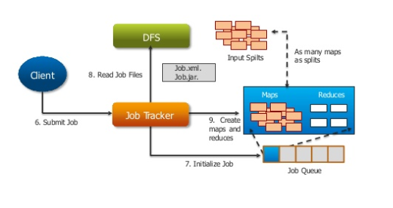
MapReduce Stage 2

Slide 6
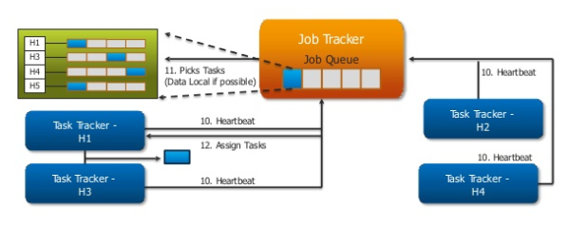
MapReduce Stage 3

Slide 7
