Slide 1
Lecture 10
SQOOP

Slide 2
What is Sqoop?
Apache Sqoop is a tool inHadoop ecosystem which is designed to transfer data betweenHDFS(Hadoop storage) and relational database servers like MySQL, Oracle RDB, SQLite, Teradata, Netezza, Postgres etc.
It efficiently transfers bulk data between Hadoop and external data stores such as enterprise data warehouses, relational databases, etc.
This is how Sqoop got its name –“SQL to Hadoop& Hadoop to SQL”.
Sqoop transfer data between hadoop and relational DB servers.
Sqoop is used to import data from relational DB such as MySQL, Oracle.
Sqoop is used to export data from HDFS to relational DB.
Again, Sqoop uses the MapReduce mechanism for its operations like import and export work and work on a parallel mechanism as well as fault tolerance.
A Map only Job is launched with individual mappers responsible for transferring a slice of dataset.

Slide 3
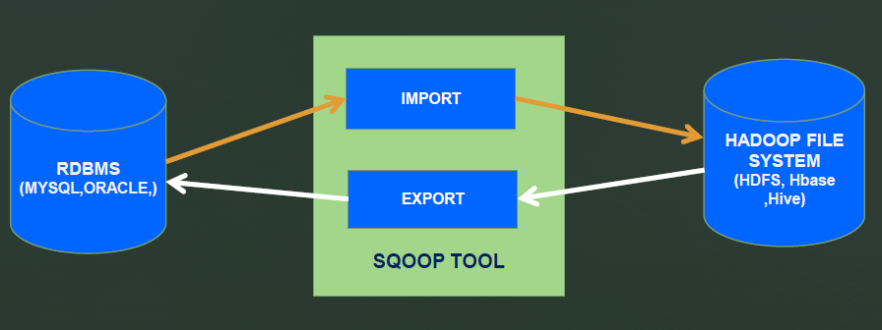
Sqoop Architecture

Slide 4
Features of Sqoop
Full Load : Apache Sqoop can load the whole table by a single command. You can also load all the tables from the database using a single command.
Incremental Load: Load parts of the table when it is updated. It supports two types of incremental loads; append and lastmodified.
Parallel Import/Export : It uses YARN framework and hence achieve parallelism.
Import Results of SQL Query
Compression : Can compress your data by using deflate(gzip) algorithm. Can also store data in compressed Hive table.
Connectors for all major RDBMS Databases: It provides connectors for multiple RDBMS databases.
Load Data Directly into Hbase/Hive.

Slide 5
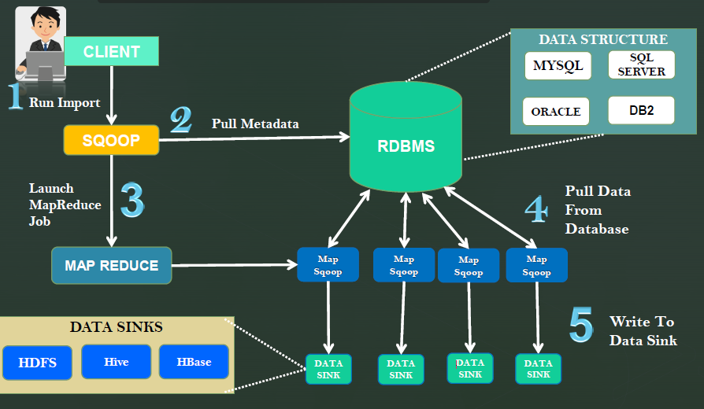
Five Stage Sqoop Import Overview

Slide 6
Sqoop Import Into HDFS
SQOOP Import
Import individual tables from RDBMS to HDFS.
Each row in a table is treated as records in HDFS.
All record are stored as text data in text files or binary files.
Importing a Table into HDFS Syntax:
Takes JDBC urland connects to database--table-Source table name to be imported.--username-Username to connect to database.--password-Password of the connecting user.--target-dir -Imports data to the specified directory.
By default, these files contain comma delimited files with new line separating records. User can override this.

Slide 7
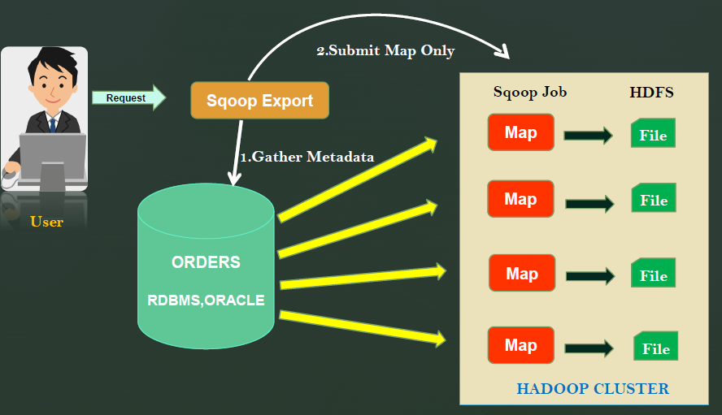
Exporting data using Sqoop

Slide 8
Sqoop Export
Step-1
SQOOP introspects database to gather the necessary metadata for the data being imported.
Step-2
Transfer the data
SQOOP divides the input dataset into splits.
Sqoop uses the individual Map task to push the splits to the database.
Each Map task performs this transfer over many transaction in order to ensure optimal throughput and minimal resource utilization.
The target table must already exist in the database. Sqoop performs a set of INSERT INTO operations, without regard for existing content. If Sqoop attempts to insert rows which violate constraints in the database (for example, a particular primary key value already exists), then the export fails.

Slide 9
Sqoop Import into Hive
--hive-import
Appending above to SQOOP import command, SQOOP takes care of populating the hive metastore with appropriate metadata for the table and also invokes the necessary commands to load the table and partition.
Using Hive import, SQOOP converts the data from the native data types within the external datastoreinto the corresponding types in hive.
SQOOP automatically chooses the native delimiter set used by hive.

Slide 10
Connecting to a database Server
The connect string is similar to a URL, and is communicated to Sqoop with the --connect argument.
This describes the server and database to connect to; it may also specify the port.
You can use the—username and—password or-P parameters to supply a username and a password to the database.
For example:
sqoopimport --connect jdbc:mysql://IPAddress:port/DBName--table tableName--username sqoop--password sqoop

Slide 11
Controlling Parallelism
Sqoop imports data in parallel from most database sources. You can specify the number of map tasks (parallel processes) to use to perform the import by using the -m or --num-mappers argument.
NOTE: Do Not increase the degree of parallelism higher than that which your database can reasonably support. For e.g., Connecting 100 concurrent clients to your database may increase the load on the database server to a point where performance suffers as a result.
Sqoop uses a splitting column to split the workload. By default, Sqoop will identify the primary key column (if present) in a table and use it as the splitting column
The low and high values for the splitting column are retrieved from the database, and the map tasks operate on evenly-sized components of the total range. By default, four tasks are used. For example, if you had a table with a primary key column of id whose minimum value was 0 and maximum value was 1000, and Sqoop was directed to use 4 tasks, Sqoop would run four processes which each execute SQL statements of the form SELECT * FROM sometable WHERE id >= lo AND id < hi, with (lo, hi) set to (0, 250), (250, 500), (500, 750), and (750, 1001) in the different tasks.
•NOTE: Sqoop cannot currently split on multi-column primary key. If your table has no index column, or has a multi-column key, then you must also manually choose a splitting column.

Slide 12
Incremental Imports
Sqoop provides an incremental import mode which can be used to retrieve only rows newer than some previously-imported set of rows.
Sqoop supports two types of incremental imports:
1)append and 2)lastmodified.
Append : You should specify append mode when importing a table where new rows are continually being added with increasing row id values. You specify the column containing the row’s id with --check-column. Sqoop imports rows where the check column has a value greater than the one specified with --last-value.
LastModified : should be used when rows of the source table may be updated, and each such update will set the value of a last-modified column to the current timestamp. Rows where the check column holds a timestamp more recent than the timestamp specified with --last-value are imported.

Slide 13
Limitations of Sqoop
Sqoop cannot be paused and resumed. It is an atomic step. If it is failed we need to clear things up and start again.
Sqoop Export performance also depends upon the hardware configuration (Memory, Hard disk) of RDBMS server.
Sqoop is slow because it still uses Map Reduce in backend processing.
Failures need special handling in case of partial import or export.
For few databases Sqoop provides bulk connector which has faster performance. It uses a JDBC connection to connect with RDBMS based on data stores, and this can be inefficient and less performance.

Slide 14
Sqoop Commands
A basic import of a table
sqoop import --connect jdbc:mysql://192.168.45.1:3306/sakila--table film --username sqoop--password sqoop
Load sample data to a target directory
sqoop import --connect jdbc:mysql://192.168.45.1:3306/sakila--table film --username sqoop--password sqoop--target-dir'/user/cloudera/test/film' -m 1
Controlling the import parallelism (8 parallel tasks):
sqoop import --connect jdbc:mysql://192.168.45.1:3306/sakila--table film --username sqoop--password sqoop--target-dir'/user/cloudera/test/film' --split-by film_id-m 8

Slide 15
Sqoop Commands
Import all tables
sqoop import-all-tables --connect jdbc:mysql://192.168.45.1:3306/sakila--username sqoop--password sqoop
SQOOP EXPORT
sqoop export --connect jdbc:mysql://192.168.45.1:3306/sakila--table test --username sqoop--password sqoop--export-dir/user/cloudera/actor
SQOOP Version:
$ sqoop version
List tables present in a database
sqoop list-tables --connect jdbc:mysql://192.168.45.1:3306/sakila--username sqoop--password sqoop

Slide 16
Sqoop Commands
Incremental import
sqoop import --connect jdbc:mysql://192.168.45.1:3306/sakila --table film --username sqoop --password sqoop --target-dir '/user/cloudera/test/film' -m 1 –incremental append –check-column emp_id --last-value 7
Save target file in tab separated format
Sqoop import --connect jdbc:mysql://192.168.45.1:3306/sakila --table actor --username sqoop--password sqoop --check-column actor_id --incremental append --last-value 180 --target-dir/user/cloudera/test/film3 --fields-terminated-by '\t‘
Selecting specific columns from the EMPLOYEES table
Sqoop import --connect jdbc:mysql://192.168.45.1:3306/sakila--table actor --username sqoop -password sqoop --columns 'actor_id,first_name,last_name' --target-dir/user/cloudera/test/actor1
Query usage to import with condition
Sqoop import --connect jdbc:mysql://192.168.45.1:3306/sakila--query 'select * from film where film_id< 91 and $CONDITIONS' --username sqoop--password sqoop--target-dir'/user/cloudera/test/film2' --split-by film_id-m 2

Slide 17
Sqoop Commands
Storing data in SequenceFiles
Sqoop import --connect jdbc:mysql://192.168.45.1:3306/sakila --table film --username sqoop --password sqoop --as-sequencefile
--target-dir/user/cloudera/test
Importing data to Hive:
Sqoop import --connect jdbc:mysql://192.168.45.1:3306/sakila --table language --username sqoop-password sqoop-m 1 --hive-import
Import only the schema to hive table
sqoop create-hive-table --connect jdbc:mysql://192.168.45.1:3306/sakila --table actor --username sqoop-password sqoop --fields-terminated-by ','

Slide 18
Sqoop eval
The eval tool allows users to quickly run simple SQL queries against a database; results are printed to the console. This allows users to preview their import queries to ensure they import the data they expect.
sqoopeval --connect jdbc:mysql://192.168.45.1:3306/sakila --query 'select * from film limit 10' --username sqoop --password sqoop
sqoopeval --connect jdbc:mysql://192.168.45.1:3306/sakila --query "insert into test values(200,'test','test','2006-01-01 00:00:00')" --username sqoop --password sqoop

Slide 19
Any Questions?
THANK YOU!

