Slide 1
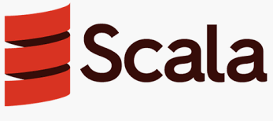
Programming In Scala

Slide 2
Contents
What is Scala?
Why Scala
Scala Features
Java to Scala
Scala Installation
A feel of Scala

Slide 3
What is Scala
Scala stands for “Scalable Language”
Is so named because it was designed to grow with the demand of its users.
Scala compiles to byte code in the JVM. Scala compiles program into JVM bytecodes.
Interoperability with Java, so you can easily use Java ecosystem.

Slide 4
Scala As Bazaar
Eric Raymond introduced two metaphors for model of software development
BAZAAR
CATHEDRAL

Slide 5
What makes Scala scalable?
Scala provides a fusion of Object oriented and functional programming language
For other languages, where objects and functions are two different values. In Scala, each function is a value.
Functional | Object Oriented
Emphasizes use of functions. | Classes and objects are used.
Data in the functions is immutable | Data used here is mutable
Declarative programming style | Imperative programming style
Parallel programming supported | Parallel programming not supported.

Slide 6
Why Scala?
Scala is concise. No boilerplate code! (semicolons, getter/setters,return). Fewer lines of code mean not only less typing, but also less effort at reading and understanding programs and fewer possibilities of defects
Scala is high-level. OOP and FP let you write more complex programs.
Scala is statically typed, verbosity is avoided through type inference so it look likes it’s a dynamic language but it’s not.

Slide 7
“If I were to pick a language
to use today other than Java,
it would be Scala.”
- James Gosling
Creator of Java

Slide 8
Scala Usecases
Big data and Science
Web Application Development, REST API Development
Distributed System, Concurrency and Parallelism
Scientific Computation like NLP, Numerical Computing and Data Visualization 20

Slide 9

They all use scala

Slide 10
Features of language
Scala language design
Basic of Scala
Functional programming in scala
Object oriented programming.

Slide 11
Scala language design
Scala Type System
Everything is an Expression
Lexical scope

Slide 12
Scala type system
Scala, unlike some of the other statically typed languages (C, Pascal, Rust, etc.), does not expect you to provide redundant type information. You don't have to specify a type in most cases, and you certainly don't have to repeat it.
Scala has a unified type system, enclosed by the type Any at the top of the hierarchy and the type Nothing at the bottom of the hierarchy

Slide 13
Everything is an expression
In programming language terminology, an "expression" is a combination of values and functions that are combined and interpreted by the compiler to create a new value, as opposed to a "statement" which is just a standalone unit of execution and doesn't return anything
def ifThenElseExpression(aBool:Boolean) = if aBool then 42 else 0

Slide 14
Lexical scope(Static)
Scala uses lexical scoping like many other languages.
Lexical scoping (sometimes known as static scoping ) is a convention used with many programming languages that sets the scope (range of functionality) of a variable so that it may only be called (referenced) from within the block of code in which it is defined. The scope is determined when the code is compiled. A variable declared in this fashion is sometimes called a private variable.
The opposite approach is known as dynamic scoping . Dynamic scoping creates variables that can be called from outside the block of code in which they are defined. A variable declared in this fashion is sometimes called a public variable.

Slide 15

Installation steps
1. Verify your java installation using
Java --version
2. Download & Install Scala http://www.scala-lang.org/download/.
3. Add the installed software to your environment
4. Type scala in Console

Slide 16
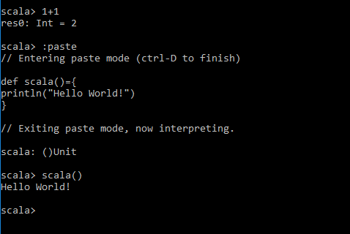
Running Basic Scala

Slide 17
Any questions?
THANK YOU

