Slide 1
Lecture 4
MapReduce

Slide 2
Contents
MapReduce Introduction
Basic Terminology
HDFS Architecture
MapReduce Job and Stages
MapReduce Example
Map Function
Reduce Function
MapReduce Concepts(JobTracker and TaskTracker)
BottleNecks
Setting up MapReduce Job
Driver Class
Mapper Class
Shuffle and Sort Class
Reduce Class

Slide 3
MapReduce Introduction
Hadoop provides a reliable storage system and analysis system.
Storage is provided by HDFS and analysis done by MapReduce.
MapReduce is programming model for processing.
MapReduce decomposes work into small parallelised map and reduce tasks which are scheduled for remote execution on slave nodes.
MapReduce works by manipulating key/value pairs in general format.

Slide 4
Basic Terminology
A job is a full programme.
A task is the execution of a single map or reduce task over a slice of data called slit.
A Mapper is a map task.
A Reducer is a reduce task.

Slide 5
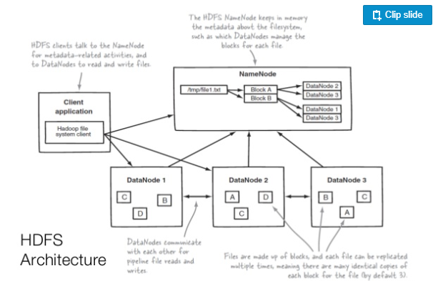
HDFS Architecture

Slide 6
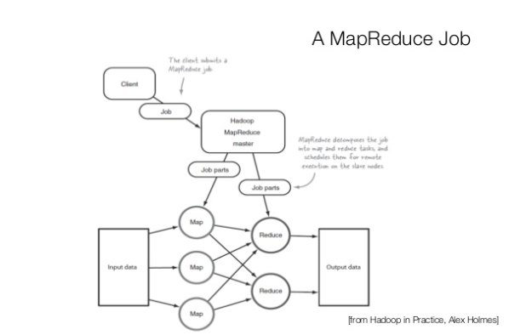
MapReduce Job

Slide 7
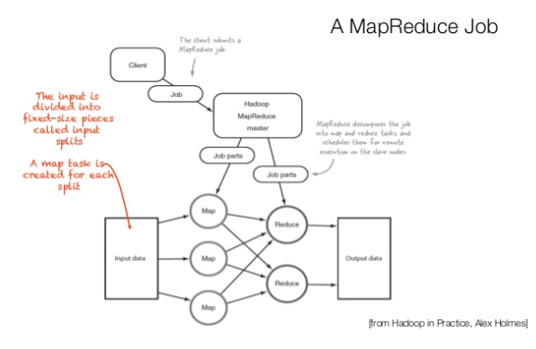
MapReduce Stage

Slide 8
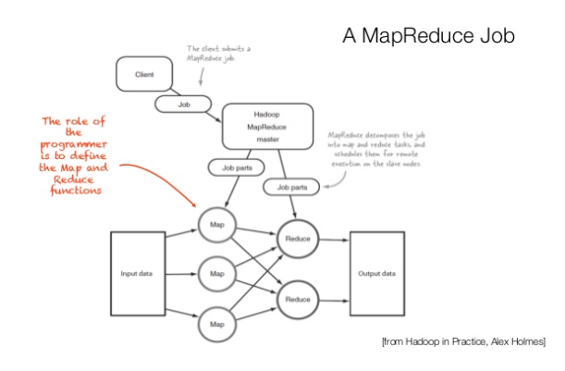
MapReduce Stages

Slide 9
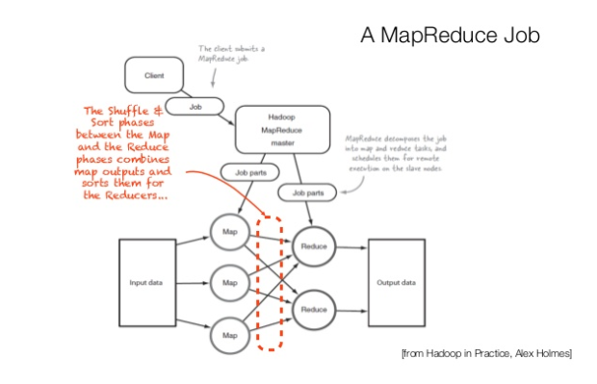
MapReduce Stages

Slide 10
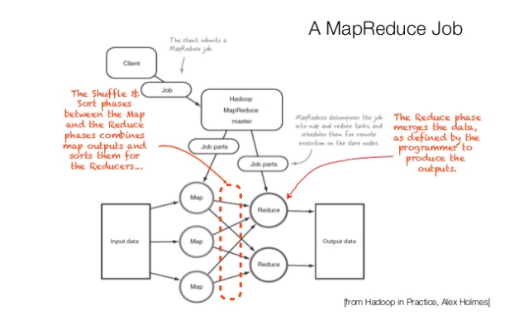
MapReduce Stages

Slide 11
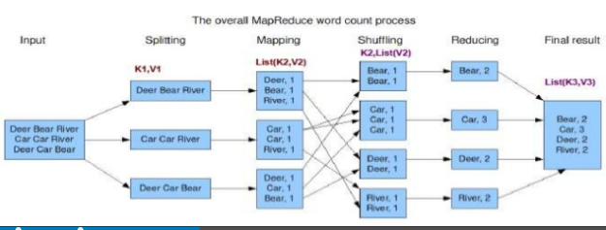
MapReduce Example

Slide 12
Map Function
Mapper takes as input a key/value pair which represents a logical record from the input data source.
It produces zero or more o/p key/value pairs for each input pair.
Eg a filtering function may only produce if a certain condition is met.
Eg a counting function may produce multiple key/value pairs, one per element being counted.
Map(in_key,in_value) → list(temp_key,temp_value)

Slide 13
Reduce Function
A single reducer handles all the map output for a unique map output key
A reducer outputs zero to many key/value pairs
The output is written to HDFS location or external DB.
Reduce(temp_key, list(temp_values))→ list(out_key,out_value)

Slide 14
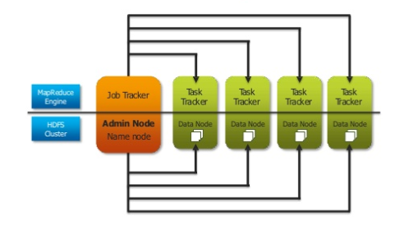
MapReduce Concepts(Hadoop 1.0)
Notes:
JobTracker : It is responsible for accepting jobs from clients, dividing those jobs into tasks and assigning those tasks to be executed by worked nodes.
Task Tracker : It is a process that manages the execution of the tasks currently assigned to that node. Each TaskTracker has a fixed number of slots for executing tasks (two maps and two reduces by default.)

Slide 15
MapReduce
JobTracker(Master):
Controls MapReduce Jobs
Assigns Map and Reduce task to the other nodes on the cluster.
Monitors the task as they are running.
Relaunches failed tasks on the other nodes in the cluster.
TaskTracker(Slave)
A single task tracker per slave node
Manages the execution of individual tasks on the node.
Can instantiate many JVMs to handle tasks in parallel.
Communicates back to Job Tracker via heartbeat.

Slide 16
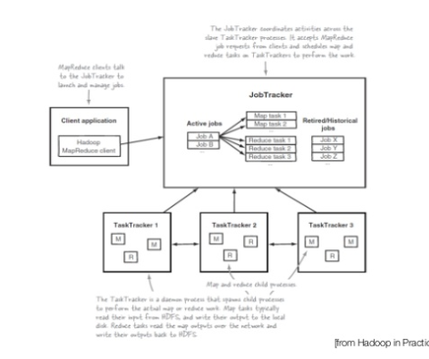
MapReduce Architecture

Slide 17
Bottlenecks?
Reducers cannot start until all Mappers are finished and the output has been transferred to reducers and sorted.
The percentage of Mappers which should finish before the Reducers start retrieving data is configurable.
For slow mappers, Hadoop uses speculative execution-
If a mapper appears to be running significantly slower that the others, a new instance of the Mapper will be started on another machine on the same data.
The results of first Mapper to finish will be used and the other will be terminated.

Slide 18
Setting Up MapReduce Job
A job object forms the specification for the job.
Job needs to know:
The jar file which will be distributed across the cluster, setJarByClass()
the input path(in HDFS) for the job, FileInputFormat.addInputPath()
The output path(in HDFS) for the job, FileInputFormat.setOutputPath()
The Mapper and Reducer classes, setMapperClass() and setReducerClass()
The output key and value classes, setOutputKeyClass() and setOutputValueClass()

Slide 19
Setting up MapReduce Job contd.
The Mapper output key and value classes if they are different from the reducer; setMapOutputKeyClass() and setMapOutputValueClass()
The job name , which by default is the jarname , setJobName()
The default input considers files as lines of text

Slide 20
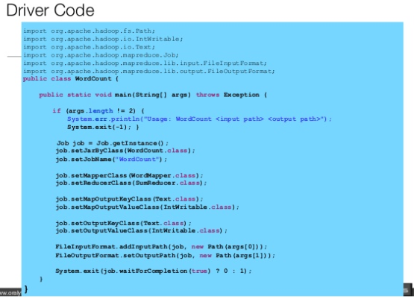

Slide 21
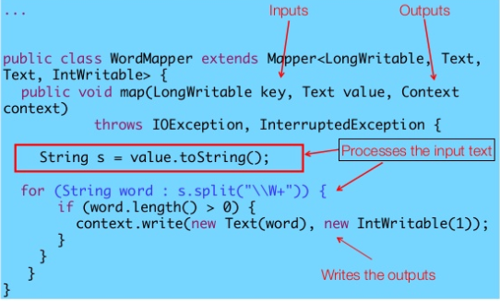
Mapper Class

Slide 22
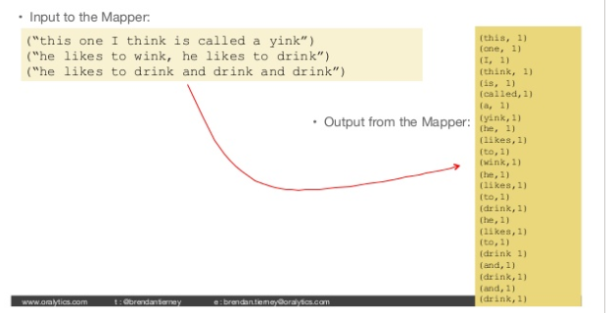
What Mapper does?

Slide 23
Shuffle and Sort?
Shuffle
Integrates the data(key/value) pairs from outputs of each mapper.
Integrates into 1 file
Sort
The set of intermediate keys on single node is automatically sorted by Hadoop before they are presented to Reducer.
Sorted within key
Determines which subset of Data goes to which Reducer

Slide 24
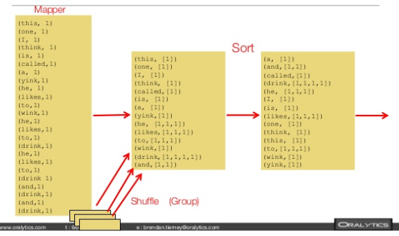
Shuffle and Sort Contd.

Slide 25
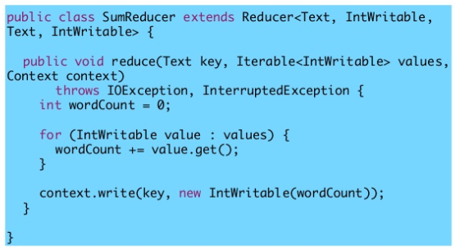
Reducer Class

Slide 26
Any Questions
THANK YOU!

