Slide 1
Lecture 5
YARN(Yet Another Resource Negotiator)

Slide 2
YARN
YARN(Yet Another Resource Negotiator) is cluster resource management system for Hadoop.
YARN was introduced in Hadoop 2 to improve the MapReduce implementation and eliminate Hadoop 1 scheduling disadvantages.
YARN is connecting link between high level applications(Spark,Hbase etc.) and low level Hadoop environment.
With introduction of YARN, Hadoop transformed from only MapReduce framework to big data processing core.

Slide 3
Anatomy of YARN
It provides its core services using two types of long running daemon:
1. Resource Manager (one per cluster): is responsible for tracking the resources in a cluster, and scheduling applications. Actually it responses to resource requests from Application Master(one per each YARN application), via requesting to Node Managers. It doesn’t monitor and collect any job history. It is only responsible for cluster scheduling. Actually ResourceManager is a single point of failure but Hadoop 2 support High availability which can restore ResourceManager data in case of failures.
2. Node Manager(one on every node) : is responsible to monitor nodes and containers resources such as CPU, Memory, Disk Space, Network etc. It also collect log data and report that information to the Resource Manager.
A container executes an application specific process with a constrained set of resources.

Slide 4
Application Master
Application Master actually runs in a separate container process on a slave node.
It has one instance per application, instead of JobTracker, which has a single daemon that ran on a Master node and tracked the process of all applications which was point of failures.
It is responsible to sent heartbeat messages to the ResourceManager with its status and the state of the application’s resource needs.
Hadoop 2 supports uber(lightweight) tasks which can be run by ApplicationMaster on same node, without wasting time for allocation.
ApplicationMaster should be implemented for each YARN application type, in case of MapReduce it designed to execute Map and Reduce tasks.

Slide 5
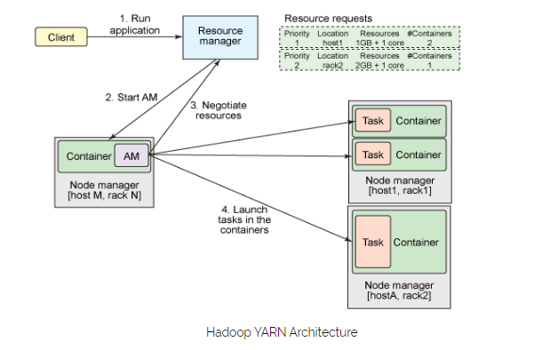
YARN Architecture

Slide 6
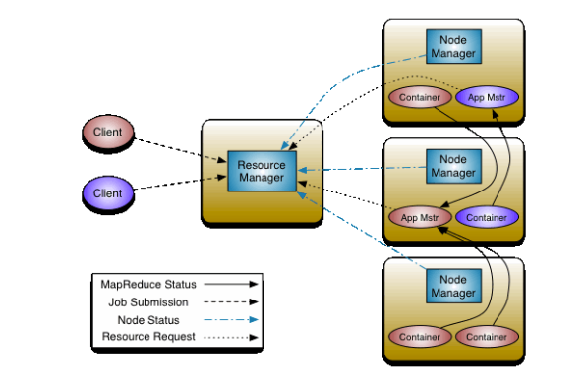
YARN Architecture

Slide 7
Anatomy of YARN
Steps to run YARN application:
Client does a request to ResourceManager to run application.
ResourceManager requests NodeManagers to allocate container for creating ApplicationMaster instance on available (which has enough resources) node.
When ApplicationMaster instance already run , it itself send requests(heartbeats,app resource needs etc.) to ResourceManager and manage application.

Slide 8
MapReduce 2 vs MapReduce1
MapReduce 2(Advantages) | MapReduce 1 (Disadvantages)
Has three schedulers for shared cluster resource allocation. FIFO, capacity and Fair scheduler. | Has underutilization problem because it support only FIFO scheduler.
It supports Uber tasks which can be run by Application Master in same node without wasting for resource allocation. | Doesnot support Uber tasks.
Uses resourceManager with high availability support. And also run ApplicationMaster | JobTracker single point of failure
Supports different version of MapReduce in the cluster. | Supports only one MapReduce function

Slide 9
Scheduling in YARN
Scheduling is an important task when Hadoop cluster is shared between many users and tasks. Problem is which user’s task should be run first or which task should be run first, big one or small one.
Hadoop 1 which use FIFO scheduler with slot (fixed cpu, memory and disk count) based model was very inefficient for shared clusters, whereas Hadoop 2 introduced Capacity (by Yahoo) and Fair (by Facebook) schedulers with container (dynamic cpu, memory and disk count) allocation model as part of the Yarn, which is more efficient than FIFO scheduler.
Yarn supports three schedulers FIFO, Capacity and Fair schedulers, we’ll consider them in next slide. It also provide opportunity to create your own scheduler by extending Fair scheduler class.

Slide 10
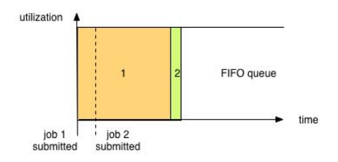
FIFO(First In First Out)
Simplest and most understandable scheduler.
It doesn’t need any configuration.
But it is not suitable for shared clusters because big applications eat all resources.
Notes:
Simplest and most understandable scheduler.
It doesn’t need any configuration.
But it is not suitable for shared clusters because big applications eat all resources.

Slide 11
Capacity Scheduler
Allows sharing of Hadoop cluster along organizational lines(each one in a queue) . Queues may be further divided in hierarchical fashion
each organization is allocated a certain capacity of the overall cluster.
if there is more than one job Capacity Scheduler may allocate the spare resources to jobs in the queue, even if that causes the queue’s capacity to be exceeded. (queue elasticity.)
when demand increases, the queue will only return to capacity as resources are released from other queues as containers complete. If it’s not have configured policy

Slide 12
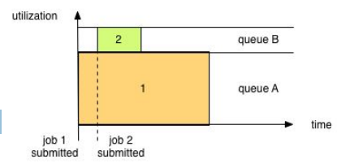
Capacity Scheduler Contd.

Slide 13
Fair Scheduler
Fair Scheduler dynamically balance resources (evenly between all tasks) between all running jobs. There is also queue hierarchy for organisations.
If queue policy is not configured it is Fair (50/50% or 1:1)
Preemption allows the scheduler to kill containers for queues that are running with more than their fair share of resources
Delay scheduling allows allocating container in same node where application was submitted.
Dominant Resource Fairness (drf) gives priority to tasks which have the most dominant resources

Slide 14
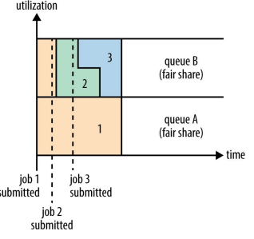
Fair Scheduler Contd.

Slide 15
Any Questions?
THANK YOU!

