Slide 1

Lecture 8
Hive Queries

Slide 2
Select Query:
Select * from table_name;
Select name, salary from employees;
eg : Subordinates- array , deductions - map, address - struct
select name,subordinates,deductions, address from employee:
John Doe ["Mary Smith","Todd Jones"] {"Federal Taxes":0.2,"State Taxes":0.05,"Insurance":0.1} {"street":"1 Michigan Ave.","city":"Chicago","state":"IL","zip":60600}
To access elements:
Select name, subordinates[0],deductions[“State Taxes”],address.city;
We can also perform operations at the time of selecting columns:
eg ;
SELECT upper(name), salary, deductions["Federal Taxes"], round(salary * (1 - deductions["Federal Taxes"])) FROM employees;

Slide 3
Operations:
1. Arithmetic Operators:
A+B, A-B,A*B,A/B
If the types of the two value differ, the value of smaller of two types gets promoted to wider of other value.
2. Mathematical Functions:
round(d),rand(),exp(d),cos(d), positive(d),negative(d)

Slide 4
Operations:
Aggregate Functions:
Returns a single value resulting from some computation over many rows.
Select count(*),avg(salary) from employees;
Eg : count(*),count(expr), sum(col), sum(distinct col), avg(col),min(col),max(col)
Usually we perform aggregation by setting
set hive.map.aggr=true;
It will attempt to do top level aggregations in map phase.
Table generating functions:
It takes single column and expand them to multiple columns or rows.
Explode(array),explode(map)
Select explode subordinates as sub from epmployees;

Slide 5
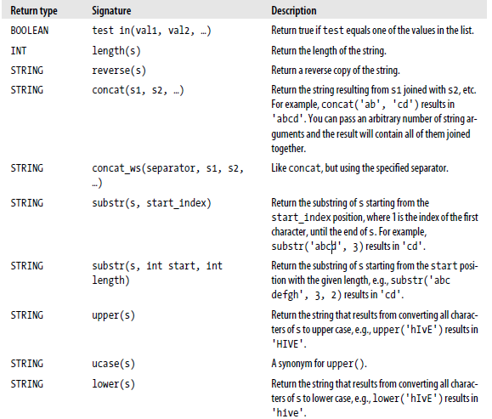

Slide 6
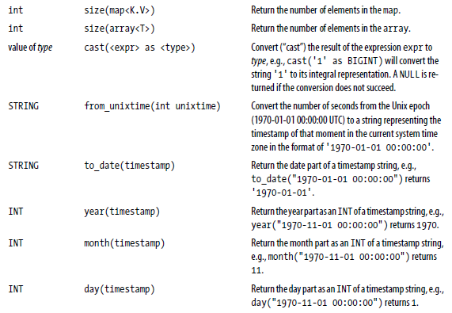

Slide 7
Other Functions
Limit Clause: It puts an upper limit to the number of rows returned:
Select * from employees limit 2;
Column Alias: Give anonymous column a name
Select upper(name) as name_up from employees;
Case..When..Then Statements :
Hive> select name,salary case when salary<50000 then ‘low’
when salary >= 50000.0 and salary < 70000.0 then 'middle’
else 'very high’ end as bracket from employees;
Like and Rlike :
Ends with Ave.:- SELECT name, address.street FROM employees WHERE address.street LIKE '%Ave.';
City begins with 0 :- SELECT name, address.city FROM employees WHERE address.city LIKE 'O%';
Street Contains Chicago :- SELECT name, address.street FROM employees WHERE address.street LIKE '%Chi%';

Slide 8
Clauses:
Group By : It is used in conjunction with aggregate functions to group the result set by one or more columns and then perform an aggregation over each group.
Having: The HAVING clause lets you constrain the groups produced by GROUP BY in a way that could be expressed with a subquery, using a syntax that’s easier to express.
SELECT year(ymd), avg(price_close) FROM stocks
WHERE exchange = 'NASDAQ' AND symbol = 'AAPL'
GROUP BY year(ymd)
HAVING avg(price_close) > 50.0;

Slide 9
Clauses Contd:
Order and Sort By:
Order By : It performs a total ordering of the query result set. This means that all the data is passed through a single reducer, which may take an unacceptably long time to execute for larger data sets.
Eg : SELECT s.ymd, s.symbol, s.price_close FROM stocks s ORDER BY s.ymd ASC, s.symbol DESC;
SORT BY : It orders the data only within each reducer, thereby performing a local ordering, where each reducer’s output will be sorted. Better performance is traded for total ordering.
Eg : SELECT s.ymd, s.symbol, s.price_close FROM stocks s SORT BY s.ymd ASC, s.symbol DESC;

Slide 10
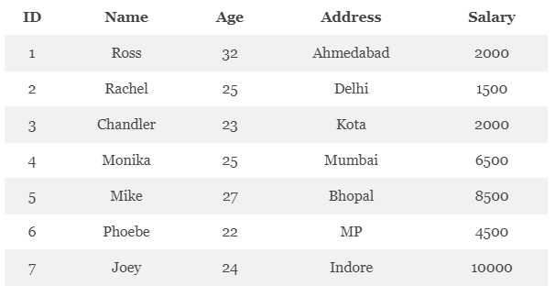
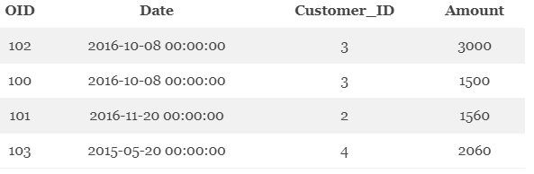
Joins:

Slide 11
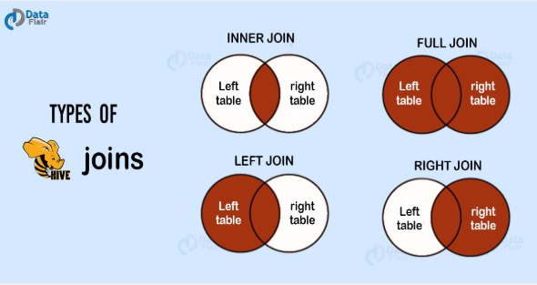

Slide 12
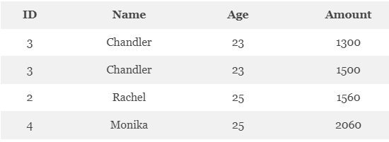
Inner Join:
SELECT c.ID, c.NAME, c.AGE, o.AMOUNT FROM CUSTOMERS c JOIN ORDERS o ON (c.ID = o.CUSTOMER_ID);

Slide 13
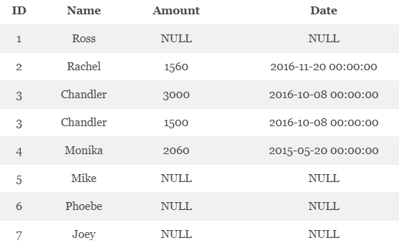
Left Outer Join:
It returns all the values from the left table. Also, the matched values from the right table, or NULL in case of no matching JOIN predicate.
hive> SELECT c.ID, c.NAME, o.AMOUNT, o.DATE FROM CUSTOMERS c LEFT OUTER JOIN ORDERS o ON (c.ID = o.CUSTOMER_ID);

Slide 14
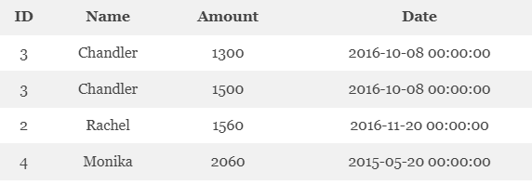
Right Outer Join:
SELECT c.ID, c.NAME, o.AMOUNT, o.DATE FROM CUSTOMERS c RIGHT OUTER JOIN ORDERS o ON (c.ID = o.CUSTOMER_ID);

Slide 15
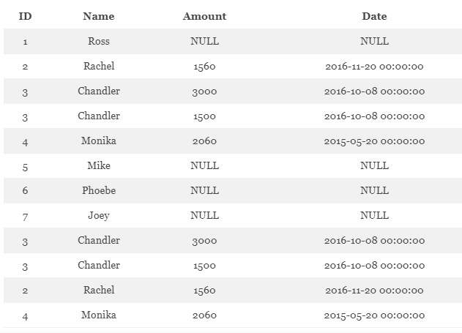
Full Outer Join:
SELECT c.ID, c.NAME, o.AMOUNT, o.DATE FROM CUSTOMERS c FULL OUTER JOIN ORDERS o ON (c.ID = o.CUSTOMER_ID);

Slide 16
Any Questions?
THANK YOU

