Slide 1
Welcome to Itvedant
Introduction & Policies

Slide 2
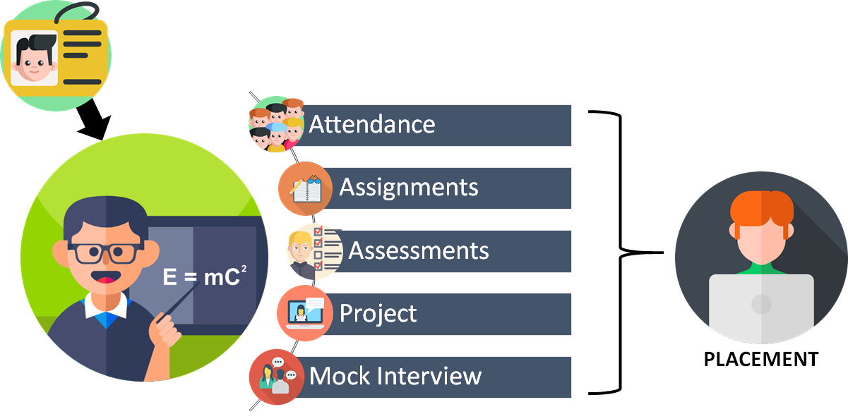
Modular Process Lifecycle

Slide 3
Attendance
90% Attendance is mandatory
Initial 2 weeks absenteeism to be avoided
Break application / email to be submitted
Email to respective faculty and student coordinator
Only 2 breaks allowed in full package (all modules)

Slide 4
Assignments
Completion as per given deadline
Each task is allotted 5 marks
Assignment is to be submitted to PORTAL (https://student.itvedant.com)
Types of files supported
Notes:
On this slide student portal login is to be explained
Also talk about notes available

Slide 5
Assessments
1 exam after each module
50 marks (MCQ’s + Practical)
Grading Patterns (in percentile)
A grade - 85 to 100
B grade - 75 to 84
C grade - 60 to 74
D grade - less than 60
Notes:
Grade C is the passing criteria for certificate

Slide 6
Project / Case Study
50 marks
1 week after module completion
Topic is student choice
Guidance by us (faculty)
Evaluation Technique:
Time plan followed
Github link
Documentation

Slide 7
Mock Interview
1st round - will be in classroom by faculty
2nd round - cross faculty technical round
Clear both for next step >> PLACEMENTS

Slide 8
Soft Skills & Personality Improvisation
During & Post lectures session on:
Interview handling skills
Resume preparation
Communication skills
Corporate etiquettes
Right attitude and discipline

Slide 9
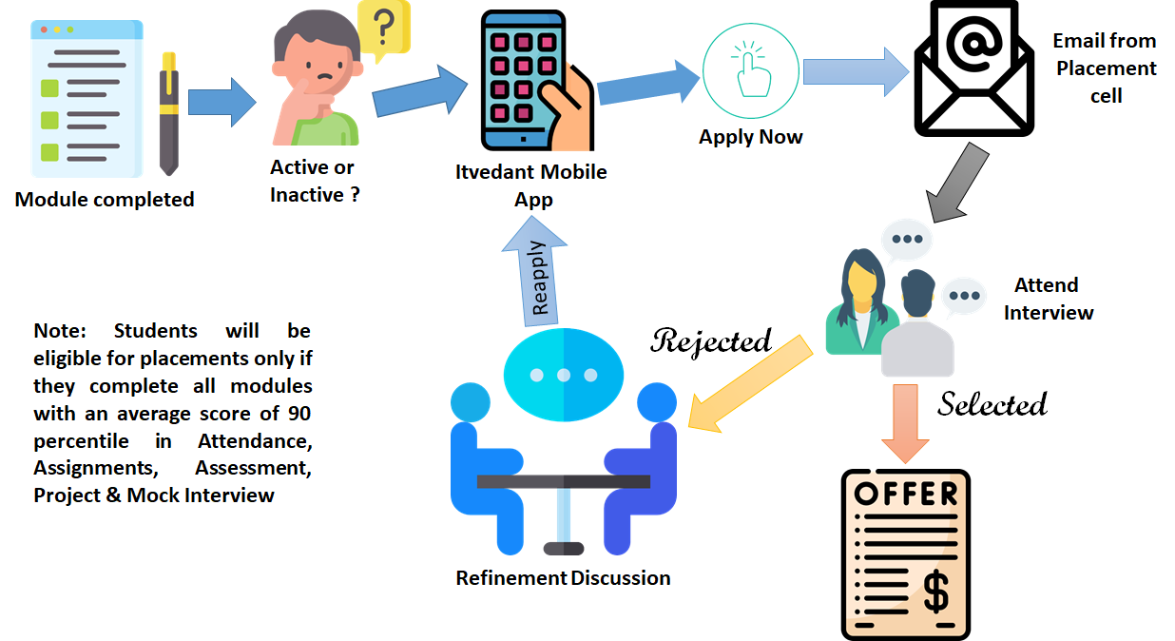
Placement Cycle
Notes:
Demo of mobile app
Every email received from the Placement cell has to be reverted (positive or negative response).
Every student who has applied for the job opportunity has to compulsorily attend the interview. Only valid reasons will be accepted for absenteeism for interview subjected to approval from faculty and placement cell
If the student doesn’t attend 3 interviews after being shortlisted, he/she will be blacklisted from placement.
Refinement Discussion can be done with faculty or placement cell member

Slide 10
Know Your Mentor
Faculty who took first lecture is your mentor
Connect your mentor for placement active status

Slide 11
Certificate
Downloadable certificate
Available on portal and Mobile app
Note: will be able to download only after completion of modules, assignments, assessments and project / case study.

Slide 12
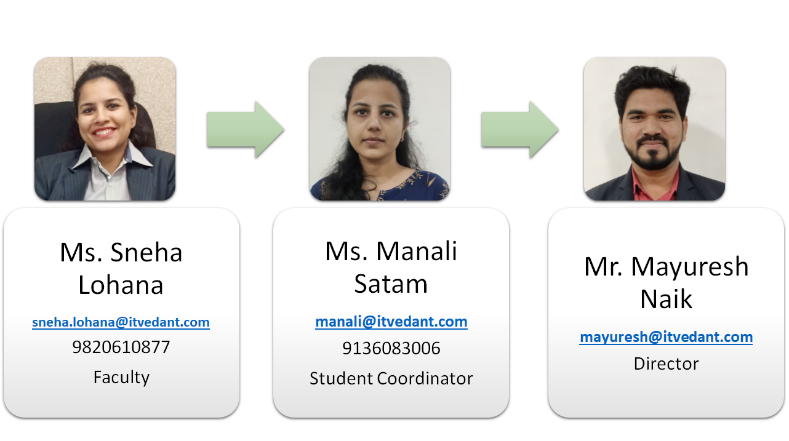
Placement/Escalation/Feedback Channel
Notes:
Here every faculty can add their own picture and contact details

Slide 13
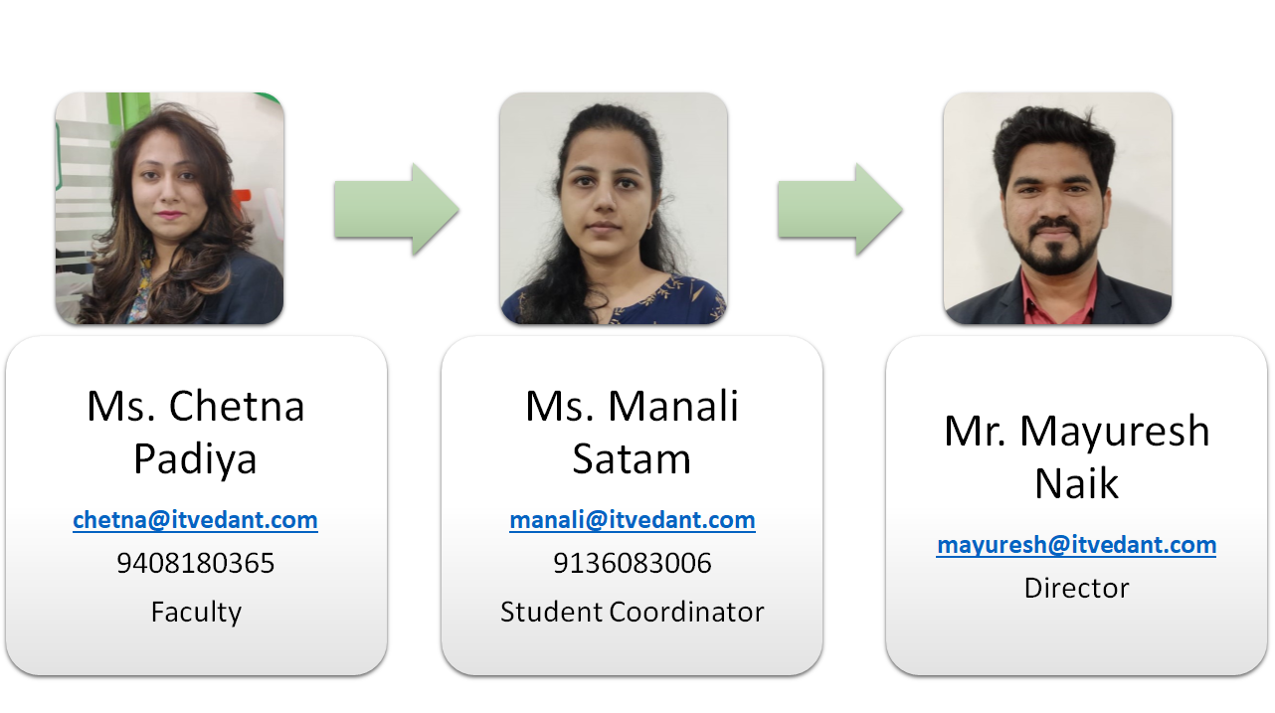
Placement/Escalation/Feedback Channel
Notes:
Here every faculty can add their own picture and contact details

Slide 14


