Slide 1
Recommender Systems & Collaborative Filtering
Mark Levene
(Follow the links to learn more!)

Slide 2
What is a Recommender System
E.g. music, books and movies
In eCommerce recommend items
In eLearning recommend content
In search and navigation recommend links
Use items as generic term for what is recommended
Help people (customers, users) make decisions
Recommendation is based on preferences
  Of an individual
  Of a group or community

Slide 3
Types of Recommender Systems
Content-Based (CB) – use personal preferences to match and filter items
  E.g. what sort of books do I like?
Collaborative Filtering (CF) – match `like-minded’ people
  E.g. if two people have similar ‘taste’ they can recommend items to each other
Social Software – the recommendation process is supported but not automated
  E.g. Weblogs provide a medium for recommendation
Social Data Mining – Mine log data of social activity to learn group preferences
  E.g. web usage mining
We concentrate on CB and CF

Slide 4
Content-Based Recommenders
Find me things that I liked in the past.
Machine learns preferences through user feedback and builds a user profile
Explicit feedback – user rates items
Implicit feedback – system records user activity
  Clicksteam data classified according to page category and activity, e.g. browsing a product page
  Time spent on an activity such as browsing a page
Recommendation is viewed as a search process, with the user profile acting as the query and the set of items acting as the documents to match.

Slide 5
Collaborative Filtering
Match people with similar interests as a basis for recommendation.
  Many people must participate to make it likely that a person with similar interests will be found.
  There must be a simple way for people to express their interests.
  There must be an efficient algorithm to match people with similar interests.

Slide 6
How does CF Work?
Users rate items – user interests recorded. Ratings may be:
  Explicit, e.g. buying or rating an item
  Implicit, e.g. browsing time, no. of mouse clicks
Nearest neighbour matching used to find people with similar interests
Items that neighbours rate highly but that you have not rated are recommended to you
User can then rate recommended items

Slide 7
Example of CF MxN Matrix with M users and N items
(An empty cell is an unrated item)
Items / Users | Data Mining | Search Engines | Data Bases | XML
Alex | 1 |  | 5 | 4
George | 2 | 3 | 4
Mark | 4 | 5 |  | 2
Peter |  |  | 4 | 5

Slide 8
Observations
Can construct a vector for each user (where 0 implies an item is unrated)
  E.g. for Alex: <1,0,5,4>
  E.g. for Peter <0,0,4,5>
On average, user vectors are sparse, since users rate (or buy) only a few items.
Vector similarity or correlation can be used to find nearest neighbour.
  E.g. Alex closest to Peter, then to George.

Slide 9
Case Study – Amazon.com
Customers who bought this item also bought:
Item-to-item collaborative filtering
  Find similar items rather than similar customers.
Record pairs of items bought by the same customer and their similarity.
  This computation is done offline for all items.
Use this information to recommend similar or popular books bought by others.
  This computation is fast and done online.

Slide 10
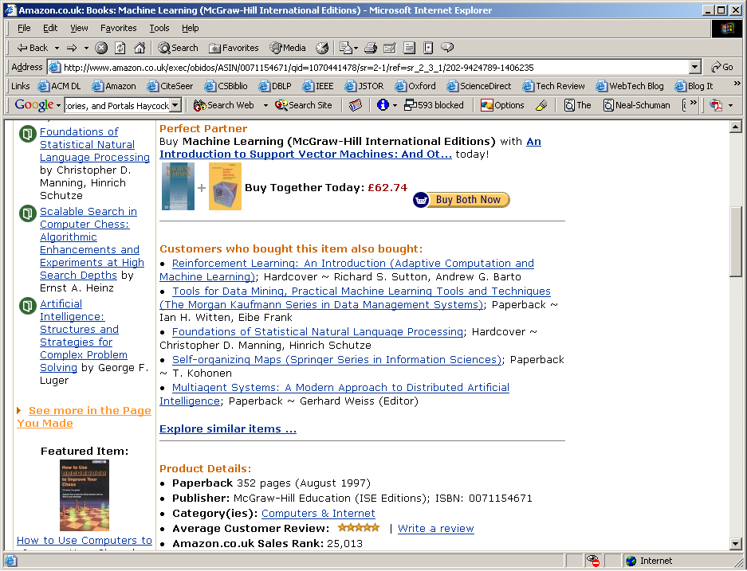
Amazon Recommendations

Slide 11
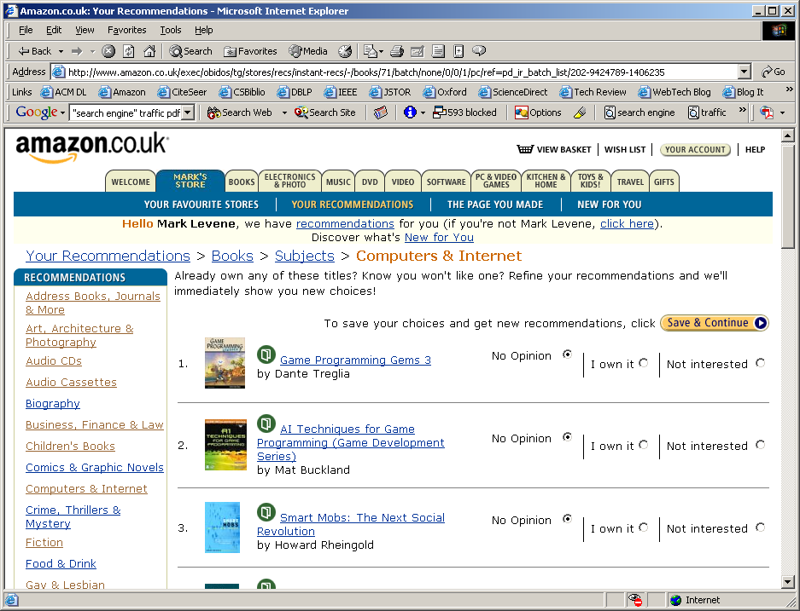
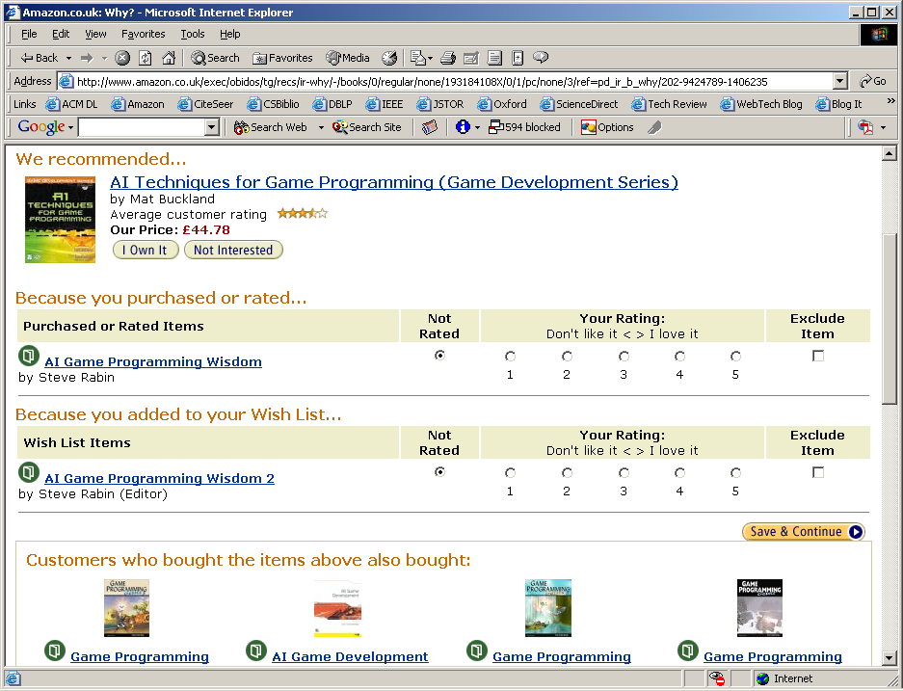
Amazon Personal Recommendations

Slide 12
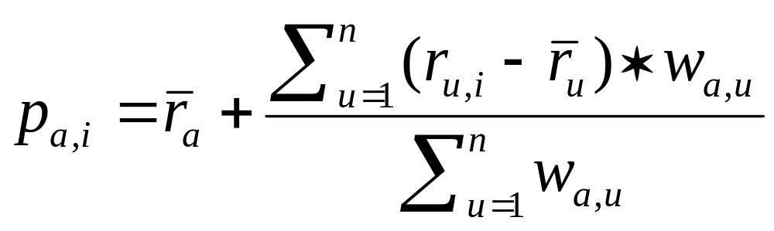
Case Study - GroupLens
Use movielens as an example.
Users rate items on a scale of 1 to 10.
Nearest neighbour prediction with correlation to weight user similarity.
Evaluation – how far are the predictions from the recommendations.
p – prediction, r – rating, r-bar – average rating, w - similarity
a – active user, u – user, i – item,

Slide 13
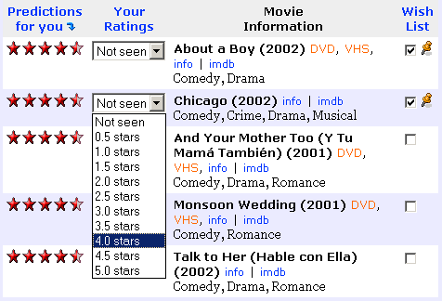
MovieLens Recommendations

Slide 14
Challenges for CF
Sparsity problem – when many of the items have not been rated by many people, it may be hard to find ‘like minded’ people.
First rater problem – what happens if an item has not been rated by anyone.
Privacy problems.
Can combine CF with CB recommenders
  Use CB approach to score some unrated items.
  Then use CF for recommendations.
Serendipity - recommend to me something I do not know already
  Oxford dictionary: the occurrence and development of events by chance in a happy or beneficial way.

