Slide 1

Data Spark: Illuminating Insights for Global Electronics
Retail Analytics in the Electronics Industry

Slide 2
Problem Statement and Business Use case:
Global Electronics, a leading retailer of consumer electronics, has provided with several datasets containing information about their customers, products, sales, stores, and currency exchange rates. The company seeks to leverage this data to better understand their business and identify areas for improvement.
I have tasked with conducting a comprehensive Exploratory Data Analysis (EDA) to uncover valuable insights from the Global Electronics company’s data. The goal is to provide actionable recommendations that can enhance customer satisfaction, optimize operations, and drive overall business growth. By analyzing Global Electronics' customer, product, sales, and store data, we aim to identify key insights that will enhance marketing strategies, optimize inventory management, and improve sales forecasting. This will help tailor marketing campaigns, develop better products, plan effective promotions, and decide on store expansions and optimizations. Additionally, understanding the impact of currency exchange rates on sales will allow for better international pricing strategies. Overall, these insights will help Global Electronics increase customer satisfaction and drive business growth.

Slide 3
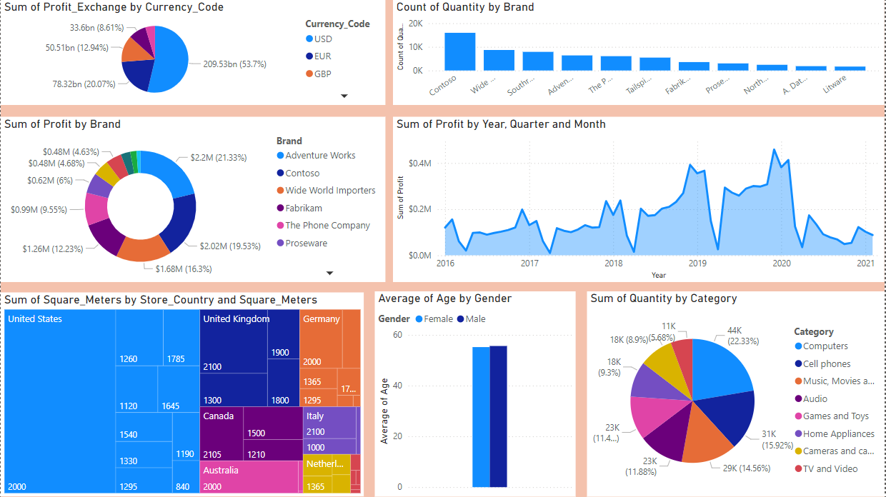

Slide 4
Overall Analysis:
Profit Trends (2016-2021)
Upward Trend (2016-2019): Profit shows steady growth with periodic peaks and troughs, culminating in the highest peak in 2019.
Downward Shift (2020): A noticeable decline in 2020, likely impacted by the global pandemic, affecting sales and operations in most regions.
Profits are minimal in 2021.
Seasonal Variations
Profits experience regular, seasonal fluctuations each year, with specific months consistently outperforming others.
Brand Performance
Top Contributors:
Adventure Works: $2.2M (21.33%) of total profit.
Contoso: $2.02M (19.33%).
The top two brands account for approximately 40% of total profits.
Other Brands: Tailspin Toys and Northwind Traders contribute smaller shares to overall profits.

Slide 5
Currency Distribution
USD: Dominates profit share, contributing over half of the total.
Other Currencies: GBP and EUR follow USD; AUD contributes smaller portions.
Regional & Sales Channel Insights
U.S. and Online Sales: Consistently leading in profit, with the U.S. reaching its highest profit in 2019.
Other Regions: France, Netherland and Australia show steady but lower profits than the U.S. and Online sales.
Product Categories
Movie DVDs and Desktops have the highest sales volumes, indicating popular, high-demand items.
Washers and Dryers, with high average unit prices, are premium offerings and low Quantities Sold.
Music DVDs and Desktops have high quantities sold but lower average prices.
Customer Demographics
Average Age: 56 years.
Gender Balance: Males slightly outnumber females by just 1.4%, indicating a nearly balanced customer base.

Slide 6
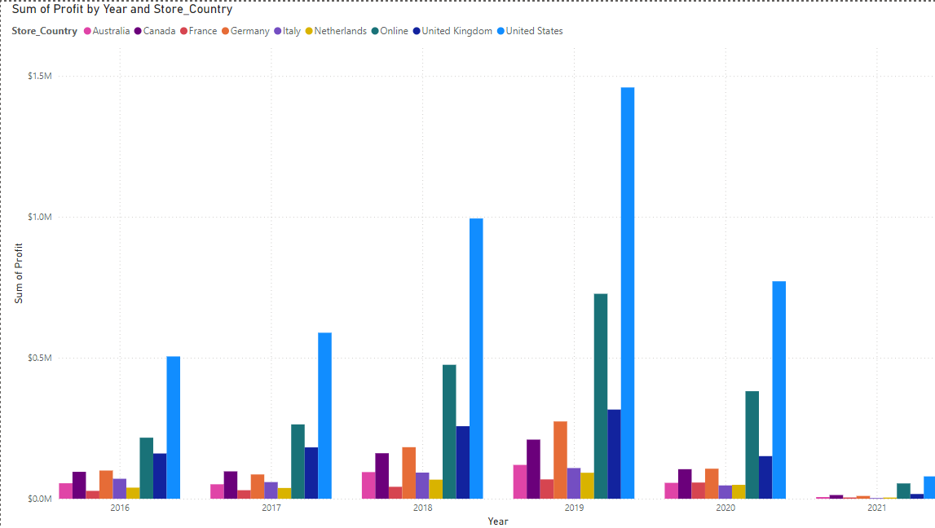
There is a noticeable increase in profit from 2016 to 2019 for most countries, with a significant peak in 2019, especially for the United States, which seems to have the highest profit.
Profit declines in 2020 across most countries, likely due to the pandemic's impact on sales and operations.

Slide 7
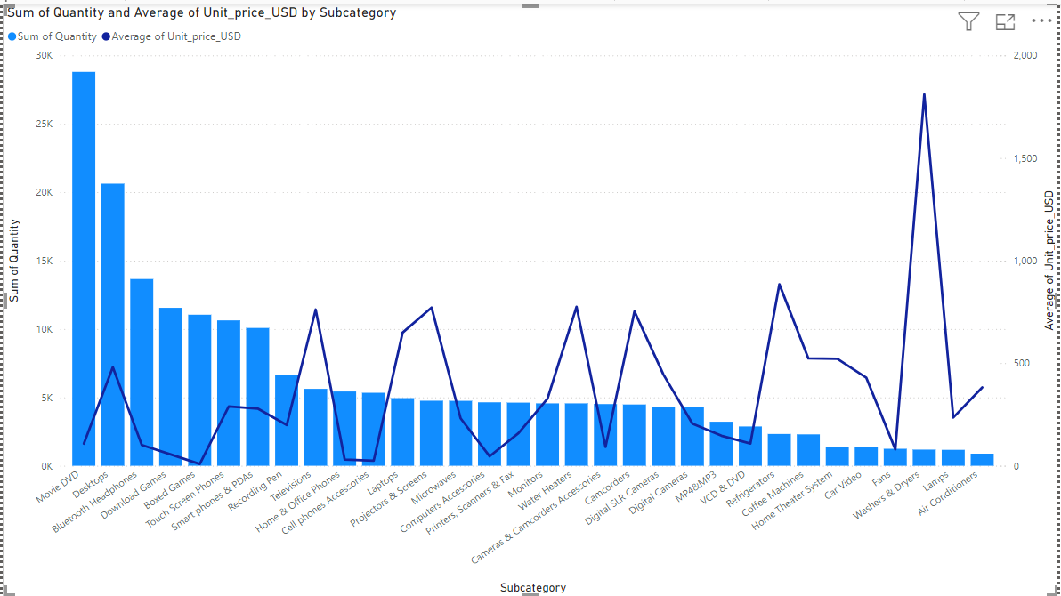
Movie DVDs and Desktops have the highest quantities sold, indicating popular categories with likely high demand but lower average prices. Washers and Dryers stand out with high average unit prices, which suggests these are premium products but have lower quantities sold.

Slide 8
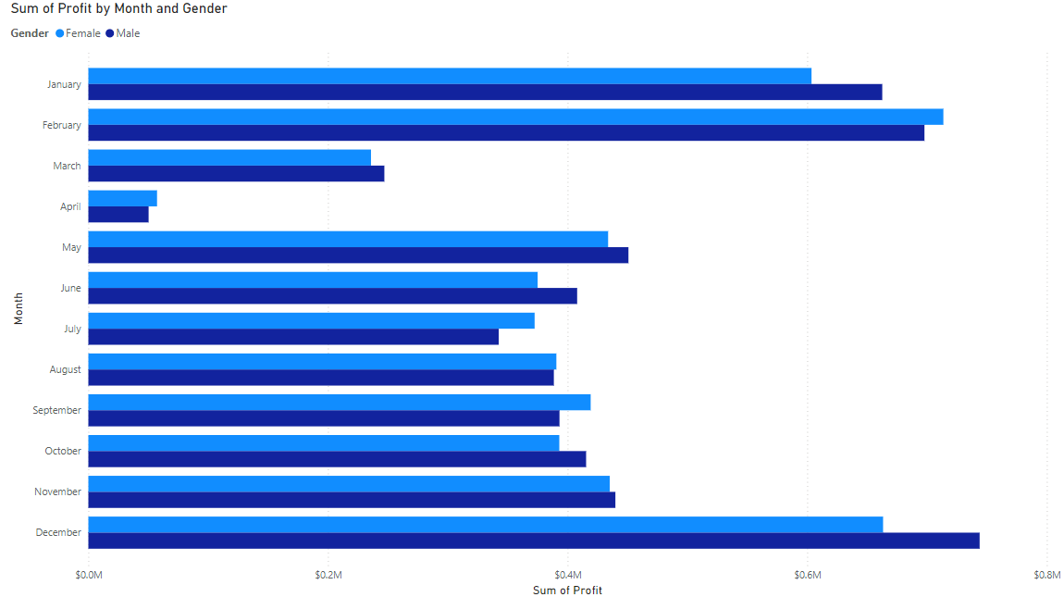
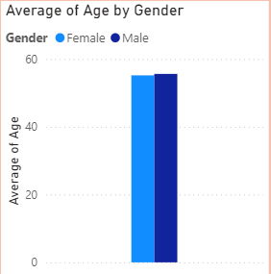
The average customer age is 56 years. Male customers make up just 1.4% more than female customers.
December has the highest profit for both genders. April shows a significantly low profit compared to other months for both genders.

Slide 9
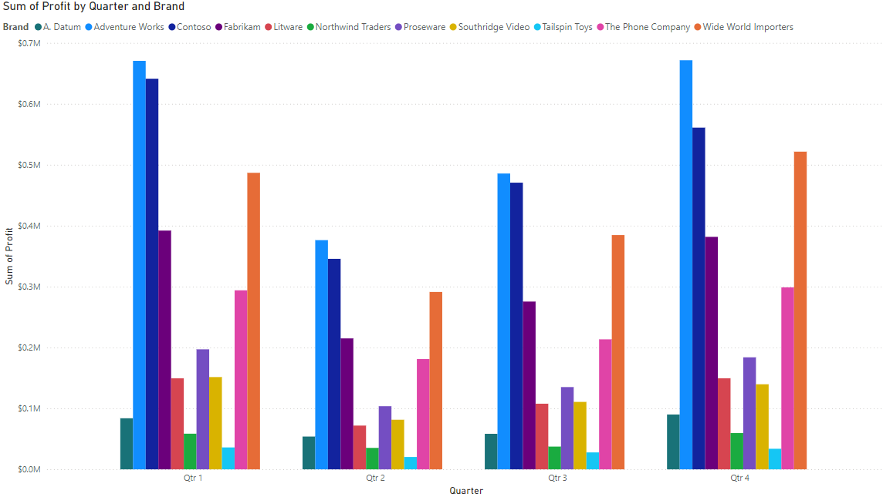
Brands like Adventure Works and Contoso consistently show high profits across all quarters, particularly in quarters 1, 3, and 4.
Some brands, like Northwind Traders and Tailspin Toys, have consistently low profits across all quarters.

Slide 10
Targeted areas for improvement:
Diversify Sales based on Areas:
Strengthen online sales channels to ensure stability during uncertain times like Pandemic.
Adapt sales and marketing strategies to suit the unique needs of each region, especially for countries with lower profit contributions.
Seasonal Campaigns:
Use historical data to identify the most profitable months(January/February/December) and develop targeted campaigns during these periods.
Increase stock levels for high-demand products(Movie DVD/Desktops) in peak seasons to avoid stockouts and capture higher sales.
Promote Smaller Brands:
Increase marketing for smaller brands like Tailspin Toys and Northwind Traders to distribute profit reliance and strengthen brand diversity.
Consider introducing new products under less-contributing brands to attract new customer segments

Slide 11
Refine Product Mix:
Focus on promoting high-margin items like Washers and Dryers while maintaining volume-driven categories.
Localized Marketing:
Develop region-specific campaigns in places like France, Netherland and Australia to strengthen sales in these markets.
Age-Specific Campaigns:
Since the average customer age is 56, design marketing campaigns that resonate with this demographic, such as lifestyle-based messaging.
Ensure the slight gender difference is maintained by targeting marketing inclusively to appeal to both male and female customers.

Slide 12
Thank you

