Slide 1
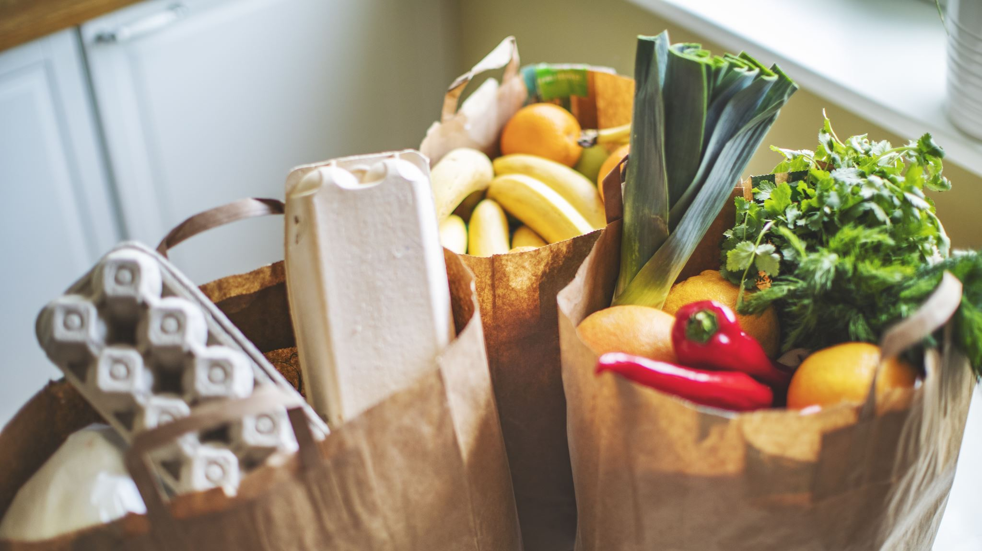
Food waste Application for warehouse
Kallepu meena kumari(10627538)

Slide 2
Introduction
Every year in the ireland, 1.1 million tons of food are wasted.
It is thought that approximately 50% of the food wasted is still edible.
In order to control food waste in warehouse created application using flutter.
User can see the nearest food item along with the distance.
The specialised Food Waste Warehouse Application developed using Flutter offers an efficient way for warehouse operators to tackle food waste effectively

Slide 3
Methodology
Creating an online and mobile application targeted at reducing food waste by addressing extra commodities in warehouses close to their expiration date is the main emphasis of the research approach used in this dissertation
The Flutter framework was selected as the development environment for several convincing reasons.
Using Flutter's capabilities, the project aims to create a user-centric and efficient application that not only tackles the problem of food waste in warehouses.
This research strategy will lead the development, testing, and deployment of the application to decrease food waste and create a more sustainable future.

Slide 4
Tech stack
Flutter: Is used to create mobile application which is user friendly.
The effectiveness of DART programming in application development is effective, as it uses client-optimized language for fast applications and other platforms.
Back end Technologies :
Mongo db: MongoDB is a NoSQL database management system that provides a flexible and scalable approach to storing and managing data.
We have database for storing and managing items details, pick ups and user details.
Cloudinary image: It unables user to store images

Slide 5
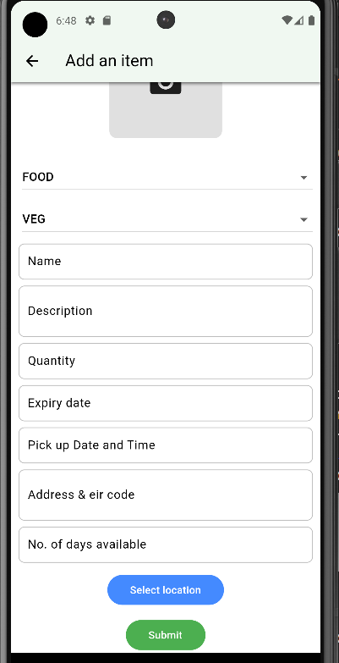
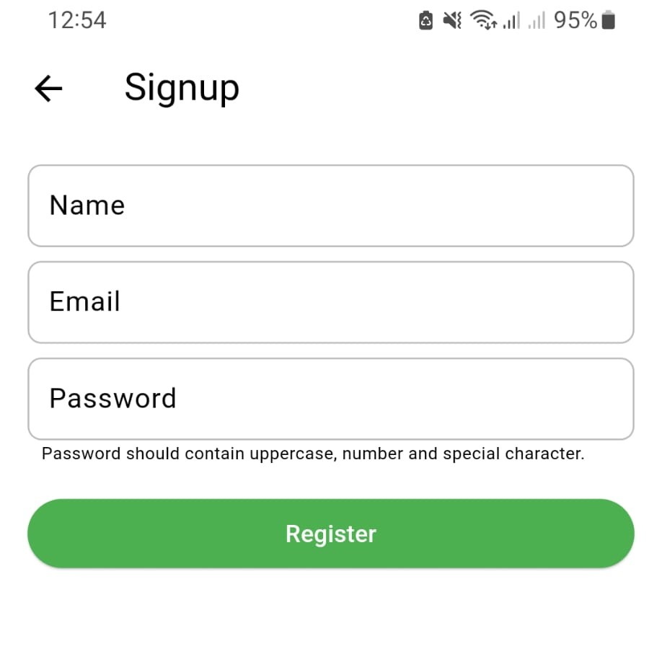
Implementation
Donor’s item page
Sign up page

Slide 6
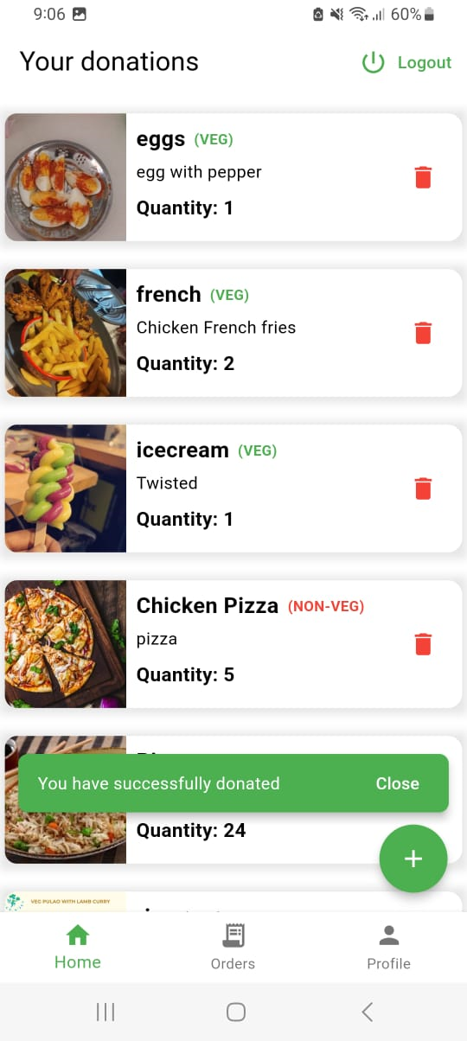
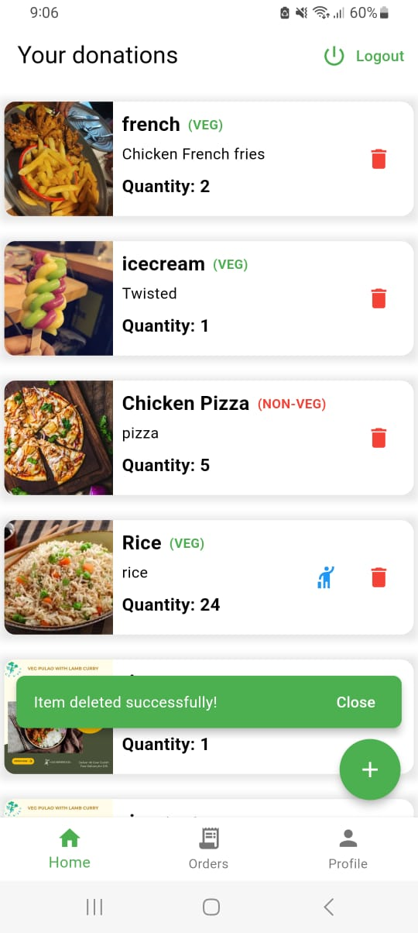

Slide 7
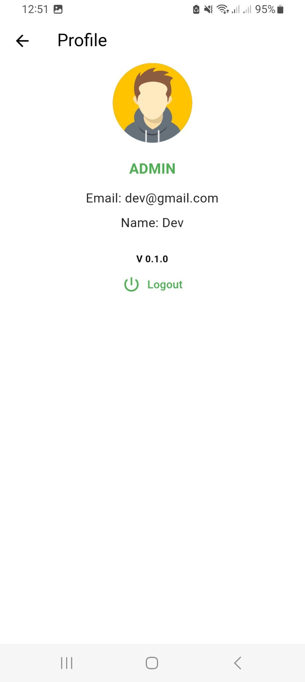
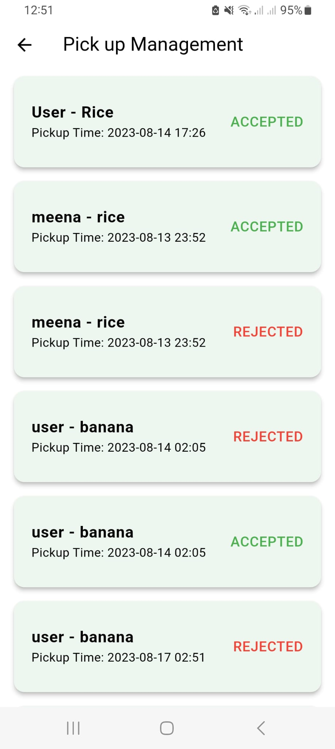
Profile page
Donor pick up page

Slide 8
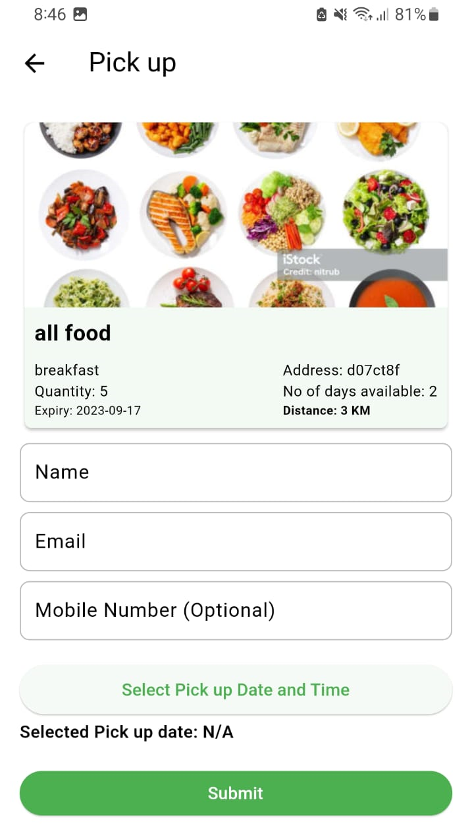
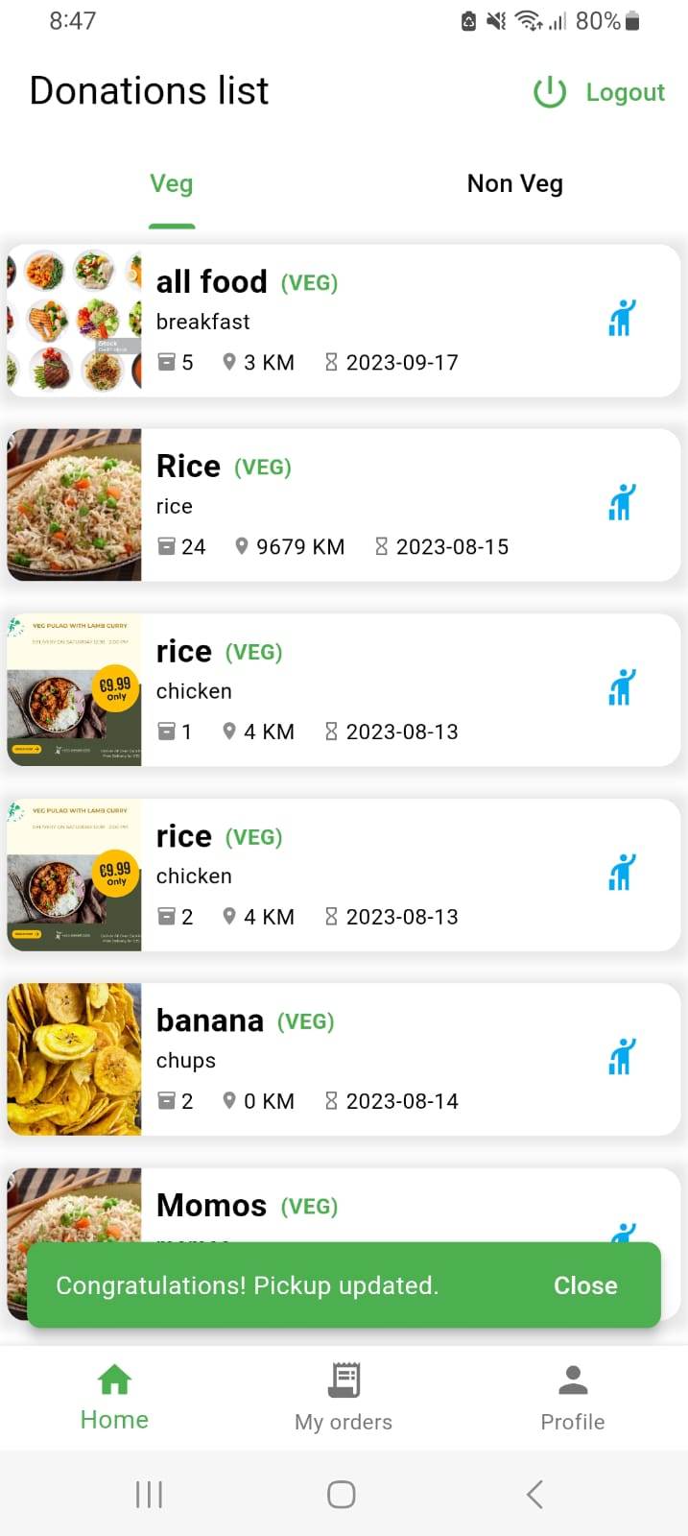
User pick up item page

Slide 9
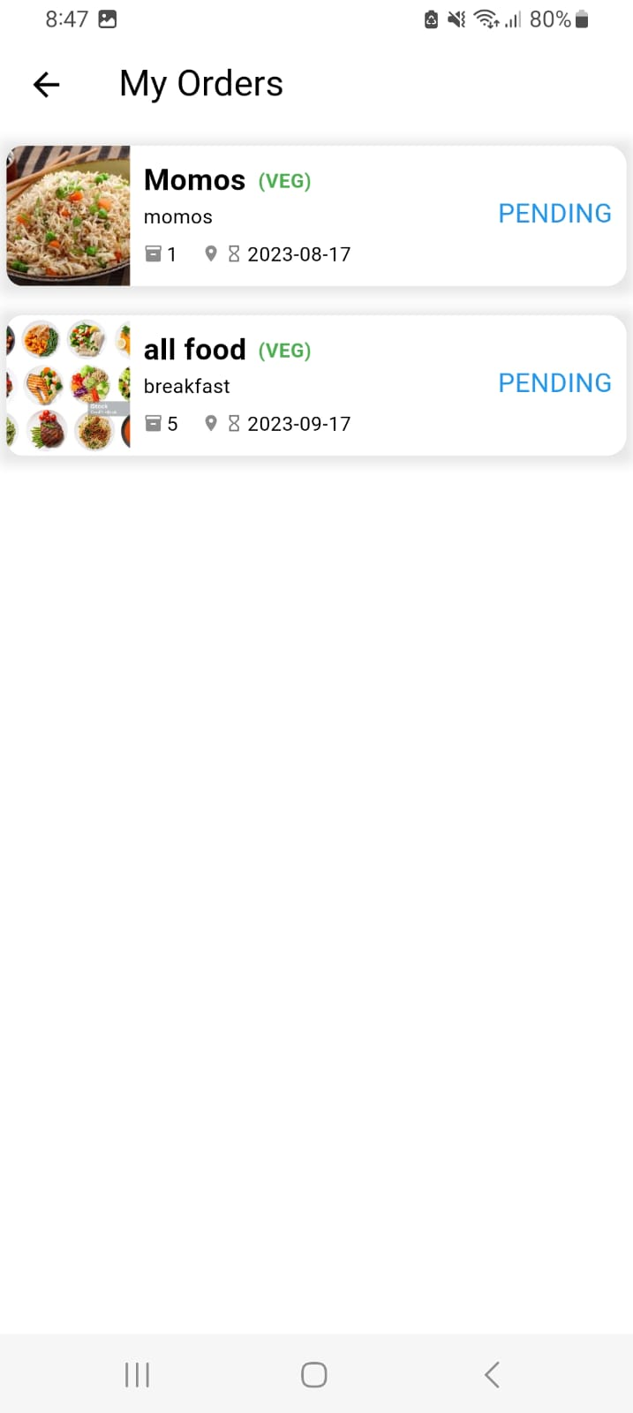
My orders page

Slide 10
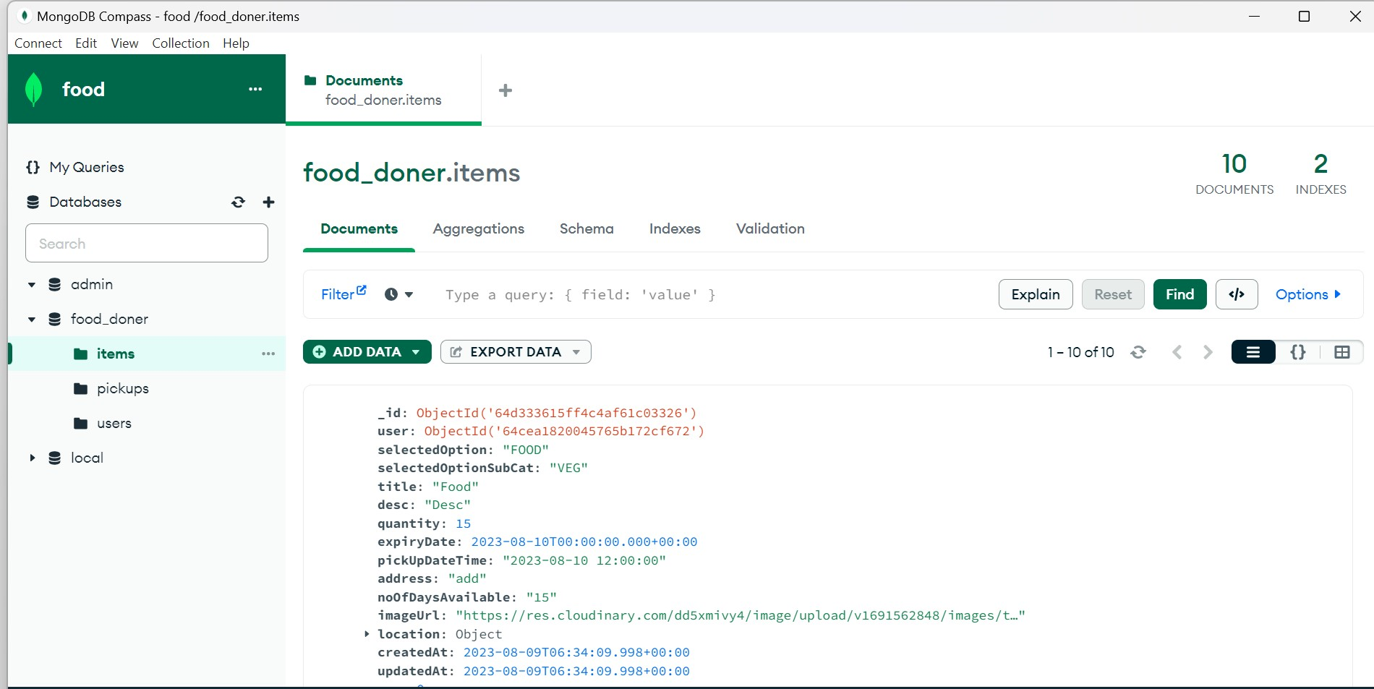
Back end
Items back end

Slide 11
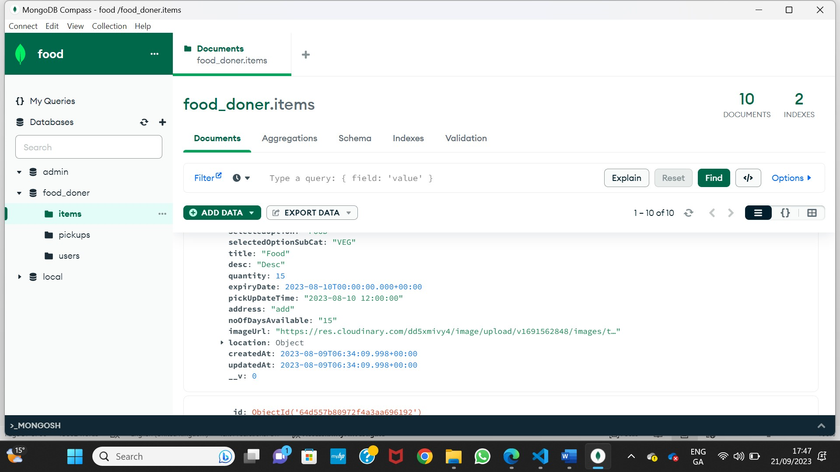
Item’s database

Slide 12
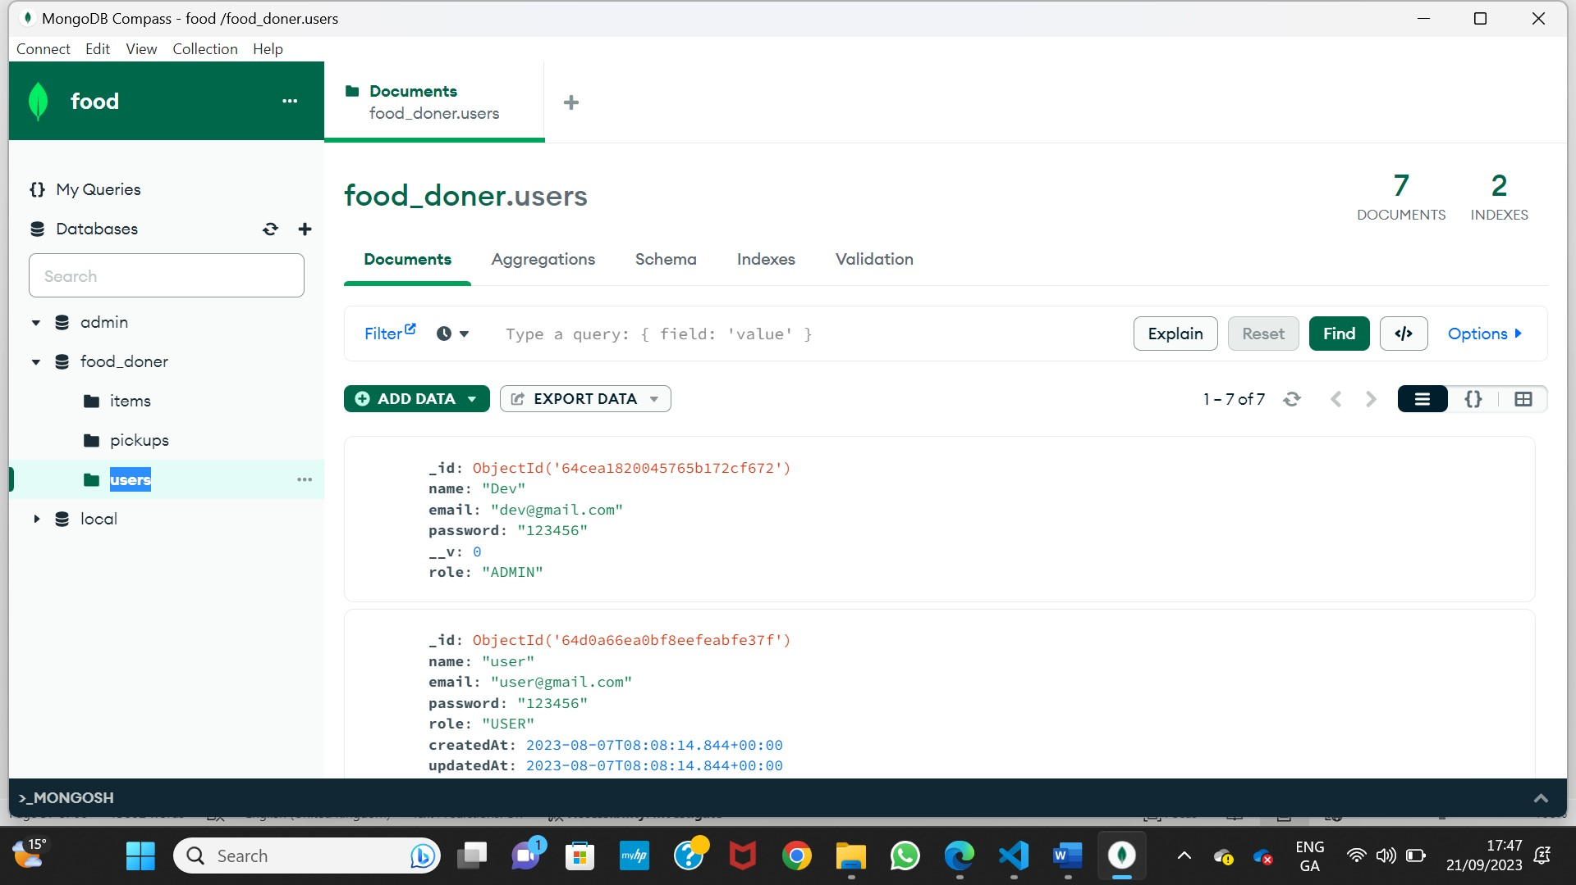
User database

Slide 13
Conclusion
Throughout the development of this application, many valuable learning outcomes are achieved.
Developing a Food Waste Warehouse application using Flutter can enhance mobile app development skills.
The crucial aspect of this study is to create an intuitive and appealing user interface. This study helps to learn user-friendly interfaces that enhance the user experience and skill that is transferable to various other app development projects.
Collaboration between food donors, volunteers, and beneficiaries needs to be promoted through user involvement, trust-building, and community engagement techniques

