Slide 1

Sentiment Analysis on U.S. Airline Dataset
Meena Rapaka
Siva Naga Lakshmi Karamsetty
Ying Ke

Slide 2
Scope
Using sentiment analysis, we apply different models in order to recognize the best performing model.
The tweets are categorized into positive, negative and neutral sentiments.
We visualize the sentiments for different U.S Airlines.

Slide 3
Dataset
Dataset contains 14640 tweets from 7700 users which were analyzed.
The contributors were asked to first classify positive, negative, and neutral tweets which determines the sentiment of the tweet.
Six different airlines data is integrated into the dataset.
Variables such as text, airline_sentiment are considered as base parameters.

Slide 4
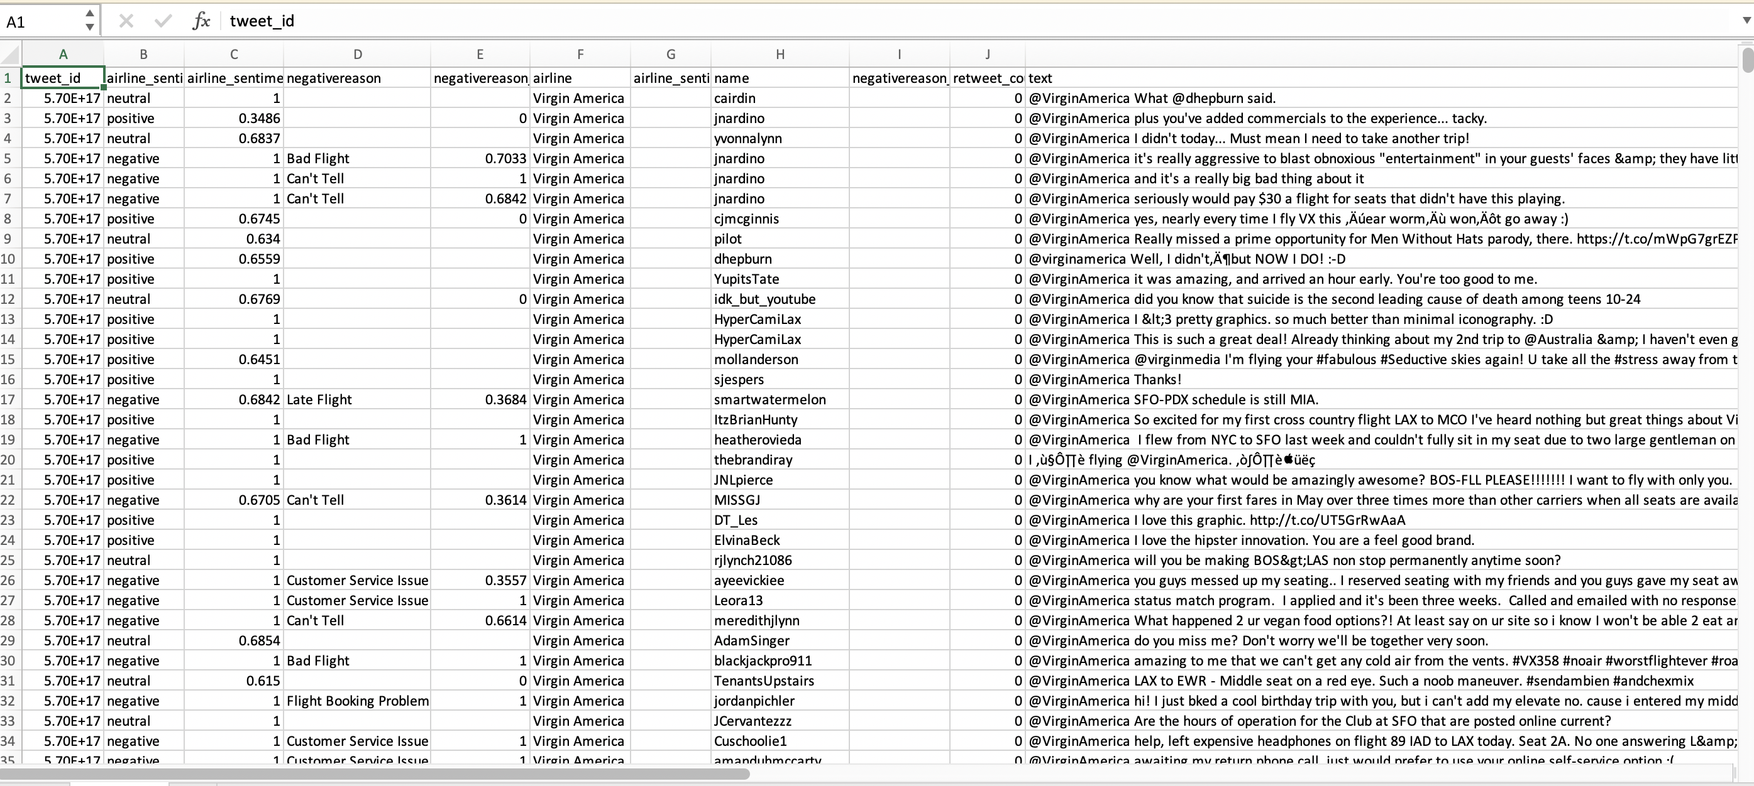
Dataset

Slide 5
Data Cleansing
As a part of data cleaning, unnecessary columns are removed.
1
We define the functions to clean data.
2
Tweets are tokenized and lemmatized and the message is appended to “msg_list”.
3

Slide 6
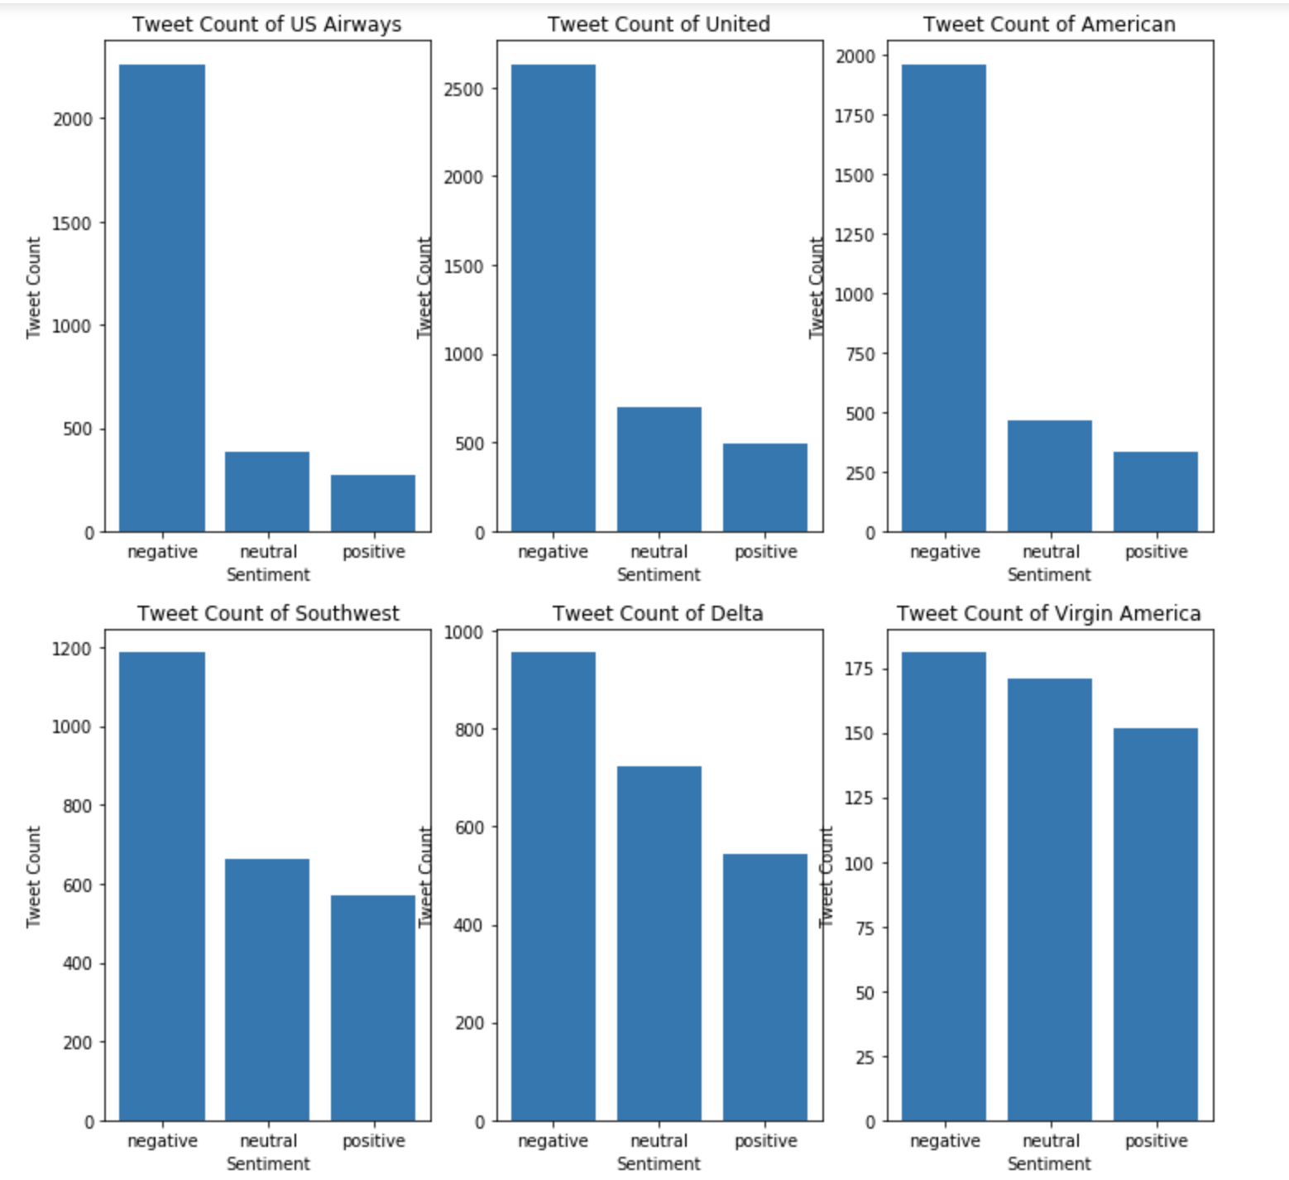
Visualization from Tweets

Slide 7
Data Preprocessing
Dataset is split into 80% training and 20% test data.
We extract features from Cleaned tweets:
TF-IDF
Bag of words

Slide 8
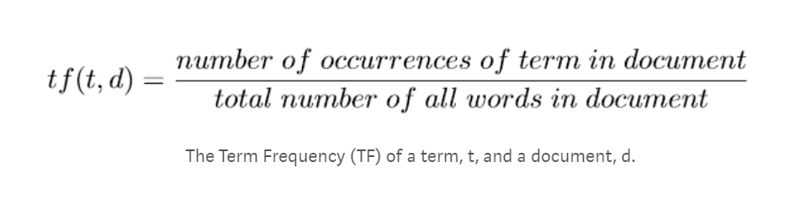
TF-IDF
Term frequency – inverse document frequency (tf - idf)
It is a numerical statistic that is intended to reflect how important a word is to a document in a collection or corpus.
The tf–idf value increases proportionally to the number of times a word appears in the document.

Slide 9
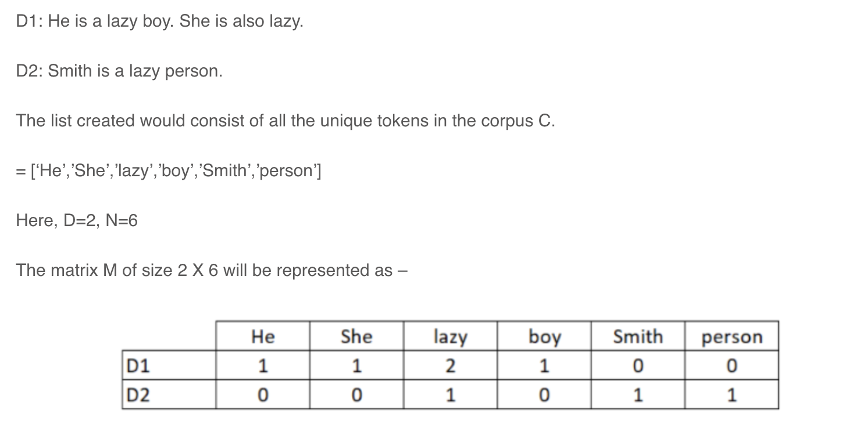
Bag of Words
The bag-of-words model is a way of representing text data when modeling text with machine learning algorithms.
The bag-of-words model is simple to understand and implement and has seen great success in problems such as language modeling and document classification.

Slide 10

Model Building
Here we build the predictive models on the dataset using the two-feature set – TF-IDF and Bag of Words.
K nearest neighbor (KNN)
Support Vector Machine (SVM)
Decision Trees
Random Forest
Logistic Regression

Slide 11
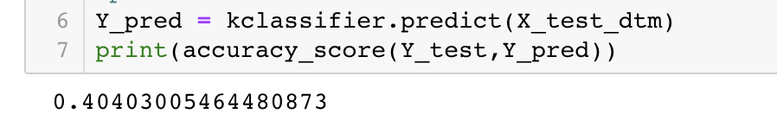
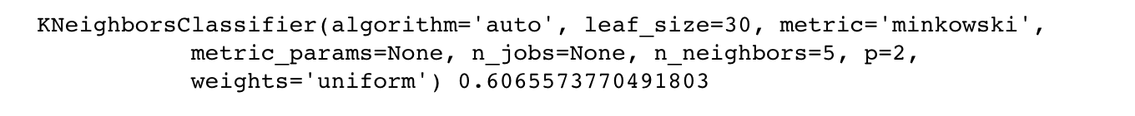
K-Nearest Neighbor
The data points are separated into several classes to predict the classification of a new data point.

Slide 12
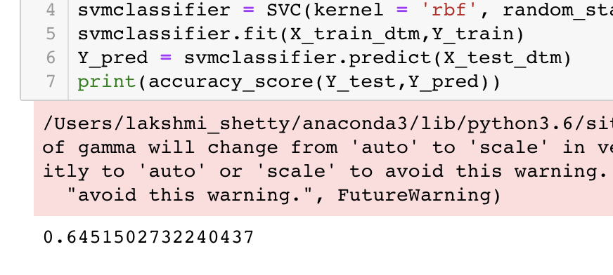
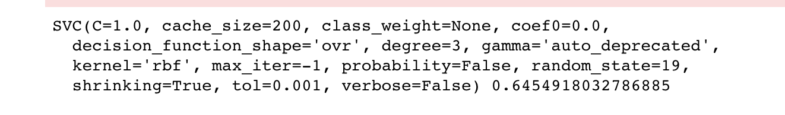
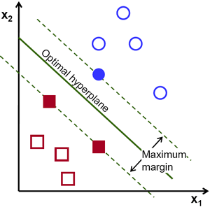
Support Vector Machine
A discriminative classifier formally defined by a separating hyperplane. In other words, given labeled training data (supervised learning), the algorithm outputs an optimal hyperplane which categorizes new examples.
In two-dimensional space this hyperplane is a line dividing a plane in two parts where in each class lay in either side.

Slide 13
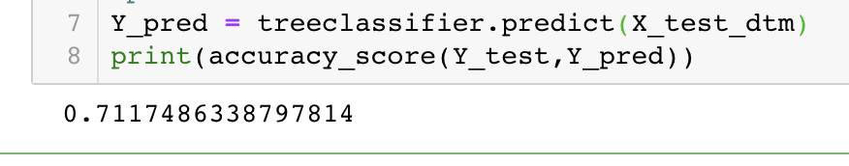
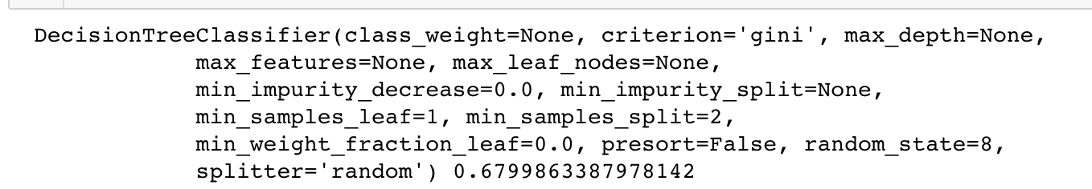
Decision Trees
A decision tree is a graph that uses a branching method to illustrate every possible outcome of a decision.

Slide 14
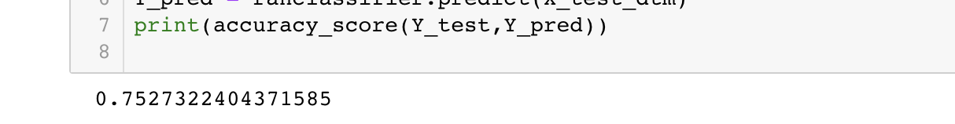
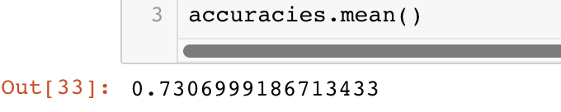
Random Forest
Random forests are an ensemble learning method for classification and regression.
It operates by constructing a multitude of decision trees and outputs the mean prediction of individual trees.

Slide 15
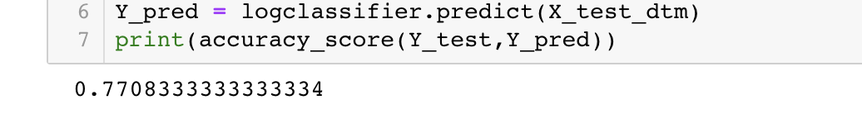
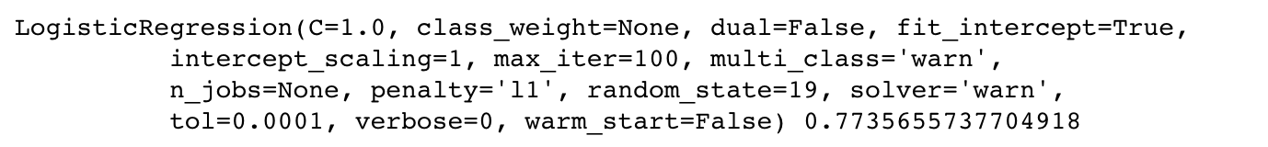
Logistic Regression
Common predictive analysis which is used to describe data and analyze the relationship between one dependent binary variable and one or more nominal, ordinal, interval or ratio-level independent variables.
Ex: to classify a boy or girl in data

Slide 16
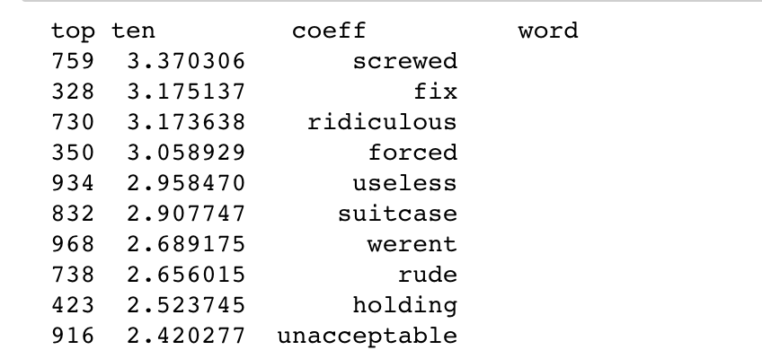
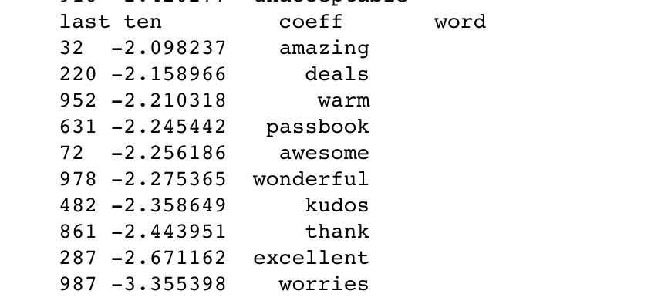
Bag of Words

Slide 17
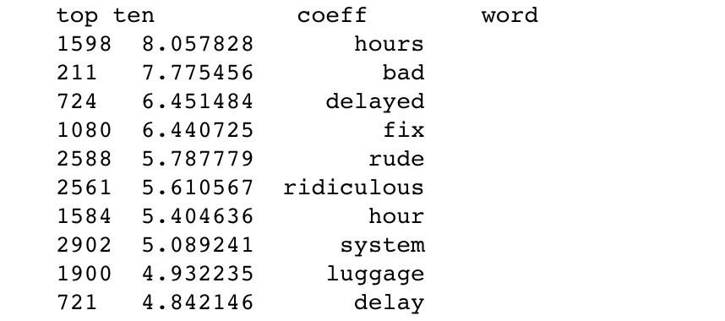
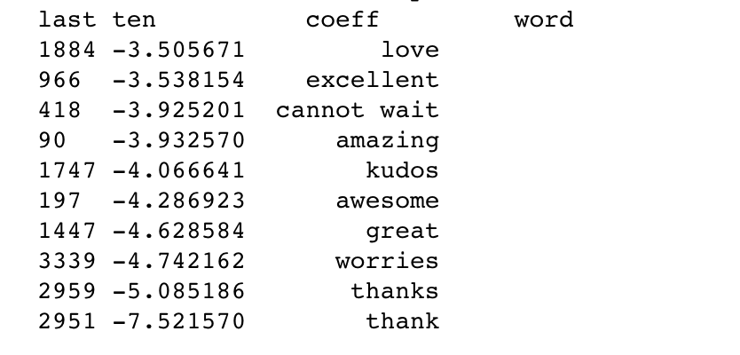
TF-IDF

Slide 18
Model Comparison
Model | Accuracy (TF-IDF) | Accuracy (Bag of Words)
K Nearest Neighbor | 40.4% | 60.6%
Support Vector Machine | 64.5% | 64.5%
Decision Trees | 71.1% | 67.9%
Random Forest | 75.2% | 73%
Logistic Regression | 77% | 77.3%
Naïve Bayes | 75% | 73.5%

Slide 19
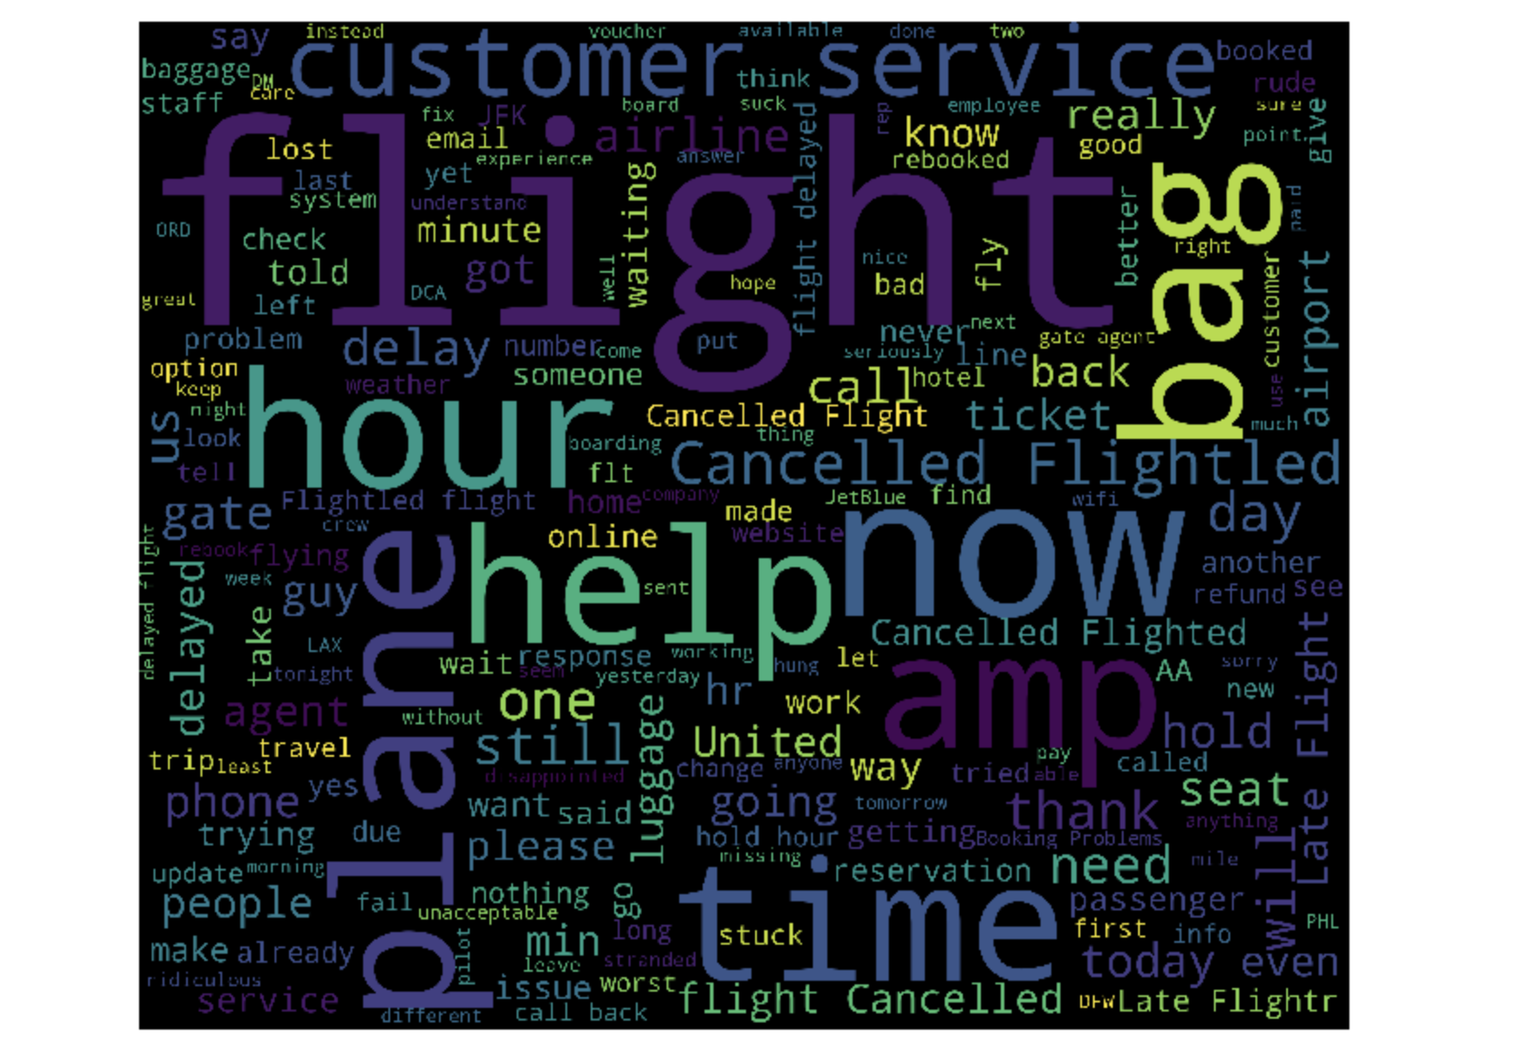
Data Analysis

Slide 20

Conclusion
Found that Logistic regression was a better model with an accuracy of 77% for TF-IDF and Bag of Words features.

Slide 21


