Slide 1
BARKATULLAH UNIVERSITY INSTITUTE OF TECHNOLOGY
PROJECT TITLE
SALES PREDICTION MANAGEMENT SYSTEM
SUBMETTED TO: SUBMITTED BY
Mrs. Kamini Maheshwari Meenaz Ansari,
Dr. Diwakar Singh, Renuka Singhare ,
Narpandra Singh Lodhi

Slide 2
CONTENTS
TITLE
INTRODUCTION AND MOTIVATION
PROJECT DISCRIPTION
CODES
MODELS
HARDWARE AND SOFTWARE REQUIRMENT
RESULTS/OUTPUT
AIMS AND OBJECTIVES
REFERENCES

Slide 3
SALES PREDECTION MANAGEMENT SYSTEM

Slide 4
INTRODUCTION AND MOTIVATION
Prediction of sales is a difficult problem as there are many factors on which the sales are dependent. This is especially prominent in case of sales which requires a versatile prediction system. The sales of stores are dependent on factors like similar stores nearby, holidays, promotions etc. In this paper Linear Regression model of Machine Learning is discussed. This model has been used for many years for marketing and sales prediction. This method is mostly used for finding out cause and effect relationship between variables.
Production management is the process of effectively planning and regulating the operations of that part of an enterprise which is responsible for actual transformation of materials into finished products

Slide 5
PROJECT DISCRIPTION
Prediction of sales using LINEAR REGRATION MODLE of machine learning.
Basically we have given a data set with all the attributes (like when the product has been purchased during which period and in how much amount )which are dependent on sales and from those data and attributes we have to predict the sales .

Slide 6
Numpy pandas matplotlib.pyplot

Slide 7
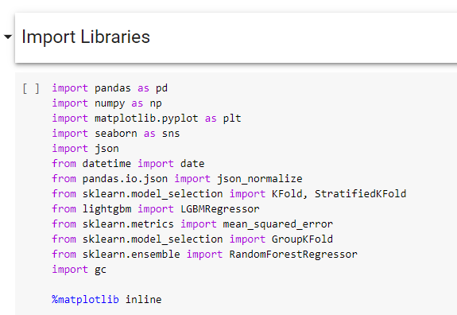

Slide 8
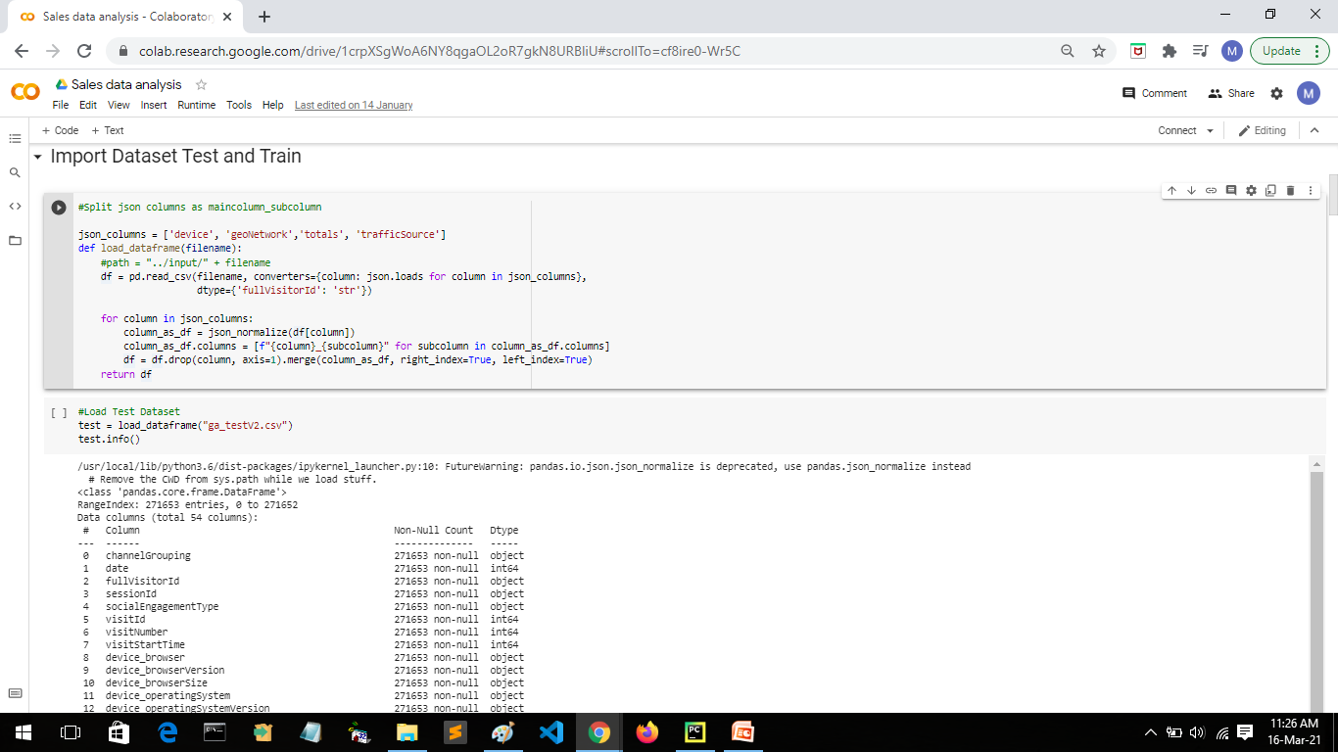

Slide 9
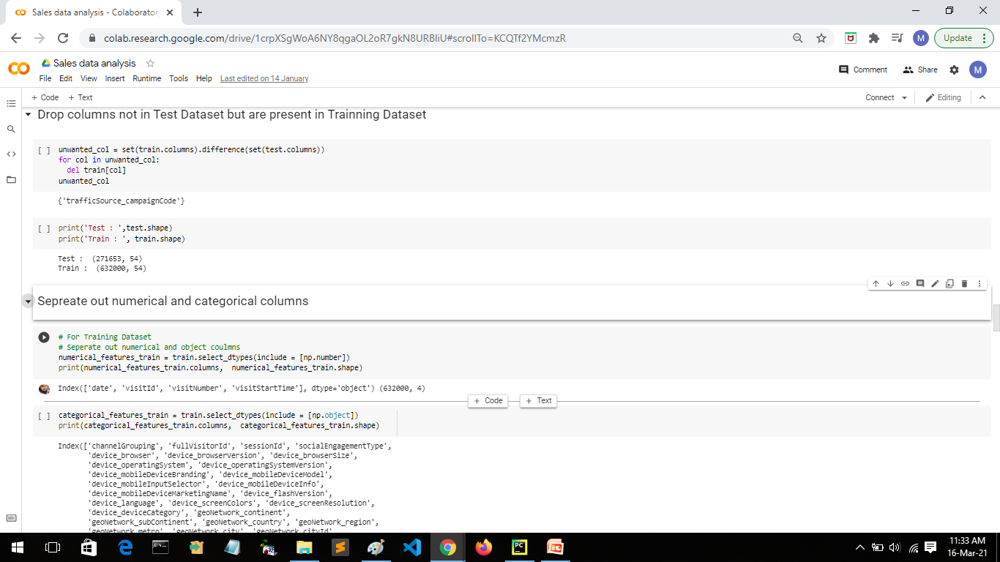

Slide 10
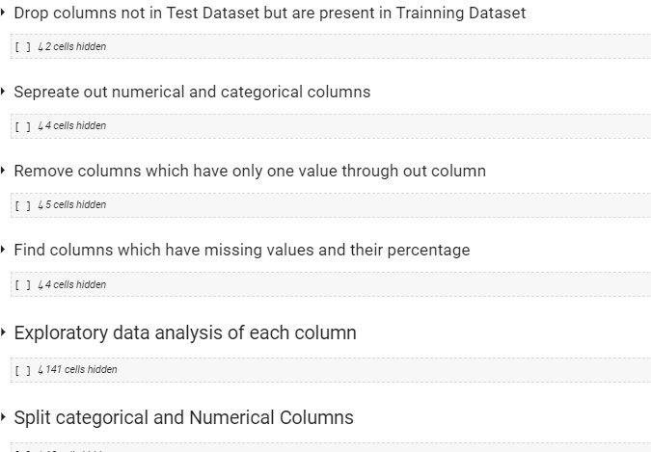

Slide 11
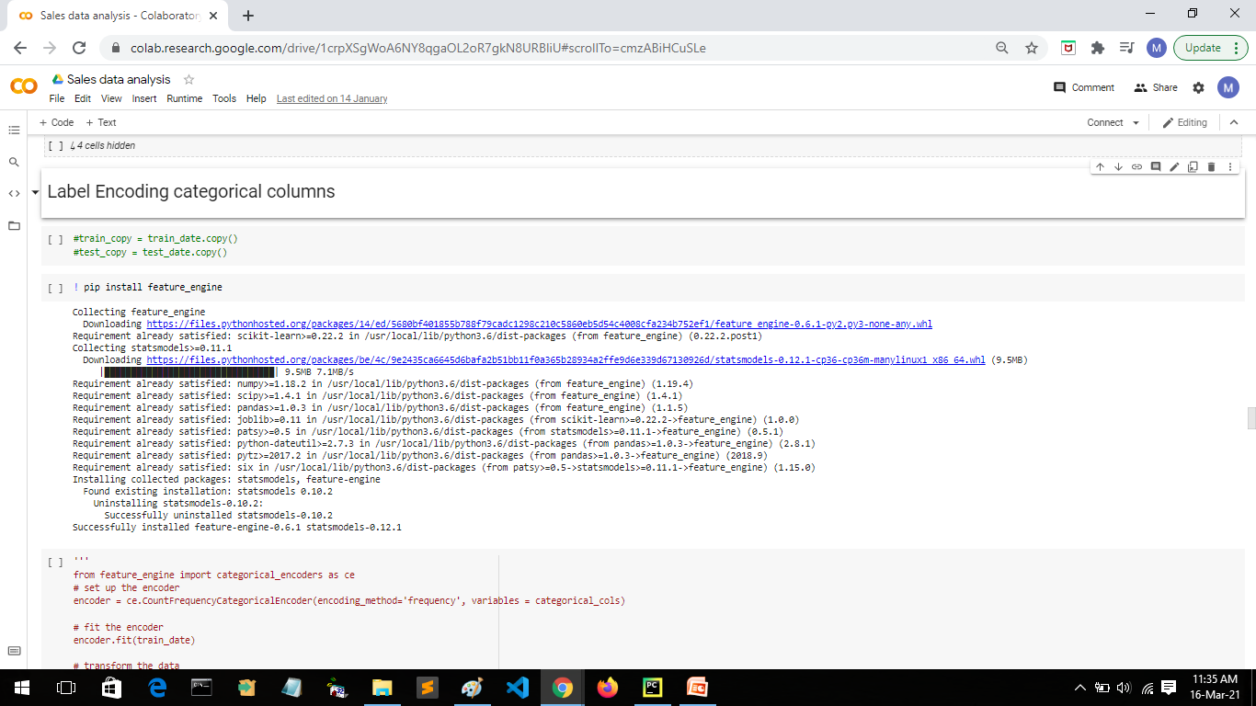

Slide 12
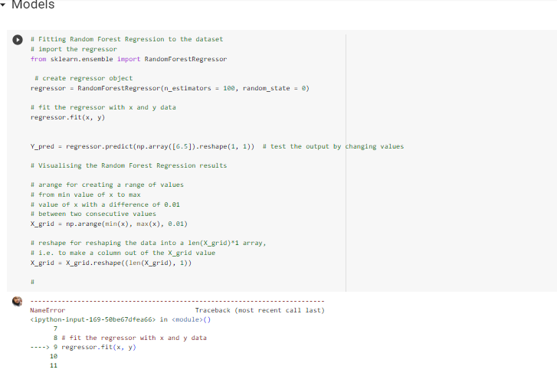

Slide 13
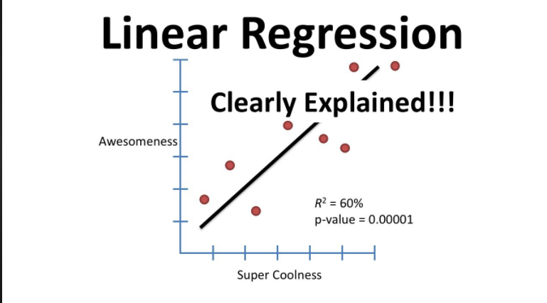
LINEAR REGRESSION MODEL
Linear regression in machine learning is a widely used algorithm in machine learning and statistics

Slide 14
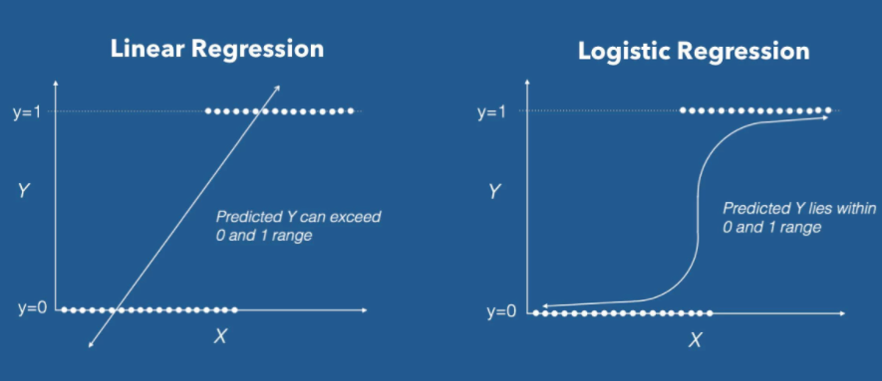
LOGISTICS REGRESSION MODEL

Slide 15
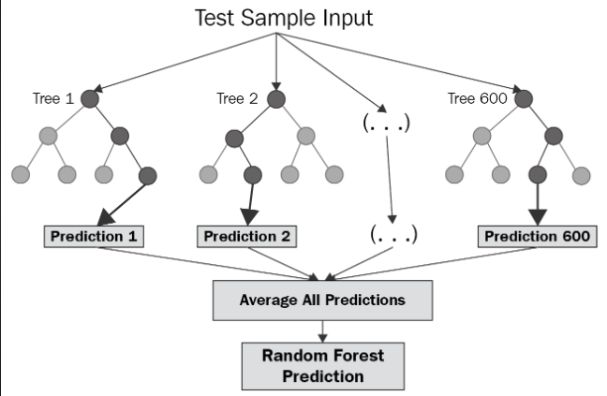
RANDOM FOREST

Slide 16
GRADIENT BOOSTING MODEL
Like Random Forest, Gradient Boosting is another technique for performing supervised machine learning tasks, like classification and regression. The implementations of this technique can have different names, most commonly you encounter Gradient Boosting machines (abbreviated GBM) and XGBoost. XGBoost is particularly popular because it has been the winning algorithm in a number of recent Kaggle competitions.

Slide 17
LIGHTGBM
LightGBM is a gradient boosting framework based on decision trees to increases the efficiency of the model and reduces memory usage. It uses two novel techniques: Gradient-based One Side Sampling and Exclusive Feature Bundling (EFB) which fulfills the limitations of histogram-based algorithm that is primarily used in all GBDT (Gradient Boosting Decision Tree) frameworks. The two techniques of GOSS and EFB described below form the characteristics of LightGBM Algorithm. They comprise together to make the model work efficiently and provide it a cutting edge over other GBDT frameworks

Slide 18
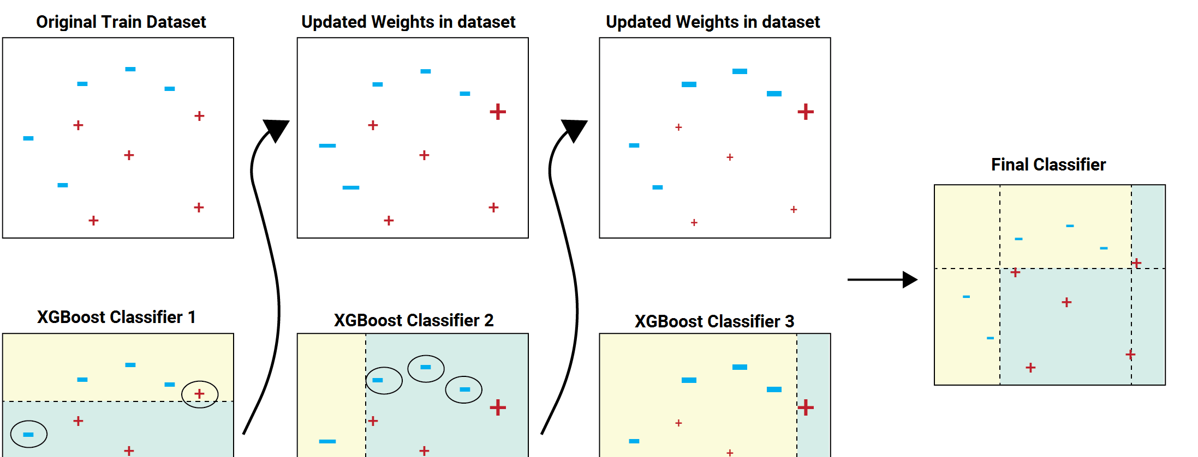
XGBOOST

Slide 19
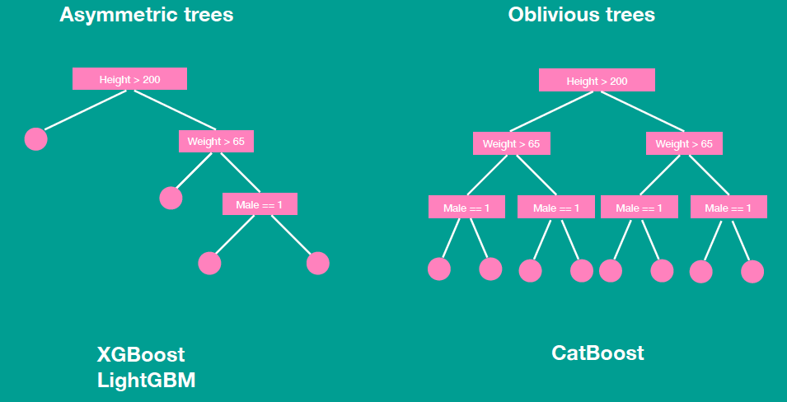
CATBOOST

Slide 20
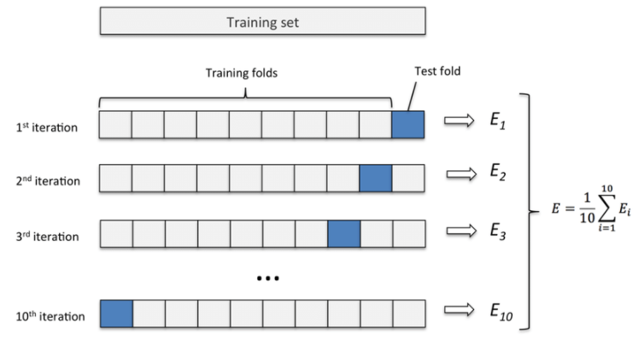
K_FOLD

Slide 21
HARDWARE AND SOFTWARE REQUIRMENT
HARDWARE REQUIREMENT:-
12 GB RAM
4 GB HARD DISK
SOFTWARE REQUIREMENT:-
Python IDE
Firefox, chrome , browser
Sublime text editor / visual code studio text editor

Slide 22
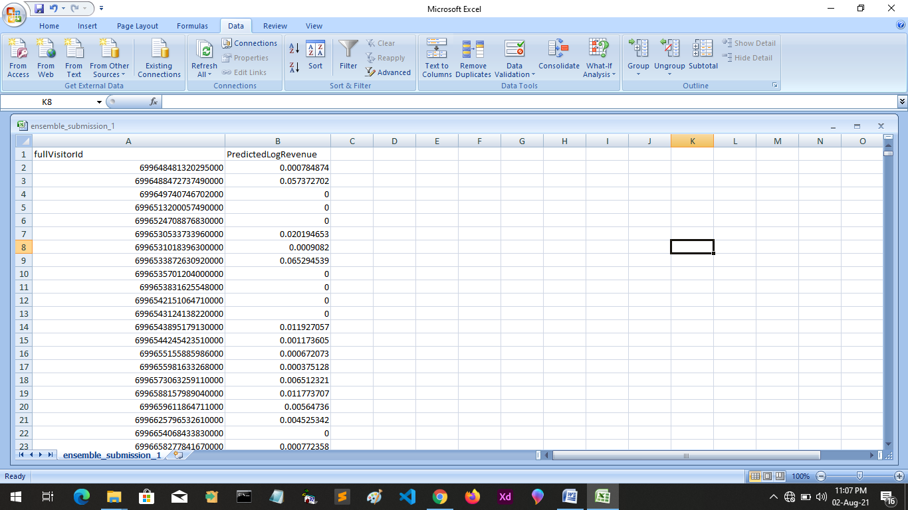
RESULT/OUTPUT

Slide 23
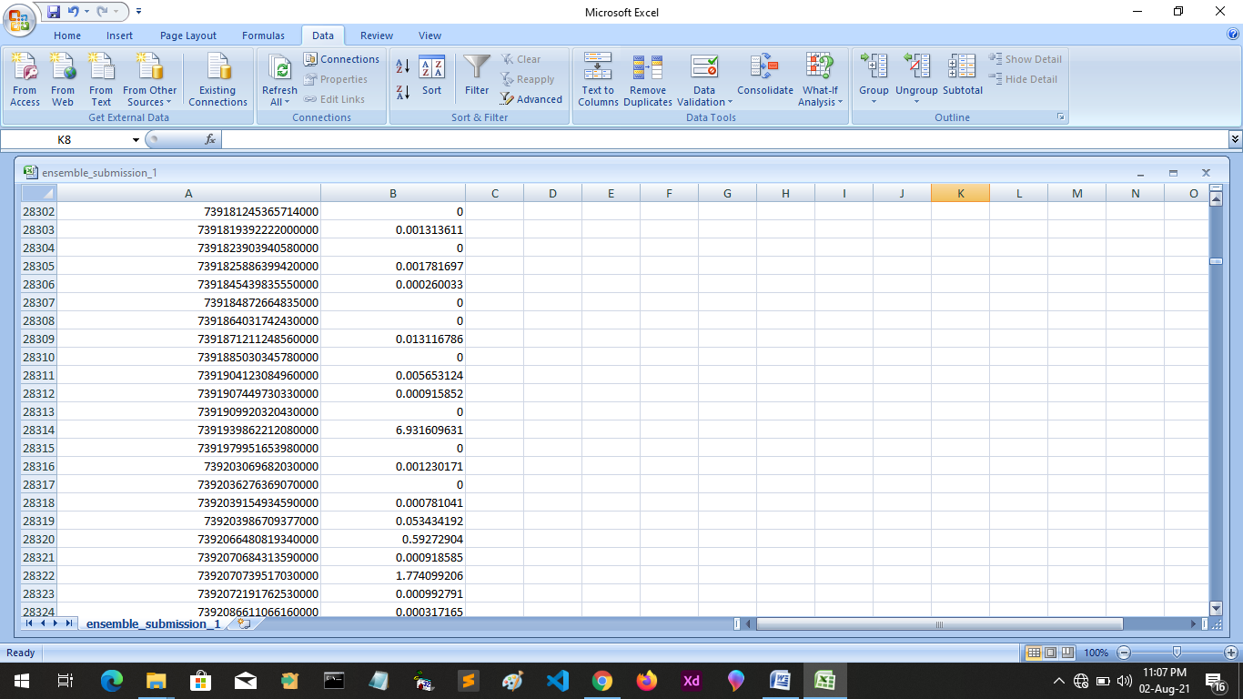

Slide 24
AIMS AND OBJECTIVES
The main aim of this system is to predict the sales on the bases of given data attribute and to increase the sales of the product.

Slide 25
REFERENCES
https://www.kaggle.com/c/ga-customer-revenue-prediction/overview
W3school

Slide 26
THANK YOU

