Slide 1

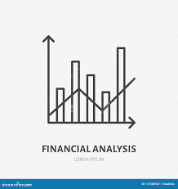
By Zarmeena Hafeez Khan

Slide 2
FINANCIAL ANALYISIS
When analyzing the investment returns of a company, financial analysis techniques can be used to gain insight into the company's profitability, efficiency, liquidity, and leverage. Ratio analysis is a commonly used technique that compares different financial metrics to provide a snapshot of a company's financial health. This company’s financial analysis can be seen as a self-perpetuating cycle where the initial success of these investments are leading to increased confidence and further investments, which in turn are leading to an even greater success. Positive feedback can be seen from the growth. The investments into the company have to be seen increasing for it to have such positive returns. With each month, the company can be seen to making a greater profit deeming it an advantage to the company itself and its image.

Slide 3
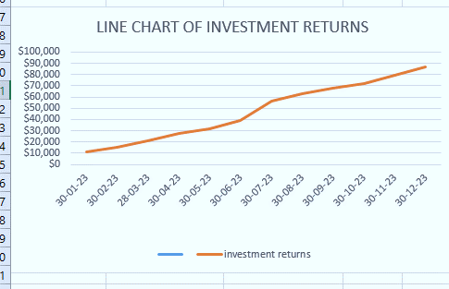
LINE CHART OF THE RETURNS

Slide 4
Overview of key financial metrics and investment strategies.
Key financial metrics and investment strategies are important tools for evaluating investment opportunities and making informed investment decisions. There are several investment strategies that investors can use to achieve their investment goals. One common strategy is value investing, which involves identifying undervalued companies with strong fundamentals and long-term growth potential. This company seems to be doing it as can bee seen with its increasing returns. if this company's stock price increases due to strong financial performance, this can lead to increased investor confidence and more investment in the company's stock. This increased investment can then drive the stock price even higher, which reinforces the initial success and leads to even more investment. The average returns and standard deviation also shows how well this company seems to be performing.

