Slide 1
AI BASED CONTENT MODERATOR
PIP104 Capstone Project
Review2
Batch Number:G07
Under the Supervision of,
Dr. Alamelu Mangai Jothidurai
Associate Professor
School of Computer Science and Engineering
Presidency University
Roll Number | Student Name
20211CAI0078 | B MEENU
20211CAI0201 | V DEEKSHITHA
20211CAI0180 | GADDAM SAI LIKHITHA
20211CAI0115 | AISHWARYA VILAS PATIL

Slide 2
Introduction
NLP enables machines to understand, process, and generate human languages.
FastText, developed by Facebook AI Research, excels in multilingual text categorization using sub-word level character n-grams.
FastText handles out of vocabulary words and complex languages, making it effective for tasks like sentiment analysis and language identification.
It supports both supervised and unsupervised learning for various text-based tasks.
FastText is highly useful in multilingual contexts for accurate language processing.
Generative AI uses deep learning to create original content from patterns in large datasets, with models like GPT and DALL·E.
It is applied in areas like content creation, design, and research but raises ethical concerns around copyright and misinformation.
Task 1: Language Identification in Devanagari script identifies languages like Nepali, Marathi, Sanskrit, Hindi.
Task 2: Hate Speech Detection detects harmful content in underrepresented languages such as Marathi and Nepali.
Task 3: Target Identification for Hate Speech identifies specific targets like individuals, organizations, or communities, enhancing content moderation and digital safety.

Slide 3
Literature Review
Authors | Title of the paper | Where it was Published | Understanding of the paper
[1] Indhuja K, Indu M, and Sreejith C | Text Based Language Identification System for Indian Languages Following Devanagari Script | International Journal of Engineering Research & Technology, 3(4) | Proposed an n-gram-based system for identifying Devanagari languages such as Hindi, Sanskrit, Marathi, Bhojpuri, and Nepali. The system extracts text features to classify languages.
[2] K.E. Abdelfatah, G. Terejanu, A.A. Alhelbawy | Unsupervised detection of violent content in Arabic social media | Computer Science and Information Technology (CS IT), pp. 1-7 | This paper discusses the rapid spread of hate speech on social media, focusing on how user anonymity and algorithmic amplification enable the distribution of violent and harmful content, leading to societal polarization and violence.
[3] Abozinadah, E.A., Jones Jr, J.H. | A Statistical Learning Approach to Detect Abusive Twitter Accounts | Proceedings of the International Conference on Compute and Data Analysis. | This study explores the broader implications of hate speech on social dynamics, emphasizing its role in perpetuating stereotypes and affecting marginalized communities, with a focus on social tensions and cultural identity.

Slide 4
Literature Review
Authors | Title of the Paper | Where it was published | Understanding of the paper
[4] Surendrabikram Thapa et al. | RUHate-MM: Identification of Hate Speech and Targets using Multimodal Data from Russia-Ukraine Crisis | Companion Proceedings of the ACM on Web Conference 2024 (pp. 1854-1863) | Developed the RUHate-MM dataset to enhance hate speech detection during the Russia-Ukraine crisis. Challenges included linking text and images, particularly in memes, and subjectivity in manual annotation for target identification.
[5] Chiril, P., Pamungkas, E. W., Benamara, F., Moriceau, V., & Patti, V | Emotionally informed hate speech detection: a multi-target perspective. | Cognitive Computation, 1-31. | Developed a multi-target hate speech detection model that integrates affective knowledge for improved accuracy but noted challenges in generalizing across datasets without target-specific data.

Slide 5
Literature Review
Authors | Title of the paper | Where it was Published | Understanding of the paper
[6] Dwitama, A. P. J., Fudholi, D. H., & Hidayat, S. | Indonesian hate speech detection using bidirectional long short-term memory (Bi-LSTM). | Jurnal RESTI (Rekayasa Sistem dan Teknologi Informasi), 7(2), 302-309. | The tasks of hate speech recognition and target classification within Indonesian social media content are examined in the paper .
[7] Do, H. T. T., Huynh, H. D., Van Nguyen, K., Nguyen, N. L. T., & Nguyen, A. G. T. | Hate speech detection on vietnamese social media text using the bidirectional-lstm model | arXiv preprint arXiv:1911.03648. | The paper investigates the detection of hate speech in Vietnamese social media data. Language recognition, hate speech identification, and indirectly target categorization—classifying posts and comments as "Clean," "Offensive," or "Hate"—are among the important subtasks that the study tackles.
[8] Purbey, J., Pullakhandam, S., Mehreen, K., Arham, M., Sharma, D., Srivastava, A., & Kadiyala | 1-800-SHARED-TASKS@ NLU of Devanagari Script Languages: Detection of Language, Hate Speech, and Targets using LLMs | arXiv preprint arXiv:2411.06850. | Fine-tuned multilingual models such as IndicBERT V2, MuRIL, and Gemma-2 were used for language detection. Target categorization further divided hate speech into "individual," "organization," and "community" categories.

Slide 6
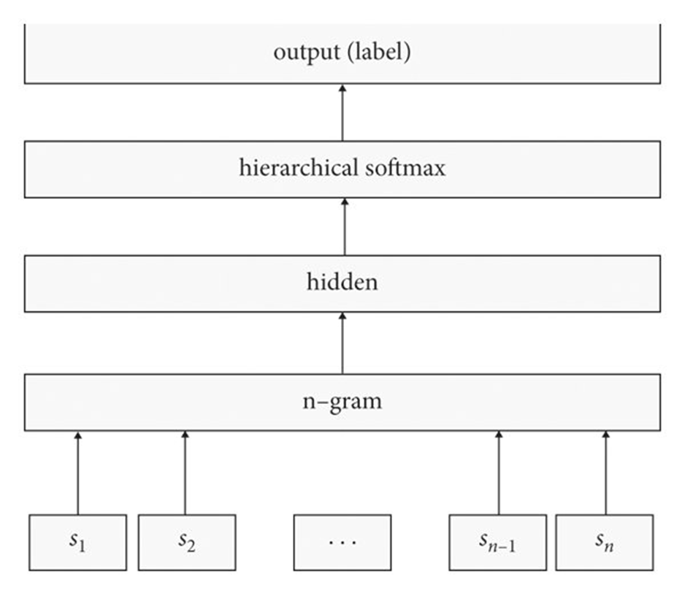
Methodology-fasttext
Input Layer:
Represents the input data, in this case, an n-gram.
Each input node (s1, s2, ..., sn1, sn) corresponds to a word or token in the n-gram.
Hidden Layer:
Processes the input n-gram and extracts relevant features.
The number of nodes in this layer determines the model's capacity to learn complex patterns.
Hierarchical Softmax Layer:
A specialized layer designed for efficient prediction of categorical variables, especially when the vocabulary size is large.
Instead of computing probabilities for all possible output classes (as in traditional softmax), hierarchical softmax organizes the output space into a tree structure.
This reduces the computational complexity of the prediction process, making it more efficient.
Output Layer:
Represents the predicted output, which is the label or class associated with the input n-gram.
Overall Function:
The network takes an n-gram as input, processes it through the hidden layer, and then uses the hierarchical softmax layer to predict the most likely label or class.

Slide 7
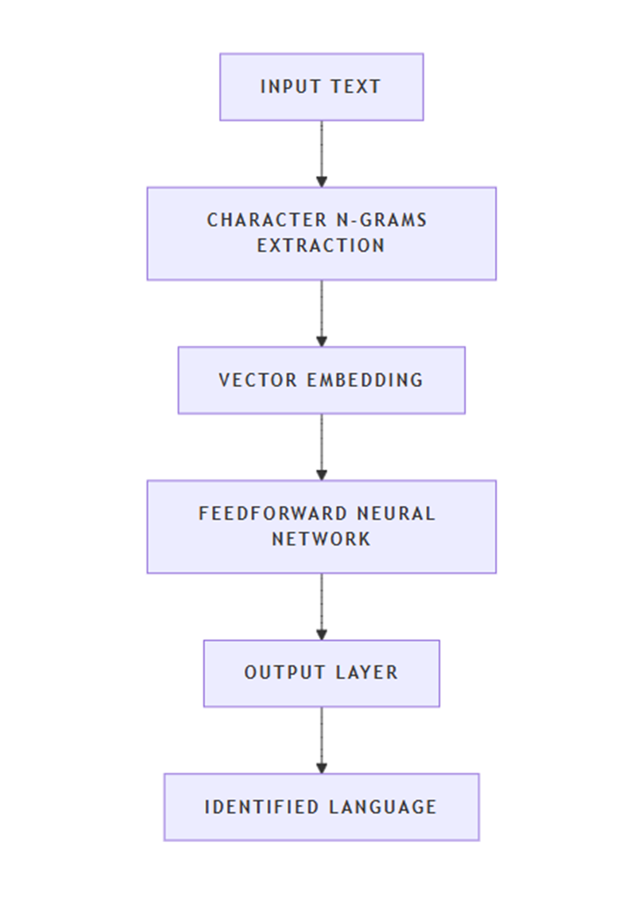
Methodology-langID
Character N-grams: The model extracts character n-grams from each word in the input text. N-grams are contiguous sequences of n characters within a word, which help capture language specific patterns.
Vector Embedding: These character n-grams are then embedded into vectors using lookup tables. This step converts the n-grams into a numerical format that the neural network can process.
Feedforward Neural Network: The embedded vectors are fed into a feedforward neural network. This network consists of multiple layers of neurons that process the input and learn to identify the language based on the patterns in the n-grams.
Output Layer: The final layer of the network outputs a probability distribution over the possible languages. The language with the highest probability is chosen as the identified language.

Slide 8
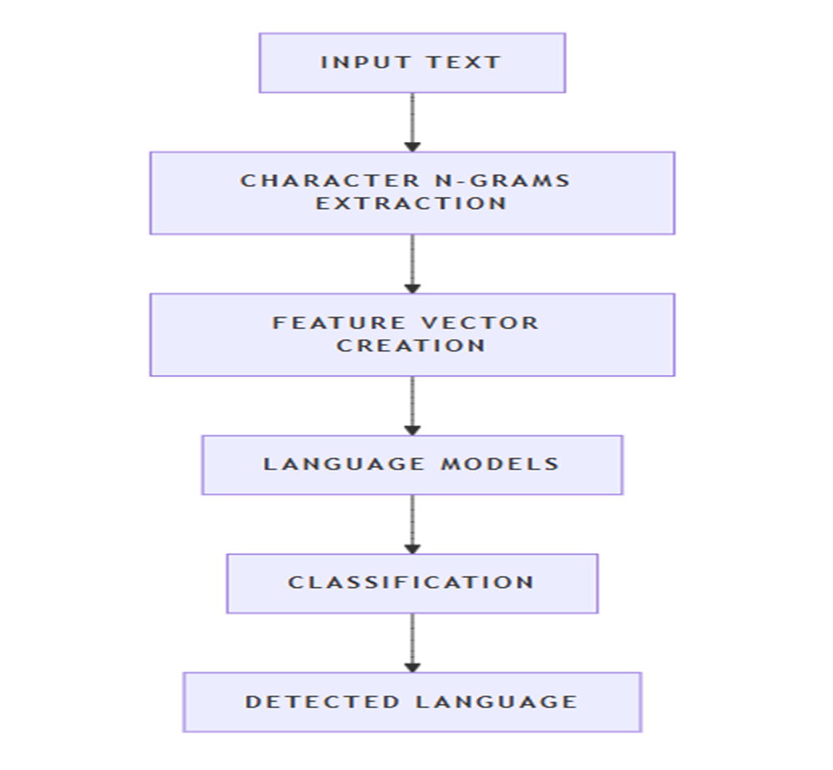
Methodology-langDetect
The LangDetect model architecture is based on statistical methods rather than deep learning.
Character N-grams Extraction: LangDetect extracts character n-grams from the input text. These n-grams are sequences of characters that help capture language specific patterns.
Feature Vector Creation: The extracted n-grams are converted into a feature vector, which is a numerical representation of the text.
Language Models: LangDetect uses pretrained language models for each supported language. These models are statistical models trained on large text corpora in different languages.
Classification: The feature vector is compared against the pretrained language models to determine the most likely language of the input text.

Slide 9
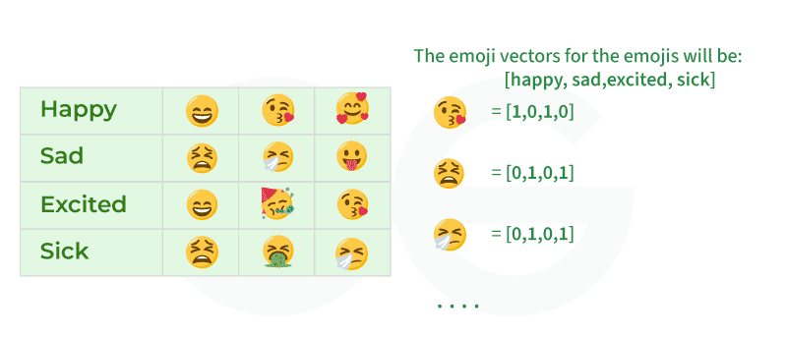
Word Embeddings
Word embeddings is a way to convert textual information into numeric form, which in turn can be used as input to machine learning algorithms.
It allows words with similar meanings to have a similar representation.
method of extracting features out of text so that we can input those features into a machine learning model to work with text data. They try to preserve syntactical and semantic information.

Slide 10
Word Embedding Techniques in NLP
Frequency-based Embeddings
Prediction-based Embeddings
Frequency-based embeddings are representations of words in a corpus based on their frequency of occurrence and relationships with other words.
TF-IDF *
Co-occurrence matrix
Prediction-based embeddings are generated by training models to predict words in each context.
Word2Vec (Skip-gram and CBOW)
FastText
GloVe*
*TF-IDF: Term Frequency-Inverse Document Frequency
*Glove: Global Vectors for Word Representation

Slide 11
Generation of fastText Embeddings
Instead of learning vectors for words directly, fastText represents each word as an n-gram of characters.
For example, take the word, “artificial” with n=3, the fastText representation of this word is <ar, art, rti, tif, ifi, fic, ici, ial, al>, where the angular brackets indicate the beginning and end of the word.
This helps capture the meaning of shorter words and allows the embeddings to understand suffixes and prefixes.

Slide 12
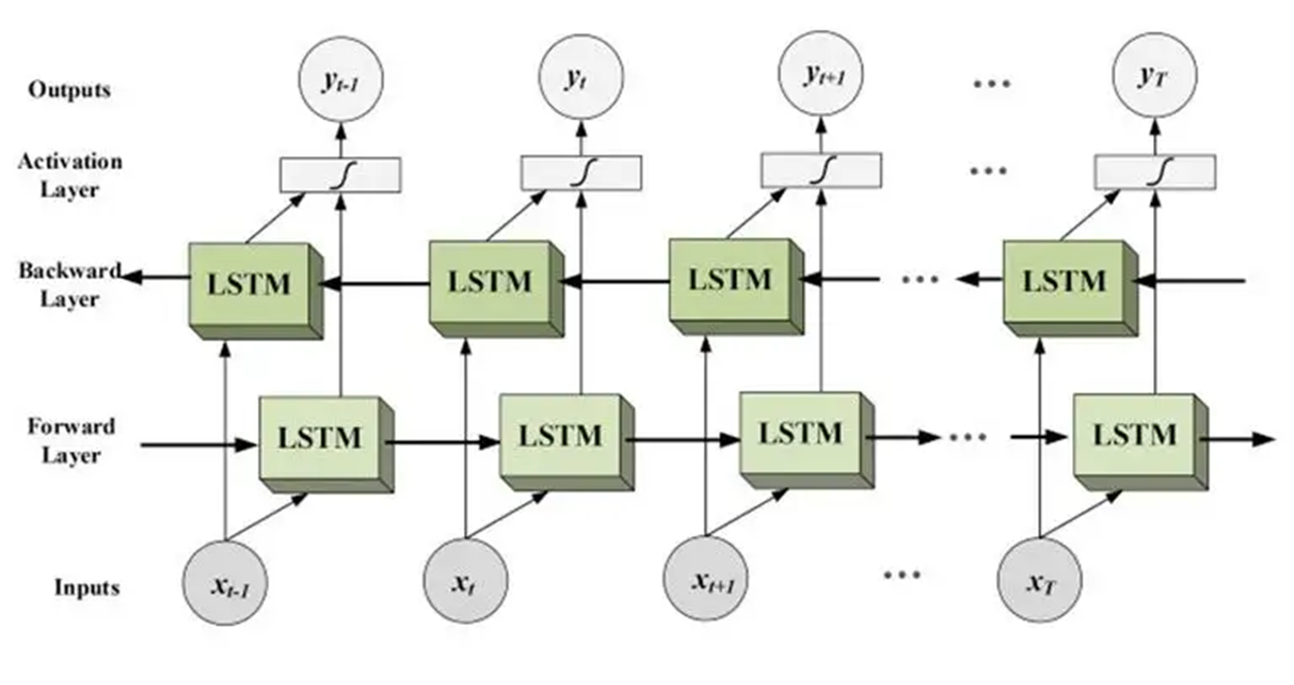
BIDIRECTIONAL LSTM
Bi-LSTM (Bidirectional Long Short-Term Memory) is a type of recurrent neural network (RNN) that processes sequential data in both forward and backward directions.
It combines the power of LSTM with bidirectional processing, allowing the model to capture both past and future context of the input sequence.

Slide 13
BIDIRECTIONAL LSTM
To understand Bi-LSTM, let’s break down its components and functionality:
LSTM (Long Short-Term Memory)
LSTM is a type of RNN designed to overcome the limitations of traditional RNNs in capturing long-term dependencies in sequential data.
It introduces memory cells and gating mechanisms to selectively retain and forget information over time.
LSTMs have an internal memory state that can store information for long durations, allowing them to capture dependencies that may span across many time steps.
Bidirectional Processing
Unlike traditional RNNs that process input sequences in only one direction (either forward or backward), Bi-LSTM processes the sequence in both directions simultaneously.
It consists of two LSTM layers: one processing the sequence in the forward direction and the other in the backward direction.
Each layer maintains its own hidden states and memory cells.

Slide 14
Methodology-BIDIRECTIONAL LSTM
3. Forward Pass
During the forward pass, the input sequence is fed into the forward LSTM layer from the first time step to the last.
At each time step, the forward LSTM computes its hidden state and updates its memory cell based on the current input and the previous hidden state and memory cell.
4. Backward Pass
Simultaneously, the input sequence is also fed into the backward LSTM layer in reverse order, from the last time step to the first.
Like the forward pass, the backward LSTM computes its hidden state and updates its memory cell based on the current input and the previous hidden state and memory cell
5. Combining Forward and Backward States
Once the forward and backward passes are complete, the hidden states from both LSTM layers are combined at each time step.
This combination can be as simple as concatenating the hidden states or applying some other transformation.

Slide 15
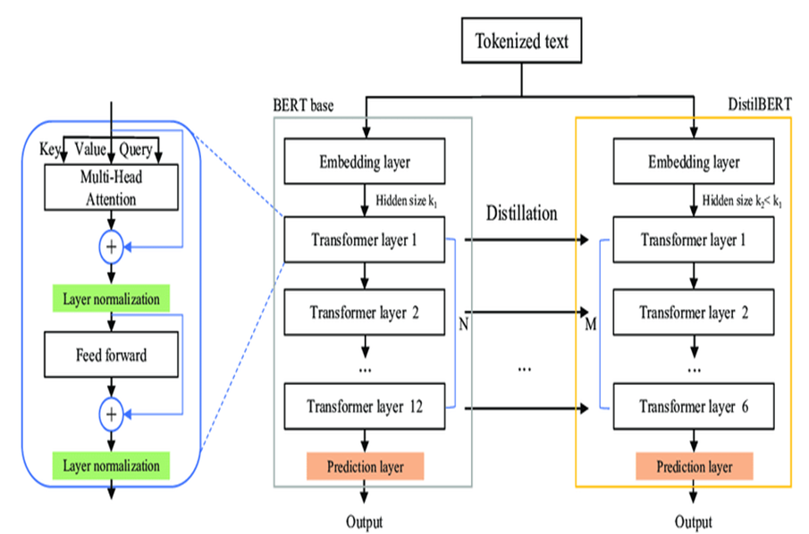
Methodology-DistilBERT
DistilBERT model is a distilled form of the BERT model.
The size of a BERT model was reduced by 40% via knowledge distillation during the pre-training phase while retaining 97% of its language understanding abilities and being 60% faster.
A triple loss is introduced by combining language modeling, distillation, and cosine-distance losses to take advantage of the inductive biases learned by larger models during pre-training.
DistilBERT is a compact, faster, and lighter model that is cheaper to pre-train and can easily be used for on-device applications.

Slide 16

Methodology-DistilBERT
1. Tokenized Text:
The input text is first tokenized (broken down into individual words or sub words).
2. Embedding Layer:
The tokens are converted into numerical representations (embeddings).
DistilBERT typically uses a smaller embedding size (k) compared to BERT base.
3. Transformer Layers:
The core of DistilBERT's architecture is the transformer layers.
These layers consist of:
Multi-Head Attention: This mechanism allows the model to weigh the importance of different parts of the input sequence.
Feed-Forward Neural Network: This layer applies non-linear transformations to the input.
Layer Normalization: This helps stabilize the training process.
4. Distillation Process:
DistilBERT is trained using a knowledge distillation technique.
The larger BERT base model acts as the teacher, providing guidance to the smaller DistilBERT student model.
DistilBERT is trained to mimic the output of BERT base, while also being encouraged to learn more compact representations.
5. Prediction Layer:
The final layer of DistilBERT produces the output, which can be a classification, sequence labeling, or other task-specific output.

Slide 17
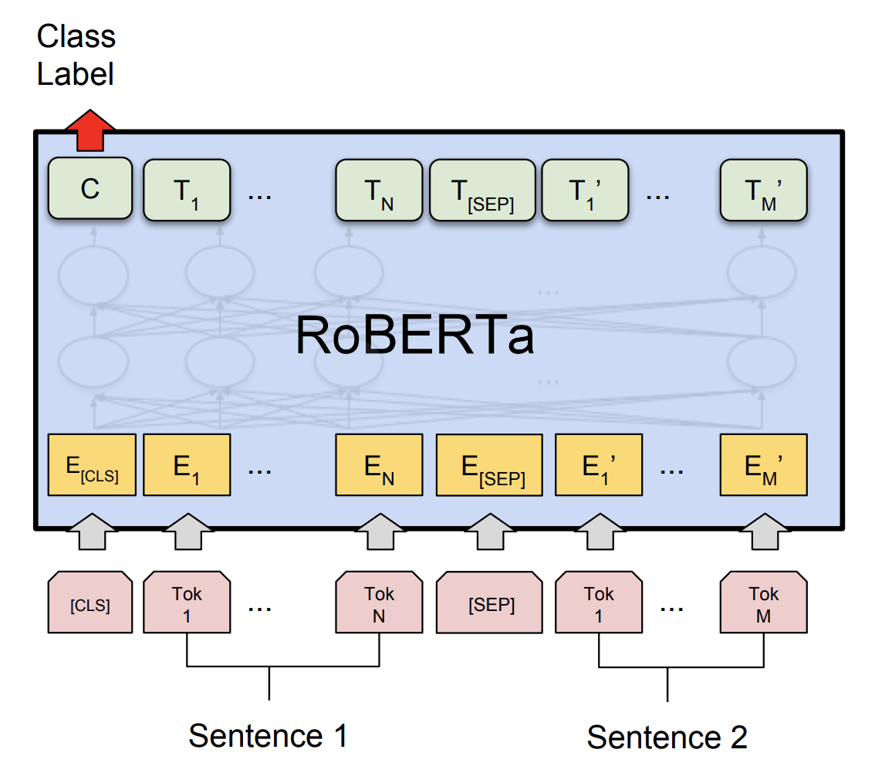
Methodology-Robustly Optimized BERT(RoBERTa)
RoBERTa is a variant of the BERT model, which was developed by researchers at Facebook AI.
RoBERTa is a transformer-based language model that uses self-attention to process input sequences and generate contextualized representations of words in a sentence.
RoBERTa was trained on a dataset of 160GB of text.
RoBERTa uses a dynamic masking technique during training that helps the model learn more robust and generalizable representations of words.

Slide 18
Methodology-google-bert/bert-base-multilingual-cased
Pretrained model on the top 104 languages with the largest Wikipedia using a masked language modeling (MLM) objective.
This model is case sensitive: it makes a difference between english and English.
BERT is a transformers model pretrained on the raw texts only in a self-supervised manner, with an automatic process to generate inputs and labels from those texts.

Slide 19
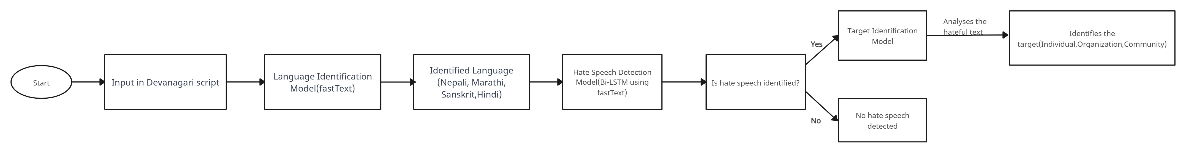
Proposed Method

Slide 20
Objectives
Determine to which language does Devanagari script belongs to among Nepali, Marathi, Sanskrit, Hindi which addresses the critical need for accurate language identification in multilingual contexts.
Identify whether it contains hate speech or not.
Identify the targets of hate speech in each hateful text.
Developing a prototype app to simulate functionality and test features before full-scale implementation.
Email fraud detection to avoid spam mail id's while creating the account.
We erase and restrict vulgar language (typed or spoken via speech-to-text) for 10-15 attempts, blocking accounts after repeated violations.

Slide 21
Timeline of Project
SUBTASKS | TITLE | TIMELINE
Subtask A | Devanagari Language Detection | 25th September-11th October
Subtask B | Devanagari Hate Speech Detection | 12th October-25th October
Subtask C | Devanagari Target Identification | 10th November-18th November

Slide 22
Expected Outcomes
FastText is computationally efficient in processing, allowing for rapid language detection, especially for large datasets.
Model robust to noise and errors in the text, making it suitable for real-world applications.
Handling of Out of Vocabulary Words.
Effective handling of codeswitching, where multiple languages are used within the same text
Accurate identification of individuals and groups targeted by hate speech.
Successful classification of hate speech targets across multiple languages using fastText and Bi-LSTM.
Automated alerts generated for hate speech targeting specific groups.
Scalable identification of hate speech targets across multiple languages and large platforms.

Slide 23
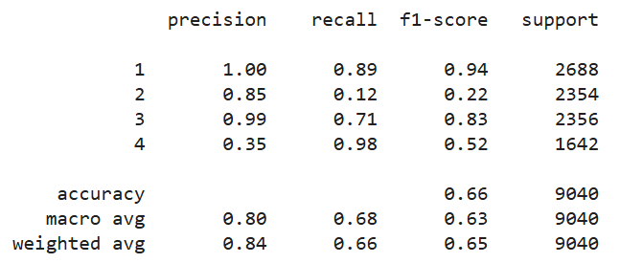
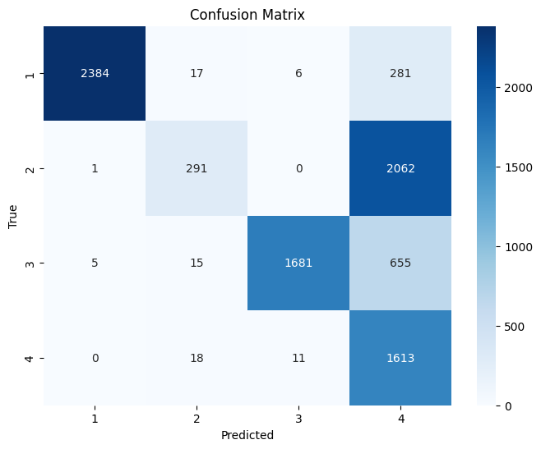
Results and Discussion: Subtask-A
Models | Accuracy
fastText | 0.66
LangDetect | 0.43
LangID | 0.42
Performance metrics of fastText on dev and test set
Comparison of models for Subtask-A
Class | Train | Dev | Test
Nepali(1) | 12544 | 26882 | 2378
Marathi(2) | 11034 | 2381 | 2396
Sanskrit(3) | 10996 | 2356 | 1697
Hindi(4) | 7664 | 1663 | 4521
Confusion matrix of fastText on dev and test set
Dataset distribution for Subtask-A

Slide 24
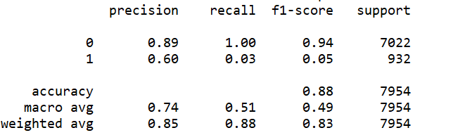
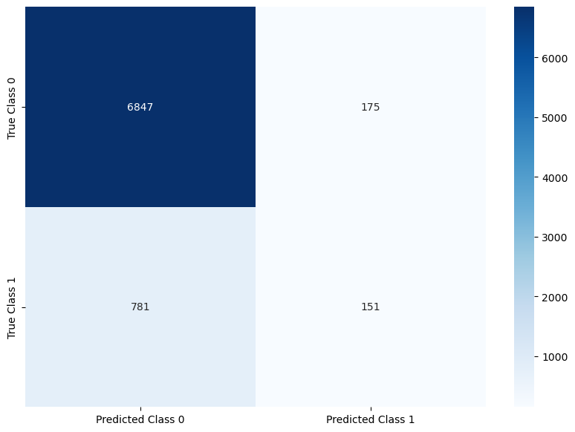
Results and Discussion: Subtask-B
Class | Train | Dev | Test
Non-hate(0) | 16854 | 7022 | 3555
Hate(1) | 2214 | 932 | 468
Performance metrics of Bi-LSTM for Subtask-B
Dataset distribution for Subtask-B
Models | Accuracy
Bi-LSTM using fastText | 0.88
Google BERT | 0.88
DistilBERT | 0.88
RoBERTa-base | 0.88
Confusion matrix for Bi- LSTM using fastText
Comparison analysis of models for Subtask-B

Slide 25
Conclusion
The trouble of recognizing writings has expanded due to the broad utilize of social media, particularly in phonetically differing countries like India. Since of etymological and social assortment, managing with despise discourse in dialects that utilize the Devanagari script—such as Hindi, Marathi, and others—presents extraordinary troubles. Progressed common dialect preparing strategies such as FastText can move forward the location of despise discourse and the individuals who spread it. Our approach decided objectives with the assistance of our technique, targets—individuals or groups—that abhor discourse is pointed towards were successfully distinguished.

Slide 26
References
[1] Indhuja, K., Indu, M., Sreejith, C., Sreekrishnapuram, P., & Raj, P. R. (2014). Text based language identification system for indian languages following devanagiri script. International Journal of Engineering, 3(4)
[2] K.E. Abdelfatah, G. Terejanu, A.A. Alhelbawy. Unsupervised detection of violent content in Arabic social media. Comput. Sci. Inf. Technol. (CS IT) (2017), pp. 1-7
[3] Abozinadah, E.A., Jones Jr, J.H., 2017. A statistical learning approach to detect abusive twitter accounts, in: Proceedings of the International Conference on Compute and Data Analysis, pp. 6–13.
[4] Thapa, S., Jafri, F. A., Rauniyar, K., Nasim, M., & Naseem, U. (2024, May). RUHate-MM: Identification of Hate Speech and Targets using Multimodal Data from Russia-Ukraine Crisis. In Companion Proceedings of the ACM on Web Conference 2024 (pp. 1854-1863).
[5] Chiril, P., Pamunkeys, E. W., Benamara, F., Moriceau, V., & Patti, V. (2022). Emotionally informed hate speech detection: a multi-target perspective. Cognitive Computation, 1-31.
[6] Dwitama, A. P. J., Fudholi, D. H., & Hidayat, S. (2023). Indonesian hate speech detection using bidirectional long short-term memory (Bi-LSTM). Jurnal RESTI (Rekayasa Sistem dan Teknologi Informasi), 7(2), 302-309.
[7] Do, H. T. T., Huynh, H. D., Van Nguyen, K., Nguyen, N. L. T., & Nguyen, A. G. T. (2019). Hate speech detection on vietnamese social media text using the bidirectional-lstm model. arXiv preprint arXiv:1911.03648.
[8] Purbey, J., Pullakhandam, S., Mehreen, K., Arham, M., Sharma, D., Srivastava, A., & Kadiyala, R. M. R. (2024). 1-800-SHARED-TASKS@ NLU of Devanagari Script Languages: Detection of Language, Hate Speech, and Targets using LLMs. arXiv preprint arXiv:2411.06850.

Slide 27
Thank You

