Slide 1
AI BASED CONTENT MODERATOR
PIP104 Capstone Project
Final Viva
Batch Number:G07
Under the Supervision of,
Dr. Alamelu Mangai Jothidurai
Associate Professor
School of Computer Science and Engineering
Presidency University
Roll Number | Student Name
20211CAI0078 | B MEENU
20211CAI0201 | V DEEKSHITHA
20211CAI0180 | GADDAM SAI LIKHITHA
20211CAI0115 | AISHWARYA VILAS PATIL

Slide 2
Introduction
The exponential growth of online platforms has been accompanied by a surge in user-generated content, including harmful material such as hate speech. The multilingual nature of this content poses significant challenges for effective moderation, particularly when different languages are involved. This study focuses on developing an AI-based content moderation system that leverages Natural Language Processing (NLP) techniques to address these challenges.
Task 1: Language Identification of Devanagari script identifies languages like Nepali, Marathi, Sanskrit, Hindi.
Task 2: Hate Speech Detection detects harmful content in underrepresented languages such as Marathi and Nepali.
Task 3: Target Identification for Hate Speech identifies specific targets like individuals, organizations, or communities, enhancing content moderation and digital safety.

Slide 3
Literature Review
Authors | Title of the paper | Where it was Published | Understanding of the paper
[1] Indhuja K, Indu M, and Sreejith C | Text Based Language Identification System for Indian Languages Following Devanagari Script | International Journal of Engineering Research & Technology, 3(4) | Proposed an n-gram-based system for identifying Devanagari languages such as Hindi, Sanskrit, Marathi, Bhojpuri, and Nepali. The system extracts text features to classify languages.
[2] K.E. Abdelfatah, G. Terejanu, A.A. Alhelbawy | Unsupervised detection of violent content in Arabic social media | Computer Science and Information Technology (CS IT), pp. 1-7 | This paper discusses the rapid spread of hate speech on social media, focusing on how user anonymity and algorithmic amplification enable the distribution of violent and harmful content, leading to societal polarization and violence.
[3] Abozinadah, E.A., Jones Jr, J.H. | A Statistical Learning Approach to Detect Abusive Twitter Accounts | Proceedings of the International Conference on Compute and Data Analysis. | This study explores the broader implications of hate speech on social dynamics, emphasizing its role in perpetuating stereotypes and affecting marginalized communities, with a focus on social tensions and cultural identity.

Slide 4
Literature Review
Authors | Title of the Paper | Where it was published | Understanding of the paper
[4] Surendrabikram Thapa et al. | RUHate-MM: Identification of Hate Speech and Targets using Multimodal Data from Russia-Ukraine Crisis | Companion Proceedings of the ACM on Web Conference 2024 (pp. 1854-1863) | Developed the RUHate-MM dataset to enhance hate speech detection during the Russia-Ukraine crisis. Challenges included linking text and images, particularly in memes, and subjectivity in manual annotation for target identification.
[5] Chiril, P., Pamungkas, E. W., Benamara, F., Moriceau, V., & Patti, V | Emotionally informed hate speech detection: a multi-target perspective. | Cognitive Computation, 1-31. | Developed a multi-target hate speech detection model that integrates affective knowledge for improved accuracy but noted challenges in generalizing across datasets without target-specific data.

Slide 5
Literature Review
Authors | Title of the paper | Where it was Published | Understanding of the paper
[6] Dwitama, A. P. J., Fudholi, D. H., & Hidayat, S. | Indonesian hate speech detection using bidirectional long short-term memory (Bi-LSTM). | Jurnal RESTI (Rekayasa Sistem dan Teknologi Informasi), 7(2), 302-309. | The tasks of hate speech recognition and target classification within Indonesian social media content are examined in the paper .
[7] Do, H. T. T., Huynh, H. D., Van Nguyen, K., Nguyen, N. L. T., & Nguyen, A. G. T. | Hate speech detection on vietnamese social media text using the bidirectional-lstm model | arXiv preprint arXiv:1911.03648. | The paper investigates the detection of hate speech in Vietnamese social media data. Language recognition, hate speech identification, and indirectly target categorization—classifying posts and comments as "Clean," "Offensive," or "Hate"—are among the important subtasks that the study tackles.
[8] Purbey, J., Pullakhandam, S., Mehreen, K., Arham, M., Sharma, D., Srivastava, A., & Kadiyala | 1-800-SHARED-TASKS@ NLU of Devanagari Script Languages: Detection of Language, Hate Speech, and Targets using LLMs | arXiv preprint arXiv:2411.06850. | Fine-tuned multilingual models such as IndicBERT V2, MuRIL, and Gemma-2 were used for language detection. Target categorization further divided hate speech into "individual," "organization," and "community" categories.

Slide 6
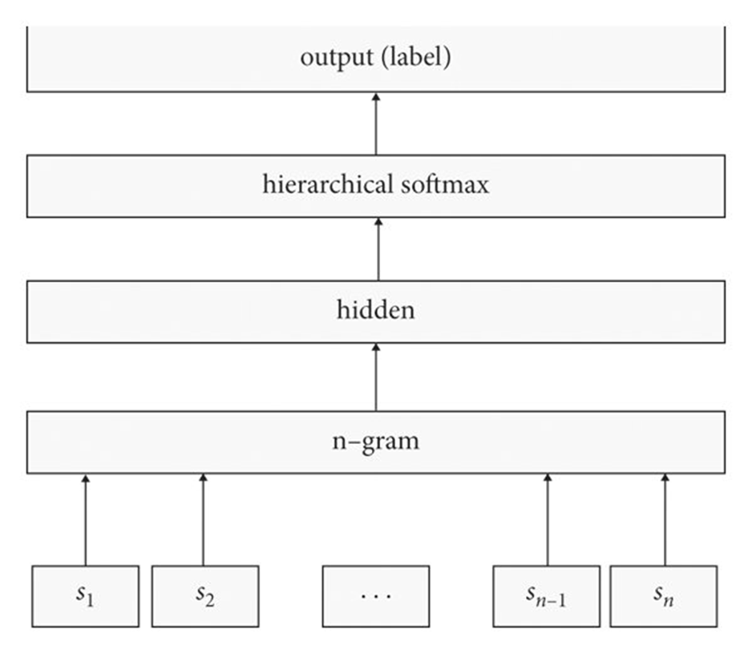
Methodology-fasttext
Input Layer:
Represents the input data, in this case, an n-gram.
Each input node (s1, s2, ..., sn1, sn) corresponds to a word or token in the n-gram.
Hidden Layer:
Processes the input n-gram and extracts relevant features.
The number of nodes in this layer determines the model's capacity to learn complex patterns.
Hierarchical Softmax Layer:
A specialized layer designed for efficient prediction of categorical variables, especially when the vocabulary size is large.
Instead of computing probabilities for all possible output classes (as in traditional softmax), hierarchical softmax organizes the output space into a tree structure.
This reduces the computational complexity of the prediction process, making it more efficient.
Output Layer:
Represents the predicted output, which is the label or class associated with the input n-gram.
Overall Function:
The network takes an n-gram as input, processes it through the hidden layer, and then uses the hierarchical softmax layer to predict the most likely label or class.

Slide 7
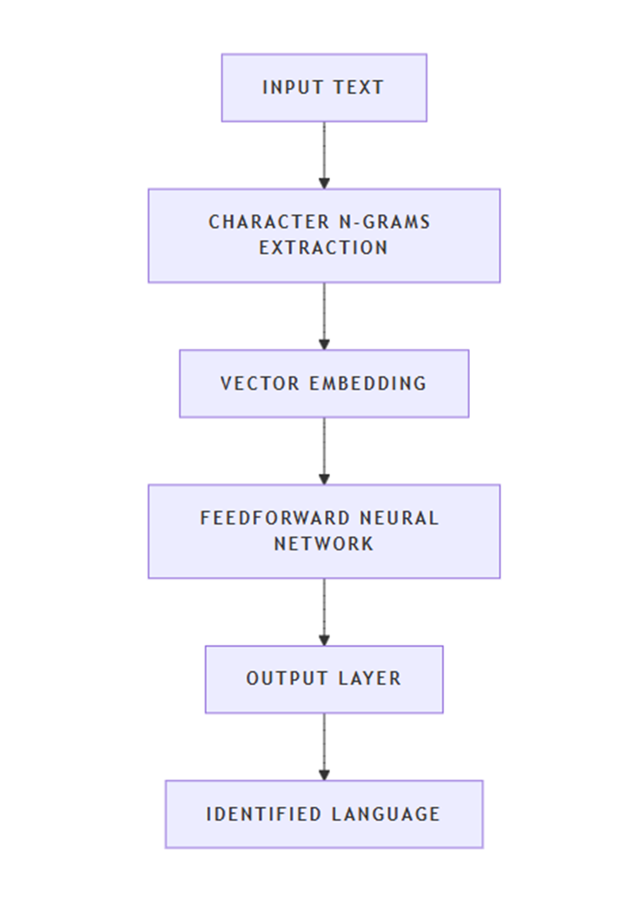
Methodology-langID
Character N-grams: The model extracts character n-grams from each word in the input text. N-grams are contiguous sequences of n characters within a word, which help capture language specific patterns.
Vector Embedding: These character n-grams are then embedded into vectors using lookup tables. This step converts the n-grams into a numerical format that the neural network can process.
Feedforward Neural Network: The embedded vectors are fed into a feedforward neural network. This network consists of multiple layers of neurons that process the input and learn to identify the language based on the patterns in the n-grams.
Output Layer: The final layer of the network outputs a probability distribution over the possible languages. The language with the highest probability is chosen as the identified language.

Slide 8
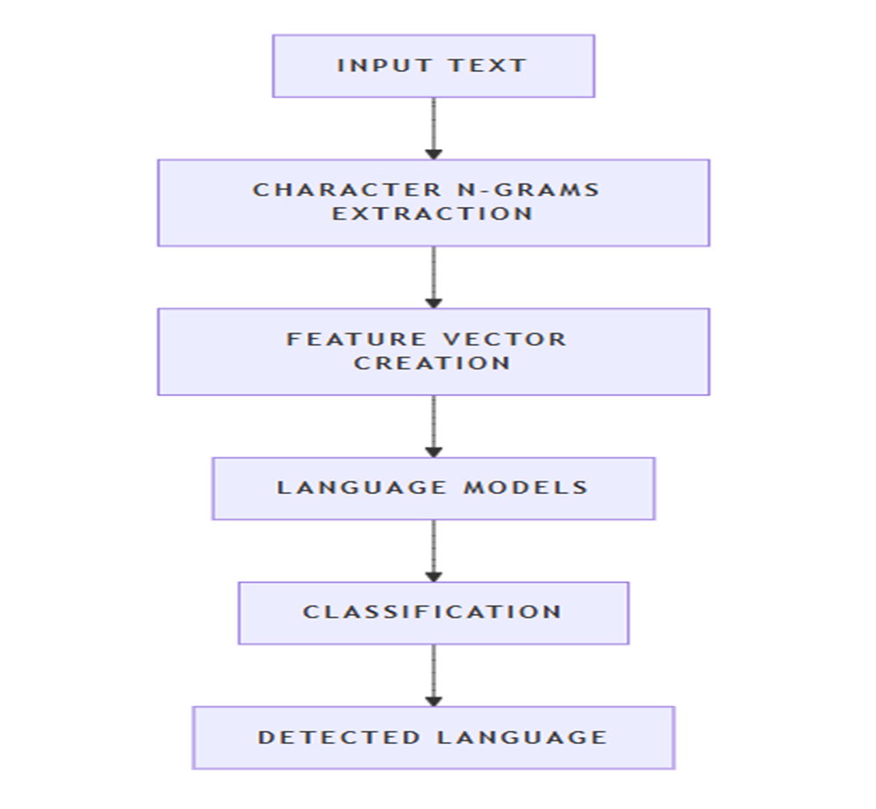
Methodology-langDetect
The LangDetect model architecture is based on statistical methods rather than deep learning.
Character N-grams Extraction: LangDetect extracts character n-grams from the input text. These n-grams are sequences of characters that help capture language specific patterns.
Feature Vector Creation: The extracted n-grams are converted into a feature vector, which is a numerical representation of the text.
Language Models: LangDetect uses pretrained language models for each supported language. These models are statistical models trained on large text corpora in different languages.
Classification: The feature vector is compared against the pretrained language models to determine the most likely language of the input text.

Slide 9
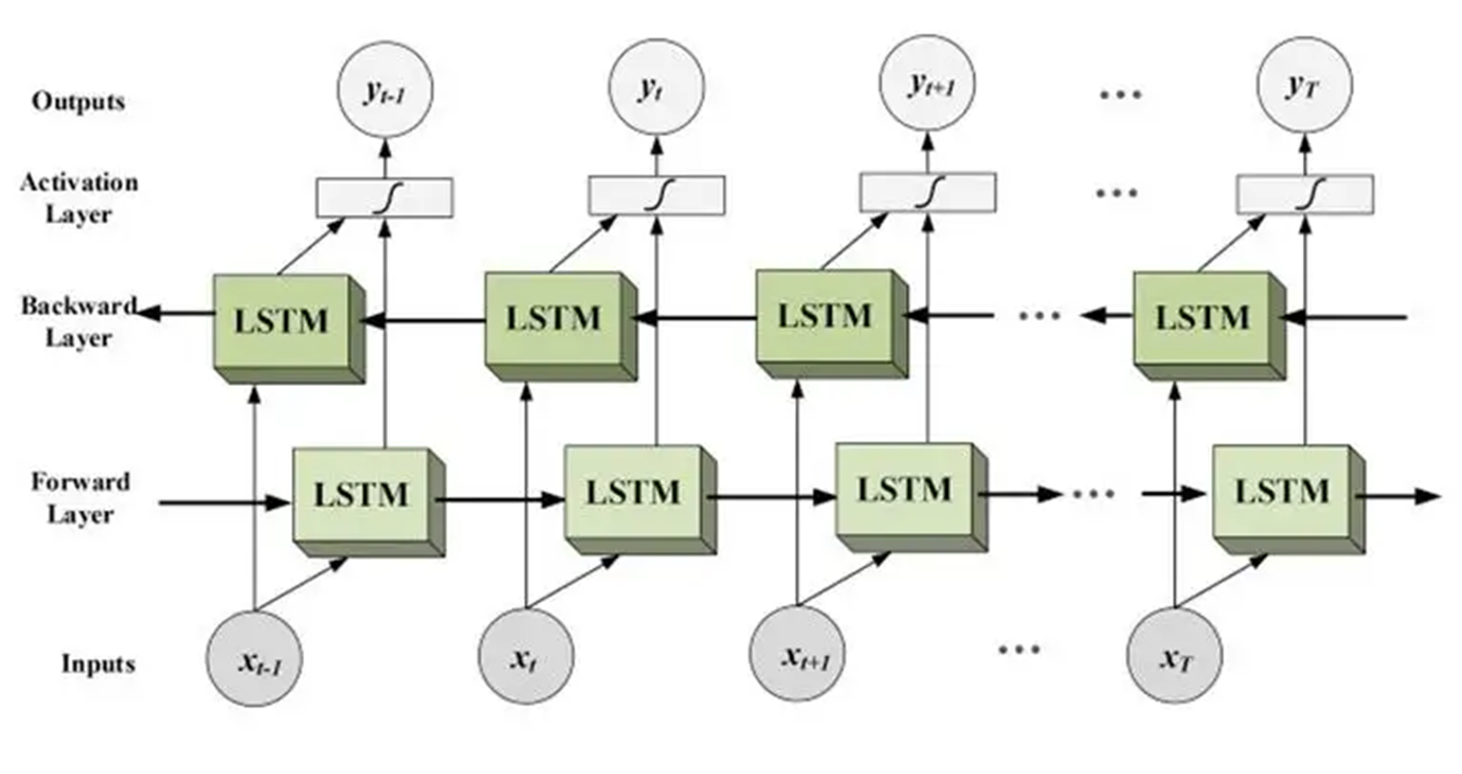
Methodology-BIDIRECTIONAL LSTM
Bi-LSTM (Bidirectional Long Short-Term Memory) is a type of recurrent neural network (RNN) that processes sequential data in both forward and backward directions To understand Bi-LSTM, let’s break down its components and functionality:
LSTM (Long Short-Term Memory)
LSTM is a type of RNN designed to overcome the limitations of traditional RNNs in capturing long-term dependencies in sequential data.
It introduces memory cells and gating mechanisms to selectively retain and forget information over time.
LSTMs have an internal memory state that can store information for long durations, allowing them to capture dependencies that may span across many time steps.
Bidirectional Processing
Unlike traditional RNNs that process input sequences in only one direction (either forward or backward), Bi-LSTM processes the sequence in both directions simultaneously.
It consists of two LSTM layers: one processing the sequence in the forward direction and the other in the backward direction.
Each layer maintains its own hidden states and memory cells.

Slide 10
Methodology-BIDIRECTIONAL LSTM
3. Forward Pass
During the forward pass, the input sequence is fed into the forward LSTM layer from the first time step to the last.
At each time step, the forward LSTM computes its hidden state and updates its memory cell based on the current input and the previous hidden state and memory cell.
4. Backward Pass
Simultaneously, the input sequence is also fed into the backward LSTM layer in reverse order, from the last time step to the first.
Like the forward pass, the backward LSTM computes its hidden state and updates its memory cell based on the current input and the previous hidden state and memory cell
5. Combining Forward and Backward States
Once the forward and backward passes are complete, the hidden states from both LSTM layers are combined at each time step.
This combination can be as simple as concatenating the hidden states or applying some other transformation.

Slide 11
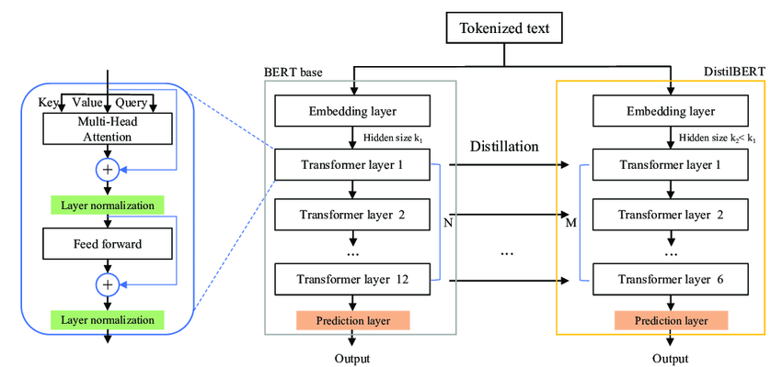
Methodology-DistilBERT
1. Tokenized Text:
The input text is first tokenized (broken down into individual words or sub words).
2. Embedding Layer:
The tokens are converted into numerical representations (embeddings).
DistilBERT typically uses a smaller embedding size (k) compared to BERT base.
3. Transformer Layers:
The core of DistilBERT's architecture is the transformer layers.
These layers consist of:
Multi-Head Attention: This mechanism allows the model to weigh the importance of different parts of the input sequence.
Feed-Forward Neural Network: This layer applies non-linear transformations to the input.
Layer Normalization: This helps stabilize the training process.
4. Distillation Process:
DistilBERT is trained using a knowledge distillation technique.
The larger BERT base model acts as the teacher, providing guidance to the smaller DistilBERT student model.
DistilBERT is trained to mimic the output of BERT base, while also being encouraged to learn more compact representations.
5. Prediction Layer:
The final layer of DistilBERT produces the output, which can be a classification, sequence labeling, or other task-specific output.

Slide 12
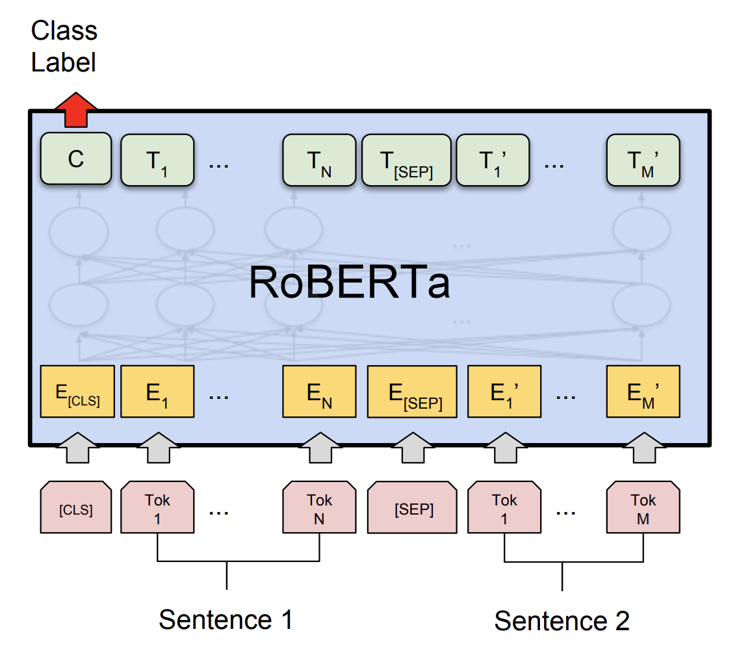
Methodology-Robustly Optimized BERT(RoBERTa)
RoBERTa is a variant of the BERT model, which was developed by researchers at Facebook AI.
RoBERTa is a transformer-based language model that uses self-attention to process input sequences and generate contextualized representations of words in a sentence.
RoBERTa was trained on a dataset of 160GB of text.
RoBERTa uses a dynamic masking technique during training that helps the model learn more robust and generalizable representations of words.

Slide 13
Methodology-google-bert/bert-base-multilingual-cased
Pretrained model on the top 104 languages with the largest Wikipedia using a masked language modeling (MLM) objective.
This model is case sensitive: it makes a difference between english and English.
BERT is a transformers model pretrained on the raw texts only in a self-supervised manner, with an automatic process to generate inputs and labels from those texts.

Slide 14
Methodology-Hate Speech CNERG/Indic-abusive-allInOne-MuRIL
MuRIL stands for Multilingual Representations for Indian Languages
The allInOne in the name refers to the Joint training/Cross-lingual training, where the model is trained using all the languages data.
It is fine-tuned on MuRIL model.
The model is trained with learning rates of 2e-5.
This model uses a BERT base architecture pretrained for 17 Indian languages.

Slide 15
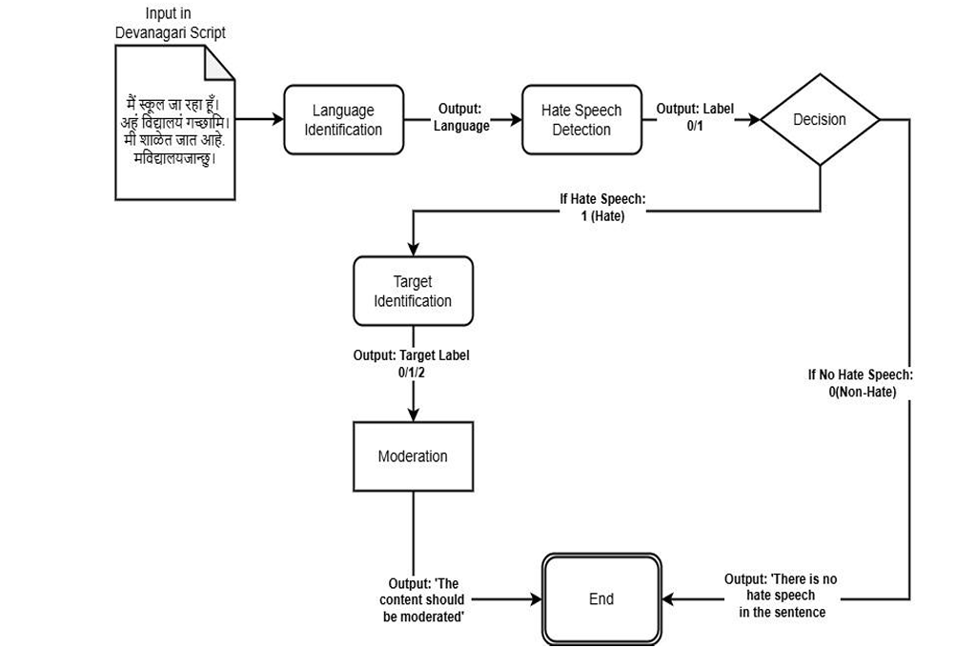
Proposed Method

Slide 16
Objectives
Determine to which language does Devanagari script belongs to among Nepali, Marathi, Sanskrit, Hindi which addresses the critical need for accurate language identification in multilingual contexts.
Identify whether it contains hate speech or not.
Identify the targets of hate speech in each hateful text.
Development of basic user interface to implement the working of above 3 objectives.

Slide 17
Timeline of Project
SUBTASKS | TITLE | TIMELINE
Subtask A | Devanagari Language Detection | 25th September-11th October
Subtask B | Devanagari Hate Speech Detection | 12th October-8th November
Subtask C | Devanagari Target Identification | 10th November-10th December
User Interface | AI-Based Content Moderator | 11th December

Slide 18
Expected Outcomes
FastText is computationally efficient in processing, allowing for rapid language detection, especially for large datasets.
Model robust to noise and errors in the text, making it suitable for real-world applications.
Handling of Out of Vocabulary Words.
Effective handling of codeswitching, where multiple languages are used within the same text
Accurate identification of individuals and groups targeted by hate speech.
Successful classification of hate speech targets across multiple languages using fastText and Bi-LSTM.
Automated alerts generated for hate speech targeting specific groups.
Scalable identification of hate speech targets across multiple languages and large platforms.

Slide 19
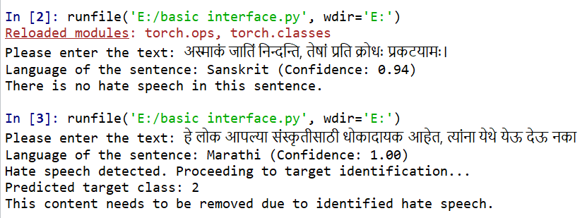
Basic User Interface

Slide 20
Dataset distribution-Subtask-A
Dataset distribution for Subtask A
Example sentences of Devanagari languages
Labels | Training Set | Dev Set | Test Set
Nepali (1) | 12544 | 2688 | 2688
Marathi (2) | 11034 | 2381 | 2356
Sanskrit (3) | 10996 | 2356 | 2354
Hindi (4) | 7664 | 1663 | 1642
Tweet | Label
के तपाई सँग खाली कोठा उपलब्द छ | 1
आमच्या गावात बारिश होती | 2
रामो वनं गच्छति। | 3
क्या आप अंग्रेज़ी बोलते हैं? | 4

Slide 21
Dataset distribution-Subtask-B
Dataset distribution for Subtask B
Distribution of labels in training set
Distribution of labels in dev set
Labels | Training Set | Dev Set | Test Set
Hate (1) | 2214 | 932 | 468
Non-Hate (0) | 16805 | 7022 | 3555
Languages | 0(non-hate) | 1(hate)
Nepali | 8164 | 1428
Marathi | 2682 | 1488
Sanskrit | 14 | 1
hindi | 8313 | 1615
Languages | 0(non-hate) | 1(hate)
Nepali | 3508 | 611
Marathi | 56 | 4
Sanskrit | 3 | 1
hindi | 3455 | 316
Distribution of labels in test set
Examples sentences on hate and non-hate
Languages | 0(non-hate) | 1(hate)
Nepali | 1688 | 364
Marathi | 208 | 12
Sanskrit | 59 | 1
hindi | 1600 | 95
Tweet | Label
ये लोग हमारे देश के लिए खतरा हैं, इन्हें यहाँ से निकाल देना चाहिए। | 1
क्या आप अंग्रेज़ी बोलते हैं? | 0

Slide 22
Dataset distribution-Subtask-C
Dataset distribution for Subtask C
Examples sentences for label 0,1,2
Labels | Train | Dev | Test
0(individual) | 1072 | 230 | 226
1(organization) | 849 | 182 | 182
2(community) | 283 | 61 | 61
Tweet | Label
मोहल्ला क्लिनिक क्लोज हैं, ठेके खुल रहे रोज है | 0
क्या आप अंग्रेज़ी बोलते हैं? | 1
ये लोग हमारे देश के लिए खतरा हैं, इन्हें यहाँ से निकाल देना चाहिए। | 2

Slide 23
Results and Discussion: Subtask-A
Performance metrics for Subtask A on dev set
Performance metrics for Subtask A on test set
Models | F1-Score | Recall | Precision
fastText | 0.6258 | 0.6769 | 0.8013
langID | 0.3872 | 0.5165 | 0.3745
langDetect | 0.6250 | 0.6765 | 0.7676
Models | F1-Score | Recall | Precision
fastText | 0.6258 | 0.6769 | 0.7997
langID | 0.3872 | 0.5165 | 0.3745
langDetect | 0.6250 | 0.6765 | 0.7976
Classification report of fastText on testing and dev dataset
PR-AUC Score
Labels | Precision | Recall | F1-Score | Support
1(Nepali) | 1.00 | 0.89 | 0.94 | 2688
2(Marathi) | 0.86 | 0.13 | 0.22 | 2354
3(Sanskrit) | 0.99 | 0.70 | 0.82 | 2356
4(Hindi) | 0.35 | 0.99 | 0.52 | 1642
Accuracy |  |  | 0.66 | 9040
Macro Average | 0.80 | 0.68 | 0.63 | 9040
Weighted Average | 0.84 | 0.66 | 0.65 | 9040
Models | PR-AUC
fastText | 0.92
langDetect | 0.70
langID | 0.73

Slide 24
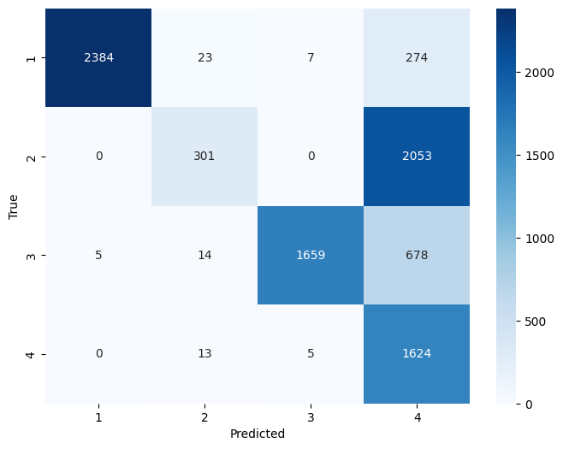
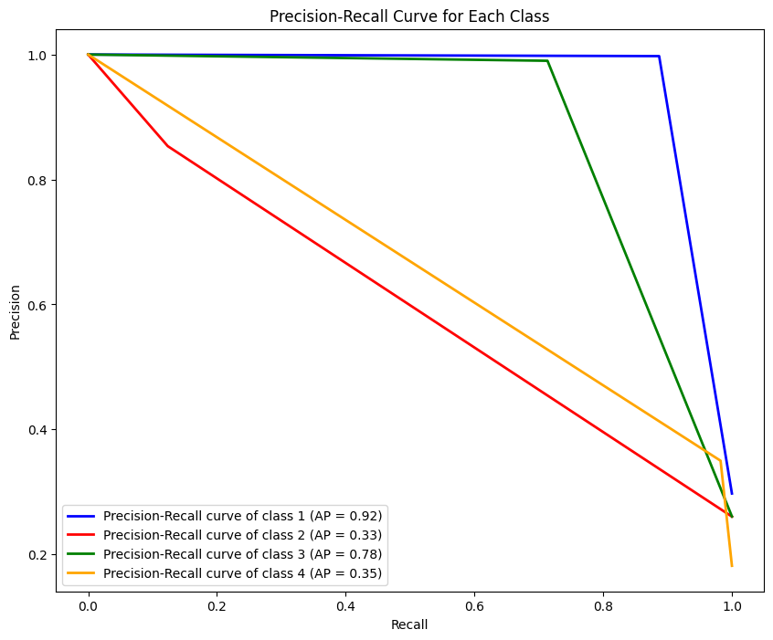
Results and Discussion: Subtask-A
Confusion matrix of fastText
PR-AUC curve of fastText

Slide 25
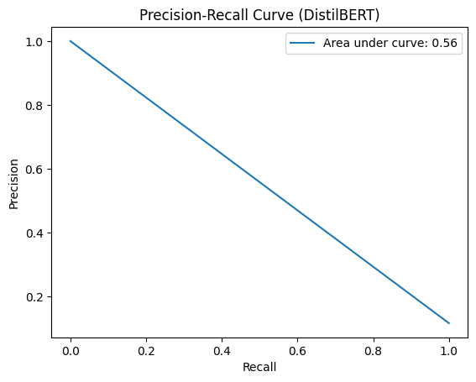
Results and Discussion: Subtask-B(without fine-tuning)
From the below table of PR-AUC curve, DistilBERT model is selected among the 3 models. However, DistilBERT exhibited an error called "Precision ill defined" when generating classification report due to data imbalance, prompting fine-tuning.
PR-AUC for models without fine-tuning
Models | PR-AUC
Bi-LSTM with fastText embeddings | 0.34
RoBERTa-Base | 0.28
Google BERT | 0.29
DistilBERT | 0.56
PR-AUC curve for DistilBERT

Slide 26
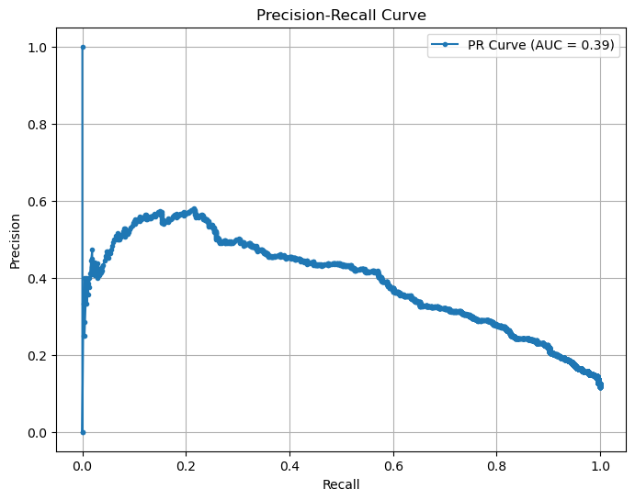
Results and Discussion: Subtask-B(with fine-tuning)
After implementing fine-tuning for the models stated in table below, the Bi-LSTM outperformed with an F1-Score of 0.9008.The respective PR-AUC curve for the models that were fine-tuned are in the table below.
The Bi-LSTM model should have been selected but despite performing fine-tuning, it failed to identify sentences which had presence of hate in them.
The PR-AUC curve for Hate-Speech-CNERG is 0.39 which is a moderate value but has a F1-Score of 86% which was successful in identifying hate speech in the input sentences.
PR-AUC curve for fine-tuned models
Models | PR-AUC
DistilBERT | 0.12
Bi-LSTM with fastText embeddings | 0.98
Hate-Speech-CNERG | 0.39
PR-AUC curve for Hate-Speech-CNERG

Slide 27
Results and Discussion: Subtask-B(with fine-tuning)
Performance metrics for Subtask B
Evaluation data classification report for Hate-speech-CNERG
Model | Description | F1-Score
Bi-LSTM with fastText emebddings | Fine-tuned on train+eval set | 0.9008
DistillBERT-base-multilingual-cased | Fine-tuned on train+eval set | 0.8500
Hate-speech-CNERG/indic-abusive-allInOne-MuRIL | Fine-tuned on MuRIL model | 0.8672
Labels | Precision | Recall | F1-score | Support
0 | 0.91 | 0.97 | 0.94 | 3553
1 | 0.51 | 0.26 | 0.34 | 470
Accuracy |  |  | 0.88 | 4023
Macro Average | 0.71 | 0.61 | 0.64 | 4023
Weighted Average | 0.86 | 0.88 | 0.87 | 4023
Testing data classification report for Hate-speech-CNERG
Labels | Precision | Recall | F1-score | Support
0 | 0.85 | 0.80 | 0.94 | 3553
1 | 0.51 | 0.26 | 0.34 | 470
Accuracy |  |  | 0.87 | 4023
Macro Average | 0.71 | 0.61 | 0.64 | 4023
Weighted Average | 0.86 | 0.88 | 0.87 | 4023
PR-AUC curve for fine-tuned models
Models | PR-AUC
DistilBERT | 0.12
Bi-LSTM with fastText embeddings | 0.98
Hate-Speech-CNERG | 0.39

Slide 28
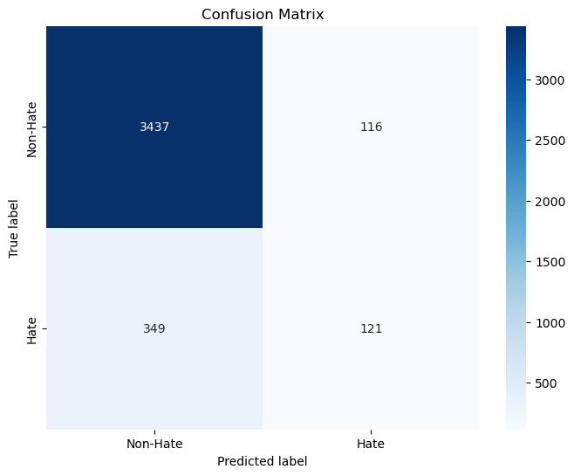
Results and Discussion: Subtask-B(with fine-tuning)
Confusion matrix of Hate-Speech-CNERG
Precision-Recall Curve of Hate-Speech-CNERG

Slide 29
Results and Discussion: Subtask-C
The study evaluated three target identification models: Google-BERT, DistilBERT, and mBERT. BERT-based-multilingual-cased outperformed with 67% accuracy and better precision-recall AUC scores, making it the best model.
Performance metrics for Subtask C
Testing data classification report for Bert-base-multilingual-cased
Models | description | F1-Score
Google-bert/bert-base-multilingual-cased | Fine-tuned on train+eval | 0.4416
Distillbert-base-multilingual-cased | Fine-tuned on train+eval | 0.4328
Bert-base-multilingual-cased | Fine-tuned on train+eval set | 0.6652
Labels | Precision | Recall | F1-score | Support
0(Individual) | 0.70 | 0.74 | 0.72 | 226
1(Organization) | 0.69 | 0.71 | 0.70 | 182
2(community) | 0.30 | 0.26 | 0.30 | 61
Accuracy |  |  | 0.67 | 469
Macro average | 0.58 | 0.57 | 0.57 | 469
Weighted Average | 0.65 | 0.67 | 0.66 | 469
PR-AUC Curve for each label
Classes | PR AUC
0(individual) | 0.74
1(organization) | 0.71
2(community) | 0.57

Slide 30
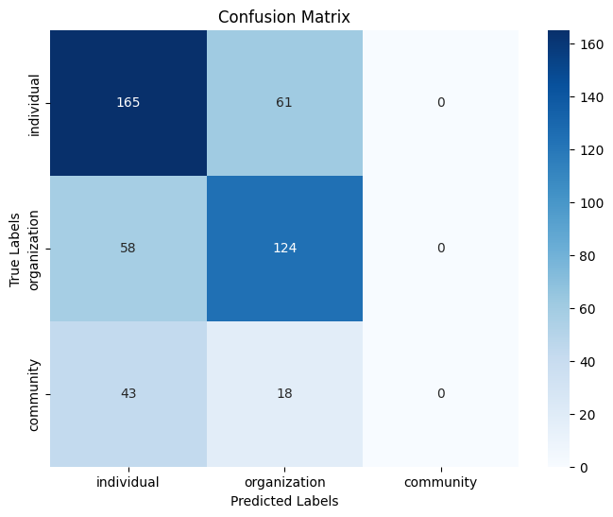
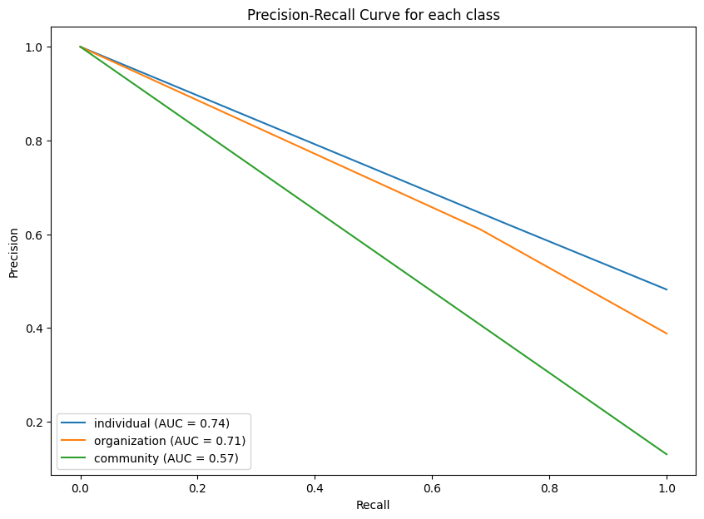
Results and Discussion: Subtask-C
Confusion matrix of mBERT
PR-AUC curve of mBERT

Slide 31
Conclusion
The trouble of recognizing writings has expanded due to the broad utilize of social media, particularly in phonetically differing countries like India. Since of etymological and social assortment, managing with despise discourse in dialects that utilize the Devanagari script—such as Hindi, Marathi, and others—presents extraordinary troubles. Progressed common dialect preparing strategies such as FastText can move forward the location of despise discourse and the individuals who spread it. Our approach decided objectives with the assistance of our technique, targets—individuals or groups—that abhor discourse is pointed towards were successfully distinguished.

Slide 32
References
[1] Indhuja, K., Indu, M., Sreejith, C., Sreekrishnapuram, P., & Raj, P. R. (2014). Text based language identification system for indian languages following devanagiri script. International Journal of Engineering, 3(4)
[2] K.E. Abdelfatah, G. Terejanu, A.A. Alhelbawy. Unsupervised detection of violent content in Arabic social media. Comput. Sci. Inf. Technol. (CS IT) (2017), pp. 1-7
[3] Abozinadah, E.A., Jones Jr, J.H., 2017. A statistical learning approach to detect abusive twitter accounts, in: Proceedings of the International Conference on Compute and Data Analysis, pp. 6–13.
[4] Thapa, S., Jafri, F. A., Rauniyar, K., Nasim, M., & Naseem, U. (2024, May). RUHate-MM: Identification of Hate Speech and Targets using Multimodal Data from Russia-Ukraine Crisis. In Companion Proceedings of the ACM on Web Conference 2024 (pp. 1854-1863).
[5] Chiril, P., Pamunkeys, E. W., Benamara, F., Moriceau, V., & Patti, V. (2022). Emotionally informed hate speech detection: a multi-target perspective. Cognitive Computation, 1-31.
[6] Dwitama, A. P. J., Fudholi, D. H., & Hidayat, S. (2023). Indonesian hate speech detection using bidirectional long short-term memory (Bi-LSTM). Jurnal RESTI (Rekayasa Sistem dan Teknologi Informasi), 7(2), 302-309.
[7] Do, H. T. T., Huynh, H. D., Van Nguyen, K., Nguyen, N. L. T., & Nguyen, A. G. T. (2019). Hate speech detection on vietnamese social media text using the bidirectional-lstm model. arXiv preprint arXiv:1911.03648.
[8] Purbey, J., Pullakhandam, S., Mehreen, K., Arham, M., Sharma, D., Srivastava, A., & Kadiyala, R. M. R. (2024). 1-800-SHARED-TASKS@ NLU of Devanagari Script Languages: Detection of Language, Hate Speech, and Targets using LLMs. arXiv preprint arXiv:2411.06850.

Slide 33
Thank You

