Slide 1
AI BASED CONTENT MODERATOR
PIP104 Capstone Project
Review1
Batch Number:G07
Under the Supervision of,
Dr. Alamelu Mangai Jothidurai
Associate Professor
School of Computer Science and Engineering
Presidency University
Roll Number | Student Name
20211CAI0078 | B MEENU
20211CAI0201 | V DEEKSHITHA
20211CAI0180 | GADDAM SAI LIKHITHA
20211CAI0115 | AISHWARYA VILAS PATIL

Slide 2
Introduction
NLP enables machines to understand, process, and generate human languages.
FastText, developed by Facebook AI Research, excels in multilingual text categorization using sub-word level character n-grams.
FastText handles out of vocabulary words and complex languages, making it effective for tasks like sentiment analysis and language identification.
It supports both supervised and unsupervised learning for various text-based tasks.
FastText is highly useful in multilingual contexts for accurate language processing.
Generative AI uses deep learning to create original content from patterns in large datasets, with models like GPT and DALL·E.
It is applied in areas like content creation, design, and research but raises ethical concerns around copyright and misinformation.
Task 1: Language Identification in Devanagari script identifies languages like Nepali, Marathi, Sanskrit, Hindi.
Task 2: Hate Speech Detection detects harmful content in underrepresented languages such as Marathi and Nepali.
Task 3: Target Identification for Hate Speech identifies specific targets like individuals, organizations, or communities, enhancing content moderation and digital safety.

Slide 3
Literature Review
Authors | Title of the paper | Where it was Published | Understanding of the paper
[1] Indhuja K, Indu M, and Sreejith C | Text Based Language Identification System for Indian Languages Following Devanagari Script | International Journal of Engineering Research & Technology, 3(4) | Proposed an n-gram-based system for identifying Devanagari languages such as Hindi, Sanskrit, Marathi, Bhojpuri, and Nepali. The system extracts text features to classify languages.
[2] K.E. Abdelfatah, G. Terejanu, A.A. Alhelbawy | Unsupervised detection of violent content in Arabic social media | Computer Science and Information Technology (CS IT), pp. 1-7 | This paper discusses the rapid spread of hate speech on social media, focusing on how user anonymity and algorithmic amplification enable the distribution of violent and harmful content, leading to societal polarization and violence.
[3] Abozinadah, E.A., Jones Jr, J.H. | A Statistical Learning Approach to Detect Abusive Twitter Accounts | Proceedings of the International Conference on Compute and Data Analysis. | This study explores the broader implications of hate speech on social dynamics, emphasizing its role in perpetuating stereotypes and affecting marginalized communities, with a focus on social tensions and cultural identity.

Slide 4
Literature Review
Authors | Title of the Paper | Where it was published | Understanding of the paper
[4] Surendrabikram Thapa et al. | RUHate-MM: Identification of Hate Speech and Targets using Multimodal Data from Russia-Ukraine Crisis | Companion Proceedings of the ACM on Web Conference 2024 (pp. 1854-1863) | Developed the RUHate-MM dataset to enhance hate speech detection during the Russia-Ukraine crisis. Challenges included linking text and images, particularly in memes, and subjectivity in manual annotation for target identification.
[5] Chiril, P., Pamungkas, E. W., Benamara, F., Moriceau, V., & Patti, V | Emotionally informed hate speech detection: a multi-target perspective. | Cognitive Computation, 1-31. | Developed a multi-target hate speech detection model that integrates affective knowledge for improved accuracy, but noted challenges in generalizing across datasets without target-specific data.

Slide 5
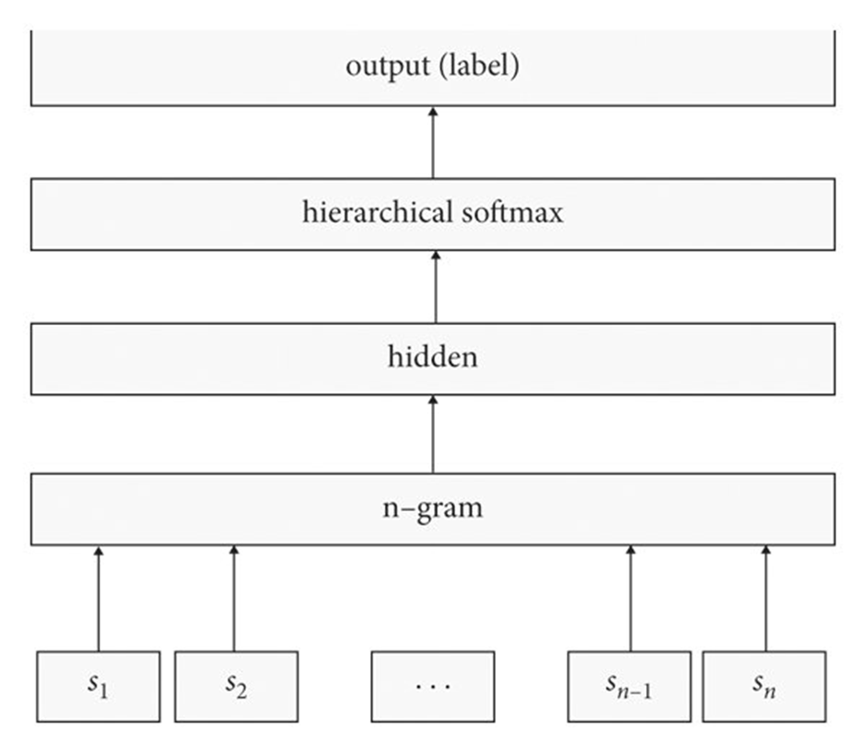
Methodology-fasttext
Input Layer:
Represents the input data, in this case, an n-gram.
Each input node (s1, s2, ..., sn1, sn) corresponds to a word or token in the n-gram.
Hidden Layer:
Processes the input n-gram and extracts relevant features.
The number of nodes in this layer determines the model's capacity to learn complex patterns.
Hierarchical Softmax Layer:
A specialized layer designed for efficient prediction of categorical variables, especially when the vocabulary size is large.
Instead of computing probabilities for all possible output classes (as in traditional softmax), hierarchical softmax organizes the output space into a tree structure.
This reduces the computational complexity of the prediction process, making it more efficient.
Output Layer:
Represents the predicted output, which is the label or class associated with the input n-gram.
Overall Function:
The network takes an n-gram as input, processes it through the hidden layer, and then uses the hierarchical softmax layer to predict the most likely label or class.

Slide 6
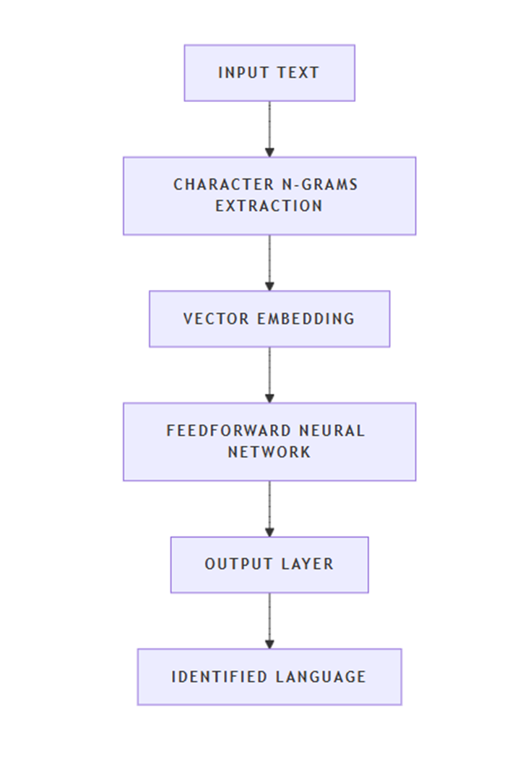
Methodology-langID
Character N-grams: The model extracts character n-grams from each word in the input text. N-grams are contiguous sequences of n characters within a word, which help capture language specific patterns.
Vector Embedding: These character n-grams are then embedded into vectors using lookup tables. This step converts the n-grams into a numerical format that the neural network can process.
Feedforward Neural Network: The embedded vectors are fed into a feedforward neural network. This network consists of multiple layers of neurons that process the input and learn to identify the language based on the patterns in the n-grams.
Output Layer: The final layer of the network outputs a probability distribution over the possible languages. The language with the highest probability is chosen as the identified language.

Slide 7
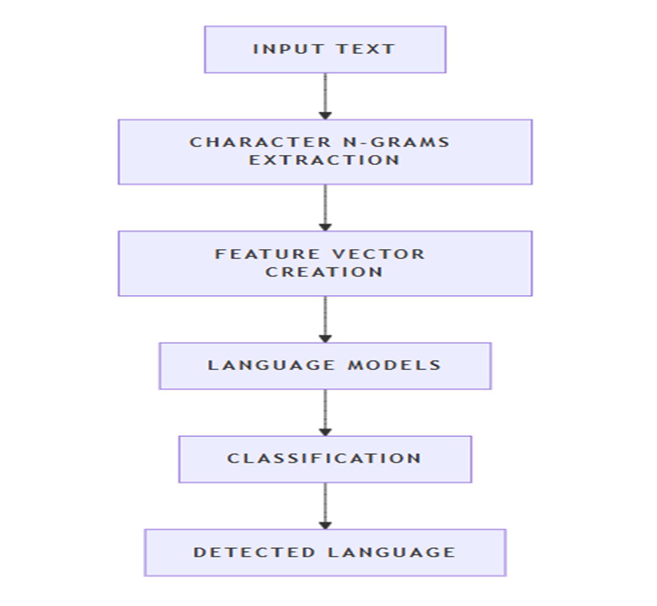
Methodology-langDetect
The LangDetect model architecture is relatively straightforward and is based on statistical methods rather than deep learning. Here's a detailed breakdown:
Character N-grams Extraction: LangDetect extracts character n-grams from the input text. These n-grams are sequences of characters that help capture language specific patterns.
Feature Vector Creation: The extracted n-grams are converted into a feature vector, which is a numerical representation of the text.
Language Models: LangDetect uses pretrained language models for each supported language. These models are statistical models trained on large text corpora in different languages.
Classification: The feature vector is compared against the pretrained language models to determine the most likely language of the input text.

Slide 8
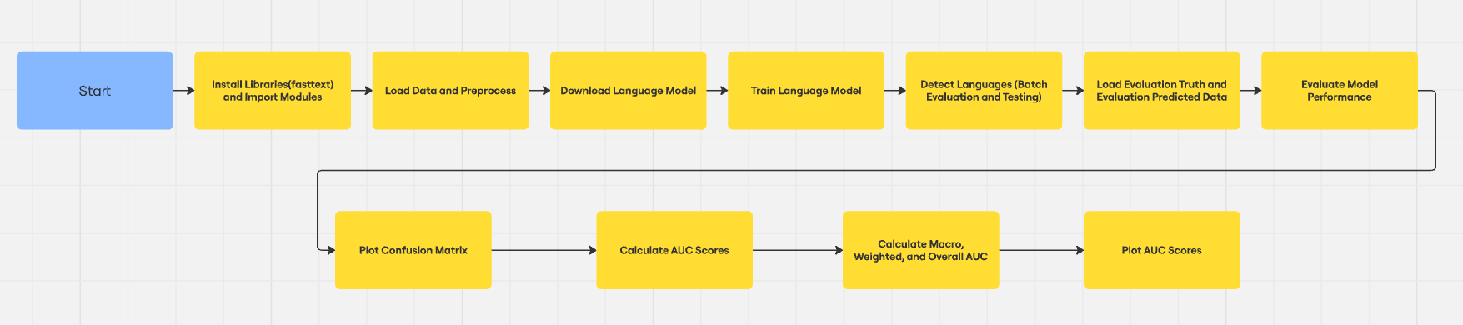
Proposed Method

Slide 9
Objectives
Determine to which language does Devanagari script belongs to among Nepali, Marathi, Sanskrit, Hindi which addresses the critical need for accurate language identification in multilingual contexts.
Identify whether it contains hate speech or not.
Identify the targets of hate speech in each hateful text.
Developing a prototype app to simulate functionality and test features before full-scale implementation.
Email fraud detection to avoid spam mail id's while creating the account.
We erase and restrict vulgar language (typed or spoken via speech-to-text) for 10-15 attempts, blocking accounts after repeated violations.

Slide 10
Timeline of Project
SUBTASKS | TITLE | TIMELINE
Subtask A | Devanagari Language Detection | 25th September11th October
Subtask B | Devanagari Hate Speech Detection | 12th October25th October
Subtask C | Devanagari Target Identification | 10th November18th November

Slide 11
Expected Outcomes
FastText is computationally efficient in processing, allowing for rapid language detection, especially for large datasets.
Model robust to noise and errors in the text, making it suitable for real-world applications.
Handling of Out of Vocabulary Words.
Effective handling of codeswitching, where multiple languages are used within the same text
Accurate identification of individuals and groups targeted by hate speech.
Successful classification of hate speech targets across multiple languages.
Automated alerts generated for hate speech targeting specific groups.
Scalable identification of hate speech targets across multiple languages and large platforms.

Slide 12
Conclusion
The trouble of recognizing writings has expanded due to the broad utilize of social media, particularly in phonetically differing countries like India. Since of etymological and social assortment, managing with despise discourse in dialects that utilize the Devanagari script—such as Hindi, Marathi, and others—presents extraordinary troubles. Progressed common dialect preparing strategies such as FastText can move forward the location of despise discourse and the individuals who spread it. Our approach decided objectives with the assistance of our technique, targets—individuals or groups—that abhor discourse is pointed towards were successfully distinguished.

Slide 13
References
[1] Indhuja, K., Indu, M., Sreejith, C., Sreekrishnapuram, P., & Raj, P. R. (2014). Text based language identification system for indian languages following devanagiri script. International Journal of Engineering, 3(4)
[2] K.E. Abdelfatah, G. Terejanu, A.A. Alhelbawy. Unsupervised detection of violent content in Arabic social media. Comput. Sci. Inf. Technol. (CS IT) (2017), pp. 1-7
[3] Abozinadah, E.A., Jones Jr, J.H., 2017. A statistical learning approach to detect abusive twitter accounts, in: Proceedings of the International Conference on Compute and Data Analysis, pp. 6–13.
[4] Thapa, S., Jafri, F. A., Rauniyar, K., Nasim, M., & Naseem, U. (2024, May). RUHate-MM: Identification of Hate Speech and Targets using Multimodal Data from Russia-Ukraine Crisis. In Companion Proceedings of the ACM on Web Conference 2024 (pp. 1854-1863).
[5] Chiril, P., Pamunkeys, E. W., Benamara, F., Moriceau, V., & Patti, V. (2022). Emotionally informed hate speech detection: a multi-target perspective. Cognitive Computation, 1-31.

Slide 14
Thank You

