Slide 1
Identification of Different Medicinal Plants/Raw materials through Image Processing Using Machine Learning Algorithms
PIP4004 University Project
Review-2
Batch Number: CSE_CAI_CAP_07
Under the Supervision of,
Dr. Afroz Pasha
Assistant Professor
School of Computer Science and Engineering
Presidency University
Roll Number | Student Name
20211CAI0078 | B MEENU
20211CAI0201 | V DEEKSHITHA
20211CAI0180 | GADDAM SAI LIKHITHA
20211CAI0115 | AISHWARYA VILAS PATIL

Slide 2
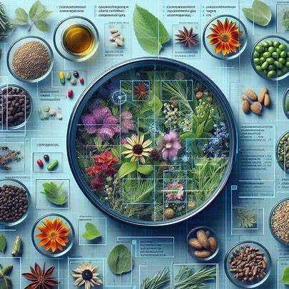
Introduction
Medicinal plants have been used for centuries to treat various ailments. However, identifying the correct plant can be challenging, as many plants look similar. This can lead to misidentification and potentially harmful consequences.
Image processing and deep learning algorithms offer a promising solution to this problem. By analyzing images of plants, these technologies can identify different species with a high degree of accuracy. This can be a valuable tool for researchers, healthcare professionals, and anyone interested in using medicinal plants safely and effectively.

Slide 3
Literature Review
Authors | Title | Where it was published | Summary of paper
[1] P. K. Sekharamantry, Dr. S. Rao, Y. Srinivas, and A. Uriti | SR-LeafNet: A Deep Learning Framework for Identifying Medicinal Plant Leaves Using Support Vector Machines | Big Data and Cognitive Computing, vol. 8, no. 12, p. 176 | Introduced PSR-LeafNet, a deep learning-based framework for medicinal plant leaf classification, integrating P-Net, S-Net, and R-Net to extract shape, color, venation, and texture features, classified using SVM.
[2] M. A. Kiflie, D. P. Sharma, and M. A. Haile | Deep learning for Ethiopian indigenous medicinal plant species identification and classification | Journal of Ayurveda and Integrative Medicine, vol. 15, no. 6, p. 100987 | Used transfer learning with pre-trained CNNs (VGG16, VGG19, Inception-V3, Xception) to classify Ethiopian medicinal plants, with VGG19 achieving the highest accuracy (94%).
[3] V. Swu, I. Kharir, and D. Bora | Identification of Different Plants through Image Processing Using Different Machine Learning Algorithms | Sambodhi, vol. 43, pp. 172-179 | Investigated plant classification through the analysis of leaf characteristics such as shape, texture, and color. Their research employed classifiers like Naïve Bayes, Support Vector Machine (SVM), and Random Forest, demonstrating that machine learning enhances accuracy in plant identification while minimizing manual effort and errors.

Slide 4
Literature Review
Authors | Title | Where it was published | Summary of paper
[4] P. S. Kanda, K. Xia, and O. H. Sanusi | A deep learning-based recognition technique for plant leaf classification | IEEE Access, vol. 9, pp. 162590-162613 | Integrated a Conditional Generative Adversarial Network (cGAN) for data augmentation, a Convolutional Neural Network (CNN) for feature extraction, and a Logistic Regression model for classification.
[5] M. S. I. Musyaffa, N. Yudistira, M. A. Rahman, A. H. Basori, A. B. F. Mansur, and J. Batoro | IndoHerb: Indonesia medicinal plants recognition using transfer learning and deep learning | Heliyon, vol. 10, no. 23 | Proposed a deep learning-based method for classifying Indonesian medicinal plants using transfer learning. Their study utilized pre-trained Convolutional Neural Networks (CNNs), such as ResNet, DenseNet, VGG, ConvNeXt, and Swin Transformer, to enhance classification accuracy.
[6] S. Kavitha, T. Satish Kumar, E. Naresh, V. H. Kalmani, K. D. Bamane, and P. K. Pareek | Medicinal plant identification in real-time using deep learning model | SN Comput. Sci., vol. 5, no. 73 | Introduced a deep learning-based technique for real-time medicinal plant identification, utilizing the MobileNet model for classification.

Slide 5
Literature Review
Authors | Title | Where it was published | Summary of paper
[7] A. S. Deshmukh, P. M. Mudhaliar, and S. Thorat | Ayurvedic plant identification using image processing and artificial intelligence | Int. J. Sci. Res. Comput. Sci. Eng. Inf. Technol., vol. 7, pp. 212-218 | Explored the integration of artificial intelligence and image processing. Their research highlights the challenges in recognizing medicinal plants due to variations in leaf shape, texture, and color.
[8] B. Dey, J. Ferdous, R. Ahmed, and J. Hossain | Assessing deep convolutional neural network models and their comparative performance for automated medicinal plant identification from leaf images | Heliyon, vol. 10, no. 1, e23655 | Conducted research on the automated identification of medicinal plants using deep convolutional neural networks (DCNN). Their study assessed the performance of seven advanced models—VGG16, VGG19, DenseNet201, ResNet50V2, Xception, InceptionResNetV2, and InceptionV3—on a dataset of 5,878 images representing 30 medicinal plant species.
[9] L. Li, Z. M. Li, and Y. Z. Wang | A method of two-dimensional correlation spectroscopy combined with residual neural network for comparison and differentiation of medicinal plants raw materials superior to traditional machine learning: a case study on Eucommia ulmoides leaves | Plant Methods, vol. 18, no. 1, p. 102 | Their study, which examined Eucommia ulmoides leaves (EULs), demonstrated outstanding accuracy, achieving 100% classification across training, testing, and validation phases.

Slide 6
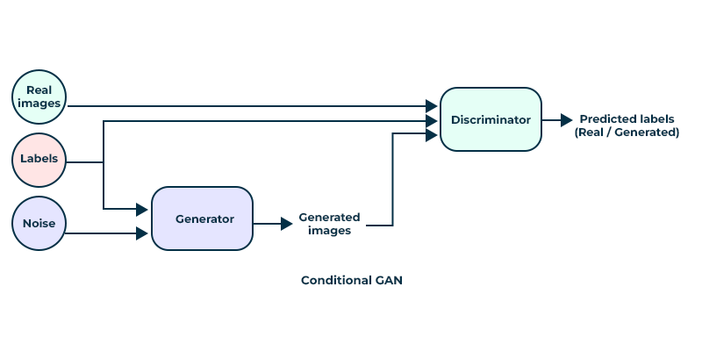
Methodology-Conditional Generative Adversarial Networks
The GAN in your code is a Conditional GAN (CGAN) because it generates images based on specific class labels, allowing for more controlled image generation compared to a standard GAN.
The generator takes a random noise vector and a conditional input (like class labels) to produce synthetic images. It typically includes layers such as dense layers, reshaping layers, and transposed convolutional layers to upsample the noise into a full image.
The discriminator receives both real images and synthetic images along with the corresponding class labels. It evaluates whether the input image is real or fake, using layers like convolutional layers, flattening, and dense layers to output a probability score.

Slide 7
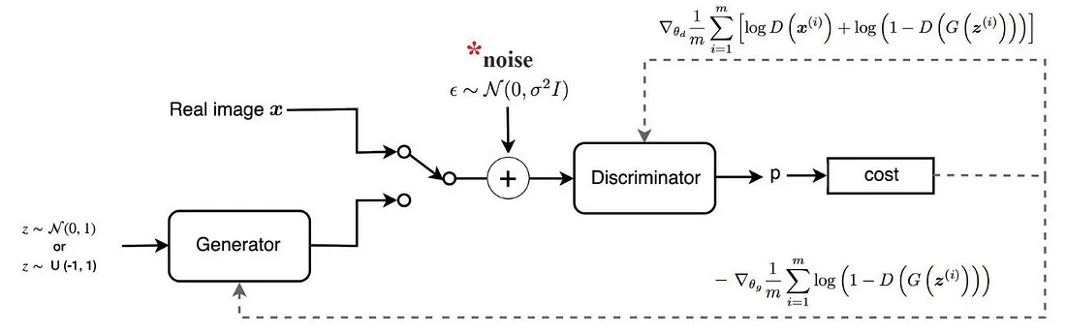
Methodology-Wasserstein Generative Adversarial Networks (WGANs)
WGAN's architecture uses deep neural networks for both generator and discriminator.
The key difference between GANs and WGANs is the loss function and the gradient penalty.
The WGAN architecture consists of a generator and a critic (instead of a discriminator).
The critic evaluates the quality of the generated samples and provides feedback to the generator.
The key innovation is the use of weight clipping or gradient penalty to enforce the Lipschitz constraint, ensuring that the critic's function remains 1-Lipschitz.
This leads to more stable training dynamics and allows for a more meaningful measure of distance between the real and generated data distributions.

Slide 8
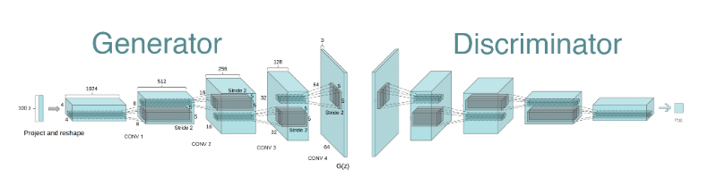
Methodology-Deep Convolutional GAN
DCGAN uses convolutional and convolutional-transpose layers in the generator and discriminator, respectively.
Here the discriminator consists of strided convolution layers, batch normalization layers, and LeakyRelu as activation function.
It takes a 3x64x64 input image. The generator consists of convolutional-transpose layers, batch normalization layers, and ReLU activations.
The output will be a 3x64x64 RGB image.

Slide 9
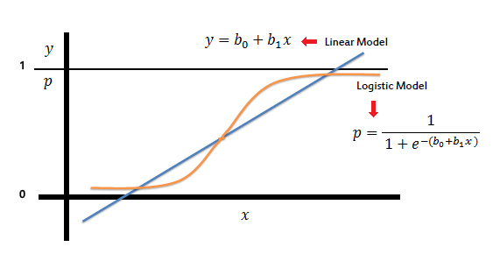
Methodology-Logistic Regression
Logistic regression is a supervised machine learning algorithm used for classification tasks where the goal is to predict the probability that an instance belongs to a given class or not.
Multinomial Logistic Regression is implemented in our code.
statistical method used for binary classification problems, but it can be extended to multi-class classification using techniques like one-vs-rest (OvR) or softmax regression.

Slide 10
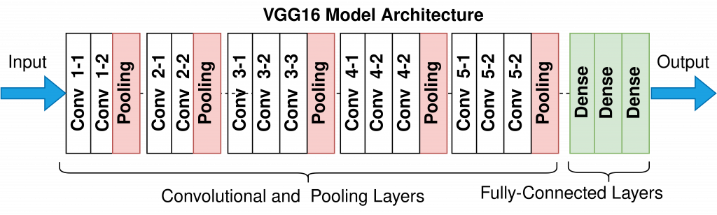
Methodology-VGG16
VGG16 is made up of 16 layers of artificial neurons that process image information
It uses 3x3 convolution filters and 2x2 maxpool layers
The network has two fully connected layers, followed by a softmax for output
VGG16 is trained on a subset of the ImageNet dataset, which contains over 14 million images

Slide 11
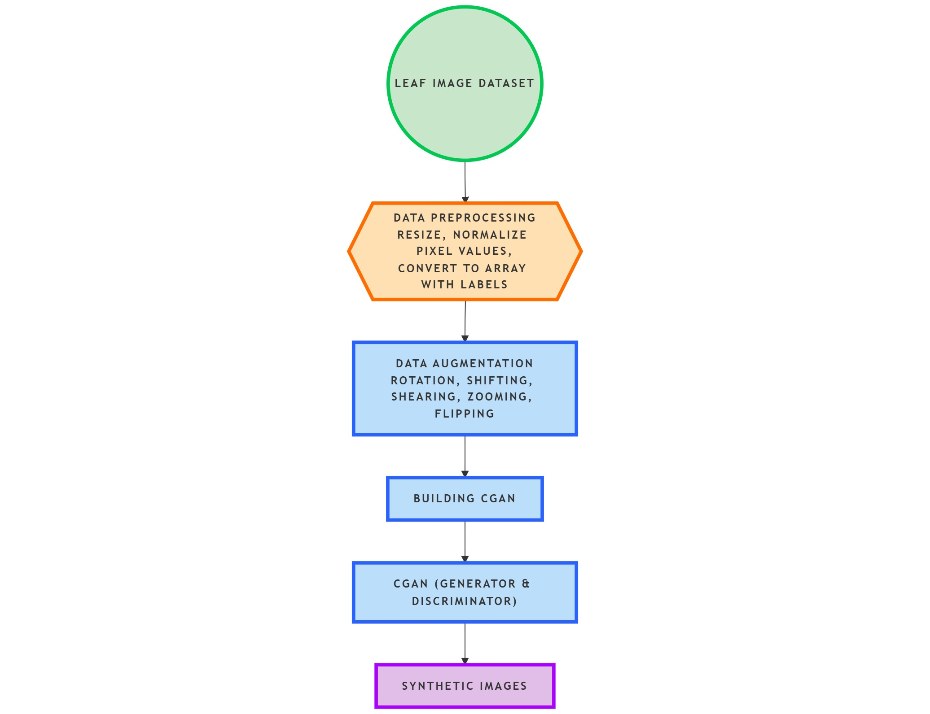
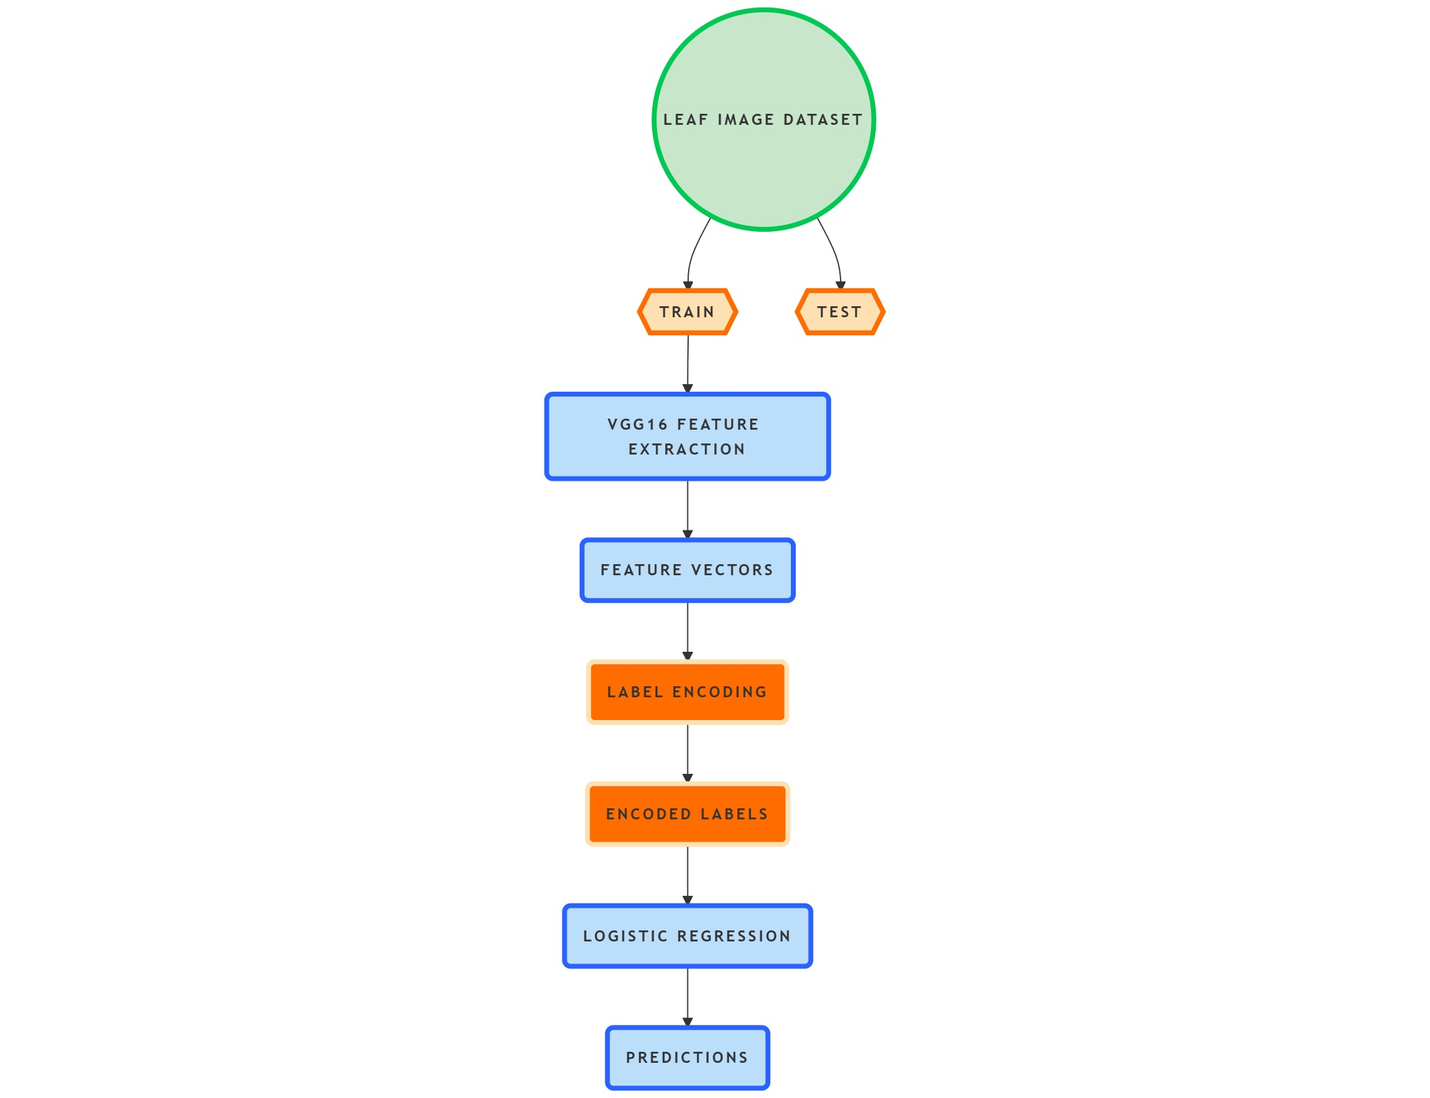
Proposed Method

Slide 12
Results
For multi-class classification, the key performance metrics to be shown are typically, accuracy, precision, recall, F1-score, and a confusion matrix, AUC-ROC Score with special consideration given to the "macro average" of these metrics across all classes.
The two models are :
CGAN with Logistic Regression(Model 1)
WGAN and DCGAN with Logistic Regression(Model 2)
Models | AUC-ROC score
CGAN with Logistic Regression(Model 1) | 0.94
WGAN and DCGAN with Logistic Regression(Model 2) | 0.99

Slide 13
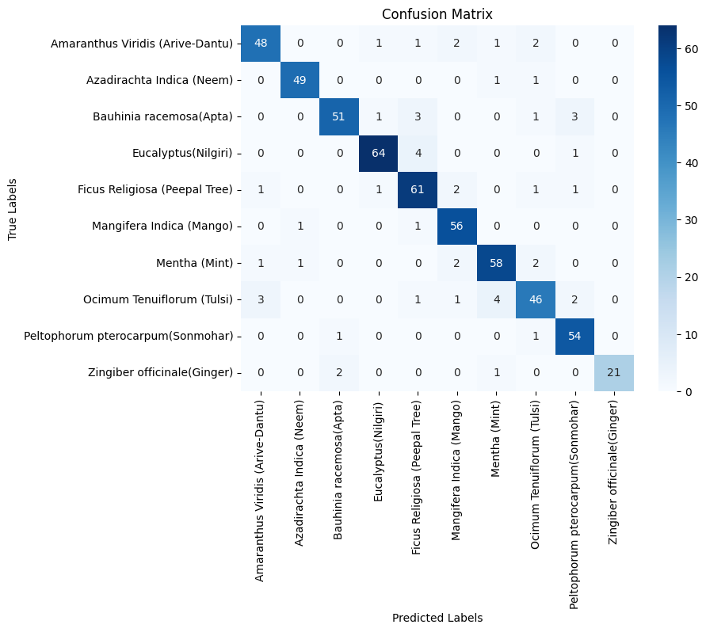

Results-Confusion Matrix-Model 1,Model 2
Confusion Matrix of Model 1
Confusion Matrix of Model 2

Slide 14
Objectives
Develop a hybrid model for Medicinal Plant Identification.
Create a Curated Dataset of Medicinal Plants and Raw Materials.
Extract and Analyze Unique Visual Features for Classification
Build a Prototype Application for Practical Demonstration

Slide 15
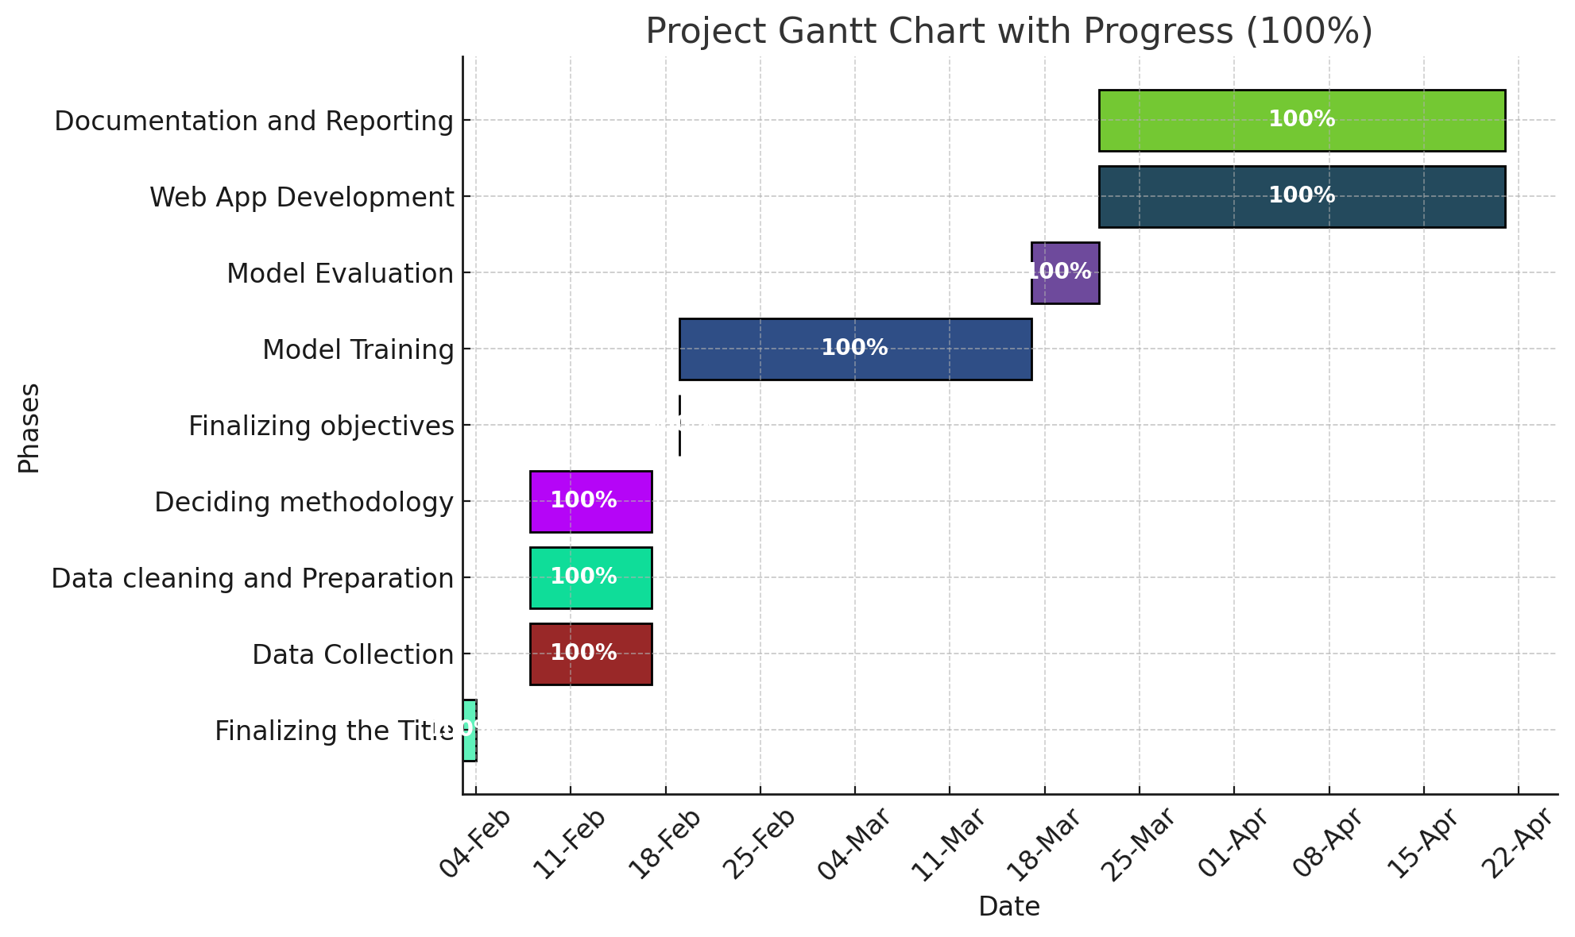
Timeline of Project

Slide 16
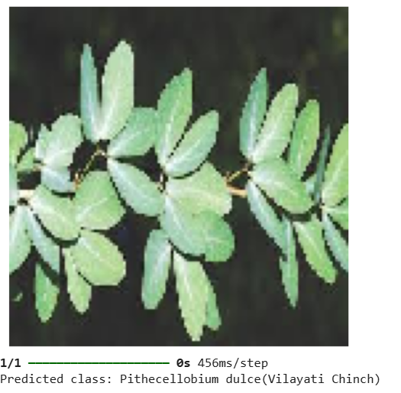
Expected Outcomes
The output shows the predicted species of the input image as shown.
The model can identify 40 species.
An application to identify the medicinal plants

Slide 17
Conclusion
This study demonstrates the feasibility and effectiveness of using image processing and machine learning algorithms for the accurate identification of various medicinal plants and raw materials. The developed system achieved an accuracy of 90.67% in identifying 10 species as mentioned in the confusion matrix showcasing its potential for practical applications in herbal medicine, quality control.

Slide 18
References
[1] P. K. Sekharamantry, Dr. S. Rao, Y. Srinivas, and A. Uriti, "PSR-LeafNet: A Deep Learning Framework for Identifying Medicinal Plant Leaves Using Support Vector Machines," Big Data and Cognitive Computing, vol. 8, no. 12, p. 176, 2024.
[2] M. A. Kiflie, D. P. Sharma, and M. A. Haile, "Deep learning for Ethiopian indigenous medicinal plant species identification and classification," Journal of Ayurveda and Integrative Medicine, vol. 15, no. 6, p. 100987, 2024. [Online]. Available: https://doi.org/10.1016/j.jaim.2024.100987
[3] V. Swu, I. Kharir, and D. Bora, "Identification of Different Plants through Image Processing Using Different Machine Learning Algorithms," Sambodhi, vol. 43, pp. 172-179, 2020.
[4] P. S. Kanda, K. Xia, and O. H. Sanusi, "A deep learning-based recognition technique for plant leaf classification," IEEE Access, vol. 9, pp. 162590-162613, 2021.
[5] M. S. I. Musyaffa, N. Yudistira, M. A. Rahman, A. H. Basori, A. B. F. Mansur, and J. Batoro, "IndoHerb: Indonesia medicinal plants recognition using transfer learning and deep learning," Heliyon, vol. 10, no. 23, 2024.
[6] S. Kavitha, T. Satish Kumar, E. Naresh, V. H. Kalmani, K. D. Bamane, and P. K. Pareek, "Medicinal plant identification in real-time using deep learning model," SN Comput. Sci., vol. 5, no. 73, 2024. doi: 10.1007/s42979-023-02398-5.
[7] A. S. Deshmukh, P. M. Mudhaliar, and S. Thorat, "Ayurvedic plant identification using image processing and artificial intelligence," Int. J. Sci. Res. Comput. Sci. Eng. Inf. Technol., vol. 7, pp. 212-218, 2021.
[8] B. Dey, J. Ferdous, R. Ahmed, and J. Hossain, "Assessing deep convolutional neural network models and their comparative performance for automated medicinal plant identification from leaf images," Heliyon, vol. 10, no. 1, e23655, 2024. [Online]. Available: https://doi.org/10.1016/j.heliyon.2023.e23655
[9] L. Li, Z. M. Li, and Y. Z. Wang, "A method of two-dimensional correlation spectroscopy combined with residual neural network for comparison and differentiation of medicinal plants raw materials superior to traditional machine learning: a case study on Eucommia ulmoides leaves," Plant Methods, vol. 18, no. 1, p. 102, 2022.

Slide 19
Thank You

