Slide 1
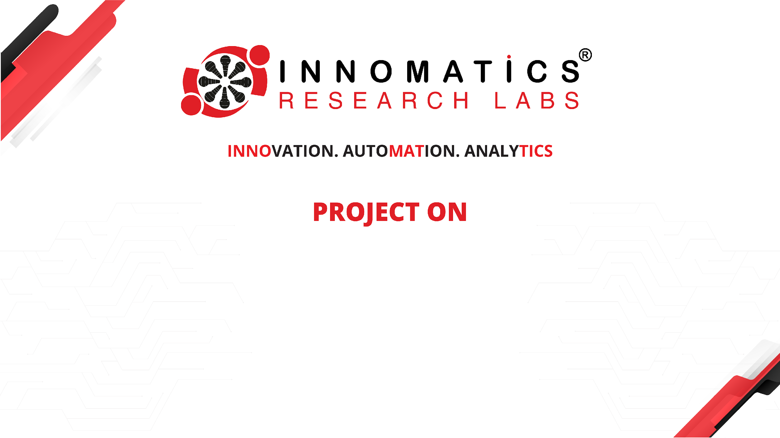
Code Refactoring and Bug Fixing

Slide 2
About me
My name is M Jyothi, a dedicated and passionate professional in the field of data science. I completed a Master's degree in Computer Applications (MCA) from Osmania University, where I honed my technical skills and developed a strong foundation in computer science. The academic environment equipped me with a solid understanding of key concepts and methodologies.
Let’s connect with on Social Network
LINKEDIN: https://www.linkedin.com/in/meenugajyothi/
GitHub: https://github.com/meenugajyothi?tab=repositories

Slide 3
Scenario:
A team of enthusiastic data scientists embarked on a mission to develop a Note Taking Application using Python, Flask, and HTML. However, their lack of experience in backend development has led to challenges in making the application fully functional. Recognizing your proficiency in backend development, you have been tasked with fixing the broken code and ensuring the application works seamlessly.
Task:
Refactor the existing codebase and ensure the proper functioning of the Note Taking Application. Document all identified bugs during the debugging process. Remember, the task is not about recreating the app from scratch. Your goal is to fix the already existing codebase and make the application work as intended.

Slide 4
Here's a summarized checklist
Review existing code.
Document identified bugs.
Fix bugs and make necessary improvements.
Test the application thoroughly.
Document changes made during the debugging process
By following these steps, you aim to have a fully functional Note Taking Application that can be used by the data science team. If you encounter specific issues during the debugging process.

Slide 5
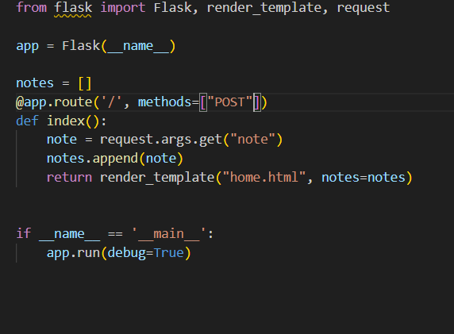
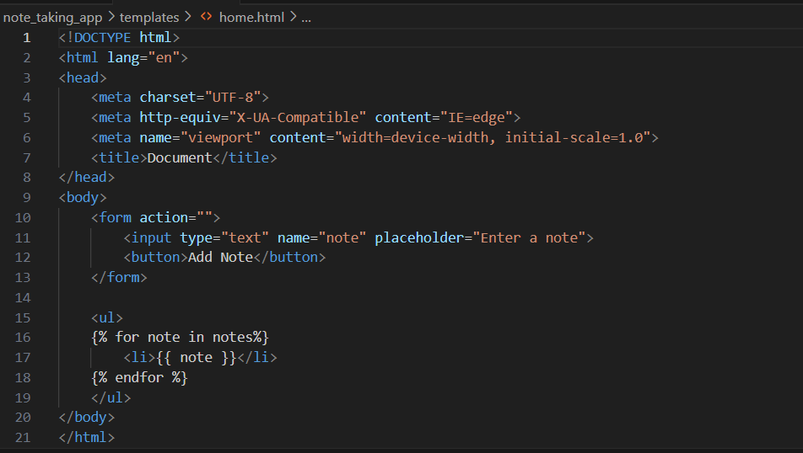
Before Fixing Bugs
HTML CODE
FLASK CODE

Slide 6
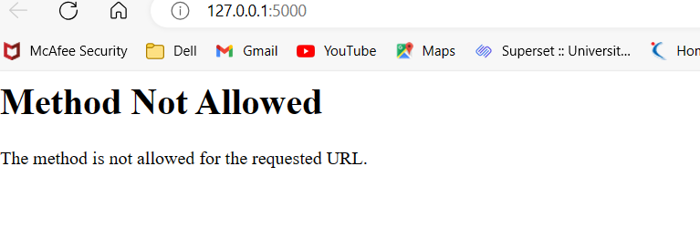
Before fixing Bug out put

Slide 7
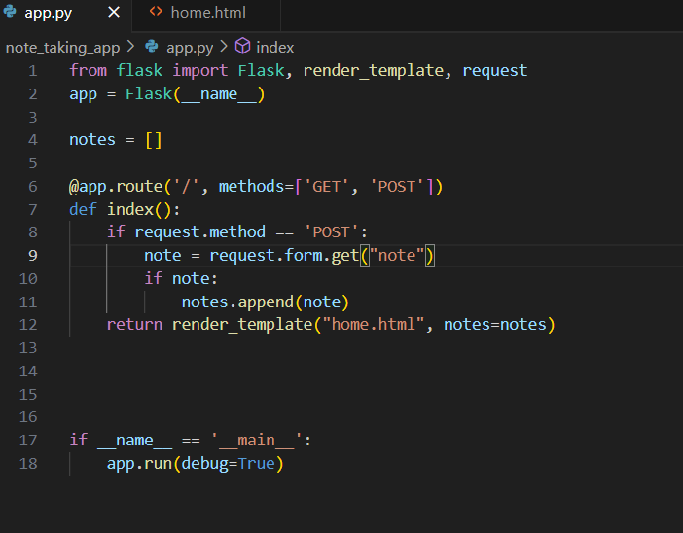
After solving bugs app.py

Slide 8
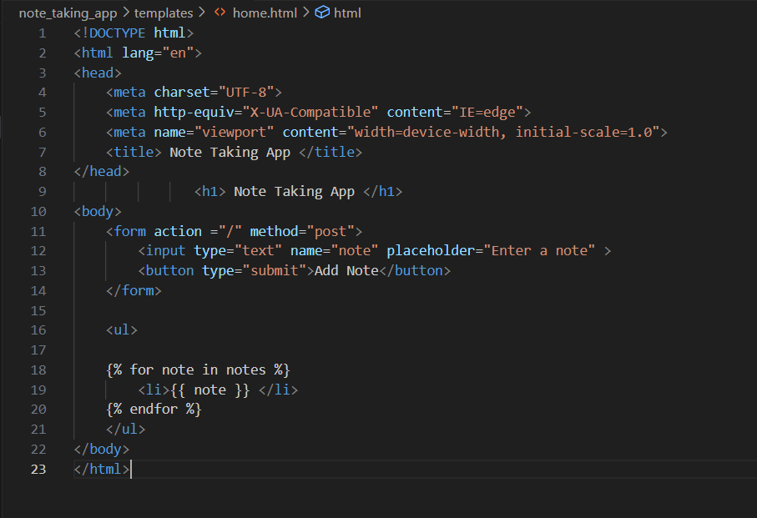
HOME.HTML

Slide 9
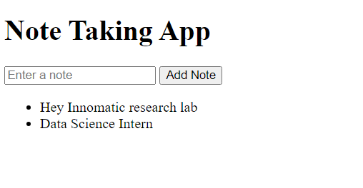
Out Put

Slide 10
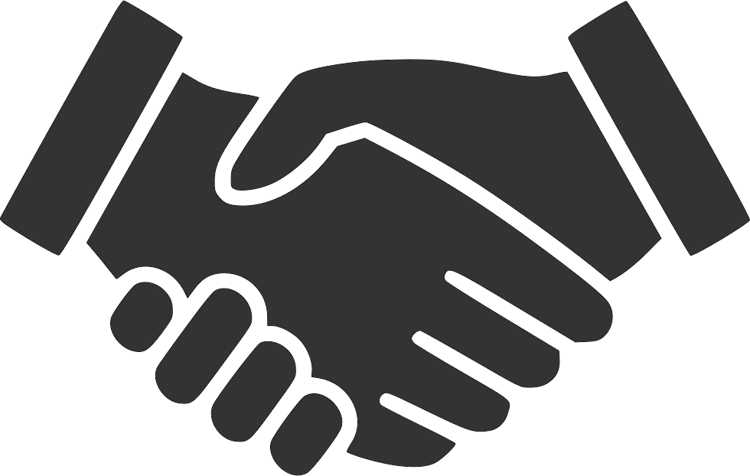
THANK YOU

