Slide 1
DETERMINING THE FACTORS THAT AFFECT THE INFANT MORTALITY AND FERTILITY RATE IN INDIAN STATES USING ANALYTICS
- MEENU JOMI
MASTER OF SCIENCE IN DATA SCIENCE | LIVERPOOL JOHN MOORES UNIVERSITY (LJMU) | JULY 2020

Slide 2
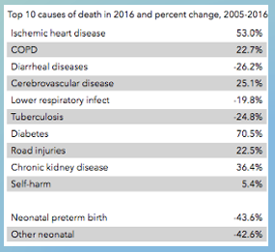
INTRODUCTION
Infant mortality is one among the top ten reasons for death rates in India.
It is different among different states.
Many cases of female infanticides does occur in India.
In the research, EDA and machine learning is used to find these factors.
It is done at national and state level
Many factors like present age, rural/urban, educational level, religion, economic activity, etc. are taken into consideration.

Slide 3
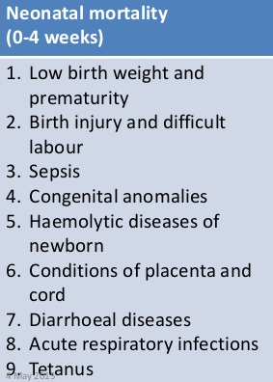
BACKGROUND
There are many researches done in infant mortality rates. But they usually include just a few factors. They included:
The location of birth is found to be a main factor.
Timing of initiation of breast feeding
Financial background of the mother
Availability of hospital facilities
There is an urgent requirement to get an up to date data on district level.

Slide 4
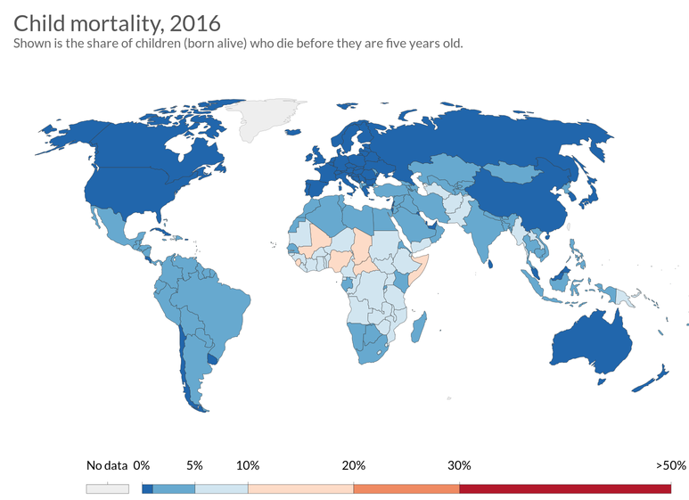
LITERATURE REVIEW
There are very few researches done on infant mortality in India.
Female education from 1st grade to 5th grade and male education from 3rd grade to 7th grade has proven to reduce infant mortality in the world.
In a case study in Russia, socioeconomic conditions, health issues of the mother, pregnancy complication, abortion and health infrastructure are the important factors.
In a study done in Bangladesh, decreasing values in variables such as maternal mortality ratio, birth rate, crude rate, population, rural population growth, the adolescent fertility rate caused the infant mortality reduction.

Slide 5
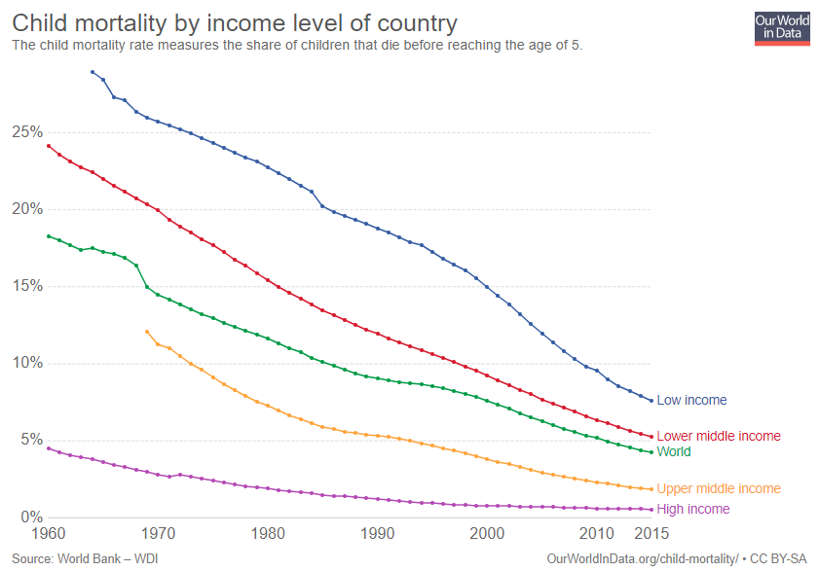
PROBLEM STATEMENT
Main aim of this research is to figure out the reasons underlying the high infant mortality rate.
Since the levels are different in each state, studying each state separately is important.
Study is done in national and state level.
The results of 2001 and 2011 are compared to see what factors have changed.

Slide 6
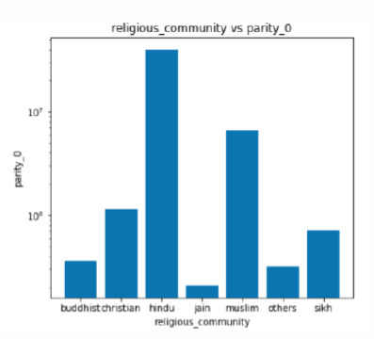
RESEARCH METHODOLOGY
The data is collected in the years 2001 and 2011 from the Indian government census.
The data was cleaned and then separated into national and state level.
The files from the census were for each State and India.
The files were merged and made into 4 tables.
The tables included data on location(rural/urban), present age, religious community, educational level and economic activity.

Slide 7
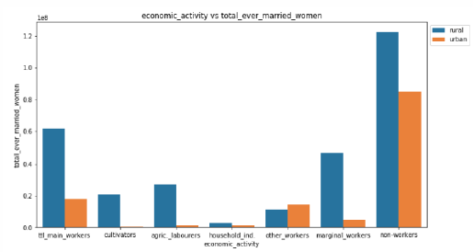
RESEARCH METHODOLOGY (cont.…)
EDA and machine learning is used to figure out the factors.
In EDA, univariate analysis, segmented analysis and bivariate analysis are used.
EDA is done in:
National level
Each state individually
Among states
In machine learning, linear regression and decision tree are used to figure out the key factors.

Slide 8
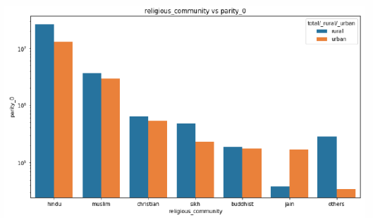
RESULTS
Most of the women are from the Hindu community, followed by the Muslim community.
SC women are more than ST women.
As the parity increases the literacy level decreases.
Most of the women are found to be non-workers.
Most women seem to be located in the rural areas.
All religious communities have more women in the rural areas, except the Jain community.

Slide 9
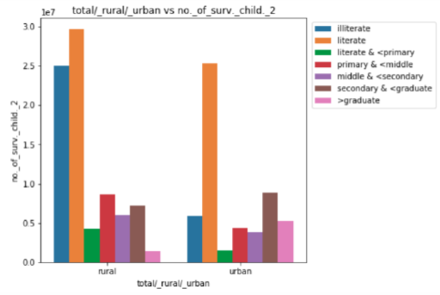
RESULTS (cont.…)
Most women with 3+ children have primary education, but women with less than 3 children have completed secondary education.
Illiteracy is higher in rural areas and literacy is higher in the urban areas. Most married women in rural areas have primary education and the ones in urban have secondary education.
Fewer women in the age group less than 19 are getting married in the Sikh community in 2011 as compared to 2001.

Slide 10
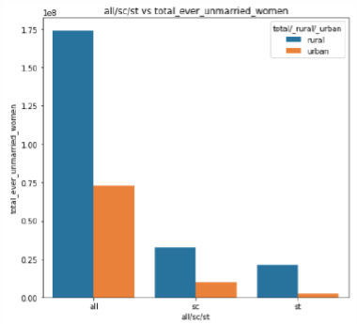
RESULTS (cont.…)
Literacy has increased among the women in the age group 20-39 in 2011 as compared to 2001.
There is an increase in the number of unmarried women who have attended secondary school in rural areas, whereas in urban areas the graduates have increased in 2011 as compared to 2001.
Number of female births are highest in Himachal Pradesh and number of male births are highest in Mizoram.

Slide 11
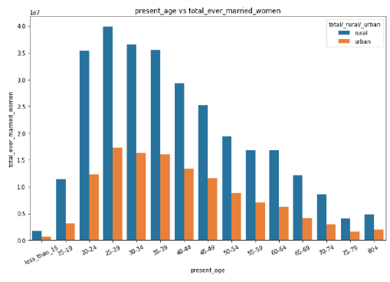
RESULTS (cont.…)
Most of the women belong to Uttar Pradesh
Illiteracy was the highest in 2001. By 2011 the number of literate women have increased and taken over the illiterate women.
Most births happens in Uttar Pradesh, Meghalaya, Jammu and Kashmir, Madhya Pradesh, Rajasthan, Nagaland and Bihar.
The lowest child births are in Puducherry, Kerala and Lakshadweep.
There are married women with one child in the age group less than 15.

Slide 12
DISCUSSION
The reasons for existing infant mortality is that more women are in the rural areas and the programs designed for educating women are usually found in urban areas.
Many women under the age of 18 are married and have children, even when the laws do not allow them.
Education level has increased in the ages 20-35. This helps to spread proper knowledge about contraceptives and infant health. This will help reduce the fertility rate.
The availability of hospitals and health facilities are mainly found in urban areas. This will deprive the women with pregnancy complications in the rural areas.
Present Age | Total children ever born (Persons)
Less than 15 | 1160122
15-19 | 12532638
20-24 | 106442170
25-29 | 222772292
30-34 | 272817414
35-39 | 289093006
40-44 | 235290198
45-49 | 216769776
50-54 | 165020992
55-59 | 147637834
60-64 | 144884016
65-69 | 110118518
70-74 | 72792580
75-79 | 33253884
80+ | 38714632

Slide 13

CONCLUSION AND FUTURE WORKS
There need to be more programs educating the rural women about pregnancy.
Women below the age of 18 should not be married or have children as that will create pregnancy complications.
Education for women must be made compulsory and proper checks need to be done to make sure child marriage does not happen.
Women need to be educated about the risk of having too many children and should be educated about contraceptives when they attend schools.
The census is conducted once in 10 years. This is not sufficient. It must be done more often. Since the census is taken every 10 years this study can be continued in 2021.

Slide 14
THANK YOU

