Slide 1
HR Analytics
Employee Attrition, Performance & Workforce Insights
Final Data Analytics Project
Project Focus
• Employee attrition drivers
• Workforce structure & diversity
• Salary and job-role patterns
• Job satisfaction and overtime
• Power BI-based HR decision support
16.1%
1,470
7.01
Attrition Rate
Dashboard Employees
Avg Tenure
Python • Pandas • Matplotlib • Seaborn • Power BI • Git/GitHub

Slide 2
Project Overview
From raw employee data to actionable HR insights
What the project does
End-to-end workflow
• Analyses employee attrition, salary, performance, satisfaction and workforce characteristics.
• Combines EDA, statistical checks, visualizations and an interactive Power BI dashboard.
• Translates analytical findings into practical HR recommendations for retention and workforce planning.
• Dataset selection & preparation
• Data cleaning and quality checks
• Exploratory Data Analysis (EDA)
• Python visualizations
• Interactive Power BI dashboard
• Business insights & recommendations
HR Analytics – Final Data Analytics Project
2

Slide 3
Problem Statement & Dataset
Understanding what drives employee attrition
Problem Statement
Dataset at a Glance
• Employee turnover can increase recruitment and training costs and affect workforce stability.
• The project investigates which employee and workplace factors are associated with higher attrition.
• Key questions: Which departments need attention? How do overtime and satisfaction relate to attrition? How does compensation vary across roles?
• 1,480 employee records in the raw CSV dataset.
• 38 columns covering age, attrition, department, job role, income, overtime, satisfaction, performance and experience.
• HR domain with employee-level records suitable for workforce analytics.
HR Analytics – Final Data Analytics Project
3

Slide 4
Data Preparation & EDA
Cleaning the data before drawing conclusions
57
7
16.1%
7.01
Missing values found
Duplicate rows found
Attrition rate
Avg. tenure
Cleaning steps
EDA focus areas
• Identified missing values in YearsWithCurrManager and treated them using the median.
• Checked and removed duplicate rows.
• Performed basic data-quality and consistency checks before analysis.
• Descriptive statistics for age, income and experience.
• Attrition by department, overtime and job satisfaction.
• Correlation analysis and IQR-based outlier detection for salary.
HR Analytics – Final Data Analytics Project
4

Slide 5
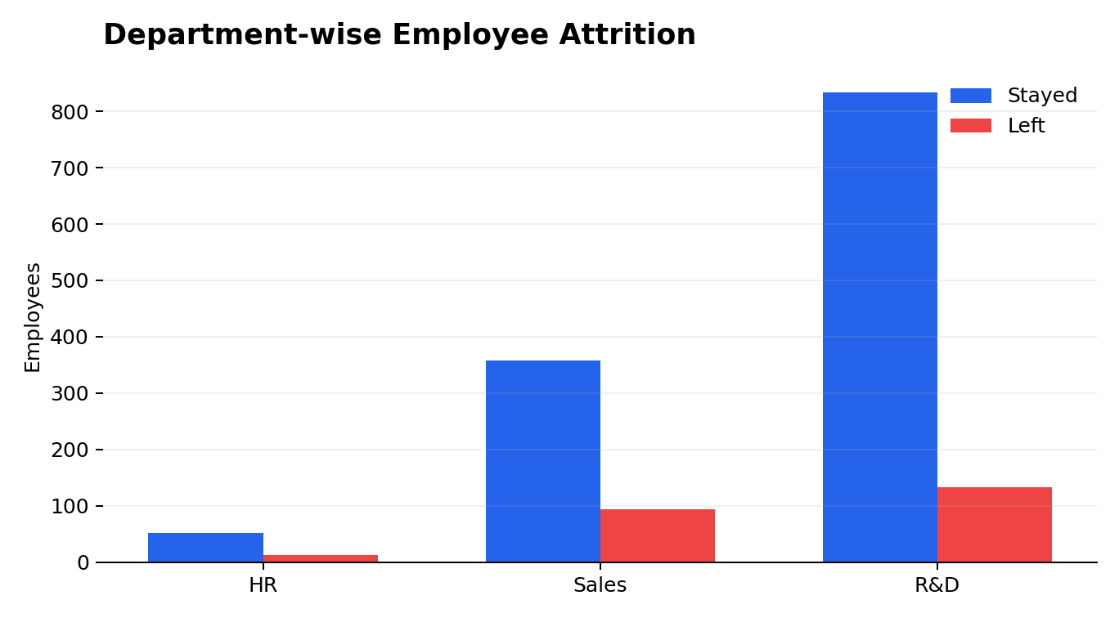
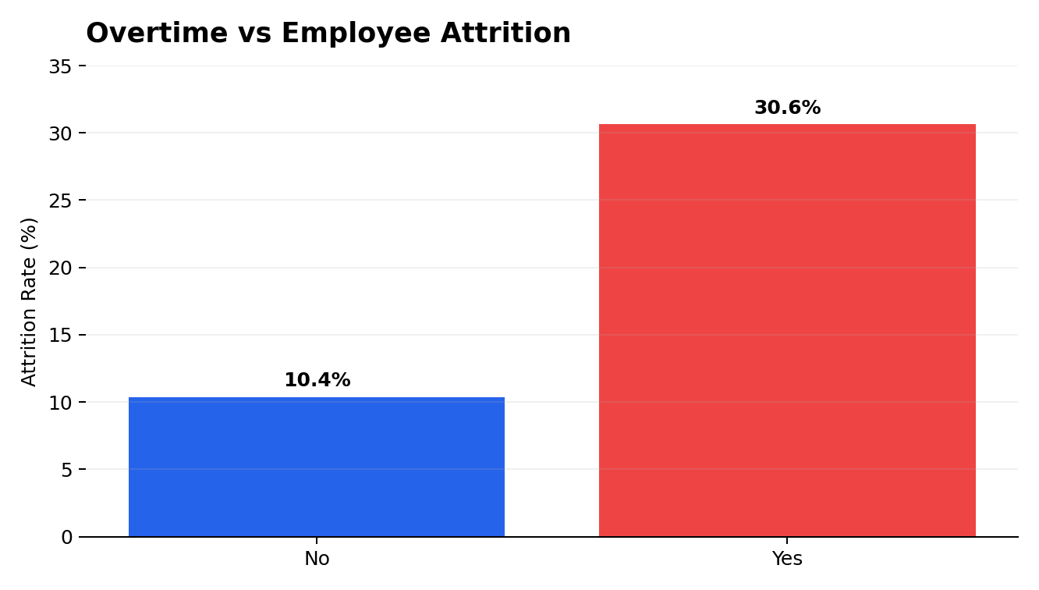
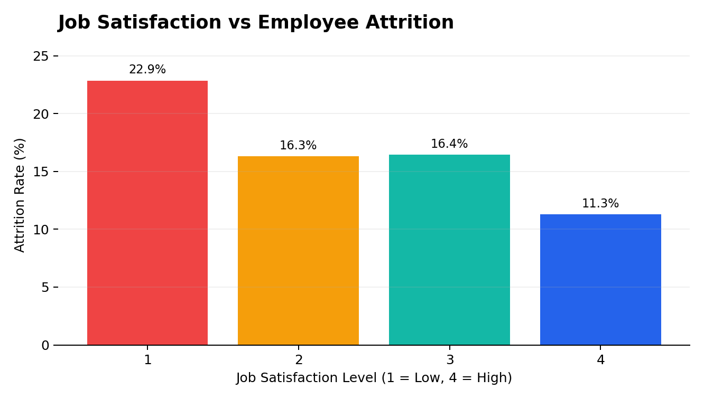
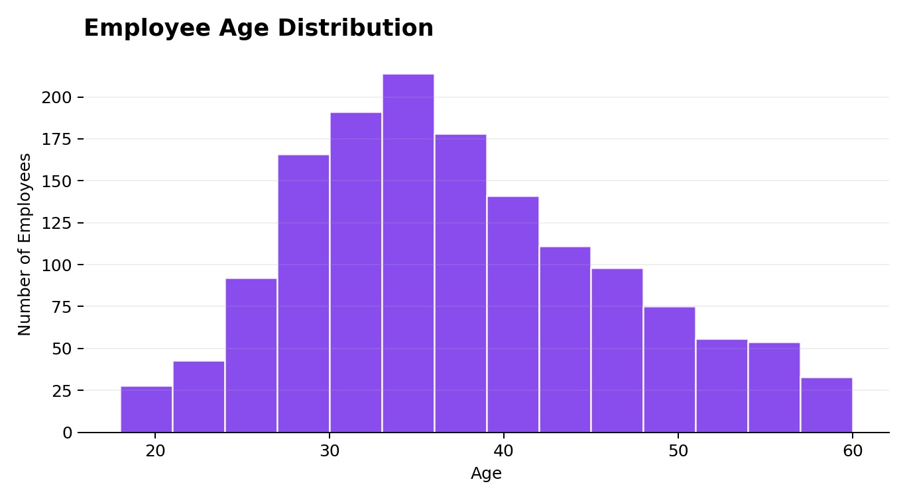
Key EDA Visualizations
The charts below highlight the strongest analytical signals
HR Analytics – Final Data Analytics Project
5

Slide 6
What the EDA Revealed
Patterns that matter for HR decisions
Attrition
Overtime
Job Satisfaction
• Overall attrition is approximately 16.1%.
• Retention remains a meaningful HR priority.
• Attrition is ~30.6% for overtime employees versus ~10.4% for non-overtime employees.
• Workload is a major signal to investigate.
• Lowest satisfaction group shows ~22.9% attrition versus ~11.3% at the highest level.
• Employee experience matters.
Department & Workforce
Compensation & Experience
• Sales has the highest attrition rate among the three departments in the dataset (~20.7%).
• R&D is the largest department by employee count.
• Average monthly income is around 6.5K and average tenure is about 7 years.
• Income varies meaningfully by job role and rises with job level/experience.
HR Analytics – Final Data Analytics Project
6

Slide 7
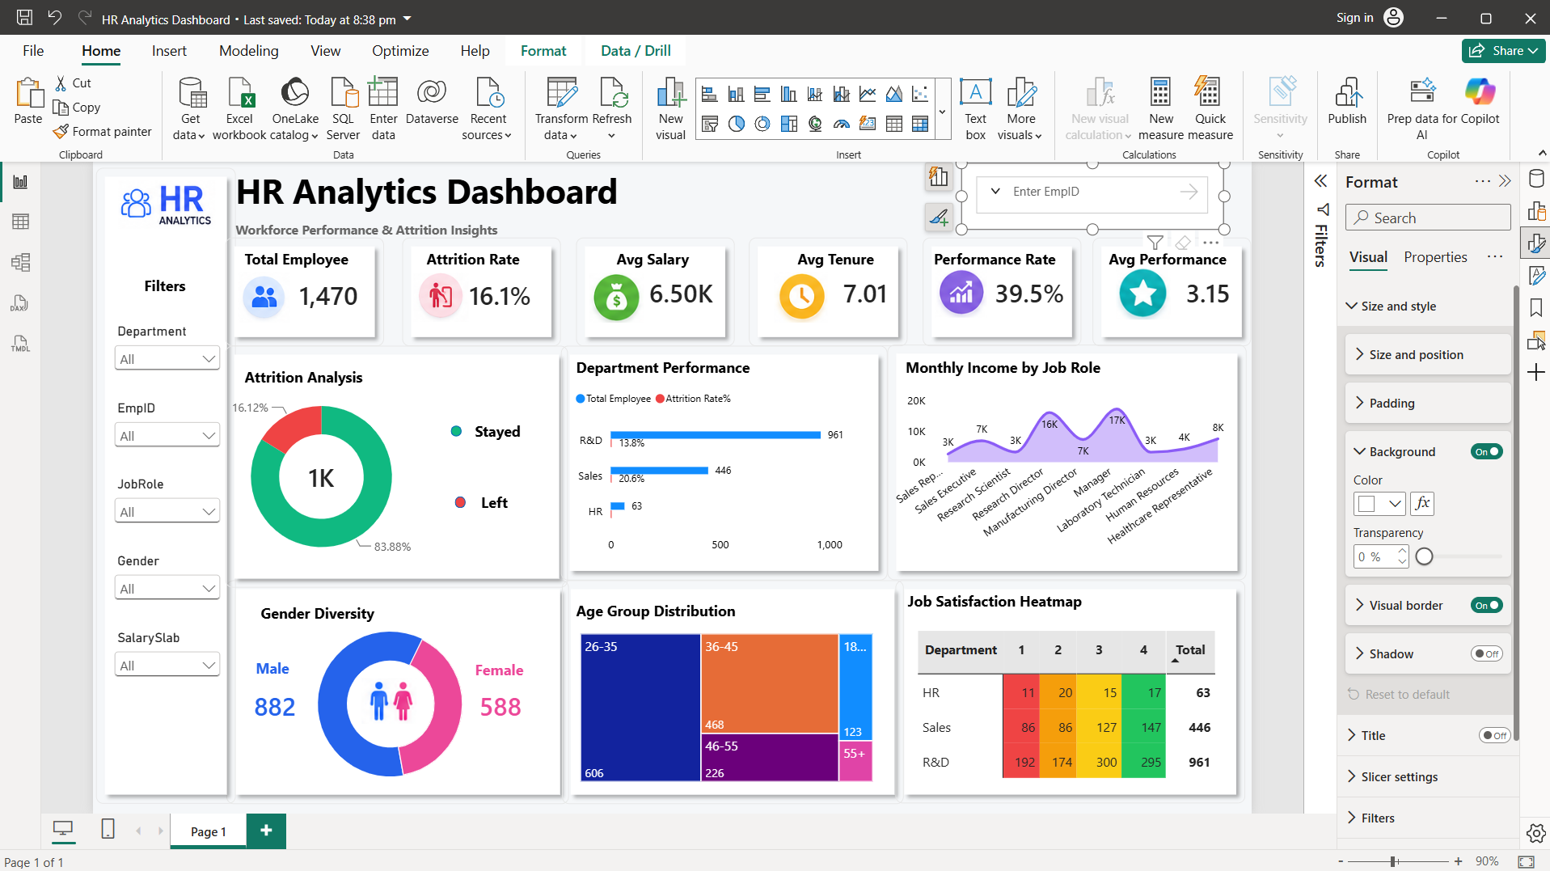
Power BI Dashboard
Interactive workforce, attrition and performance monitoring
Dashboard Features
• 6 KPI cards
• Attrition analysis
• Department performance
• Income by job role
• Gender diversity
• Age-group distribution
• Job satisfaction heatmap
• Slicers: Department, EmpID, JobRole, Gender, SalarySlab
HR Analytics – Final Data Analytics Project
7

Slide 8
Business Recommendations
Turning the analysis into action
1. Targeted Retention Program
2. Review Excessive Overtime
• Prioritize employees and departments showing higher attrition signals, especially overtime and lower satisfaction groups.
• Use regular engagement checks and manager-level retention conversations.
• Monitor overtime by department and role, then investigate teams with consistently high workloads.
• Use workforce planning and workload redistribution where required.
3. Focus on Sales Retention
4. Use Power BI for Continuous Monitoring
• Deep-dive Sales employees by job role, overtime, satisfaction, salary and tenure.
• Use the dashboard to identify specific retention hotspots.
• Track attrition, satisfaction, overtime, performance and workforce mix regularly.
• Move from one-time reporting to data-driven HR monitoring.
HR Analytics – Final Data Analytics Project
8

Slide 9
Conclusion
The project demonstrates a complete Data Analytics workflow — from raw HR data to business recommendations.
Key Takeaway
Project Deliverables
• Attrition is most actionable when viewed alongside overtime, job satisfaction and department context.
• The Power BI dashboard makes these relationships easier to monitor and communicate.
• Cleaned analysis workflow and EDA notebook
• Python visualizations
• Interactive Power BI dashboard
• GitHub documentation and version control
Thank You

