Slide 2
Wildfire Q and A Links
https://www.nfpa.org/news-blogs-and-articles/blogs/2025/01/15/los-angeles-wildfires-frequently-asked-questions
https://lao.ca.gov/Publications/Report/4952
https://nhmu.utah.edu/sites/default/files/attachments/Wildfire%20FAQs.pdf
https://www.psu.edu/news/research/story/qa-causes-spread-and-solutions-californias-wildfire-crisis
https://www.ucdavis.edu/climate/definitions/wildfire/8-wildfire-questions
https://hsph.harvard.edu/environmental-health/news/health-impacts-of-wildfires-frequently-asked-questions/
https://dec.alaska.gov/air/smoke-faq/
https://www.montecitofire.com/wildfire-prevention-preparedness-frequently-asked-questions
https://azdeq.gov/wildfire-faqs
https://www.worldvision.org/disaster-relief-news-stories/california-fires-facts-faqs-how-to-help
https://sharedsystems.dhsoha.state.or.us/DHSForms/Served/le8626.pdf
https://wildfirepartners.org/general-faq/
https://www.aspenfire.com/wildfire-faq
https://srhd.org/health-topics/environmental-health/wildfire-smoke/air-quality-wildfire-faq
https://www.pscleanair.gov/m/faq?cat=32
https://theodorepayne.org/wildfire-faq/
https://extension.oregonstate.edu/catalog/em-9193-fire-faqs-managing-wildfire-resource-benefit
https://vifr.org/wildland-fire-safety/
https://cityofpetaluma.org/wildfire-faqs/
https://www.wildfirela.org/2025/01/17/before-you-can-go-home-after-the-fires/
https://www.pa.gov/agencies/dcnr/programs-and-services/community-outreach-and-development/wildfire
http://publichealth.lacounty.gov/media/wildfire/faq.htm
https://ndresponse.gov/wildfire-faq
https://coloradosprings.gov/WildfireReady
https://des.mt.gov/Preparedness/Wildfire-Season-Resources
https://www.cawildfirefund.com/sites/wildfire/files/documents/2025/cwf-media-explainer-terms-and-questions-march-2025.pdf
https://www.dir.ca.gov/dosh/wildfire/wildfire-faq.html
https://www.worldvision.org/disaster-relief-news-stories/wildfires-facts-faqs-how-to-help
https://permitsonoma.org/wildfireadapted-faq
https://help.firststreet.org/hc/en-us/articles/5720773111063-Community-Wildfire-Risk-FAQ
https://www.elementalfilm.com/faqs
file:///Users/meenuravi/Downloads/wildfire-smoke-faq-pdf-en.pdf

Slide 3
Research Questions
How can we measure the impact of geographic granularity in geospatial Q and A?
What is the most accuracy and effective method of measuring geographic granularity uncertainty
Is this new UE method more effective than baselines? If so, how much better?

Slide 4
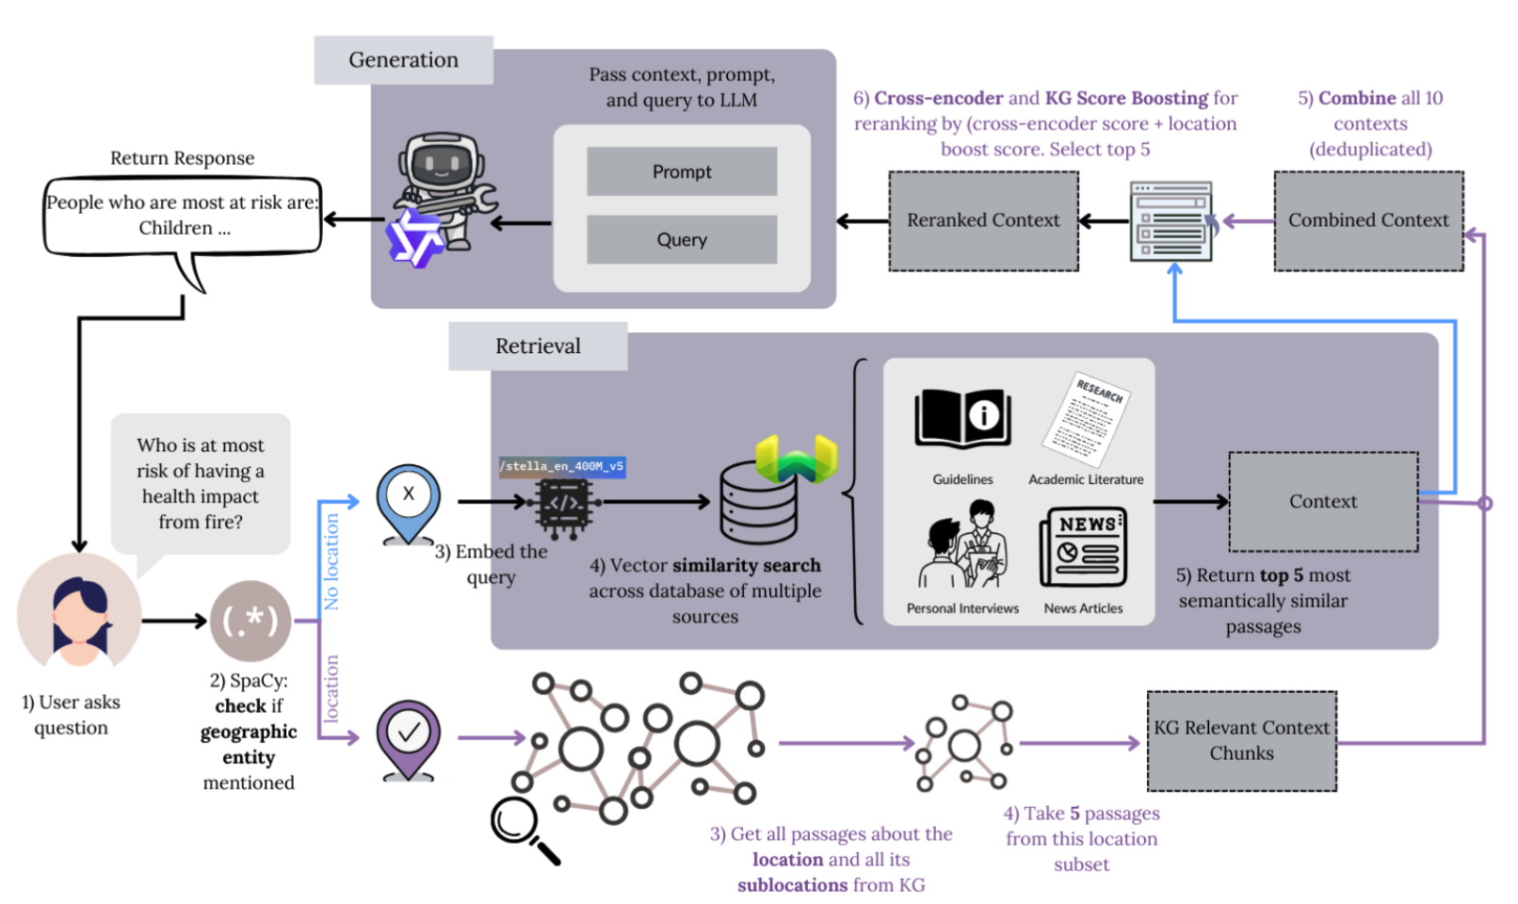
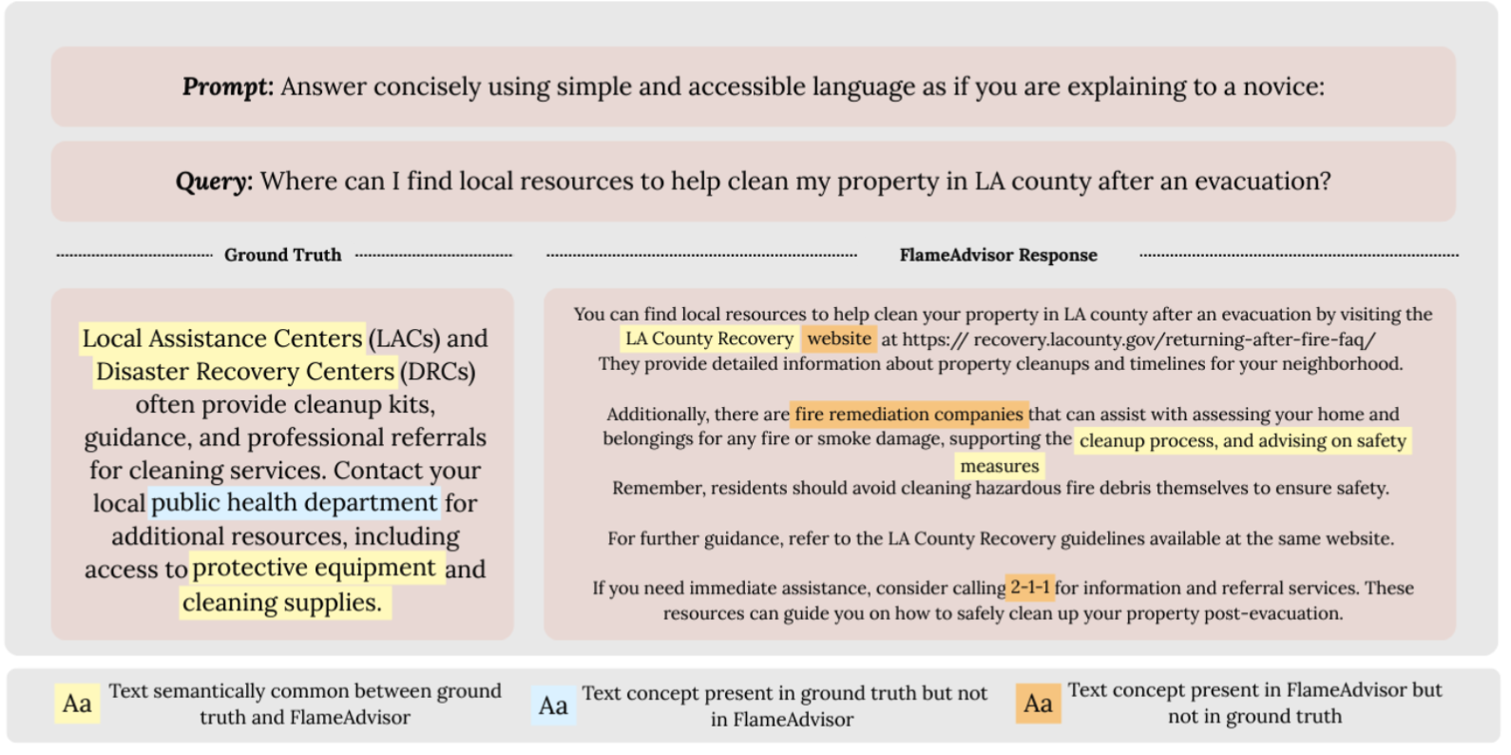
WildfireGPT
Existing large language models (LLMs) struggle to provide specific and actionable information to the general public
often generating responses that lack grounding in authoritative sources
provide generalized advice unsuitable for specific crises
suggest unreliable resource locators.
many decision support systems are catered towards professionals with domain knowledge.
Wildfire related Q and A RAG system for the public (rather than public officials)
Normal LLM may grab info from reddit or unofficial sources
RAG with guidelines helps ground answers to authoritative sources
Location aware
Sometimes no guidelines or relevant passages about a specific location so how can we still offer response but make it clear/known to user- give a trustworthy index or score

Slide 5
Geographical uncertainty quantification
Geographic granularity is still underexplored dimension of RAG uncertainty measures
Simple distance-based scoring may be insufficient
You can’t just retrieve sources and assume high confidence
Add environmental context similarity
If no documents exist at the city/county level, the RAG should retrieve documents from broader levels and lower its confidence proportionally and vice versa.
Query-dependent geographical similarity scoring for RAG uncertainty
Understand how RAG systems assess retrieved passage relevance
The dataset - wildfire Q&A benchmark with spatial metadata attached

Slide 6
Tasks
Compile a more expansive dataset of geographic related wildfire QA
Identify best method of extracting locations from passages
Label questions based on type of question (i.e., policy, health, informational etc.)
Some questions like evacuation packing list is same is all locations
Identify baseline UE measures
Identify and come up ideas for best UE measures
Identify ways for accounting for sibling relations- different county within same
Maybe doing administrative hierarchy for policy questions and geographic uncertainty for other questions

Slide 7
Sigspatial
Cikm
Ickg (ieee international conference on knowledge graph)

Slide 8
April 10 2026
Category | Domains
Primary Sources | apnews.com, reuters.com, afp.com, upi.com
National U.S. Newspapers | nytimes.com, washingtonpost.com, wsj.com, usatoday.com, npr.org
Major Regional Newspapers | chicagotribune.com, latimes.com, bostonglobe.com, dallasnews.com, sfchronicle.com, denverpost.com, seattletimes.com, startribune.com, tampabay.com, miamiherald.com, houstonchronicle.com, inquirer.com, baltimoresun.com, sandiegouniontribune.com, oregonlive.com
Major International | theguardian.com, ft.com, economist.com, abc.net.au, cbc.ca
Investigative / Long-form | propublica.org, theatlantic.com
Fire / Disaster Specific | wildfiretoday.com
Government | .gov, .org
Address reliability of news sources
How?
I filter news articles to commonly reputable domains (.gov, .org, and major)
Instead of chunking based on set number of tokens, I use semantic splitter so that similarly texts and sentences stay together
GeoExtraction
Looked at 2 geo extractors: FlairNER and bertbase NER
FlairNER seemed to perform much better
Issue to discuss:
For example I have a text like “Unlike New Mexico, Texas wildfires are much more severe” How can I get Texas instead of both New Mexico and Texas
NER methods get both. I think the other option is LLM
500 manually labeled data ner and ai model compare on manually labeled data as a way to validate

Slide 9
April 10 2026
"role": "system",
"content": (
"You are given a question-answer pair. "
"Determine whether answering the question correctly requires "
"knowledge of a specific geographic location, such as a city, county, state, region, or named fire area.\n\n"
"Answer YES if the question depends on place-specific facts.\n"
"Answer NO if the question can be answered generally without location-specific knowledge.\n\n"
"Rules:\n"
"- Return only YES or NO.\n"
"- Do not explain your choice."
I went through the questions answer dataset and manually labeled 2 things
1. Category
"1. General Wildfire behavior: causes, spread, fire science, smoke behavior, seasons, risk factors.\n"
"2. Home and property: protecting homes, defensible space, structures, insurance for homes, property damage.\n"
"3. Codes and Regulations: laws, building codes, permit rules, compliance requirements, official regulations.\n"
"4. Specific fire event: questions about a named wildfire, a particular incident, location-specific active or past fire.\n"
"5. Community: questions about how the community can help, community-level impacts.\n"
"6. Land: forests, vegetation, soil, erosion, watersheds, land management, acreage, habitat.\n"
"7. Finance: grants, loans, compensation, taxes, financial aid, business loss, economic cost.\n"
"8. Wildfire response and prevention: evacuation, preparedness, mitigation, fuel reduction, emergency response.\n"
"9. Wildfire recovery: debris removal, rebuilding, restoration, post-fire recovery steps, returning after fire.\n"
"10. Health and Safety: smoke exposure, breathing, injury, health risks, safety precautions for people.\n"
"11. Informational: general factual or definitional questions that do not fit the other categories strongly.\n\n"
2. Does it require knowledge of exact location
Then, I repeated the same process but asked llm to label it
"role": "system",
"content": (
"You are given a question. "
"Classify the QUESTION into exactly one category from the list below.\n\n"
"Rules:\n"
"- Use the answer only as supporting context.\n"
"- Classify based mainly on the question.\n"
"- Choose exactly one category.\n"
"- Return only the category name.\n"
"- Do not explain your choice."

Slide 10
April 10 2026
To do next:
For questions that are location dependent, I want to get answers for other locations
My goal is to show that while the same general information may be similar, specific details like phone numbers, who to contact – those are the parts that are different and this is where semantic similarity is not enough
Is llm as judge the way to go?- mention the types of question and evaluate like this- give instructions
Based on the change of the objective- if goal is show general formation
Graph based distance
Location query location each retrieved location and finding

Slide 11
Jurisdiction-sensitive retrieval in RAG Intro
jurisdiction sensitivity is a latent property of questions. Geographic mismatch matters disproportionately for location-sensitive questions.
Someone dealing with a wildfire in Grand County needs some answer, not none. But they also need to know "this is city-level policy, your county may differ.”
return the best available answer with a calibrated warning about how far the jurisdiction is from what was asked.
A query is jurisdiction-sensitive if the correctness or applicability of an answer depends on the governing geographic or administrative scope.
semantic relevance and geographic proximity do not capture applicability. If open burning rules are lenient in Colorado, they may be illegal in Utah despite them being proximally close
UE: the distance between what jurisdiction the question needs and what jurisdiction the answer comes from. Small distance is answer with low warning. Large distance is answer with high warning.
low risk: exact jurisdiction match
moderate risk: nested or governing jurisdiction
high risk: sibling or unrelated jurisdiction
very high risk: no grounded geographic evidence

Slide 12
Dataset Info
when risk is high, do warning, fallback, or abstention policies reduce harmful answers compared with a normal RAG baseline
General education / health / preparedness -select answer
Local policy / permit / restriction- select answer_with_warning
Live incident status / evacuation / current closures- select abstain
Source | Question | Answer | City | State | jurisdiction_type | intended_jurisdiction | expected_behavior_if_no_exact_match | Question_Type | Location Dependent

Slide 13
How to prove the risk metric adds value beyond exact-match filtering- it ranks mismatch and supports better decisions under imperfect retrieval.
Plan:
retrieve top-k with each method
for every retrieved passage, get sem sim score, jurisdiction, and the graph distance
compare methods on whether they rank better evidence higher
then generate answers
Evaluate answer / warning / abstain behavior, with LLM judge and some human checks.
Model Baselines: bge small en+gemma, bge small en+gpt-oss, bge base en+gemma, bge base en+gpt oss
Method Baselines: Similarity-only normal RAG, Exact metadata filter, jurisdiction rerank, my method
Evaluation levels: retrieval-level, answer-level
Ablations: graph distance only, granularity only (only looking levels), full metric
Judging: semantic similarity, LLM-as-judge (good at reasoning mistral, gpt oss reasoning focused) for grounded, retrievel quality etc.
How close retrieved passages are to question
How correct answer is to the ground truth (cross encoder to label to label support or opposes gt (entailment task we can check using cross encoder)
Error buckets: exact miss, sibling near-miss,
Method | Purpose
Similarity-only | Just semantic similarity
Exact filter | Uses location keyword match only
Graph-only | Graph distance
Granularity-only | Keeps only exact jurisdiction level docs
Full method | Uses graph distance + granularity + similarity
show:
filtering alone fails when exact docs are missing
similarity alone retrieves wrong-but-similar jurisdictions
this method handles mismatch better by deciding when to warn or abstain, or by preferring lower-risk evidence

Slide 14
Notes and thoughts
Most frequent rivers/mountain
Phrase it as risk-aware retrieval for scope-sensitive questions
# of questions? Loc specific- around 250 non location 250 (try to keep both around same size)
How to choose topk- threshold
I think we can phrase it as:
We investigate retrieval for geographically scope-sensitive questions using wildfire information systems as our evaluation domain, where semantically similar documents may be unsafe or inapplicable because they come from the wrong jurisdiction or authority level. We propose an applicability-risk metric that improves evidence-based ranking and supports selective answering, warning, and abstention under imperfect retrieval.
- missing or inconsistent parent-child relations – used wikidata to build initial mapping and manualy prune missing child
differences across countries in administrative structure,
ambiguous place names
places that belong to multiple relevant structures,
governing bodies that do not align cleanly with geography- ask the user/clarification
Solutions
Wikidata for hierarchy and aliases
Who’s On First or GeoNames for place identity and hierarchies
OSM or GADM for boundaries and overlap
official registries for functional authorities like school districts, tribal lands, utilities, fire districts
Add to limitations

Slide 15
Butte County has a unique geography. It extends from the floor of a valley into a high-mountain region. The landscape is made up of ridge lines that separate the county’s communities. Canyons split the county into seven regions, the jagged terrain limiting access across the ridges. Communication and outreach are difficult and time-consuming efforts for residents and officials. The physical differences in the county caused the need for custom strategies for each community.
https://www.fema.gov/case-study/ashes-paradise-community-plans-forged-wildfire

Slide 16
Week of 04/19

Slide 17
Resolving Some Limitations
Resolve a place name into its administrative hierarchy (city → county → state →region → country) using Wikidata
These 4 are the main levels referenced in these types of questions
Not much in municipality level, especially in US
4 prioritized disambiguation methods for ambiguous place names like "Springfield.”
Explicit state: if state is provided, appends it to the query for direct lookup
Context: extracts state mentions from surrounding text via flair NER
Population: picks the most populous US candidate from Wikidata
Sitelinks: fallback to the most Wikipedia-referenced candidate
Level of confidence based on number of queries asked about that location
Based on this ask
For natural area, wikidata uses:
Mouth of river, summit of mountain
In practical use we would ask user for follow up
Alias names from wikidata
E.g. the sunshine state for florida
For tribal lands, wikidata uses
Maps to all the states that the land covers
Add questions without clarifying location and test how well the clarifying questions are.

Slide 18
Get all locations from chunked passages
Use flair ner
Gets a list of mentioned locations
Uses state folder for breaking ambiguities
Get aliases also
From list use llm to get what the passage is about

Slide 19
Geo Extraction Steps
Load pkl files of semantic nodes (news + pdf)
Run process_pkl_batched which batches nodes, creates Flair sentences in parallel, predicts NER tags, extracts LOC entities with confidence ≥ 0.85, normalizes location variants, and saves checkpoints in background
If no locations found for a node, fall back to folder name
Save

Slide 20
Week of 04/26

Slide 21
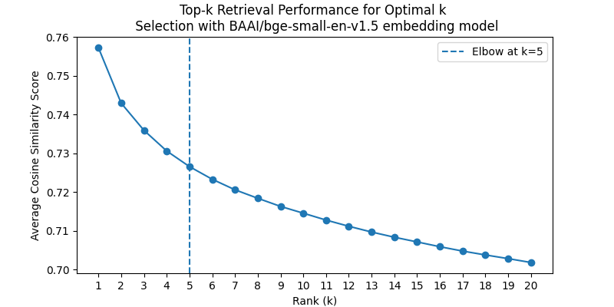

Selecting Appropriate top-k Value
Plot the quality score of answer vs k value
How relevant answer is to k value
Metric that evaluates the quality of answer (truthfulness, readability, Groundedness, uncertainty)
Final selection k=6

Slide 22
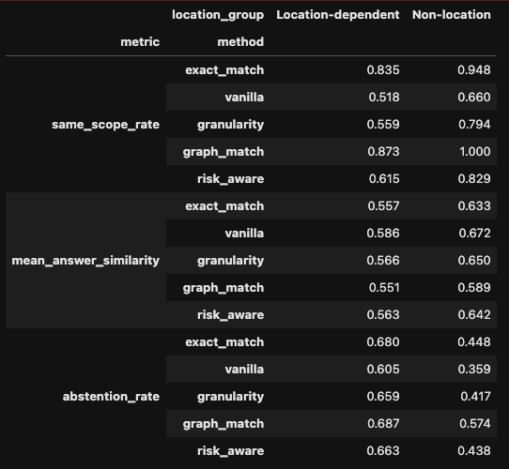
Result with bge small+gpt oss
Method | Same-scope | Answer similarity | Abstention | Insight
Exact keyword match | 0.835 | 0.557 | 0.680 | Precise when exact documents exists, but often fails/abstains
Similarity-only | 0.518 | 0.586 | 0.605 | Strong answer quality, but weakest geographic reliability
Granularity-only | 0.559 | 0.566 | 0.659 | Matching level alone helps only slightly
Graph match | 0.873 | 0.551 | 0.687 | Strongest geographic safety, but sacrifices answer quality
Full geo-first | 0.615 | 0.563 | 0.663 | Best balance between geographic reliability and usable answers
Normal Cross Encoder | Currently running

Slide 23
LLM as a judge metrics For each question, I ask to pick one and give reason Using nemotron—3-super
 | Metric | Definition
1 | Accurate Decision Rate | Measures Reliability: The ratio of queries where the system either provided a correct answer or accurately signaled its own limitations.
2 | Coverage/Attempt rate | The percentage of queries where the system attempted a factual answer. High coverage means lower abstention rate.
3 | Supported Answer | Measures Accuracy: The answer is factually correct and applies precisely to the requested jurisdiction.
4 | Wrong Confident | Measures Critical Failure: The system provided a confident answer that was factually wrong or applied to a mismatched jurisdiction.
5 | Appropriate Warning | Measure graceful fallback: The system correctly identified that evidence was partial (e.g., state-level only) and warned the user.
6 | Appropriate Abstention | Measures Safety: The system correctly refused to answer because evidence was missing or geographically irrelevant.
7 | Over-Abstention | Measures Efficiency Loss: The system refused to answer even though relevant jurisdictional evidence was present in the context.
8 | Avg. Evidence Coverage | Measures Retrieval Quality: The average number of passages (0–6) per query that were both factually and geographically relevant.
9 | 95% CI | Measures Statistical Significance: The range within which the true metric mean lies, calculated via bootstrap resampling with 1000 iterations.

Slide 24
Next Steps
5 csv files with llm generated answers and ground truths
Want to look at How correct answer is to the ground truth
cross encoder to label to label support or opposes gt
(entailment task we can check using cross encoder)
If we ask questions without clarifying location – how can we ask clarifying questions and test how well the clarifying questions are.
Question: What wildfire mitigation rules apply in Springfield?
System should not immediately retrieve from the most prominent Springfield. It should detect that Springfield has multiple plausible jurisdictions and ask:
Which Springfield do you mean: Springfield, Illinois; Springfield, Massachusetts; Springfield, Oregon; or another Springfield?
Ambiguous place names introduce a different form of geographic risk in that the system may retrieve highly relevant evidence for the wrong jurisdiction prior to applying meaningful graph-distances. In such scenarios, the appropriate behavior is not to rank or abstain immediately, but to ask a clarification question. We demonstrate this with ambiguous toponyms such as “Springfield,” where multiple U.S. jurisdictions are plausible. This case study shows how geo-risk can be used not only for retrieval-time filtering, but also for deciding when the user’s geographic intent is underspecified.

Slide 25
Case Studies
Case 1: Exact keyword filtering fails
Case 2: Similarity-only retrieves wrong jurisdiction
Case 3: Full geo-first warns or abstains
Case 4: Ambiguous toponym clarification
Experiment section- evaluating moels on quality, uncertainty at answering location specific qu, how it abstains
Evaluation criteria/settings
For each- eval matrix (3 tables)
How evaluation matrix is creted using llm as judge

Slide 26
FLLM Idea

Slide 27
Idea behind localizing geospatial decision making in LLMs
Current methods to control LLM behavior rely on prompt engineering.
However, prompting is surface-level, token-expensive, and easily manipulable by the model’s pre-trained biases.
If we understand where geography/geospatial information is stored, we can make these models more interpretable and reliable for high-stakes natural hazard mitigation tasks
Geospatial information can be ambiguous with linguistic data. We don't know if a model understands "Paris" as a location or just a high-probability token following "Eiffel Tower.”
We lack a precise map of which layers are responsible for transforming a place name into a spatial decision
Models sometimes hallucinate proximity (e.g., say two distant cities are neighbors) because their internal spatial vectors are poorly aligned

Slide 28
Potential Contributions
Identify where the specific layers where geospatial representations are most concentrated, moving from semantic tokens to physical coordinates.
Geospatial Activation Steering (GAS): introduce a technique to steer the LLM’s output by applying vector offsets without changing prompting
Show that steering the geospatial vectors significantly reduces spatial hallucinations and improves performance on regional downstream tasks

Slide 29
Research Gap: How does the model represent the concept of space, and can we manually manipulate it?
The Causal Aspect
Show that geospatial representations are not just "metadata" but are causally linked to the model’s reasoning.
previous work showed the model has a map but I want to show that shifting the internal "coordinate vector," can force the model to change its factual output
(e.g., changing its description of local flora, climate, or infrastructure) without changing the text prompt.
Steering Continuous Spaces
Geospatial Activation Steering (GAS), a framework for manipulating continuous, multi-dimensional coordinate gradients within the transformer.
Most "Representation Engineering" focuses on binary behaviors but this is a new approach to steering numerical, spatial gradients It will show how to steer a model 500 miles North or to a specific arid climate zone using activation patching.
How it is better than just Prompting
Show that internal vector steering is significantly more robust than prompt engineering for geographic metadata matching
when a model is "steered" toward a location, it is less likely to "spatial hallucinate" or be distracted by conflicting information in the prompt

Slide 30
Impact
Show that by steering the Spatial Vector, we can make the model understand the topography more clearly, leading to better disaster reasoning than if we just typed "Assume there is a mountain here" in the prompt.

Slide 31
Background Literature
https://aclanthology.org/2025.emnlp-main.813.pdf
In this work, we show that question ambiguity is linearly encoded in the internal representations of LLMs and can be both detected and controlled at the neuron level.
https://arxiv.org/html/2410.14155v2
leverage a causal mediation technique called activation patching, to measure the faithfulness of an explanation towards supporting the explained answer
https://arxiv.org/pdf/2601.12626
We search for such confluence, and ask whether the identified representation can causally explain aspects of input-output model behavior through a linear model.

