Slide 1
Introduction to Systems Programming
(CS 0449)
Palm OS Memory Management
Memory Managements and Memory APIs
Pointers and Handles (Ch.7—PDA Programming in C book & Ch.4, pg102, PalmOS Bible book).
Palm OS string functions (Ch.8—PDA Programming in C book, & Ch.9, pg314, PalmOS Bible book).

Slide 2
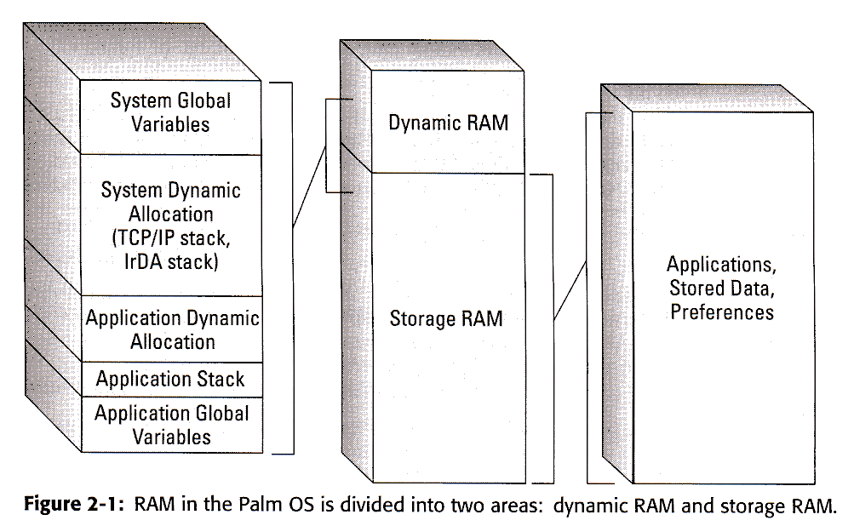
Palm OS Memory
Palm OS Version 4 and before.

Slide 3
Palm OS Architecture - Memory Management
Palm OS built on 32-bit memory architecture.
with data types: 8, 16, 32 bit-long.
(Palm OS V4.1)
Memory Addresses: 32-bit long
OS Address Space = 4 GB = 2 ³²
(to store data + code) –This is a theoretical size!
OS reserves 256 MB of address space for each card.
A Card is a logical abstraction to describe memory area used to
^{contain (ROM + RAM).}

Slide 4
Palm OS Architecture – RAM (Dynamic + Storage)
Palm OS
Desktop Computer
Dynamic RAM
(Dynamic Heap)
Actual RAM
(Physical Memory)
Storage RAM
(Storage Heap)
File System
(Hard Disk)
Heap: a complete binary tree having a level order relationship among the nodes.
  max-heap: value-parent >= value-of-each-of-its-children
  min-heap: value-parent <= value-of-each-of-its-children
60
50
55
30
10
52
50

Slide 5
Palm OS Architecture – RAM (Dynamic + Storage)
Heap in Palm OS:
An area of contiguous memory that manages and controls smaller units of memory (like the idea of a heap structure) that are called chunks.
Chunk: are in memory between 1-byte and less than 64-KB
        1-byte < Chunk < 64-KB
        = 65,528 bytes
All data in Palm OS are stored in chucks.

Slide 6
Palm OS Memory Management – RAM (Dynamic + Storage)
Dynamic RAM: Used to implement Dynamic Heap!
  -Compares to actual RAM on desktop computer.
        -Provides space for temp storage of:
        System Global Variables.
        System Dynamic Allocation (TCP/IP stack, IrDA stack).
        Application Dynamic Allocation.
        Application Stack.
        Application Global Variables.
Storage RAM: Used same way as file systems on desktop computer.
        Provides permanent storage for application & data
        Storage Heap!

Slide 7
Storage RAM in Palm OS- Memory Fragmentation
Occurs as Storage Heaps fill with data
If total free memory > new record-size
there might not be enough contiguous space in any
given heap to contain the record.
Palm OS V 1.0, 2.0
Palm OS V.3.0 & later versions use a single
large heap to prevent Fragmentation…

Slide 8
Palm OS V 1.0 & 2.0
64KB
After
Allocation
None of the heaps has enough free space.
Allocation
Fails
X
X
X
X
40KB
Before Allocation
50KB
System update 2.0.4
64KB
After
Allocation
System moves chunks from least occupied heap until enough space for new memory allocation
40KB
Before Allocation
50KB
96KB
20KB
50KB
PalmOS V3.0
Fragmentation is not a problem

Slide 9
Palm OS Memory Management – [ ROM + RAM (Dynamic + Storage) ]
ROM
    OS
    Built-in Apps
    Default DB
RAM
  Storage RAM
    Add-on Applications
    Preferences
    User data
  Dynamic RAM
    Shared by OS and active applications:
    Runtime storage
    -OS (Global variables + Dynamic allocations)
    -Active Applications (Globals, Stack, Dynamic allocations)

Slide 10
Palm OS Memory Management – Writing to RAM
Problem: Writing accidentally through an invalid pointer?
(a poorly written application)
Writing to RAM in Linux OS:
  Each application has its own address space and user’s data are in files.
  Solution:→ A bad pointer write harms only the current application.
Writing to (dynamic or worse to storage) RAM in Palm OS!
  Previous solution does not work!
  Because there is no separate address space and there is only one application running.
  Writing to dynamic RAM is not so bad, since you can always fix by resetting.
  Writing into storage RAM is bad! Will overwrite existing apps or data.
  Solution: → Hardware write protection on the storage area of RAM.

Slide 11
9- Palm OS Memory Management – Writing to Storage Memory Solution
1)
2)
Write
Direct
Write
Dynamic Memory
Write
Fails
Due to write protection
Storage Memory
To a valid block of storage Heap
Write
OS
Validate
Call
Turn off write
protection and
then turn it
back on.
Cost: on write → Slow! extra instructions!
on read → Ok.

Slide 12
10- Amount of dynamic memory available
Depends on
      Version of Palm OS
      Amount of RAM in device
Palm OS Version 3.0 and earlier
      If RAM <= 512 KB → dynamic area = 32 KB
    -If RAM <= 1 MB → dynamic area = 64 KB
    -else = 96 KB
Palm OS Version (3.1 → 3.3)
      System heap = 128 KB
Palm OS V.3.5
      If RAM < 2 MB → gives 64KB dynamic area.
    -If RAM = 2 MB → dynamic area = 128 KB.
    =4 MB → dynamic area = 256 KB.

Slide 13
Memory APIs - Allocation
API
Application Programming Interface, a set of functions and data structures
that give a developer access to certain features of an operating system or
program.
Memory Allocation (Dynamic RAM)
      MemHandle MemHandleNew(UInt32 size)
      Returns a relocatable memory chunk of desired size. Null on Err.
      Err MemHandleFree(MemHandle h)
      Free (deallocate) a relocatble memory chunk.
      It may be called with locked chunk.
      Don’t call it more than once, and don’t call it with NULL.
Memory Allocation (Storage RAM)
      MemPtr MemPtrNew(UInt32 size)
      Returns a nonrelocatable memory chunk of desired size. Null on Err.
      void MemPtrFree(MemPtr p)
      Free (deallocate) a relocatble memory chunk.
      It may be called to free locked relocatble chunk.
      Don’t call it more than once, and don’t call it with NULL.

Slide 14
Memory APIs – Locking Memory Chunks
There are APIs for locking and unlocking memory chunks.
1. MemPtr MemHandleLock(MemHandle h)
      -Lock the relocatable memory chunk and return a ptr to the locked block.
      -Err: if called on an already locked chunk with > 14 (max =14 times).
      “chunk overloacked” Err.
2. Err MemHandleUnlock(MemHandle h)
      -Unlock locked relocatable memory chunk.
      -Err: to call it if lock count=0 (not locked).
      “chunk underlocked”
3. Err MemPtrUnlock(MemPtr p)
      -Unlock locked relocatable memory chunk referenced by the pointer.
      ***It can be used if you no longer have access to the handle.
      -Err: to call it if lock count=0 (not locked).
      “chunk underlocked”
4. MemHandle MemPtrRecoverHandle(MemPtr p)
-Returns the handle associated with the passed-in locked pointer.
-Useful if misplaced handle.

Slide 15
Memory APIs –Memory Size Information
There are APIs for determining the size of memory chunks and resizing the chunk.
1. UInt32 MemHandleSize(MemHandle h)
      -Returns the size allocated for the relocatable block.
2. UInt32 MemPtrSize(MemPtr p)
      -Returns the size allocated for the block pointed to by p.
3. Err MemHandleResize(MemHandle h, UInt32 newSize)
      -Resize the specified block to new size.
      -If block is locked → a resize to a smaller size will succeed, but to a larger size, it will it will fail (unless there is a contiguous free space).
4. Err MemPtrResize(MemPtr p, UInt32 newSize)
-Resize the specified block to new size.
      -If block is locked → a resize to a smaller size will succeed, but to a larger size, it will fail (unless there is a contiguous free space).

Slide 16
Memory APIs – Heap Information
There are APIs for finding out information about cards and heaps.
1. UInt16 MemNumCards(void)
      -Returns the number of cards on the device.
2. UInt16 MemNumHeaps(UInt16 cardNumber)
      -Returns the number of memory heaps on the specified card.
3. UInt16 MemHeapID(UInt16 cardNo, UInt16 heapIndex)
      -Returns for a given heap number, it ID number, which are assigned sequentially starting from 0. i.e. HeapID=0 on card0 is the dynamic heap.
4. Err MemHeapFreeBytes (UInt16 heapID, UInt32 *freeP, UInt32 *maxP)
-Returns total free space and max contiguous free space.
5. UInt32 MemHeapSize(UInt16 heapID)
      -Returns the total size of the heap with its given ID.
6. UInt16 MemPtrHeapID(MemPtr p)
      -Returns the heap ID of the heap to which a pointer has been allocated.

Slide 17
Pointers & Handles

Slide 18
Getting Field Text
// Getting the field pointer
FieldType *field = (FieldType *) GetObjectPtr( MyFieldID );
UInt16 length;
char *textPtr;
// Getting the length of the field
length = FldGetTextLength( field );
// Getting the field text (valid only until user edits field)
// "textPtr" will be NULL if there is no text in the field
textPtr = FldGetTextPtr( field );

Slide 19
Allocating memory
// Allocate static chunk of memory
char * textPtr = MemPtrNew( 32 ) ;
// Deallocate static chunk of memory
MemPtrFree ( textPtr ) ;

Slide 20
Pointers Revisited
Pointer points to a static position in memory
Problem: memory fragmentation
1. Memory
2. delete B,D,G, add X
3.
A
A
A
B
Free
X
C
C
C
E
D
Free
?
E
E
F
F
F
X
G
Free
Free
Free
Free

Slide 21
Pointers vs. Handles
Solution: let OS manage pointers
Palm OS
Pointer table
Ptr to A
Ptr to C
Ptr to E
Ptr to F
Application
Handle to A
Handle to C
Handle to E
Handle to F
Memory
A
Free
C
Free
E
F
Allocate new handle
Free
X
Free

Slide 22
Pointers vs. Handles
Solution: let OS manage pointers
Palm OS
Pointer table
Ptr to A
Ptr to C
Ptr to E
Ptr to F
Ptr to X
Application
Handle to A
Handle to C
Handle to E
Handle to F
Handle to X
Memory
A
C
E
F
X
Free

Slide 23
Handles
//Handles are pointers to memory that may be moved by the OS.
// Allocate moveable chunk of memory
MemHandle textH = MemHandleNew( 32 ) ;
//returns a handle (textH) to a moveable chunk.
// Deallocate moveable chunk of memory
MemHandleFree ( textH ) ;

Slide 24
Handles and Pointers: Size
UInt32 length;
// Get the size of the moveable chunk
length = MemHandleSize( textH );
// Get the size of the static chunk
length = MemPtrSize( textPtr );

Slide 25
Handles, Locking and Resizing
//Because the OS may move freely a memory chunk connected to a handle, you must first lock the handle before you read/write data to the chunk.
// Lock handle before accessing contents
char * textPtr = MemHandleLock( textH ) ;
// Make sure there is enough space
MemHandleResize( textH, sizeof("Hello") + 1);
// Use the memory buffer
StrCopy( textPtr, "Hello" );
// Unlock the memory
MemHandleUnlock ( textH ) ;

Slide 26
Handles vs. Pointers
When to use handles? When to use pointers? Which is better?
Use pointers (MemPtrNew()) when:
  Memory is frequently updated (memory chunks locked for a long time are not desired), and/or
  Memory chunk locked for long periods of time (chunks not frequently updated)
  With Pointers, the memory chunks cannot be relocated (considered SRAM by the OS).
Use handles (MemHandleNew()) when:
  Lock memory chunk for short periods of time
  Infrequent need to resize memory chunk/buffer
  With handles, the memory chunk associated with the handle can be relocated.

Slide 27
Palm OS String functions
Built-in string functions, different names.
PalmOS | Standard library | Description
StrLen | strlen | Return length of string in characters
StrCopy | strcpy | Copy source string to target buffer
StrCat | strcat | Append one string to the other
StrAToI | atoi | Convert string to integer
StrIToA | itoa | Convert integer to string (as decimal)
StrIToH | itoa | Convert integer to string (as hexadecimal)
StrCompare | strcmp | Compare two strings
StrNCopy | strncpy | copy strings up to certain length
StrNCompare | strncmp | compare strings up to certain length

Slide 28
Getting Form Object Pointer
(Palm OS Bible, Chapter 8, page 268)
// We need an object pointer before we can do anything with the
// object, such as to read or change a Field text.
// The procedure below returns object pointer from its resource ID
MemPtr GetObjectPtr ( UInt16 objectID )
{
FormType * form;
form = FrmGetActiveForm ( );
return ( FrmGetObjectPtr ( form ,
FrmGetObjectIndex (form, objectID ) ) );
}
... // Usage Example
FieldType *field = (FieldType *) GetObjectPtr( MyFieldID );

Slide 29
Getting Field Text
(Palm OS Bible, Chapter 8, page 280)
// Getting the field pointer
FieldType *field = (FieldType *) GetObjectPtr( MyFieldID );
UInt16 length;
char *textPtr;
// Getting the length of the field
length = FldGetTextLength( field );
// Getting the field text (valid only until user edits field)
// "textPtr" will be NULL if there is no text in the field
textPtr = FldGetTextPtr( field );

Slide 30
Modifying Field Text
(Palm OS Bible, Chapter 8, page 281)
// Parameters: the field pointer and the new text string
void FldSetNewText( FieldType *field , char * newText)
{
MemHandle textH; // Text string handle
char * str; // temporary string pointer
textH = FldGetTextHandle( field ); // Get the field text handle
if ( textH ) { // if there was handle,
FldSetTextHandle ( field , NULL ); // then release and resize
MemHandleResize (textH , StrLen( newText ) + 1 );
}
else
textH = MemHandleNew ( StrLen( newText ) +1 );
str = MemHandleLock ( textH ); // Get text pointer and lock the handle
StrCopy ( str, newText ) ; // Copy the new string
MemHandleUnlock ( textH ); // Unlock the text memory handle
FldSetTextHandle ( field , textH ); // Set the new field value
FldDrawField ( field ); // Redraw the field
}

