Slide 1
PHQ-9 ANALYSIS
Using PHQ-9 to Analyze Seasonal Depression
Group 5: Meera Patel, Elaine Kellerman, Ryan Joseph, Mai Le

Slide 2
Hypothesis
Do individuals have higher PHQ-9 scores, indicating more severe depressive symptoms, during the winter season compared to other seasons?
Which questions have higher scores during different seasons?
Does age affect the score?
Does sex affect the score?

Slide 3
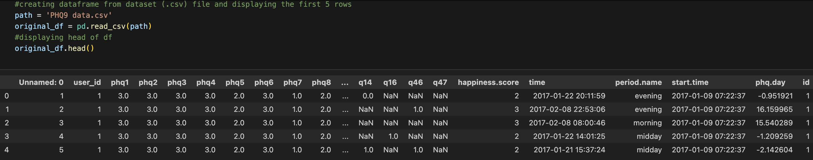
Original CSV

Slide 4
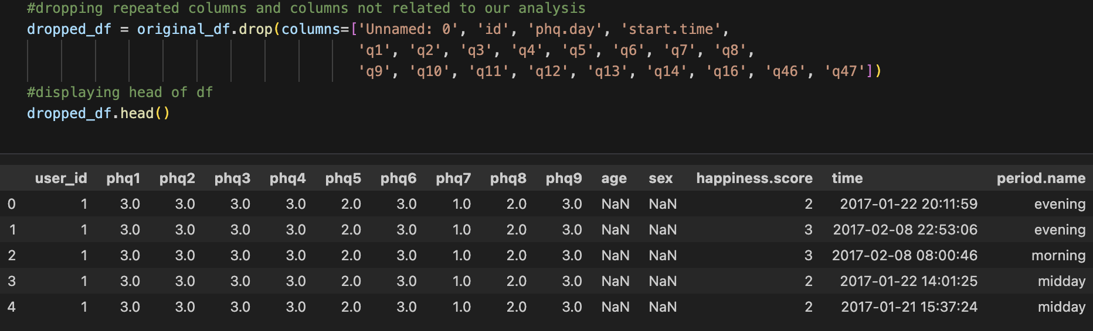
Clean CSV

Slide 5
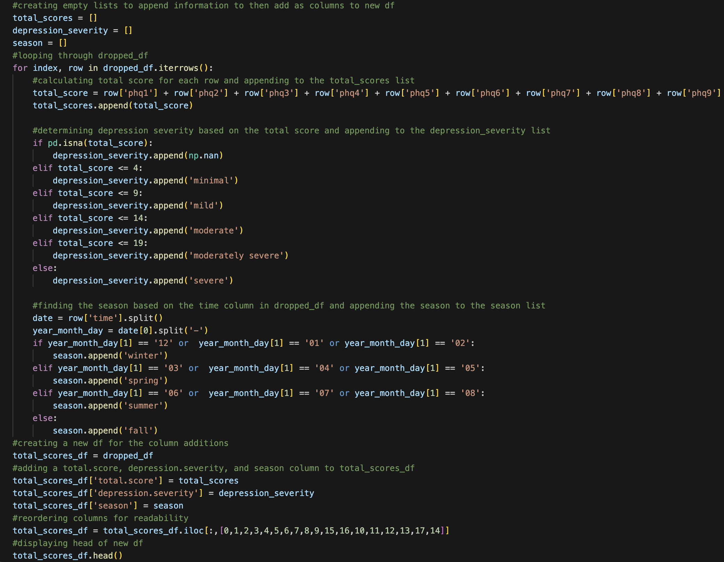
Creating New Data Frame

Slide 6
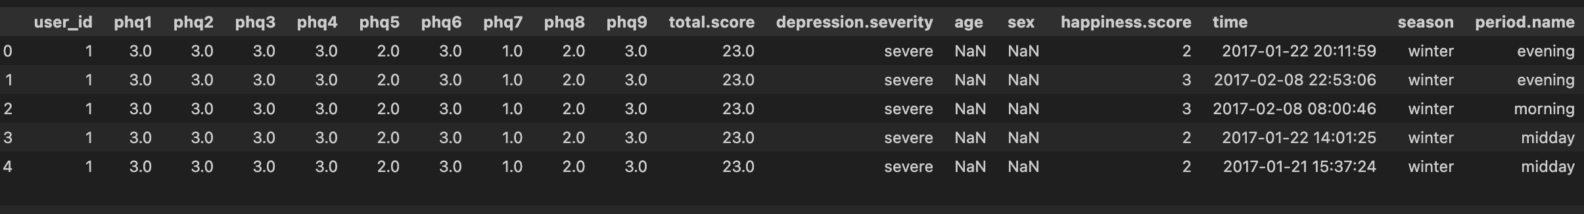
Total Scores Data Frame

Slide 7
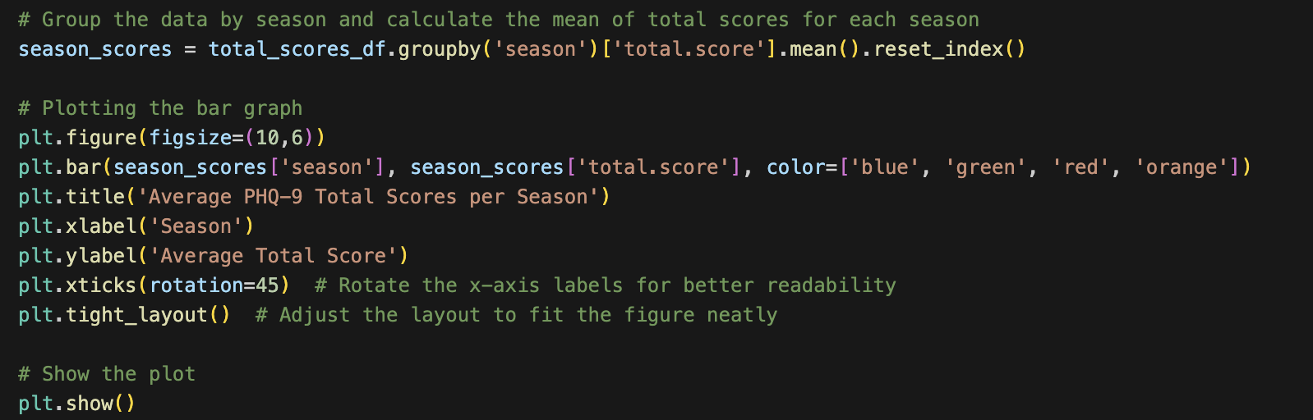
Total Scores Per Season

Slide 8
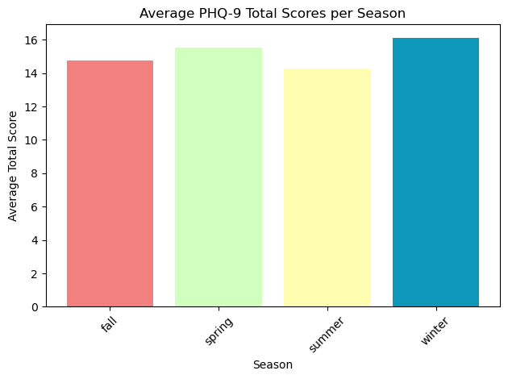
Average PHQ-9 Per Season

Slide 9
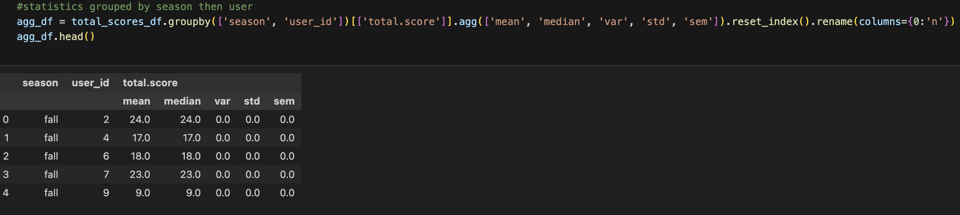
Seasonal Statistics

Slide 10
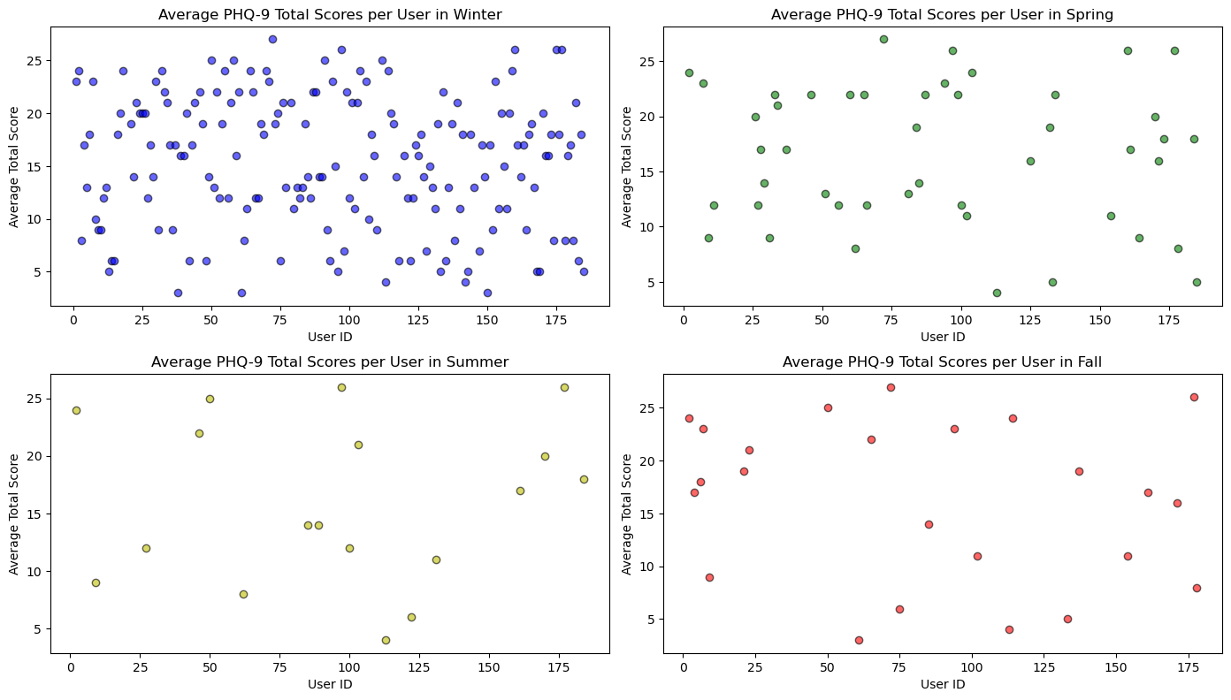
Users Average Scores Per Season

Slide 11
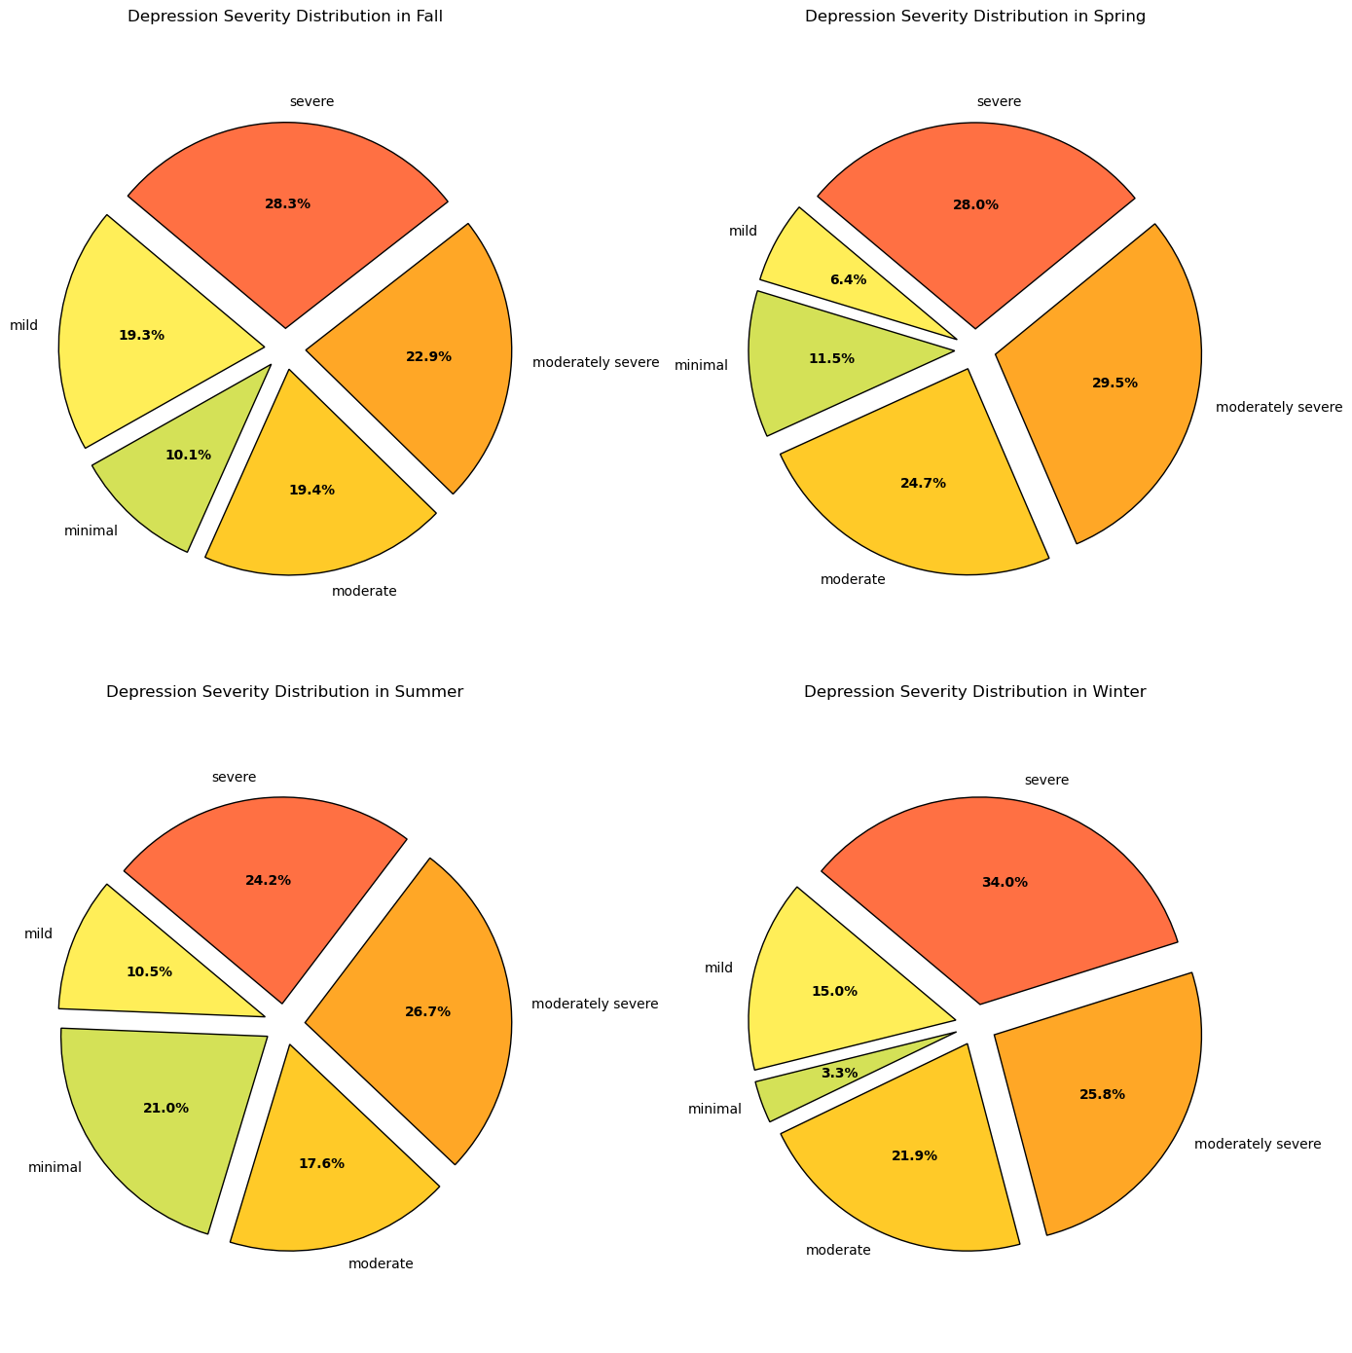
Depression Severity

Slide 12
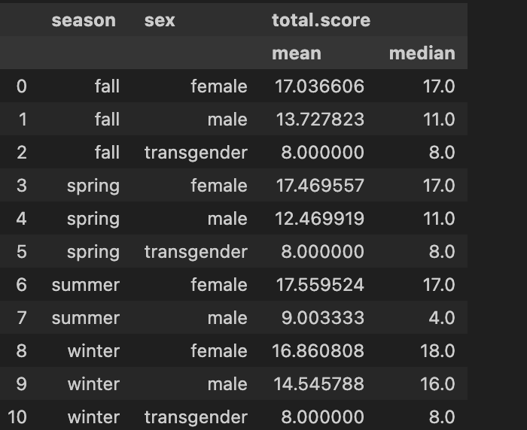
Seasonal Statistics

Slide 13
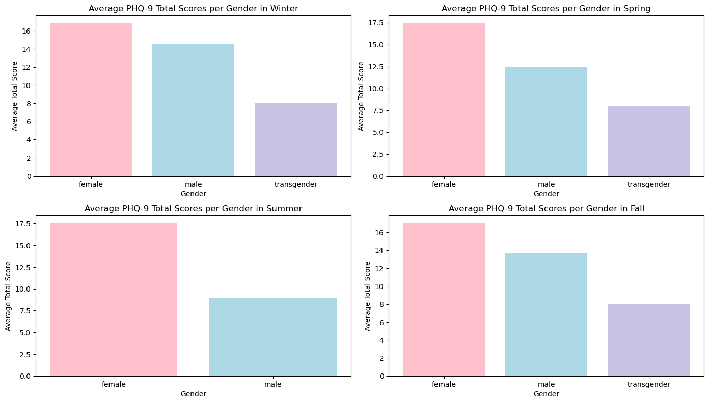
Gender Average PHQ-9 Per Season

Slide 14
Conclusions

Slide 15
Work Cited
Nandy, Subidit. ”Indicators of Anxiety or Depression”. Survey To Obtain Information On The Frequency Of Anxiety And Depression Symptoms. 27 Oct. 2022. https://www.kaggle.com/datasets/subidit/indicators-of-anxiety-or-depression
Patient Health Questionaire (PHQ-9). https://med.stanford.edu/fastlab/research/imapp/msrs/_jcr_content/main/accordion/accordion_content3/download_256324296/file.res/PHQ9%20id%20date%2008.03.pdf

