Slide 1
PHQ-9 ANALYSIS
Using PHQ-9 to Analyze Seasonal Depression
Group 5: Meera Patel, Elaine Kellerman, Ryan Joseph, Mai Le

Slide 2
Hypothesis
Do individuals have higher PHQ-9 scores, indicating more severe depressive symptoms, during the winter season compared to other seasons?
Does time of day (morning, midday, or evening) affect the total score over the seasons?
Does age affect the score?
Does sex affect the score?

Slide 3
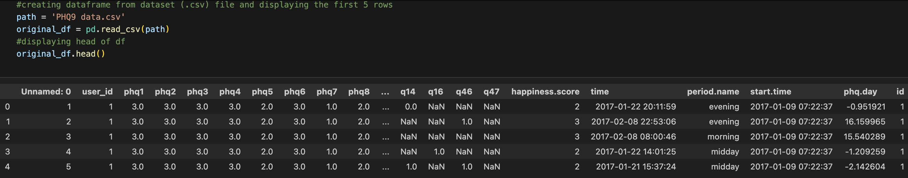
Original CSV

Slide 4
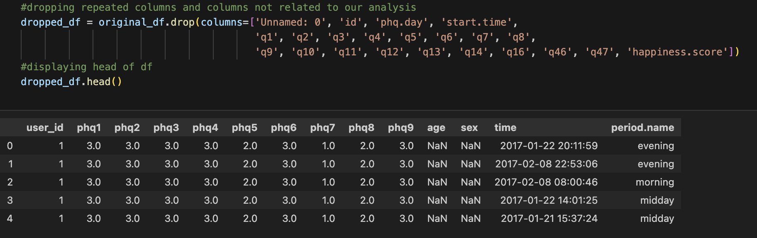
Clean CSV

Slide 5
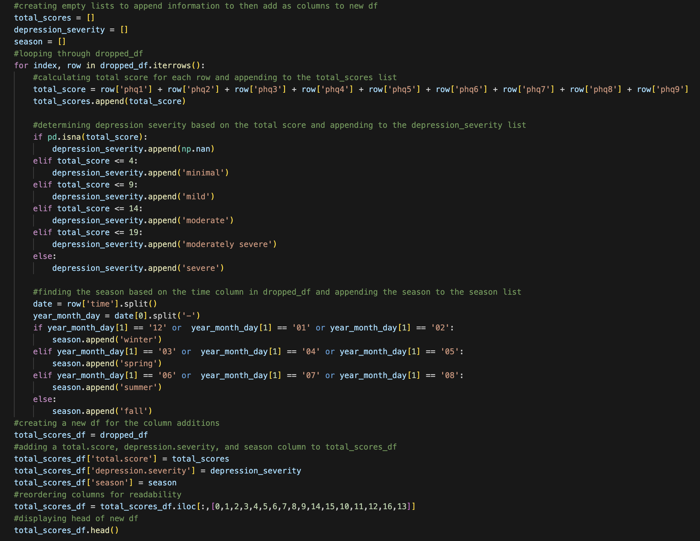
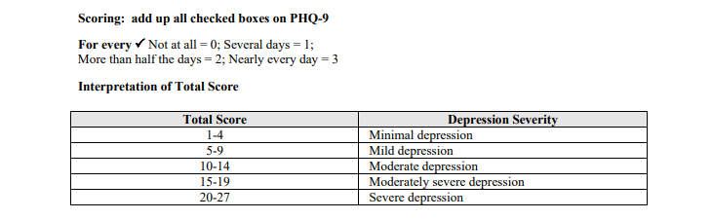
Creating New Data Frame

Slide 6
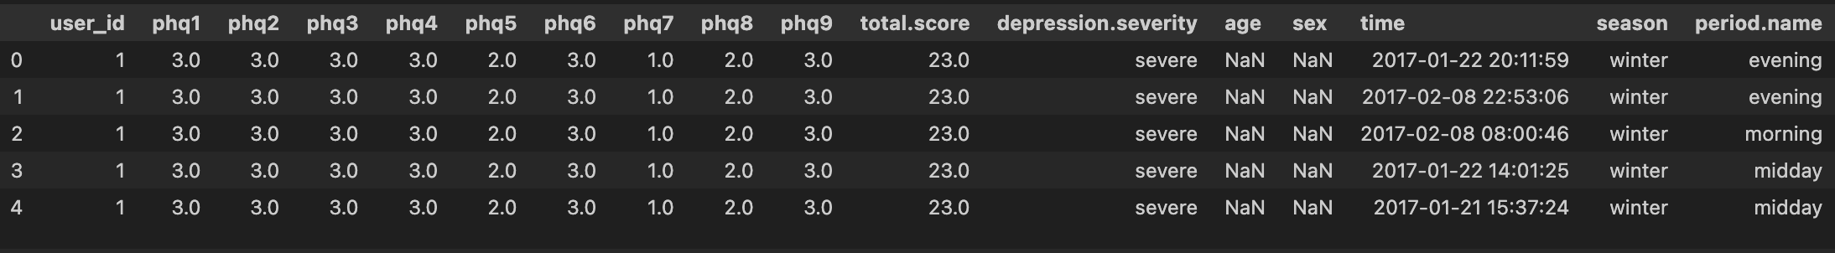
Total Scores New Data Frame

Slide 7
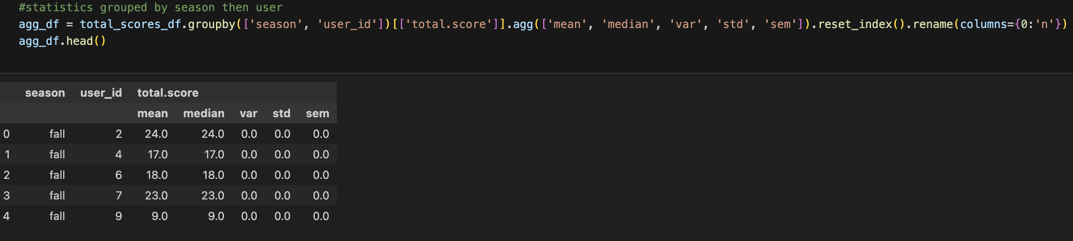
Seasonal Statistics

Slide 8
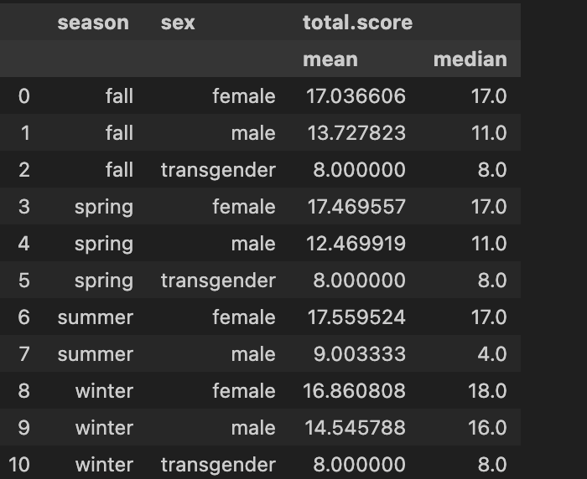
Seasonal Statistics by Gender

Slide 9
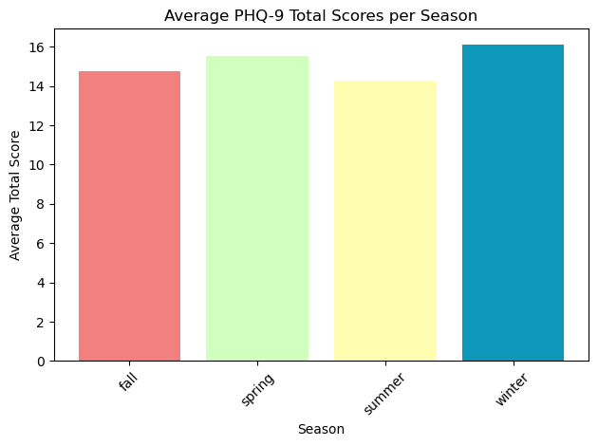
Average PHQ-9 Per Season

Slide 10
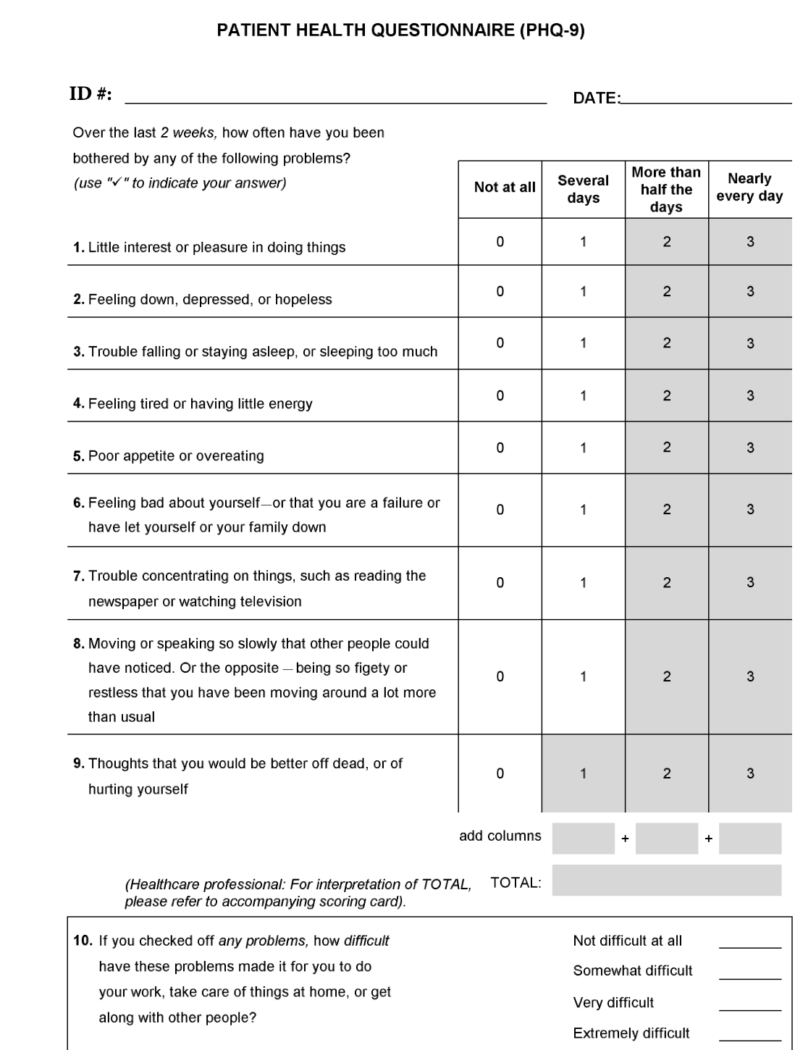
Patient Health Questionnaire

Slide 11
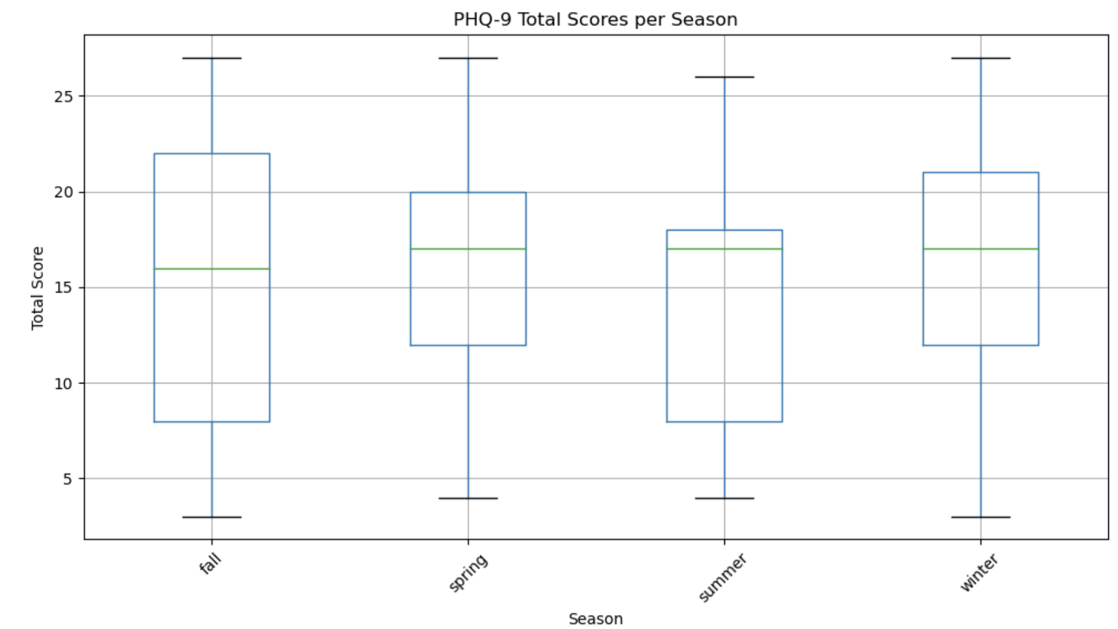
Total Scores Per Season

Slide 12
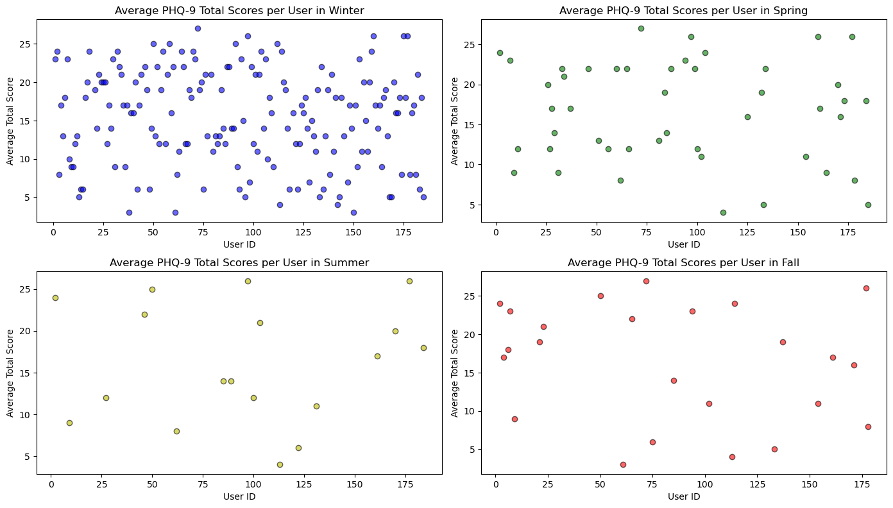
Users Average Scores and User ID Per Season

Slide 13
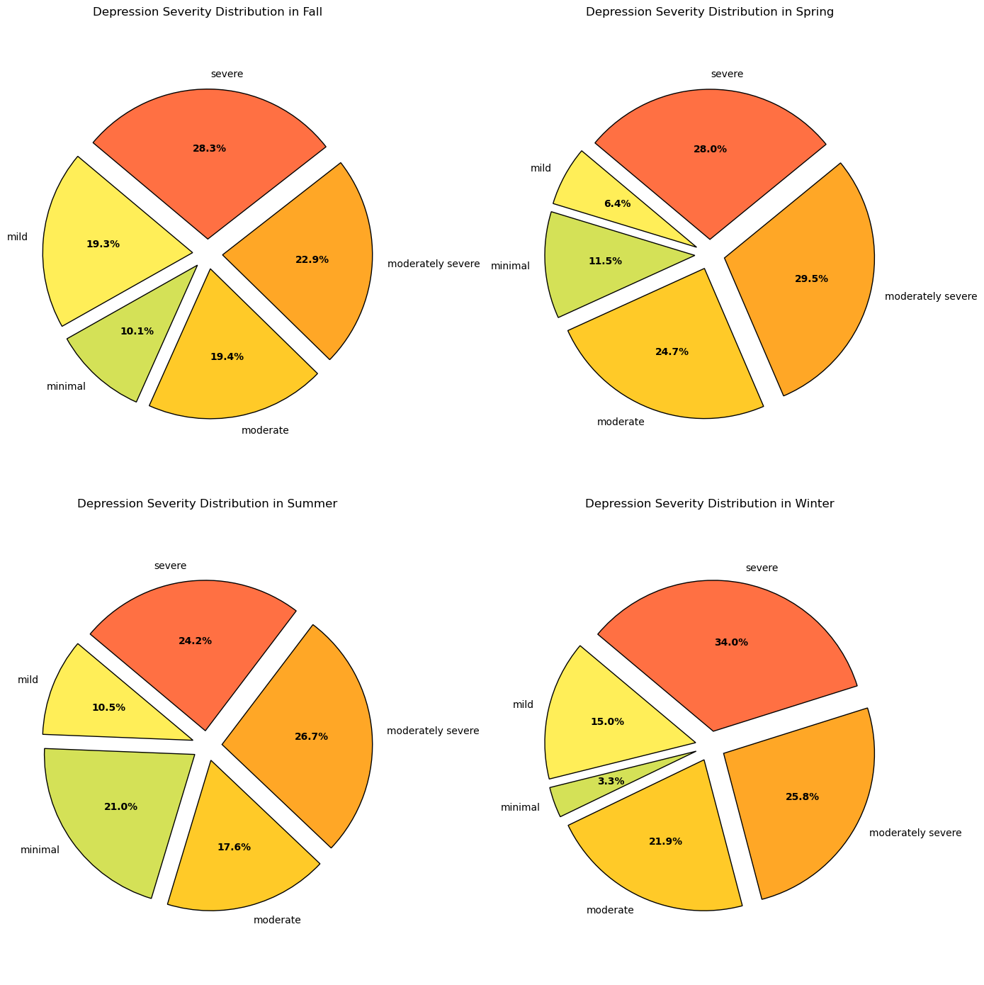
Depression Severity

Slide 14
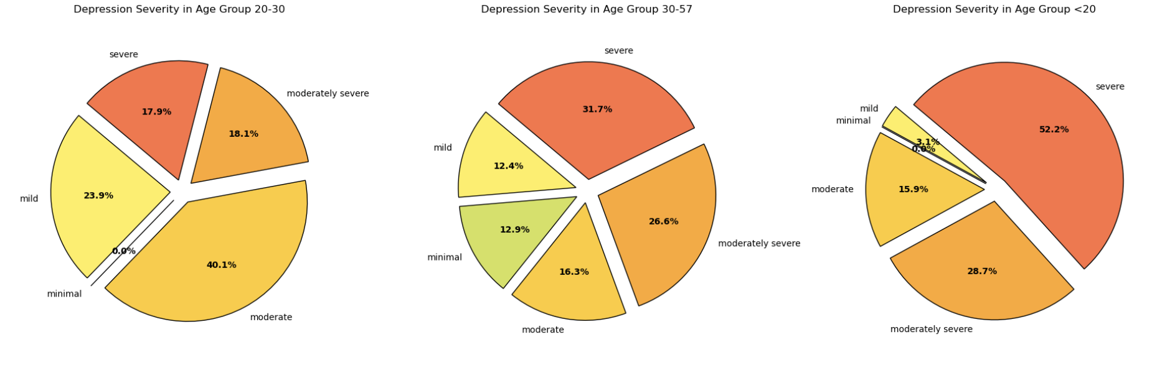
DEPRESSION SEVERITY AGE GROUP

Slide 15
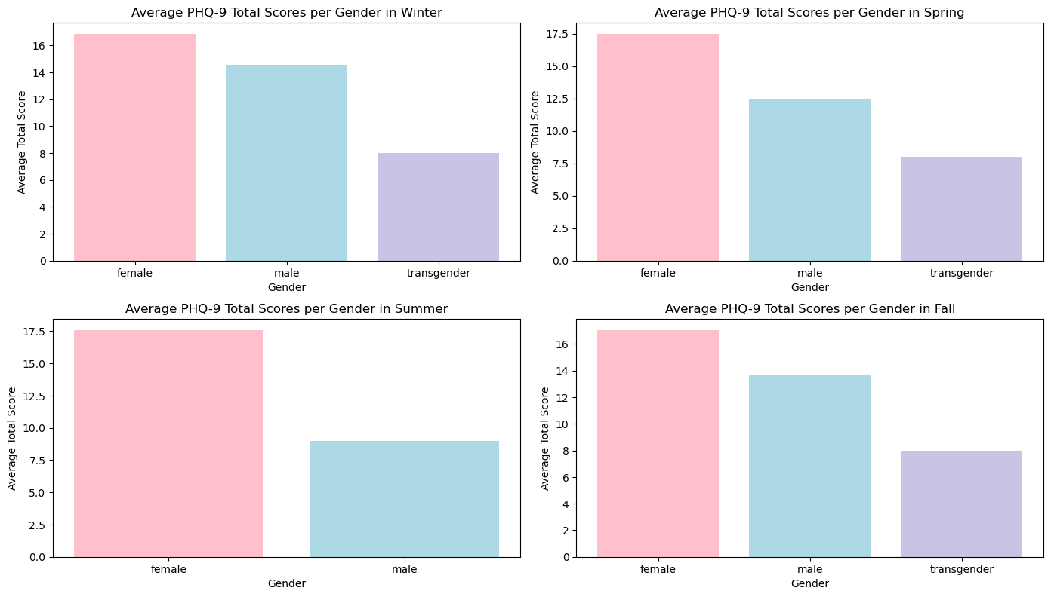
Gender Average PHQ-9 Per Season

Slide 16
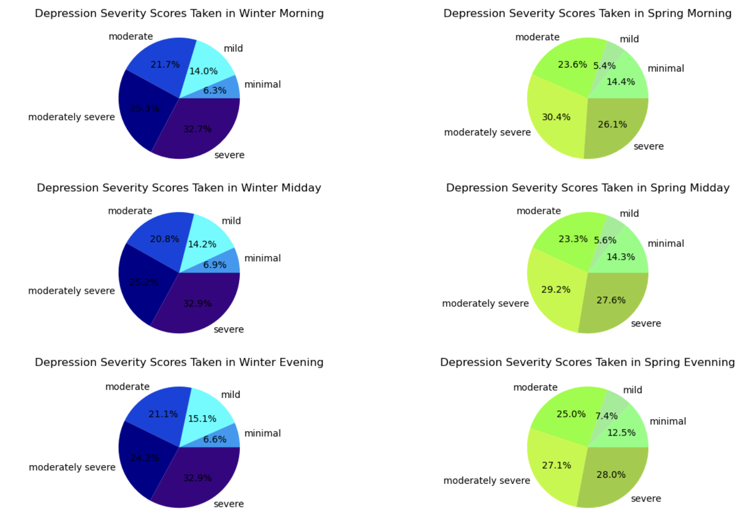
Depression Severity by Time

Slide 17
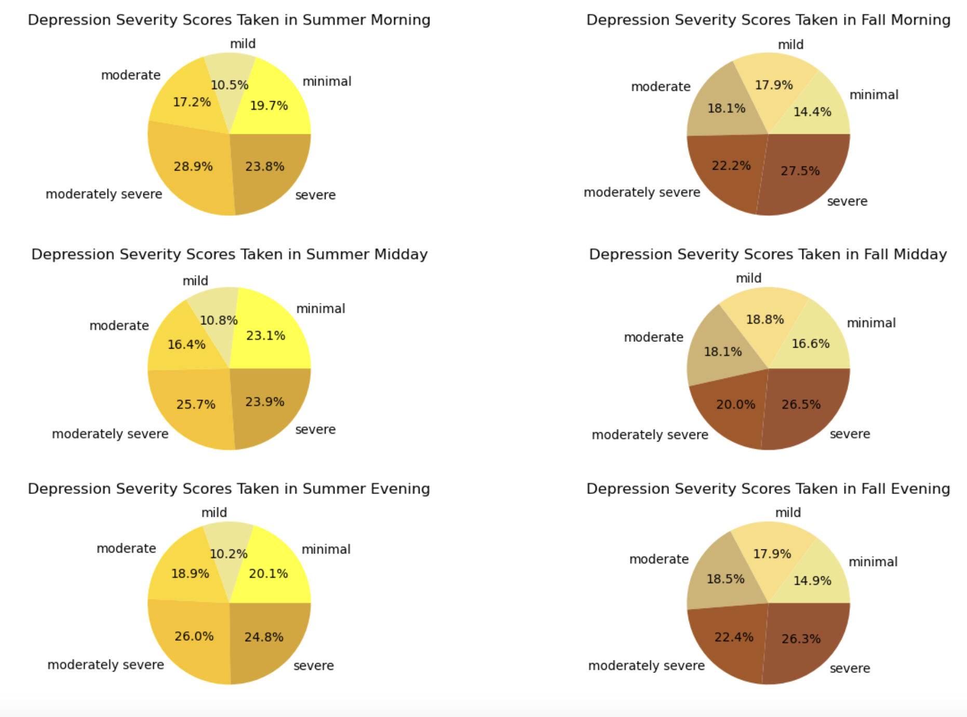
Depression Severity by Time

Slide 18
Analysis Conclusions

Slide 19
Work Cited
Burchert, Sebastian, et al. ”14-Day Smartphone Ambulatory Assessment Of Depression Symptoms And Mood Dynamics In A General Population Sample: Comparison With The PHQ-9. 3 Sept. 2019. https://zenodo.org/records/3384860#.Y8OrbdJBwUE
PHQ-9 Depression Assesment. 14-Days Of Ambulatory Mood Dynamics In A General Population. n.d. https://www.kaggle.com/datasets/thedevastator/phq-9-depression-assessment
Patient Health Questionaire (PHQ-9). https://med.stanford.edu/fastlab/research/imapp/msrs/_jcr_content/main/accordion/accordion_content3/download_256324296/file.res/PHQ9%20id%20date%2008.03.pdf

