Slide 1
PHQ-9 ANALYSIS
Using PHQ-9 to Analyze Seasonal Depression
Group 5: Meera Patel, Elaine Kellerman, Ryan Joseph, Mai Le

Slide 2
Hypothesis
Do individuals have higher PHQ-9 scores, indicating more severe depressive symptoms, during the winter season compared to other seasons?
Does time of day (morning, midday, or evening) affect the total score over the seasons?
Does age affect the score?
Does sex affect the score?

Slide 3
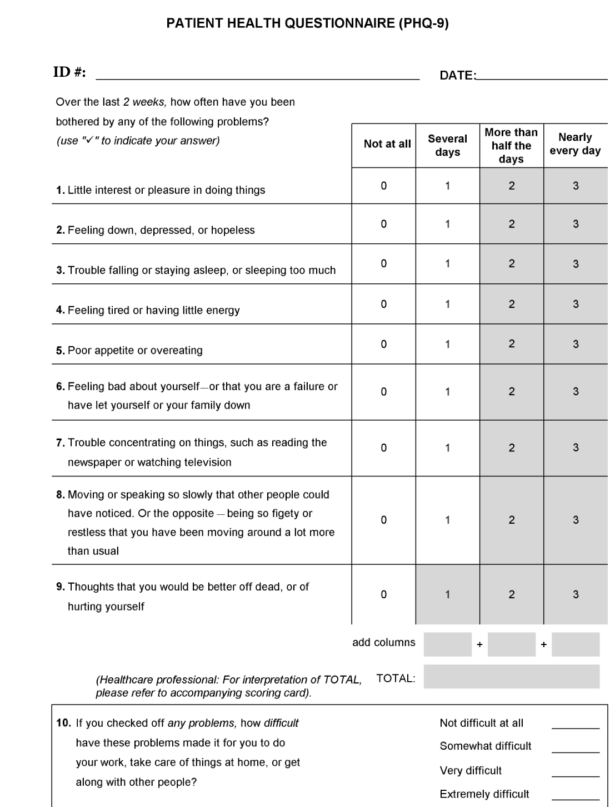
Patient Health Questionnaire

Slide 4
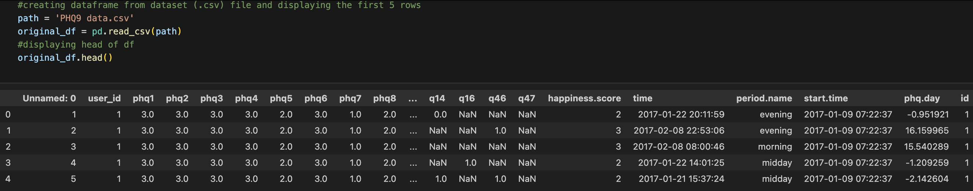
Original CSV

Slide 5
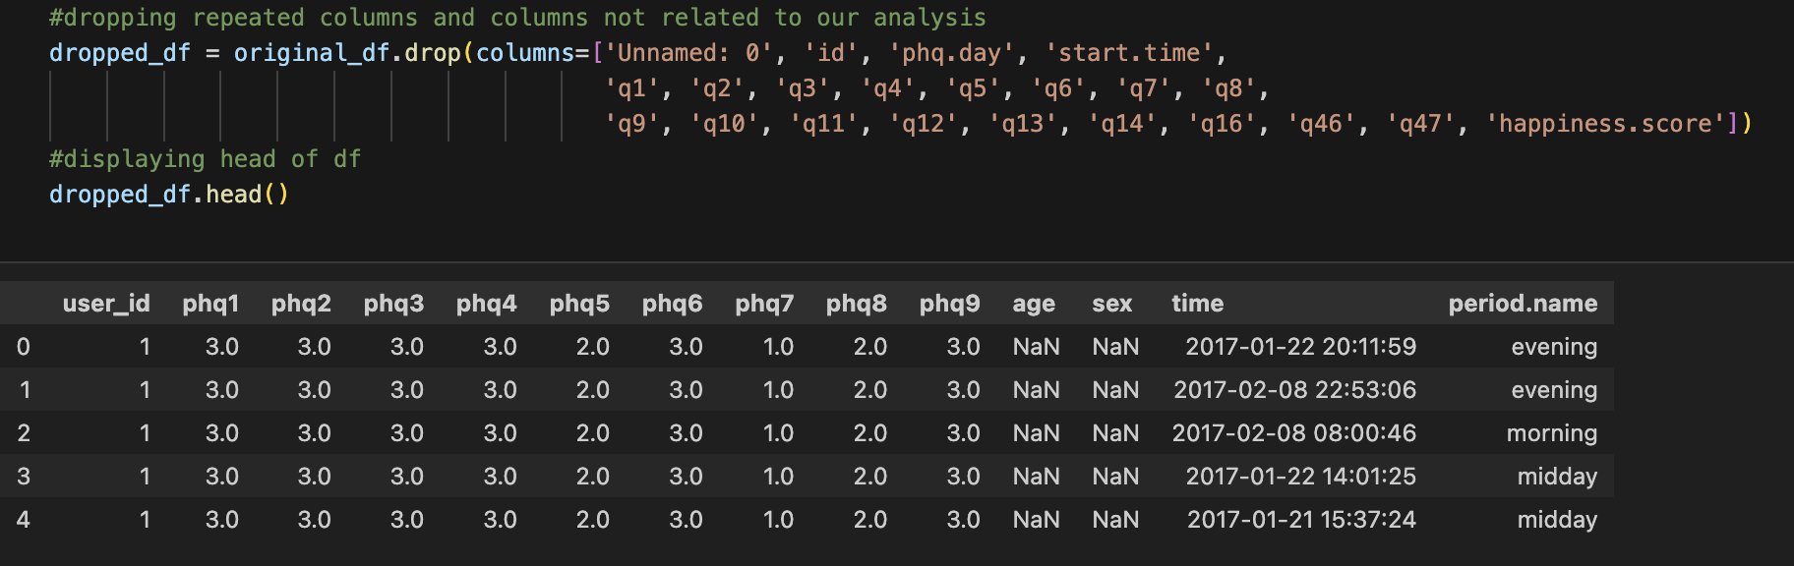
Clean CSV

Slide 6
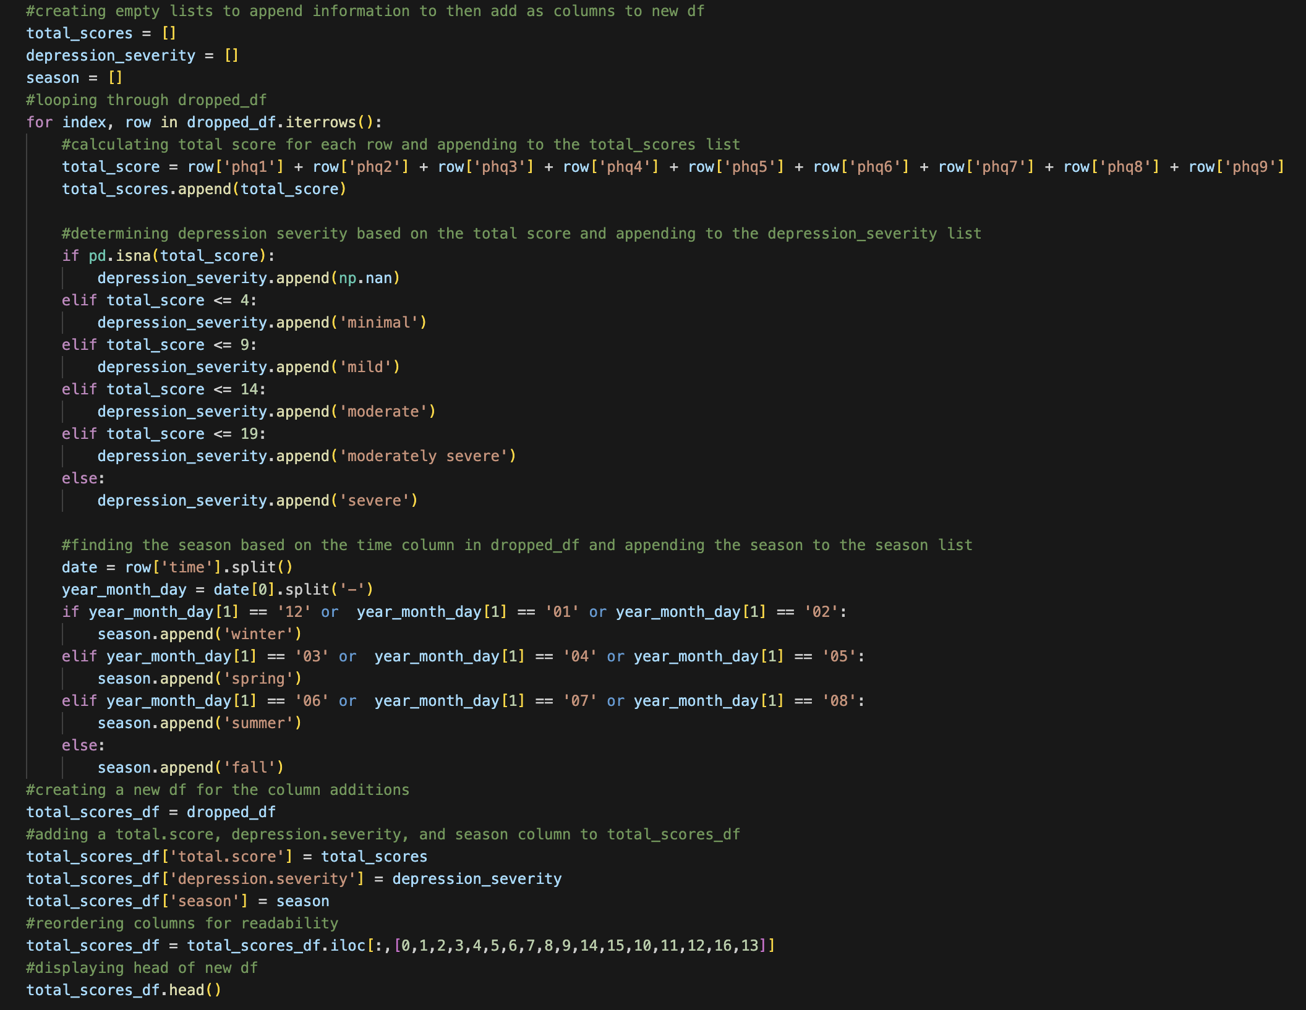
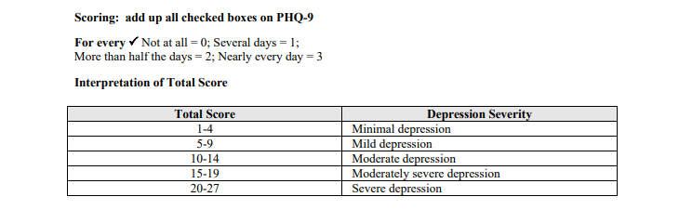
Creating New Data Frame

Slide 7
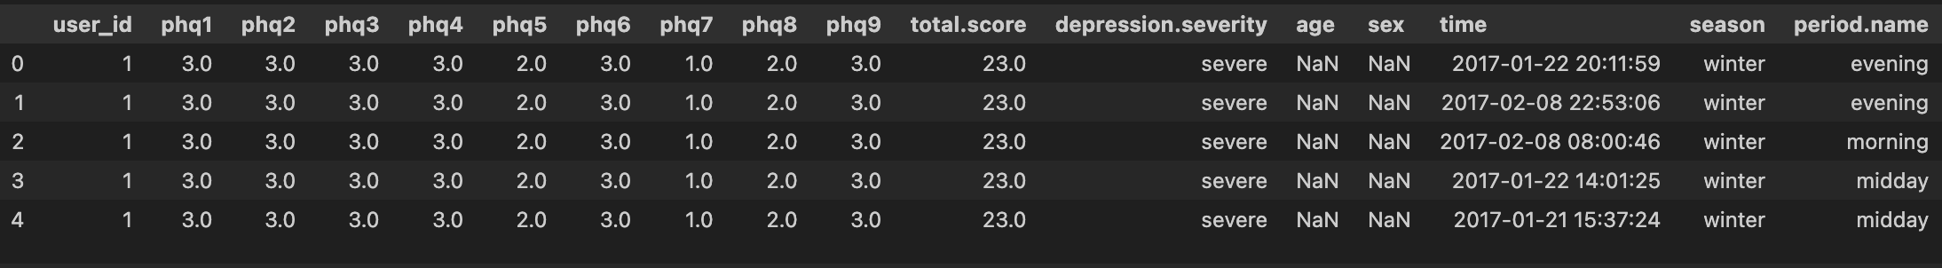
Total Scores New Data Frame

Slide 8
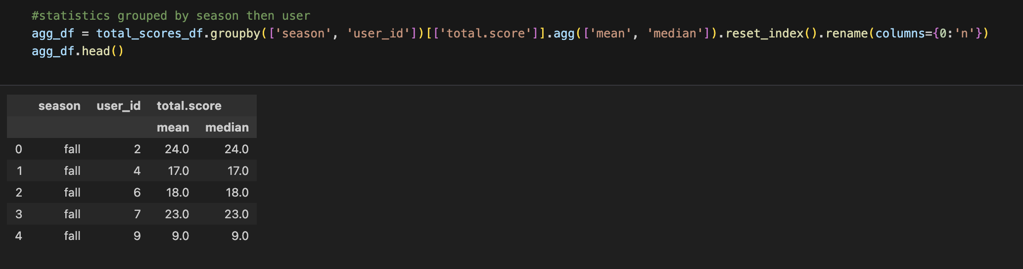
Seasonal Statistics

Slide 9
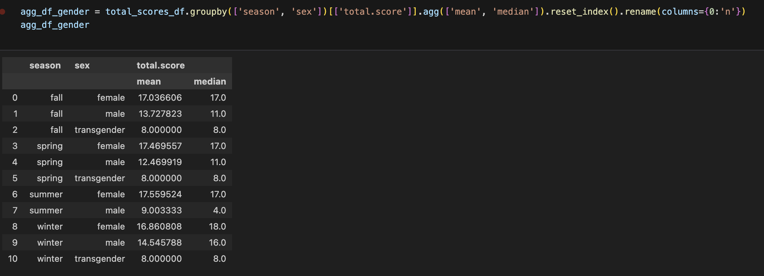
Seasonal Statistics by Gender

Slide 10
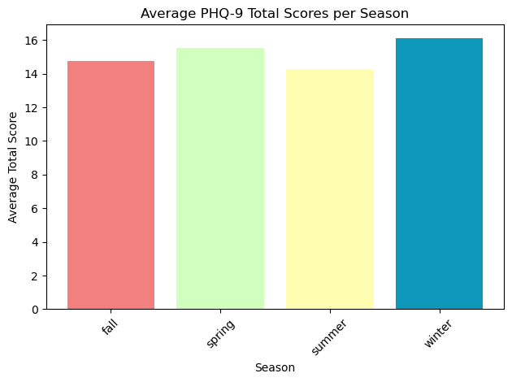
Average PHQ-9 Per Season

Slide 11
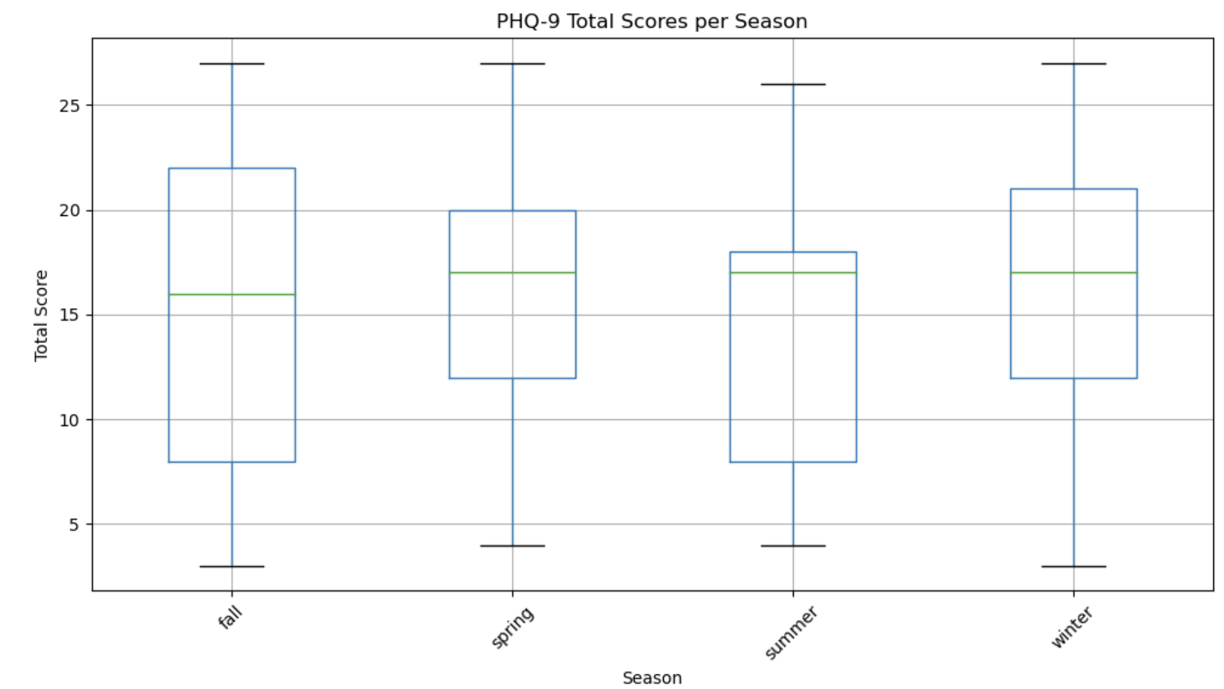
Total Scores Per Season

Slide 12
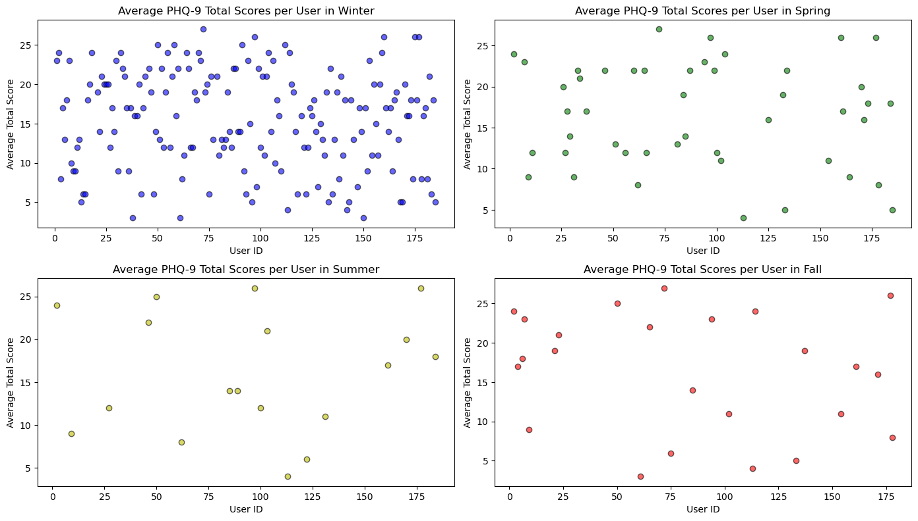
Users Average Scores and User ID Per Season

Slide 13
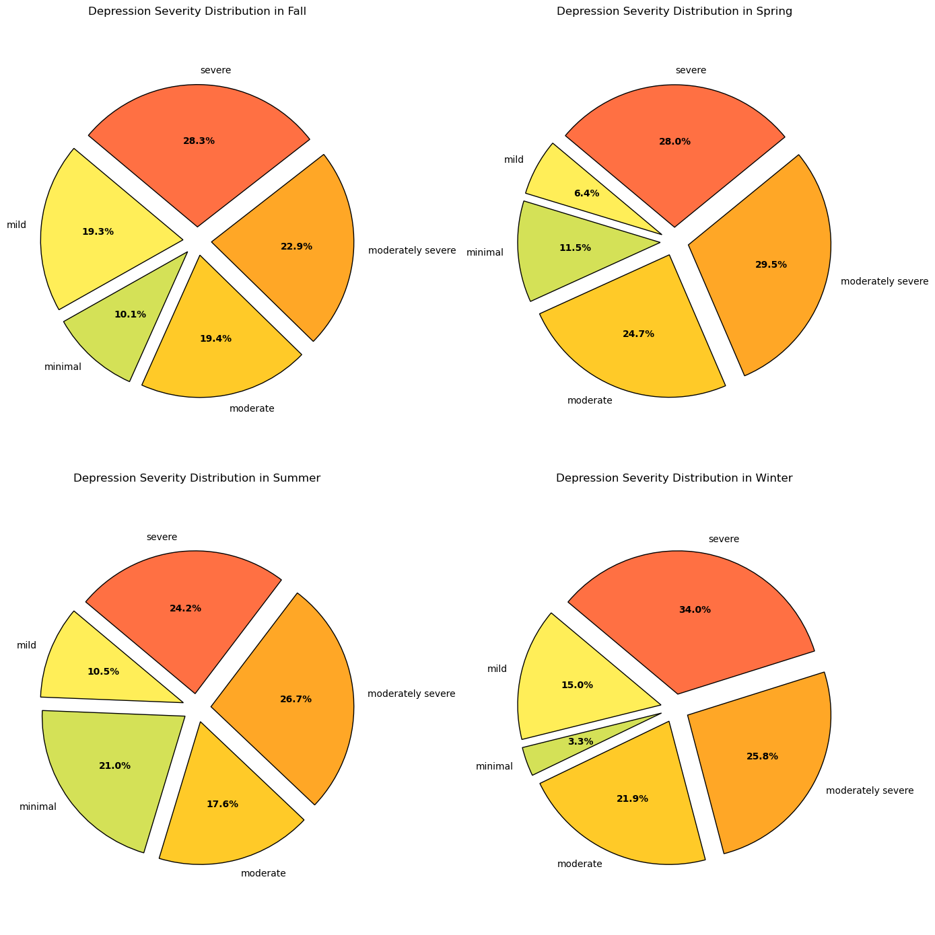
Depression Severity

Slide 14
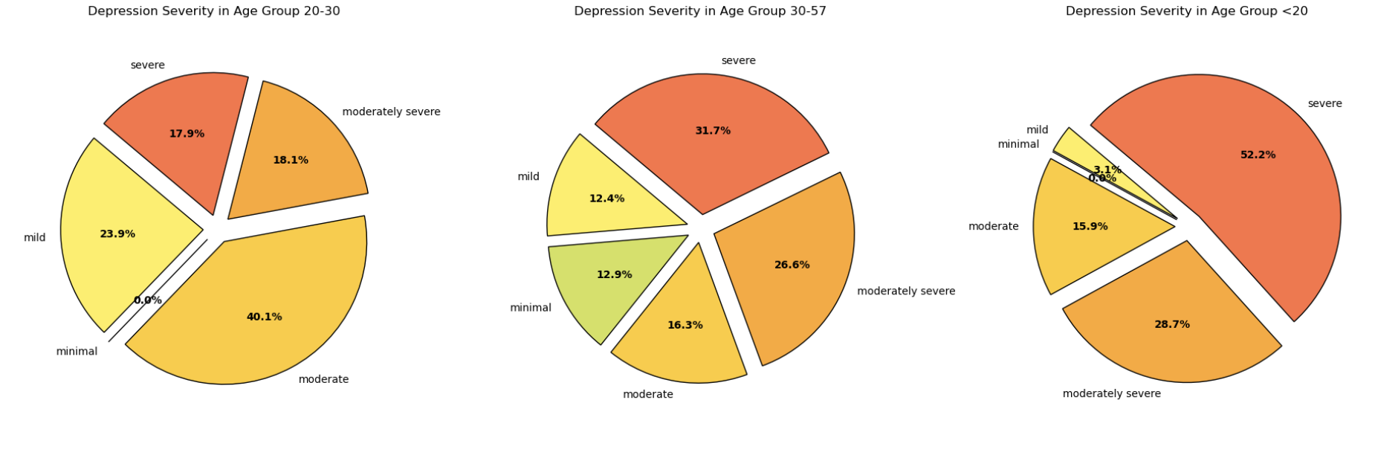
DEPRESSION SEVERITY AGE GROUP

Slide 15
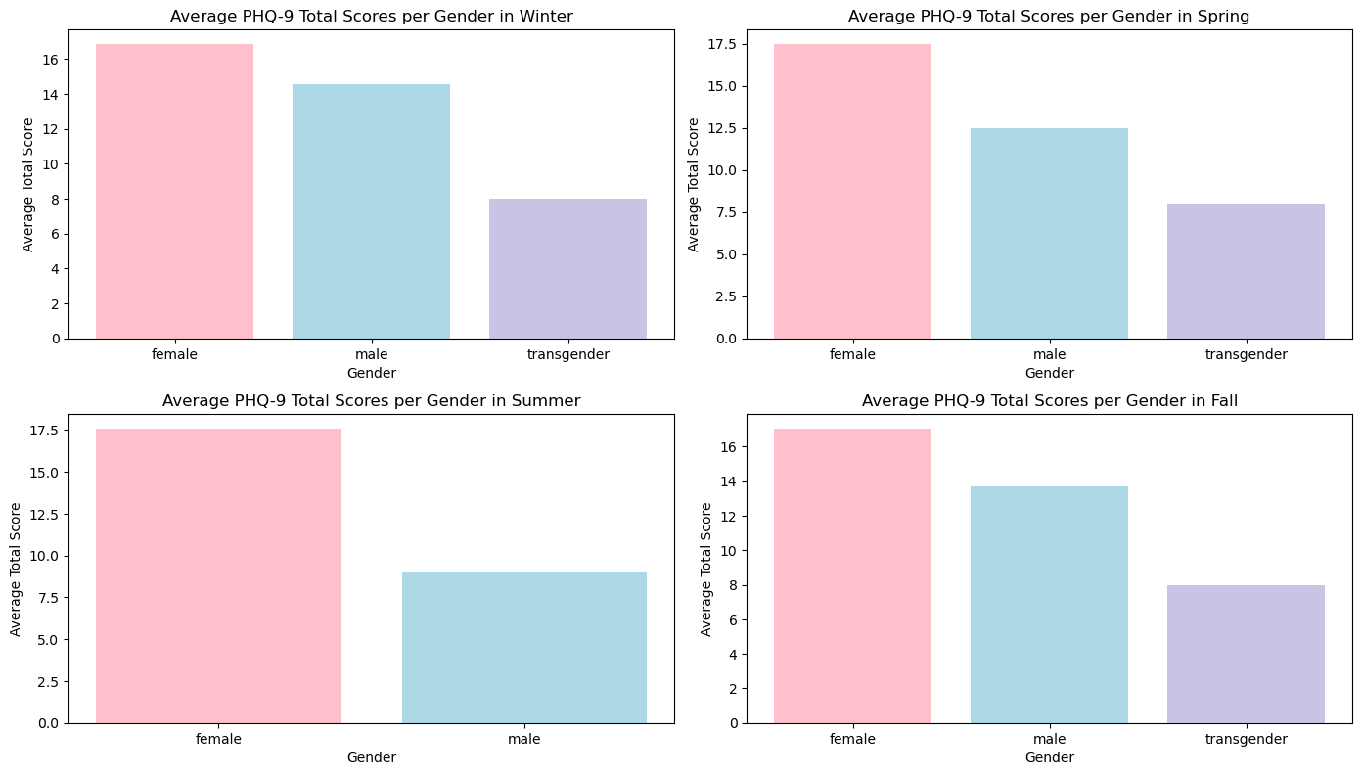
Gender Average PHQ-9 Per Season

Slide 16
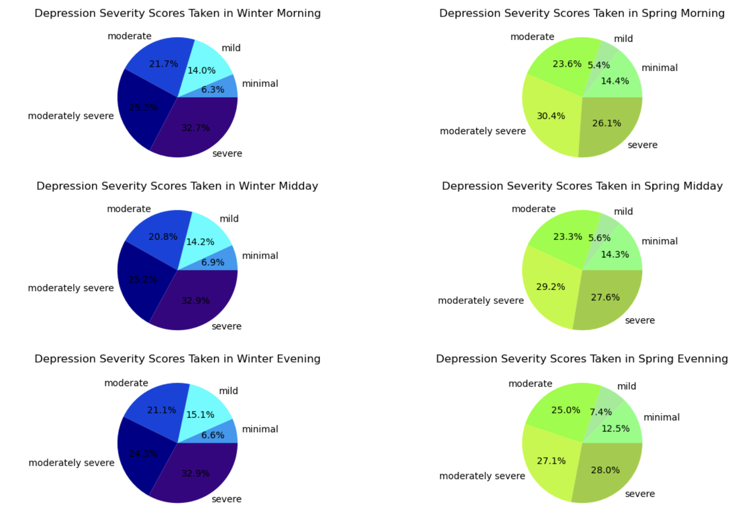
Depression Severity by Time

Slide 17
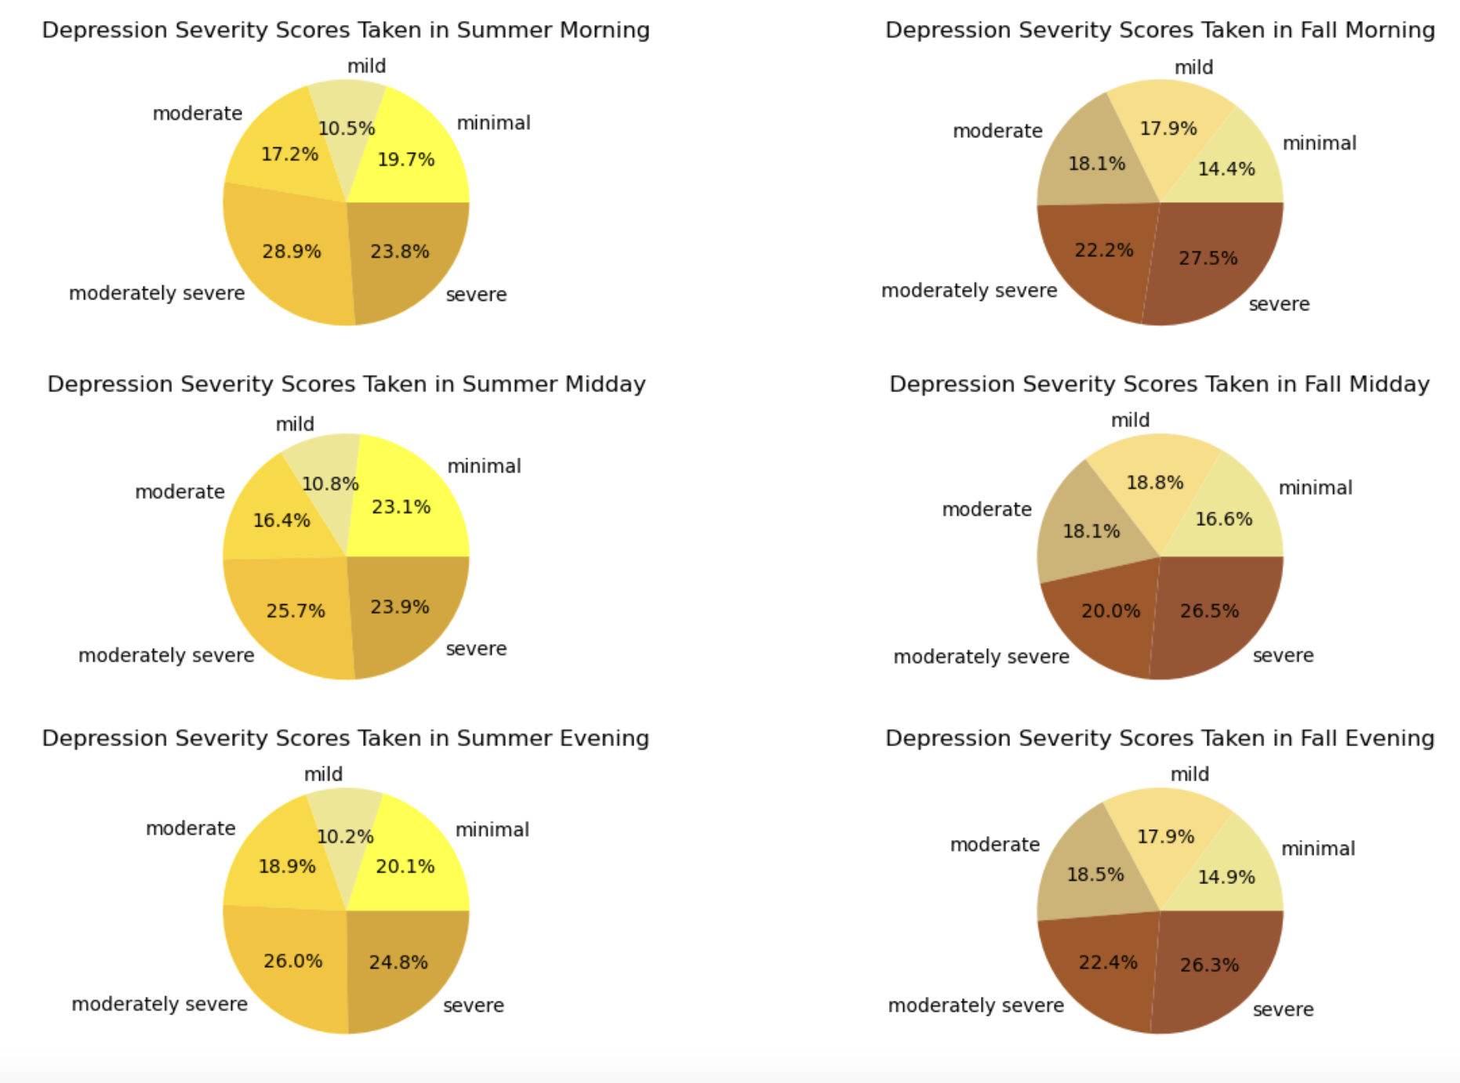
Depression Severity by Time

Slide 18
Analysis Conclusions
This dataset show to be true with the the current hypothesis. Even though the differences in the statistic numbers might seem small, this can be explained due to the small sample size and short testing period.
The consistent trend of higher depressive severity in the winter months compare to the summer months is seen throughout the data analysis. Gender identity and time period assessment was taken also played an important part in the depression fluctuation.
Since there are many complex factors that could also influence mental health, a larger population size will allow for a more significant differences in the statistic.

Slide 19
Work Cited
Burchert, Sebastian, et al. ”14-Day Smartphone Ambulatory Assessment Of Depression Symptoms And Mood Dynamics In A General Population Sample: Comparison With The PHQ-9. 3 Sept. 2019. https://zenodo.org/records/3384860#.Y8OrbdJBwUE
PHQ-9 Depression Assesment. 14-Days Of Ambulatory Mood Dynamics In A General Population. n.d. https://www.kaggle.com/datasets/thedevastator/phq-9-depression-assessment
Patient Health Questionaire (PHQ-9). https://med.stanford.edu/fastlab/research/imapp/msrs/_jcr_content/main/accordion/accordion_content3/download_256324296/file.res/PHQ9%20id%20date%2008.03.pdf

