Slide 1




GUVI - Naan Mudhalvan
Engineering Hackathon 2025
www.guvi.in

Slide 2
PROBLEM STATEMENT
Brands are constantly scrutinized on platforms like Twitter, Instagram, and Facebook. User opinions spread rapidly and often affect a company's public image and stock prices. Manually tracking every post or tweet is impractical. Traditional tools often miss sarcasm, emojis, and code-switched text. A negative post going viral can severely harm a brand's reputation. Companies want to gauge public sentiment in real time and act on it immediately. Crisis management relies heavily on early warning systems. Sentiment trends can also guide product development and marketing campaigns. The challenge lies in accurately classifying posts that use slang, abbreviations, or subtle emotional tones. Multilingual sentiment detection adds complexity. A real-time dashboard that reflects public sentiment dynamically will be invaluable to PR teams and brand managers.
Learning Programs
www.guvi.in

Slide 3
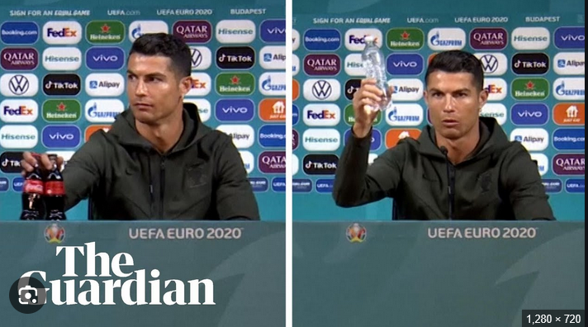
Learning Programs
www.guvi.in

Slide 4
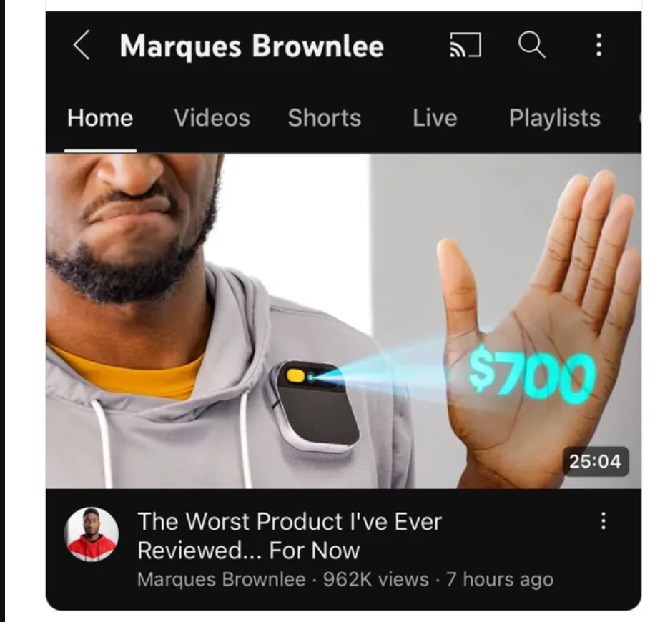
Learning Programs
www.guvi.in

Slide 5
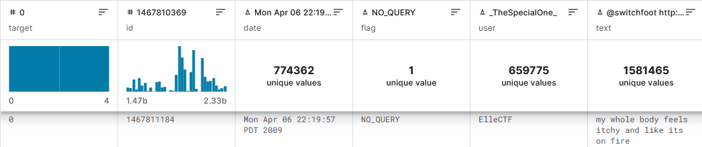
Learning Programs
www.guvi.in

Slide 6
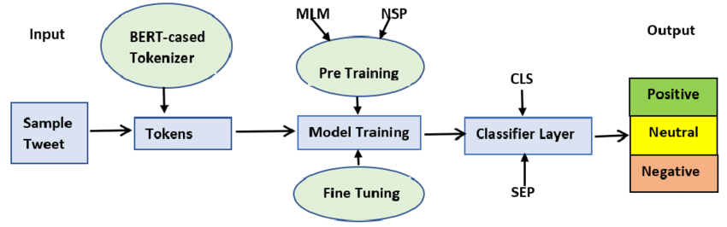
WHY DistilBERT?
Learning Programs
www.guvi.in

Slide 7
Feature | Advantage
40% smaller | Faster inference (ideal for real-time)
60% faster | Lower latency in dashboards
95% BERT accuracy | No major compromise in performance
Lightweight(half the layers) | Can be deployed on low-resource systems
Learning Programs
www.guvi.in

Slide 8
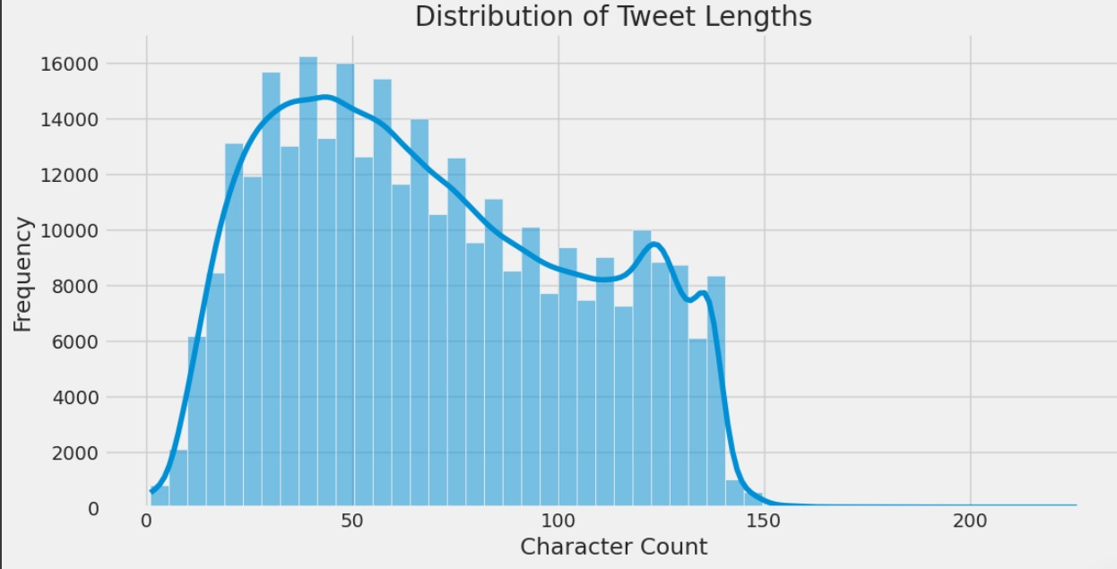
Learning Programs
www.guvi.in

Slide 9
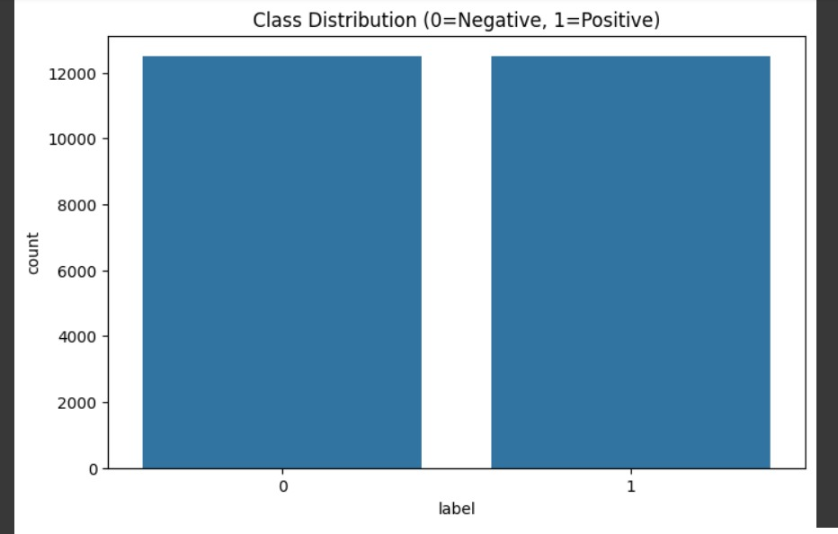
Learning Programs
www.guvi.in

Slide 10
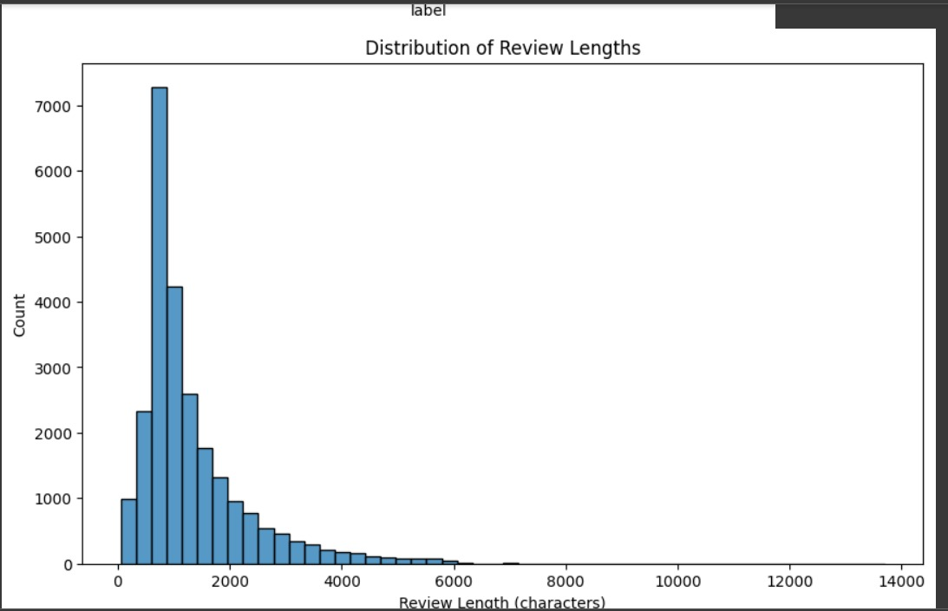
Learning Programs
www.guvi.in

Slide 11
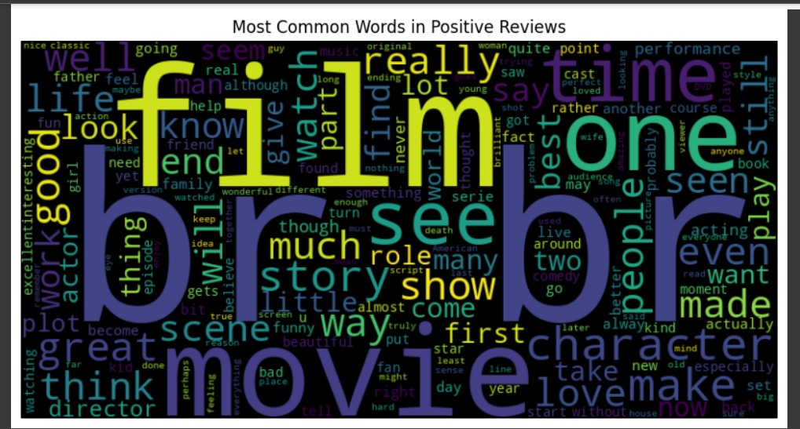
Learning Programs
www.guvi.in

Slide 12
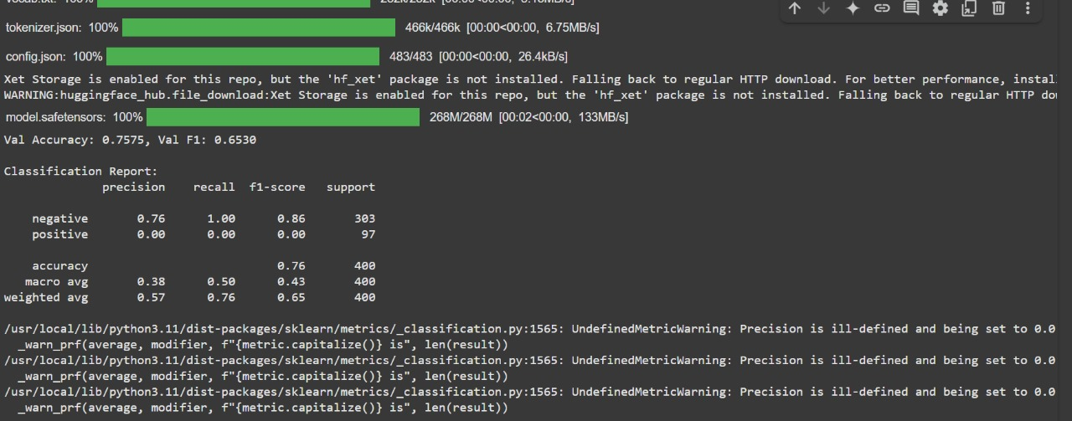
Learning Programs
www.guvi.in

Slide 13
IMPACTS
Brand Reputation Management
Crisis Response and Early Warning System
Strategic Marketing Insights
Stock Market and Investor Sentiment
TECHNIQUES
BERT Tokenization
Transfer Learning
Text Preprocessing
Sentiment Classification Layer
Multilingual Support
Learning Programs
www.guvi.in

Slide 14
OPTIMISATIONS
Model Distillation (Smaller Models)
Batch Size Tuning
Mixed Precision Training (Use FP16 instead of FP32 to reduce memory)
Learning Rate Warm-up and Decay
Learning Programs
www.guvi.in

Slide 15

FUTURE SCOPE
Learning Programs
www.guvi.in

Slide 16
Thank You
www.guvi.in

