Slide 1
Education spending & literacy in rural Punjab
MEERAB BABAR | FA24-BEDS-108
Evidence from Rural Punjab
PSLM 2019–20 Household Survey
35,925
24,630
9,713
Survey participants
People aged 10-64
Students with education spending
Notes:
Say: I work on variant 0, which is rural Punjab, using the 2019-20 PSLM survey. I ask two questions: how much do households spend on each student, and how does the ability to read change with age for women and men. I have 35,925 people, of whom 24,630 aged 10 to 64 are used for literacy and 9,173 are students with spending.

Slide 2
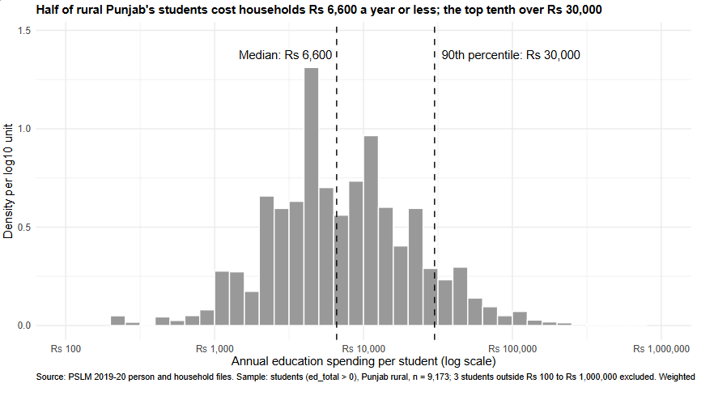
Most households spend Rs 2,000 to Rs 30,000 a year on one student
What the chart shows
Each bar is a group of students with similar spending. Spending is shown on a log scale, so each step is 10 times bigger. There are two humps and a long tail of high spenders.
The typical student
The middle student costs Rs 6,600 a year: half of students cost less, half cost more. (Without weights it would be Rs 7,000.)
The gap between families
The poorest-spending tenth stay under Rs 2,000 and the top tenth pay over Rs 30,000. That is 15 times as much. Only 3 students fell outside the chart.
Notes:
Say: This histogram shows annual spending on each student. I used a log scale because spending ranges from hundreds to hundreds of thousands of rupees. The dashed lines are the median, Rs 6,600, and the 90th percentile, Rs 30,000. The weighted median is a little lower than the unweighted one, Rs 7,000, because higher-spending students come from households with slightly smaller survey weights. The 90th percentile is 15 times the 10th, so spending varies a lot between families.

Slide 3
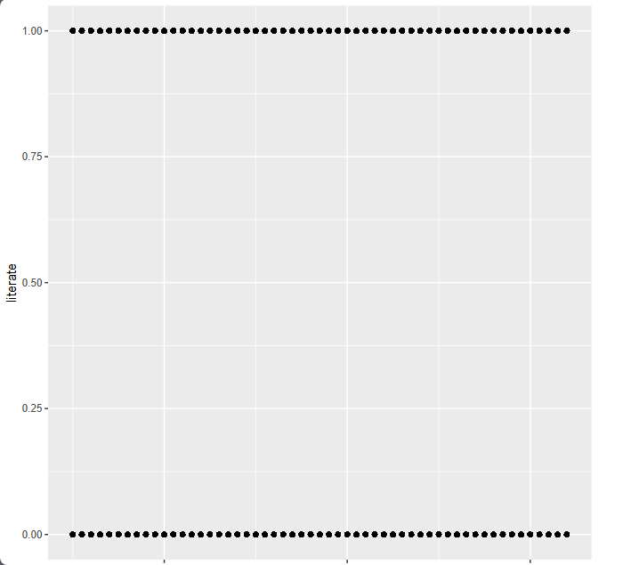
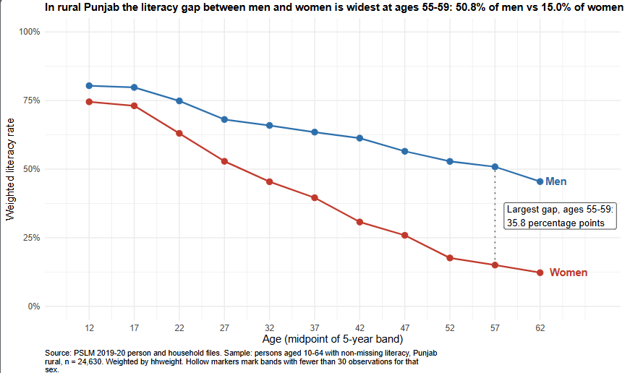
The makeover: from a cloud of dots to a clear story
Before: R default
After: my redesign
The problem
The fix
24,630 dots sit on top of each other at 0 and 1, so you cannot see any trend.
Each point is the share of people who can read in one age group, for women and men.
Conditional means
Common scale
Less ink
Rates per age band replace raw dots.
Position on one axis, two colours.
Labels on the lines, no legend.
Notes:
Say: On the left is R's default plot of literacy against age. Every person is a dot at 0 or 1, so thousands of dots overlap and no pattern is visible. On the right is my redesign. I made three changes. First, I used conditional means: the weighted literacy rate for each age band and sex. Second, I used a common vertical scale with two colours, because position is the easiest thing for the eye to compare. Third, I removed extra ink: no legend, labels directly on the lines, and a title that states the finding. The default shows every individual person, which my redesign hides.

Slide 4
Women and men start almost equal, then the gap grows with age
6.7 points
35.8 points
gap at ages 15-19: 73.1% of women and 79.8% of men can read
gap at ages 55-59, the widest: 15.0% of women and 50.8% of men can read
How to read it
What it cannot tell us
Older women probably had far less chance to go to school. This looks like a difference between generations, not people losing the skill.
We see only one survey year, so we cannot separate getting older from being born earlier.
At ages 55-59 only about 15 in 100 rural Punjab women can read, against about 51 in 100 men.
Notes:
Say: My most important finding is about literacy by age. At 15 to 19, the gap is small: 73.1 percent of women and 79.8 percent of men can read. By 55 to 59 it is 35.8 points: 15 percent of women against about 51 percent of men. As an economist I read this as a generation effect, because older women had much less access to school. What the figure cannot tell us is whether literacy changes with age or only differs between birth cohorts, because it is a single survey year.

Slide 5
THANK YOU!
ECONOMICS . EDUCATION . PAKISTAN
PSLM DATA ANALYSIS • PUNJAB RURAL
FA24-BEDS-108 | Meerab Babar

