Slide 1
ABC Orthodontics
Ryan, Alaina, Meerab, Omar

Slide 2
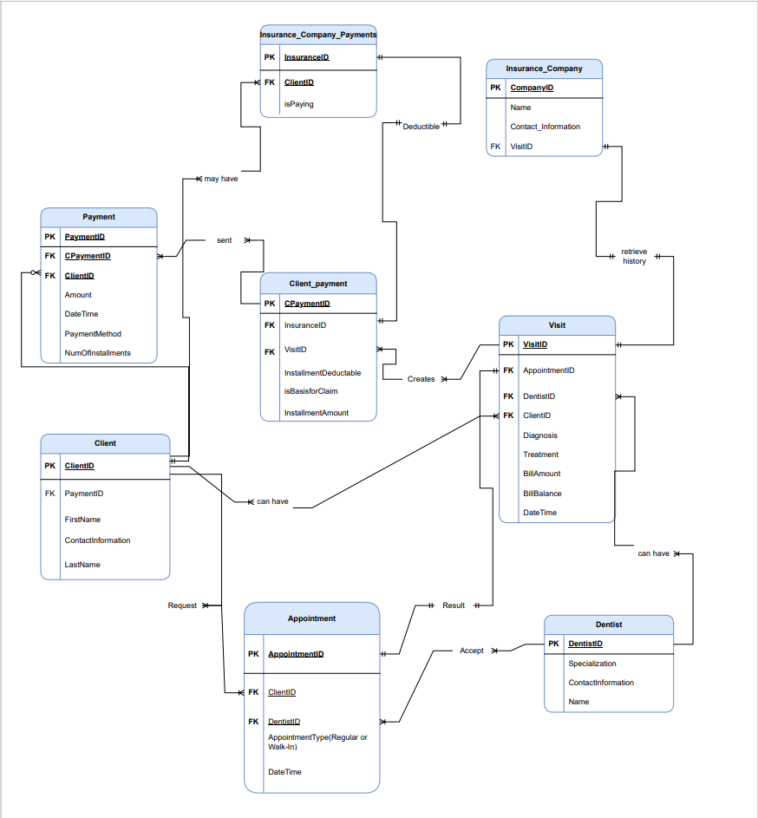
ERD diagram

Slide 3
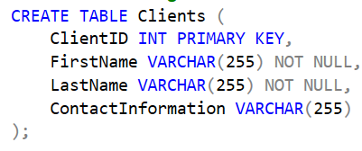
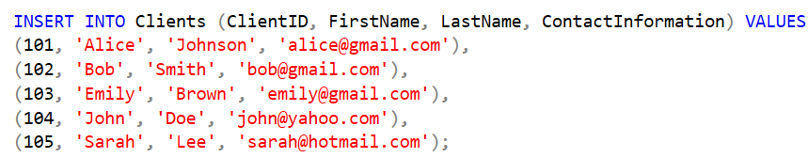
Client Table and insertions

Slide 4
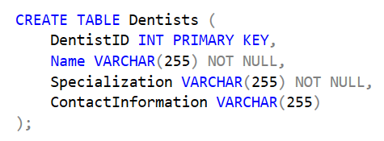
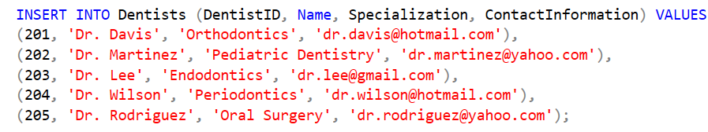
Dentists table and insertions

Slide 5
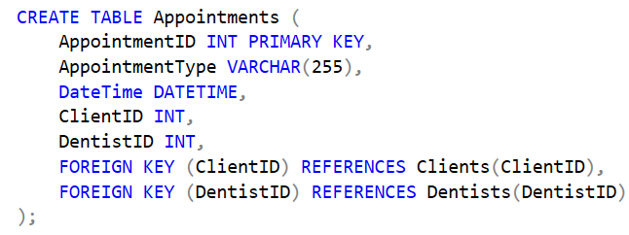
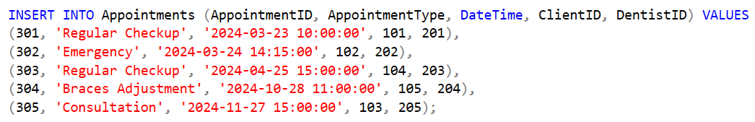
Appointments Table and Insertions

Slide 6
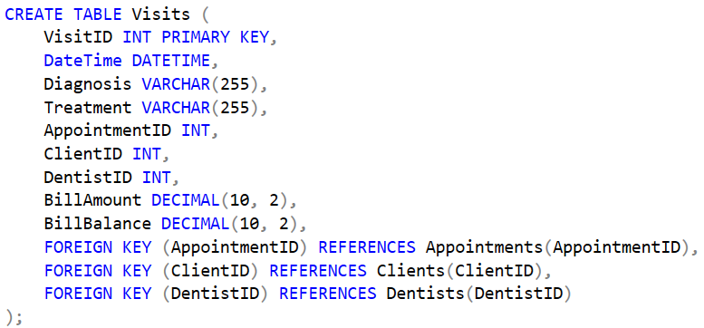
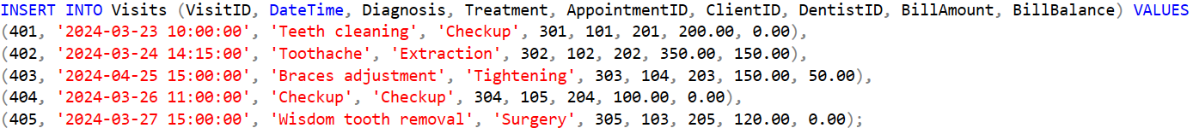
Visits Table and Insertions

Slide 7
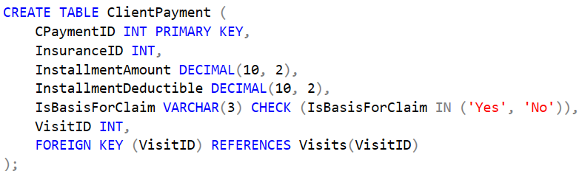
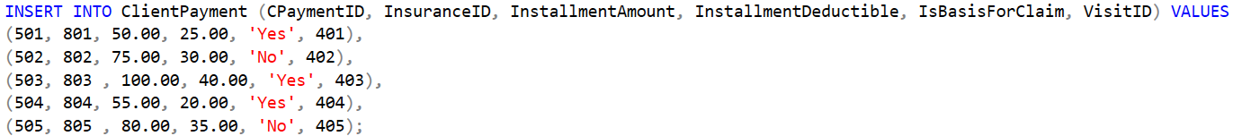
ClientPayment Table and Insertions

Slide 8
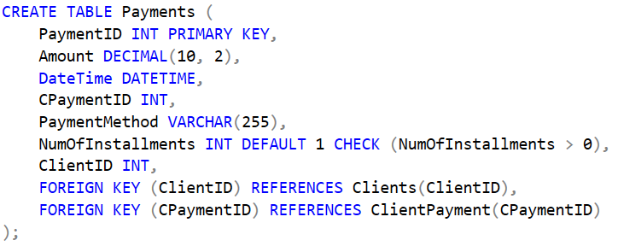
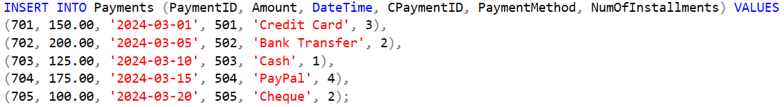
Payments Table and insertions

Slide 9
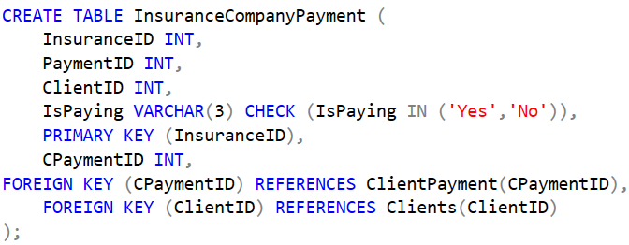
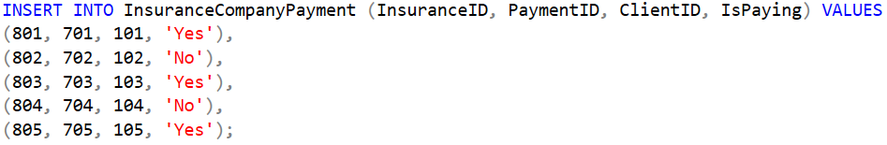
InsuranceCompanyPayment Table and Insertions

Slide 10
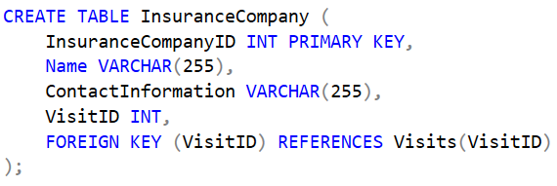
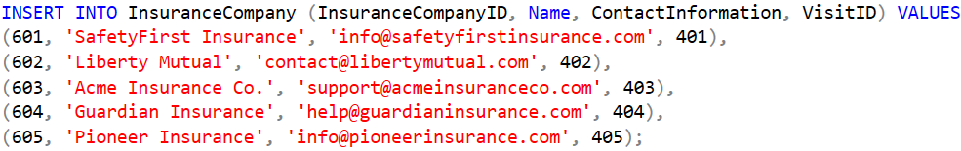
InsuranceCompany Table and Insertions

Slide 11
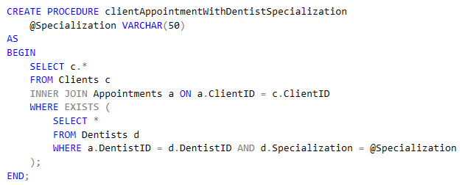
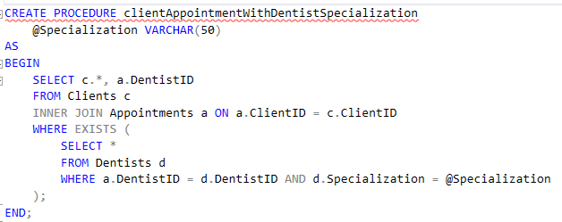
Query 1:
Create a procedure that selects all clients who have booked an appointment with a dentist with a specific specialization (using EXISTS)

Slide 12
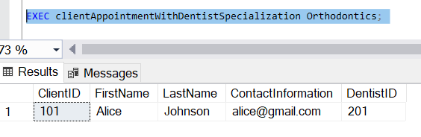
Query 1 Result:

Slide 13
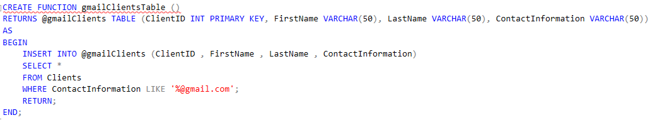
Query 2
Create a function that gets and shows all clients whose emails end with ‘@gmail.com’.

Slide 14
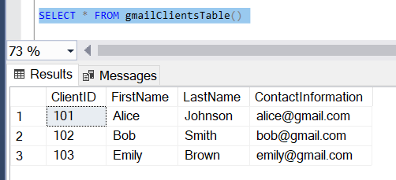
Query 2 Result:

Slide 15
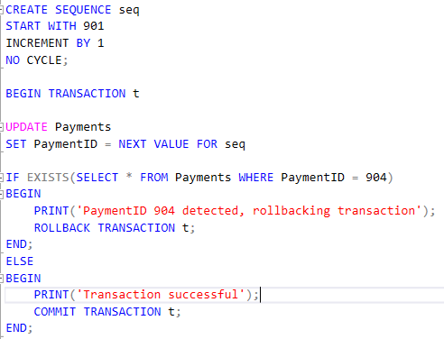
Query 3
Create a sequence beginning with a value of 901 and that increments by 1. Then begin a transaction that updates all the PaymentIDs of the Payment table with the sequence. If any of them equal 904, then the transaction will be rollbacked; else, transaction commits.

Slide 16
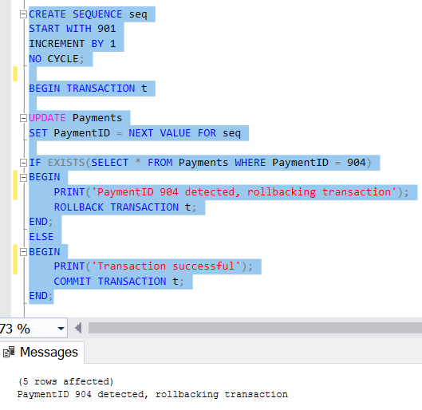
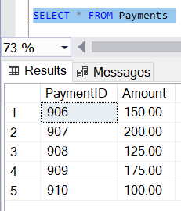
Query 3 Result:

Slide 17
Query 4:
Create an index for performance on the ClientID foreign key in the Appointments table

Slide 18
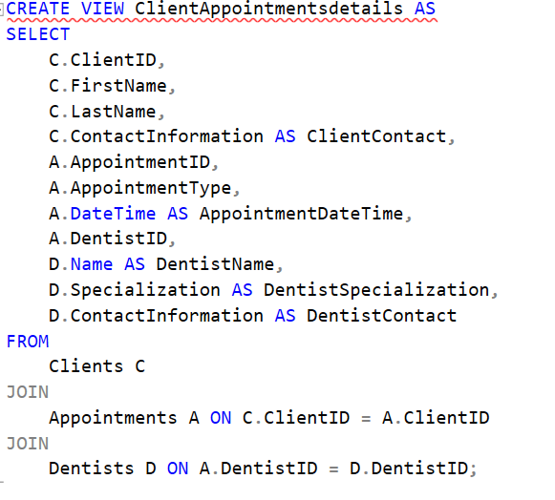
Query 5:
Create a view of all client information and their appointments details.

Slide 19
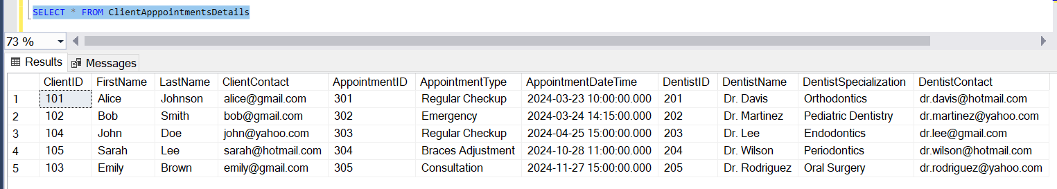
Query 5 Result:

Slide 20
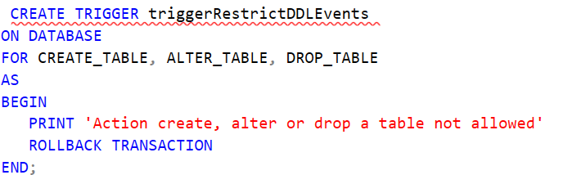
Query 6:
Create a trigger to prevent creation,deletion,and alteration on database.

Slide 21
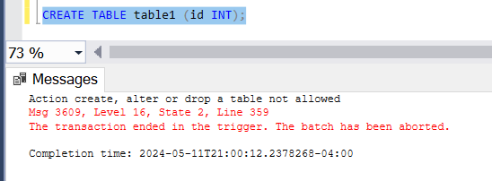
Query 6 Result:

Slide 22

Query 7:
Retrieve the number of Appointments done monthly.

Slide 23
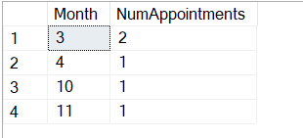
Query 7 Result:

Slide 24
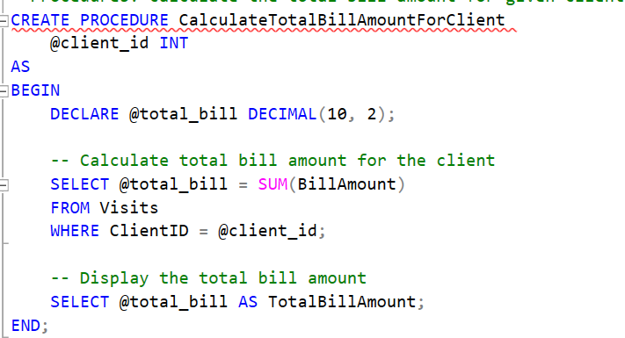
Query 8:
Create a procedure that calculates the total bill amount for a given client.

Slide 25


Query 8 Result:

Slide 26
Thanks!
Does anyone have any questions?

