Slide 1

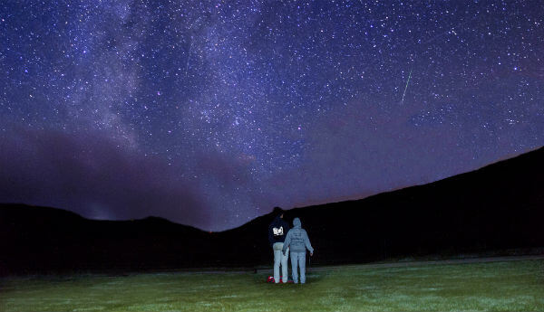
AstronEra
Events

Slide 2
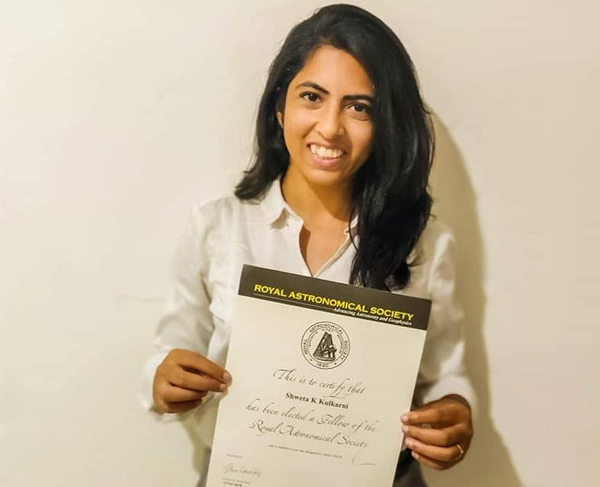

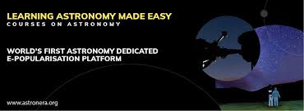
About AstronEra
AstronEra wants to tell the world about the world beyond the sky.
Astronomy is deeper than it seems....
Each person who wants to know about can learn astronomy with AstronEra with our courses and events.

Slide 3
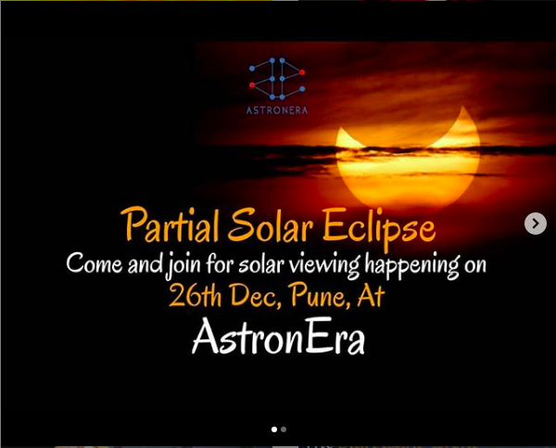
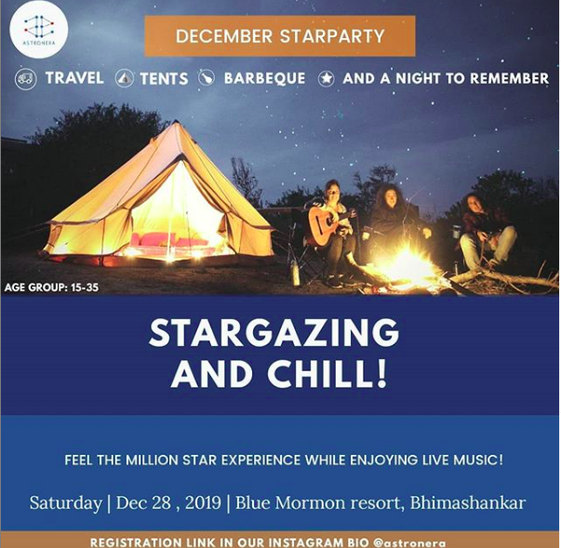
Our Recent Events

Slide 4
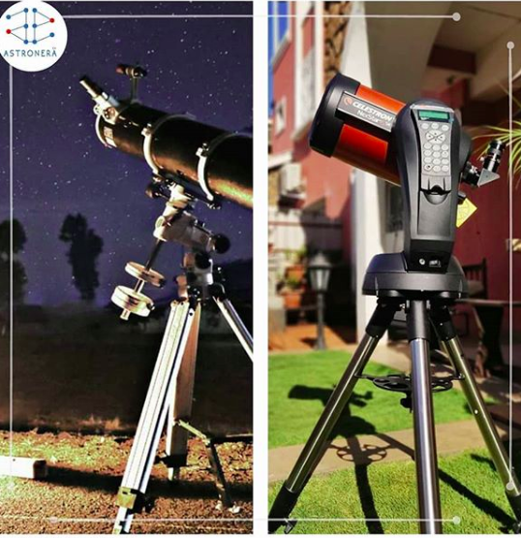
Telescopes
The 6" Newtonian Refelecter telescope and 6" Cassegrain

Slide 5
Moon Gazing Event Details
Date: On or after 28th March
Fees: 100 Rs per person
Bulk Charge: 10000Rs
Activities that could be included:
Model making
Group Activities
Lecture on Astronomy
Overnight Star Gazing
Photography Basics

