Slide 1
Spring Boot User Authentication with JWT
Syed Ahamed Meeranji
August 2025

Slide 2
Project Overview
Objective:
A Build a secure REST API for user authentication
authenticate using JSON Web Tokens (JWT)
Use MySQL as database and Spring Boot as backend
Tech Stack:
Java 17, Spring Boot, Spring Security
JWT, MySQL, Maven

Slide 3
Project Folder Structure
com.example.auth
├── controller
├── service
├── repository
├── model
├── util
└── security
Each package contains relevant classes:
- controller: API endpoints
- service: Business logic
- repository: DB access
- util: Helper classes
- security: JWT and Spring Security config

Slide 4
Authentication Flow
User registers (POST /api/register)
Data stored in MySQL (hashed password)
User logs in (POST /api/login)
JWT token is returned
User accesses protected endpoint (GET /api/user)
Token is validated via Spring Security
Response is returned

Slide 5
REST API Endpoints
REST API Endpoints
Use Header:
Authorization: Bearer <token>
Method | Endpoint | Description
POST | /api/register | Register new user
POST | /api/login | Get JWT token
GET | /api/user | Get info (needs token)

Slide 6
Database Schema
Table: users
- id (Primary Key)
- username (VARCHAR)
- email (VARCHAR)
- password (VARCHAR, stored hashed using BCrypt)

Slide 7
How to Run & Test
1. Start MySQL in XAMPP, create DB: userauth_db
2. Run the project: mvn spring-boot:run
3. Use Postman to:
- Register a user
- Login and get JWT
- Use Bearer token to access /api/user

Slide 8
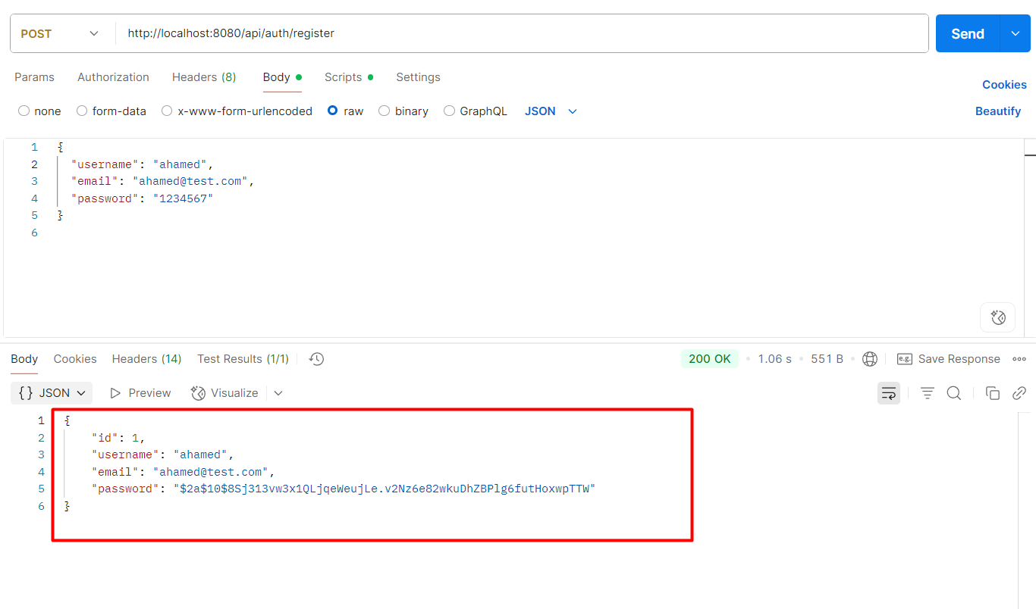
Screenshot Postman results and attach to PPT
Register screen shot

Slide 9
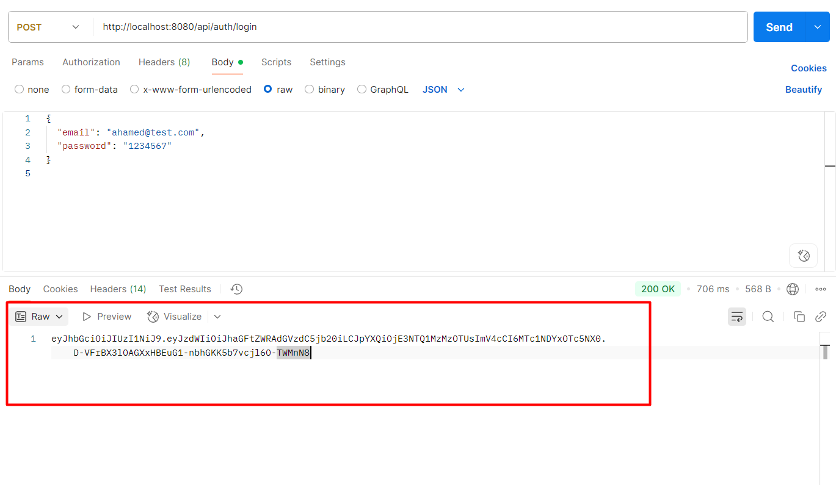
Screenshot Postman results and attach to PPT
Login screen shot

Slide 10
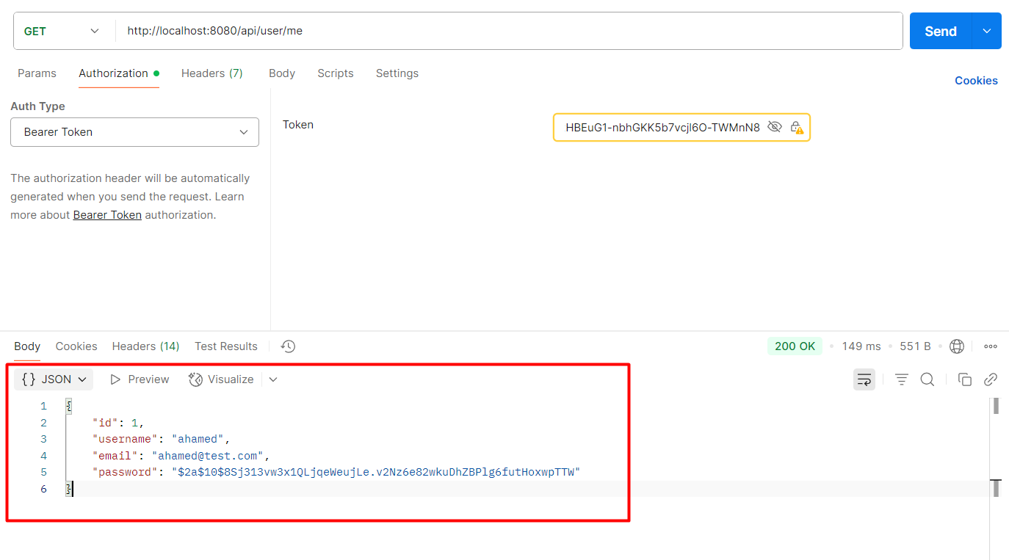
Screenshot Postman results and attach to PPT
User info screen shot

Slide 11
Thank you

