Slide 1
A Journey into Transformers
Presented by
Taimoor Ul Islam (14031) & Abuzar Khan ()

Slide 2
Table of Content
How does ChatGPT works?
Life Before Transformers?
What are Embeddings ?
What is Attention ?
GPT Architecture
Pretrainng and Finetuning
Original Transformer Arcitecture
Decoder Based Only Models and Encoder Based Models
LLM Scaling Laws
Major Models along time
How transformers are used today ?
Conclusion

Slide 3
How does ChatGPT Works ?
How does this AI system understand and generate human-like text?
Let’s explore what powers it – Transformers!

Slide 4
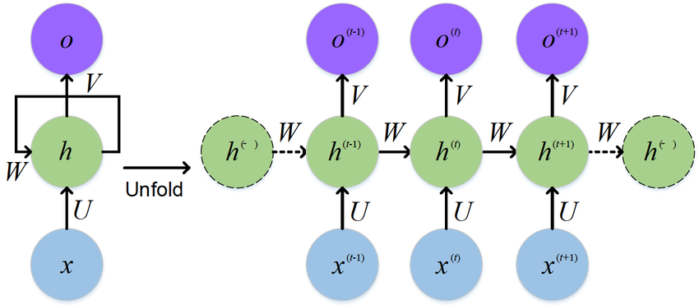
Life Before Transformers
RNNs (Recurrent Neural Networks): good for sequences but slow and hard to train
LSTMs/GRUs: improvements over RNNs, but struggled with long-range dependencies
CNNs: sometimes used for text, but limited in capturing sequential meaning
Challenges: vanishing gradients, sequential processing, memory bottlenecks

Slide 5
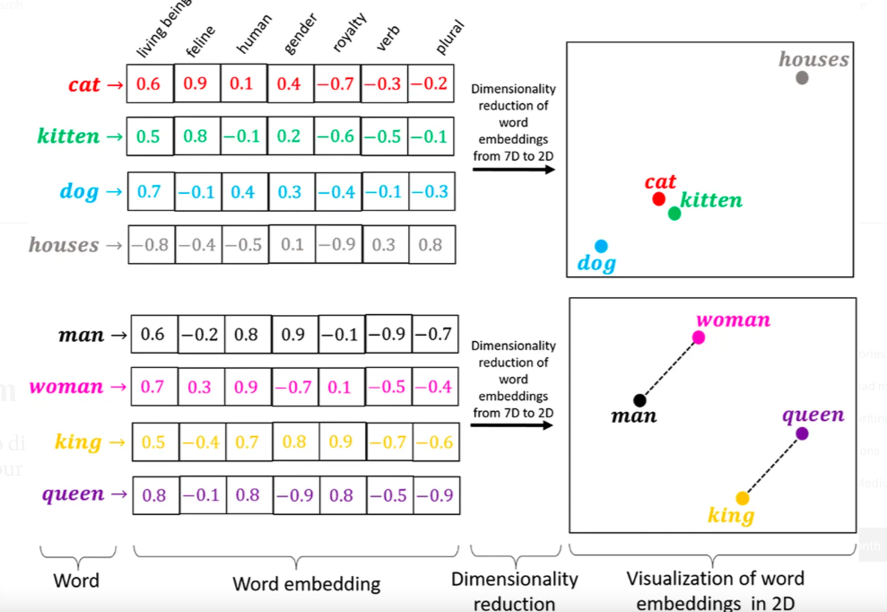
What Are Embeddings?
Convert words or tokens into dense vector representations
Preserve semantic relationships (e.g., king - man + woman = queen)
Learned during training
Foundation for input and output in transformers

Slide 6
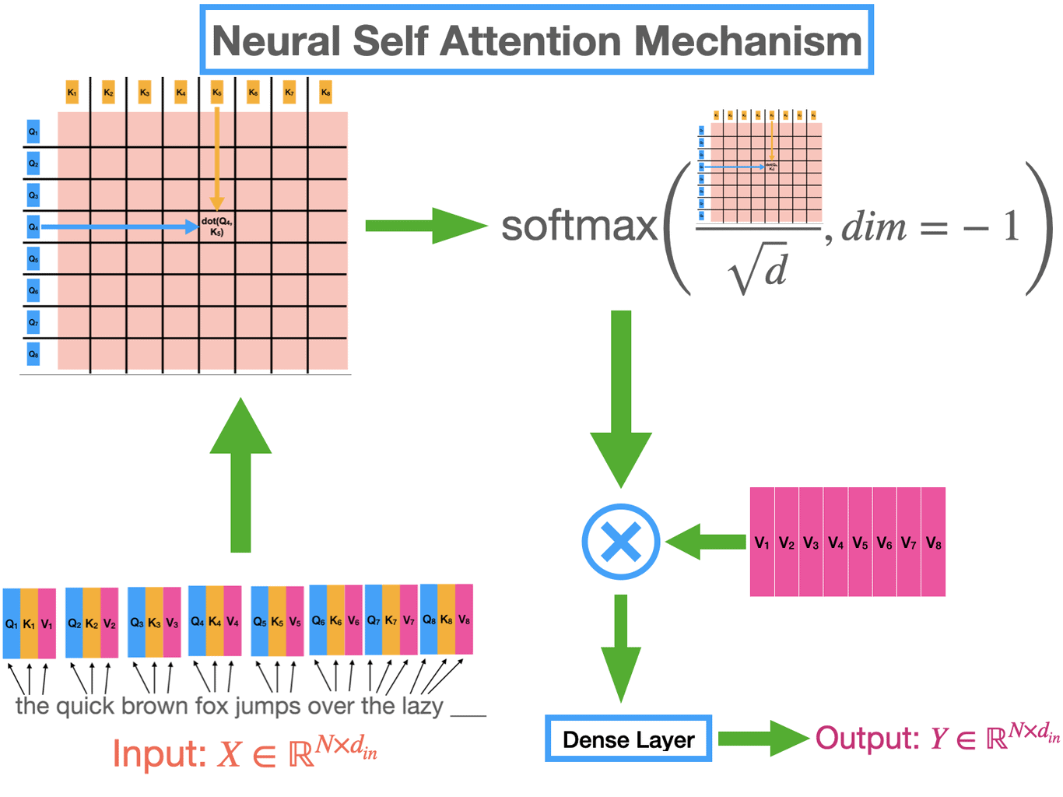
What Is Attention?
Mechanism to focus on relevant parts of the input
Computes weights (attention scores) for each token in context
Enables model to handle long-term dependencies

Slide 7
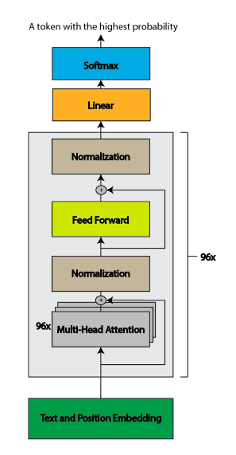
GPT Architecture
Based on decoder block from the Transformer
Stack of masked self-attention layers and feed-forward layers
Uses causal attention to prevent looking at future tokens
Trained with next-token prediction objective

Slide 8
Pretraining and Finetuning
Pretraining:
Finetuning
Trained on large-scale text with unsupervised objectives (e.g., language modeling)
Trained on specific tasks or datasets
Includes supervised fine-tuning or Reinforcement Learning (e.g., RLHF in ChatGPT)

Slide 9
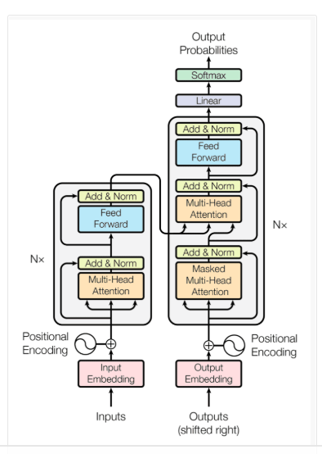
Original Transformer Architecture
Introduced in Vaswani et al. (2017)
Two main components:
Encoder: processes input sequence
Decoder: generates output sequence
Fully based on self-attention and positional encodings

Slide 10
Decoder-Only and Encoder-Only Models
Decoder-Only (e.g., GPT): good for text generation
Encoder-Only (e.g., BERT): good for classification, QA, etc.
Encoder-Decoder (e.g., T5, BART): good for translation, summarization

Slide 11
LLM Scaling Laws
Larger models → better performance, given more data and compute
Discovered empirical power-law relationships
Tradeoffs between:
Model size
Dataset size
Training steps
Basis for development of models like GPT-3, GPT-4

Slide 12
Major Models Over Time
2017 – Transformer (Vaswani et al.)
2018 – BERT, GPT
2019 – GPT-2
2020 – T5, BART, GPT-3
2022 – PaLM, Chinchilla
2023–24 – GPT-4, Claude, Mistral, Gemini, LLaMA 2
2025 – Multimodal & agentic models (e.g., Sora, Devin)

Slide 13
How Transformers Are Used Today?
Text generation: ChatGPT, Copilot, Jasper
Translation: DeepL, Google Translate
Search: Semantic search using BERT, ColBERT
Vision: Vision Transformers (ViT), CLIP
Multimodal AI: Combining text, image, audio, video
Agents & Tool Use: Agentic LLMs calling APIs or tools

Slide 14
How you can you transformer in your project?
The answer is HuggingFace and Langchain
The good part is that you don’t need to know all of the underlaying complexity which is abstracted by these libaries

Slide 15
Conclusion
Transformers revolutionized deep learning, especially NLP
Core ideas: attention, scaling, modularity
Foundation for current and future AI systems
The journey continues: multimodality, reasoning, and beyond

Slide 16
Thank You If any Question Feel Free to ask ?

