Slide 1
Robustness of persistence diagrams
Anej Placer
Ožbolt Menegatti
Jurij Slabanja

Slide 2
Problem Description
Dataset S
Distances of increasing size
Vietoris-Rips filtration
Persistence diagrams
Shake the points
Repeat
Compare diagrams

Slide 3
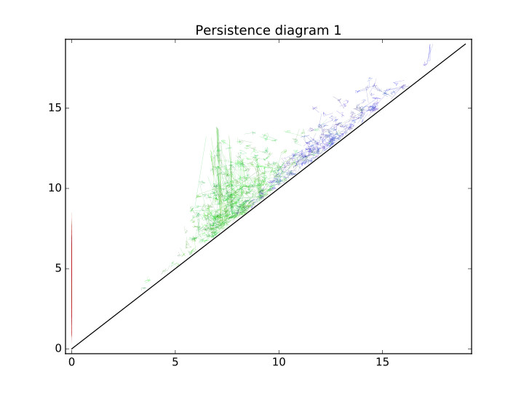
Results

Slide 4
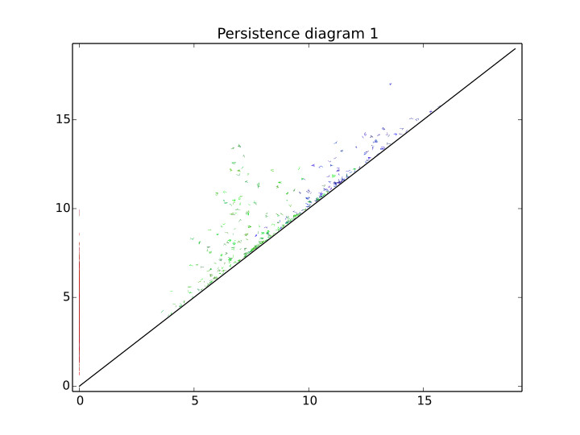

Slide 5
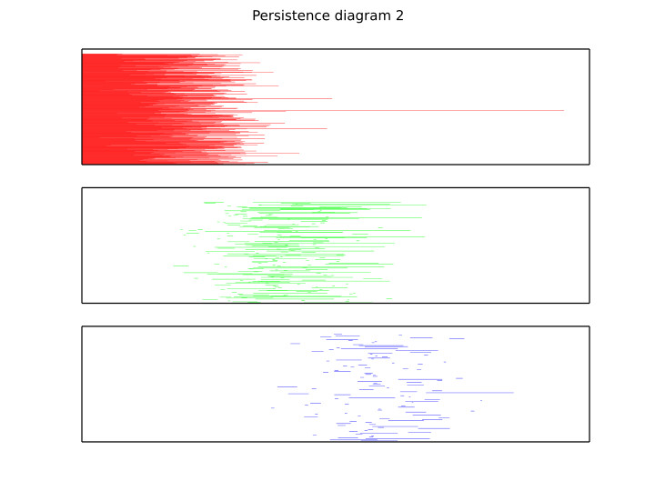

Slide 6
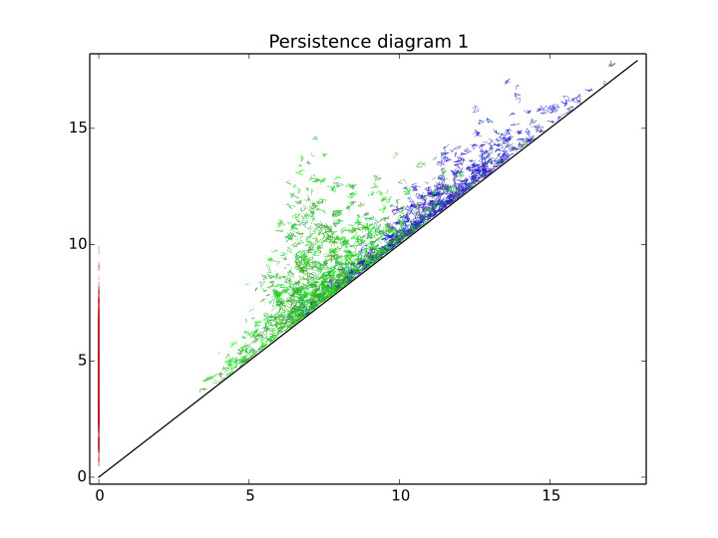

Slide 7
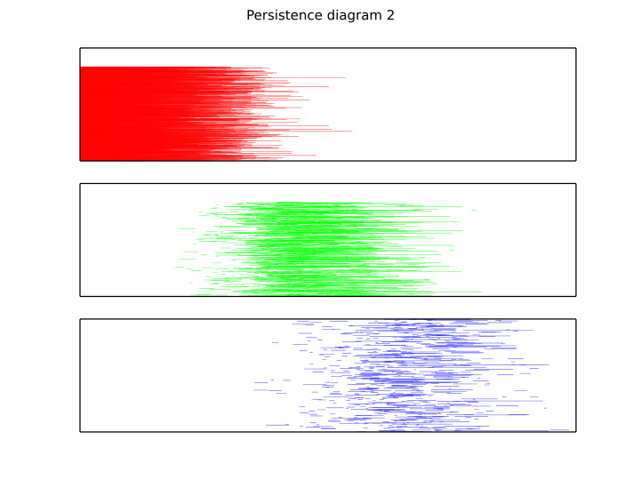

Slide 8
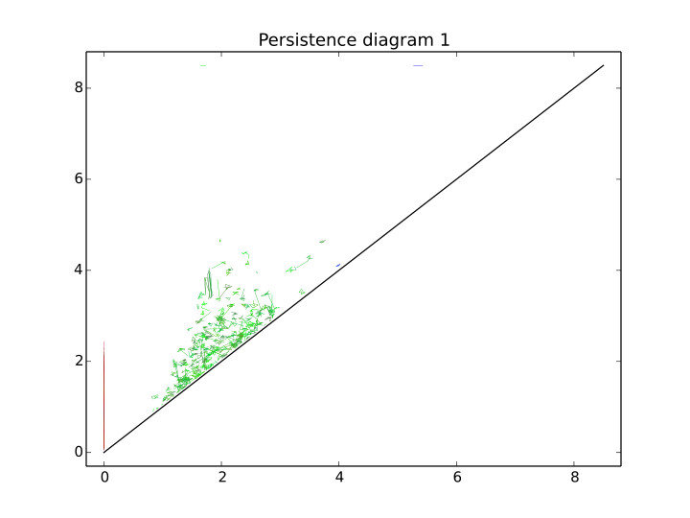

Slide 9
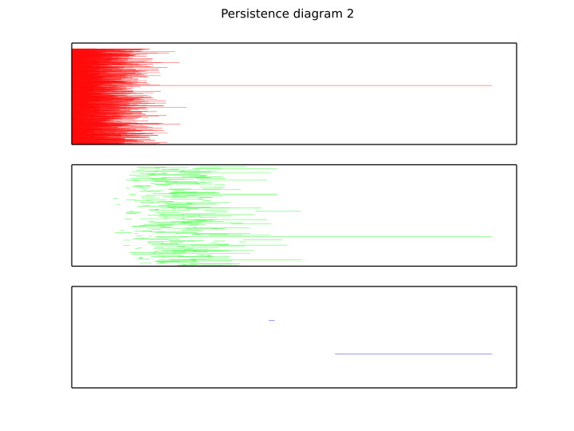

Slide 10
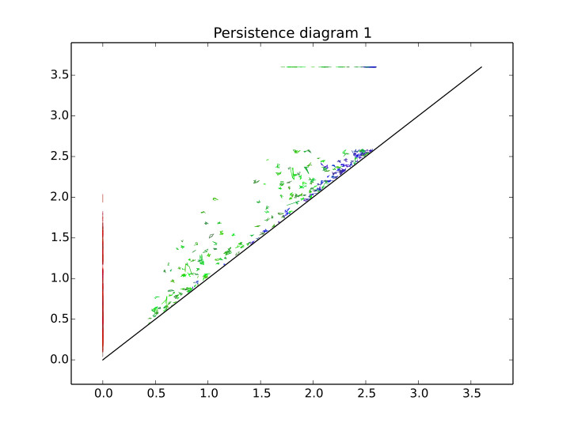

Slide 11
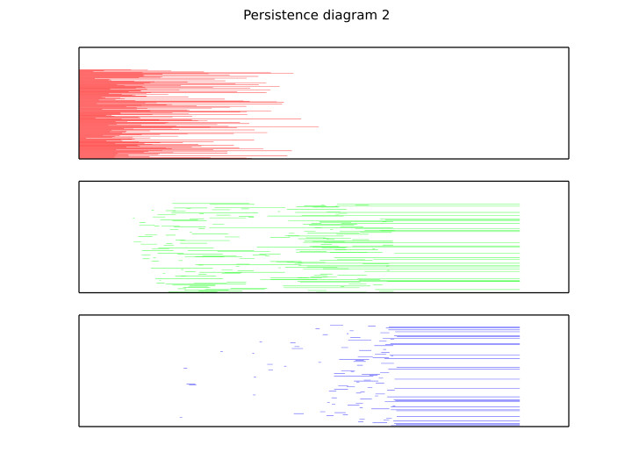

Slide 12
Bottleneck Distance
Dataset 2
Max distance 7.5, eps = 0.075
0.000, 0.122, 0.117, 0.129, 0.178, 0.089, 0.100, 0.170, 0.129, 0.122, 0.130, 0.113, 0.107, 0.128, 0.125, 0.120, 0.434
Avg = 0.154

