Slide 1
3D Coffee and Pastry Shop
Course No: CSE 4208
Course Name: Computer Graphics Laboratory
Submitted to:
Dr. Sk. Md. Masudul Ahsan,
Professor,
Dept of Computer Science and Engineering
Md. Badiuzzaman Shuvo,
Lecturer,
Dept of Computer Science and Engineering
Submitted by:
Name : Sadia Afrin
Roll : 1907037
Group : A1
Dept of Computer Science and Engineering

Slide 2
Outline:
Objectives
Introduction
Methodology
Conclusion

Slide 3
Objectives
To understand the fundamentals of OpenGL and how 2D objects are drawn through point extraction.
To implement object manipulation (translation, rotation, resizing) through keyboard inputs.
To implement Bird’s Eye View camera and rotational controls (Pitch, Yaw, Roll) for enhanced viewing.
To integrate lighting systems (point, directional, spotlights, emissive light) and control light sources via keyboard.
To apply textures to 3D objects and introduce keyboard interactions to toggle features.

Slide 4
Introduction:
Graphics rendering involves creating images from 3D models by using mathematical transformations and visual effects, forming the core of computer graphics.
OpenGL(Open Graphics Library), is a powerful to render 2D and 3D graphics, enables the creation of objects using vertices, where each point in space is defined, and these points form the shapes and surfaces of 3D objects.
Objects in OpenGL can be translated, rotated, and scaled using transformation matrices, allowing for dynamic control of objects within a scene.
OpenGL supports various lighting techniques (point, directional, spotlights) to simulate realistic effects by adjusting light sources and surface materials, enhancing the visual appearance of objects.

Slide 5
Using tools and libraries:
OpenGL: A cross-platform graphics API for rendering 2D and 3D graphics, offering powerful features like shaders, textures, and transformations.
Visual Studio: An IDE that provides tools for writing, debugging, and compiling C++ code efficiently.
C++ Language: A high-performance programming language used to implement OpenGL.
Combining OpenGL and C++: OpenGL is used to handle rendering, while C++ manages program logic, transformations, and performance optimization.
Cross-Platform Development: OpenGL, Visual Studio, and C++ together enable graphics applications that can run on various platforms, making the development process more flexible.

Slide 6
Methodology:
OpenGl 3.3 is used to simulate “Coffee and Pastry Shop” in computer graphics.
Basic objects are created in this project:
Cake portion | Coffee portion
Desks Cakes of multiple shapes Menu screen Back wall Roof of this portion Moving cake | Desks Back wall Coffee machine(pouring coffee) Cups of multiple shapes Standing menu screen
Common parts: Floor Standing lights | Table Chair

Slide 7
Methodology:
Esc: Close the window. W: Move the camera forward. S: Move the camera backward. A: Move the camera left. D: Move the camera right. R: Rotate along the active axis (X, Y, or Z). K: Translate along the negative Y-axis. L: Translate along the positive X-axis. J: Translate along the negative X-axis. O: Translate along the positive Z-axis. P: Translate along the negative Z-axis. | X: Rotate around the X-axis . Z: Rotate around the Y-axis . H: Move the camera right (along X-axis). F: Move the camera left (along X-axis). T: Move the camera forward (along Z-axis). G: Move the camera backward (along Z-axis). Q: Move the camera upward (along Y-axis). E: Move the camera downward (along Y-axis).

Slide 8
Methodology:
1: Turn off all point lights. 2: Turn on all point lights. 3: Toggle the diffuse light on/off for all point lights. 4: Toggle the specular light on/off for all point lights. 5: Turn on ambient light for all point lights. 6: Turn on diffuse light for all point lights. 7: Turn on specular light for all point lights. 8: Change the color of all point lights to green (ambient, diffuse, specular).

Slide 9
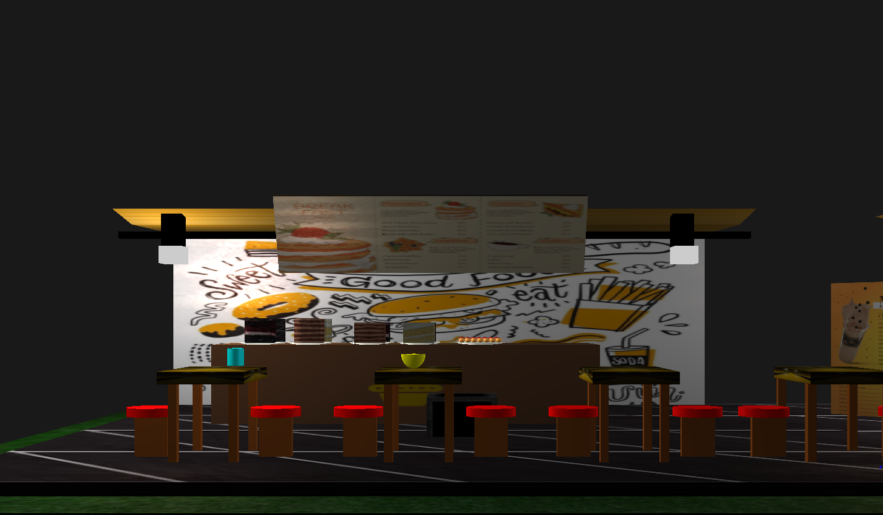
Features:
Fig 1: Cake corner

Slide 10
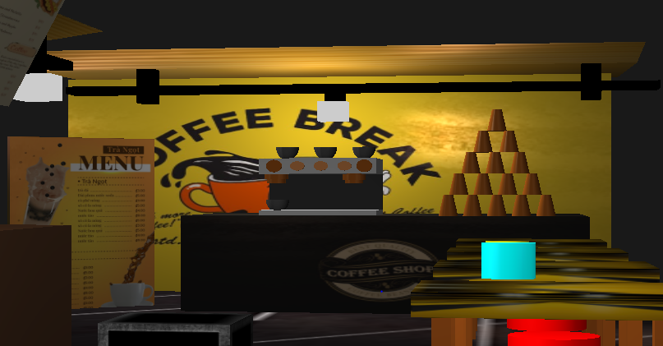
Features:
Fig 2: Coffee corner

Slide 11
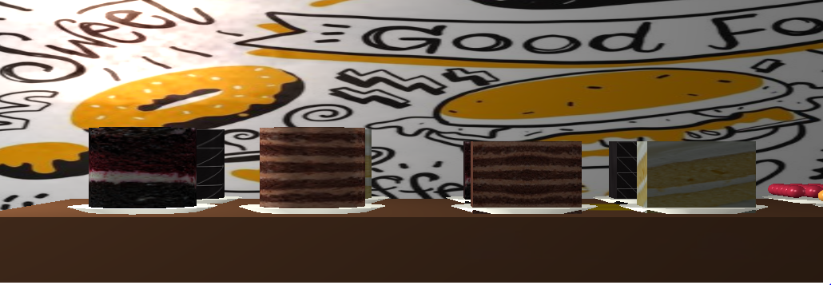
Features:
Fig 3: Cakes of Multiple shapes

Slide 12
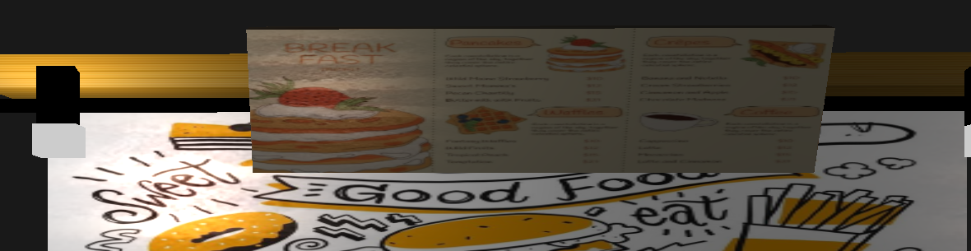
Features:
Fig 4: Menu of Cake corner

Slide 13
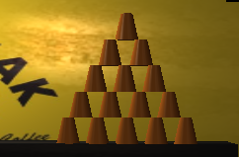
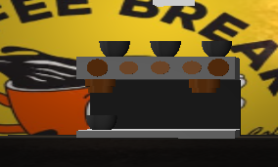
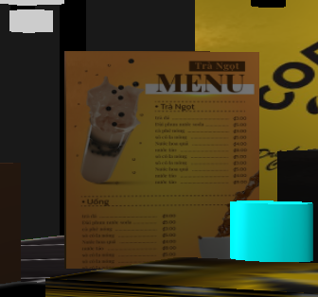
Features:
Fig 5: Coffee cups
Fig 6: Coffee machine
Fig 7: Menu of Coffee corner

Slide 14
Video:

Slide 15
Conclusion:
The project created an interactive coffee and pastry shop scene in OpenGL with user-controlled transformations like translation, rotation, and scaling on 3D objects.
Different lighting models (point, directional, spotlight) were implemented, enhancing realism along with texture mapping for objects like coffee cups and pastries.
User inputs were integrated to control camera movements and object transformations, offering flexibility in navigating and modifying the scene in real-time.
Challenges included implementing accurate lighting, texture mapping, and handling smooth user interactions, requiring efficient shader programming.
Future improvements could involve advanced animations, collision detection, and more complex lighting for an even more dynamic and engaging experience.

Slide 16
Thank you

