Slide 1

GOKARAJU RANGARAJU INSTITUTE OF ENGINEERING AND TECHNOLOGY
Department of Computer Science and Engineering
Major Project Phase-II
Review-1
Smart Platform for Breast Cancer Classification using Deep Learning Techniques
- Guide : G.Mallikarjuna Rao,Professor
M.BHAVITA-20241A0591
M.SAHITHI-20241A0595
N.VARSHA-20241A0599
R.NIKITHA-20241A05B1

Slide 2
GOKARAJU RANGARAJU INSTITUTE OF ENGINEERING AND TECHNOLOGY
Department of Computer Science and Engineering
Abstract
Breast cancer is prevalent and potentially a life-threatening disease that demands early detection for effective treatment and improved patient outcomes. Machine learning and deep learning techniques aid in breast cancer prediction by algorithms on medical images, identifying specific features and classifying disease presence or absence.The project entails a multi-stage process. First, a diverse and well-curated dataset of medical images is collected,encompassing both cancerous and non-cancerous cases. Through meticulous preprocessing and data augmentation, the dataset's quality and diversity are optimized, preparing it for subsequent analysis. Various deep learning architectures,including Convolutional Neural Networks (CNNs) and possibly more specialized models for medical image analysis, are explored to extract intricate patterns and features from the images.Upon determining the optimal model, the system is deployed to classify new, unseen medical images. The model's predictions aid healthcare professionals in making informed decisions about breast cancer diagnosis and treatment planning.

Slide 3
GOKARAJU RANGARAJU INSTITUTE OF ENGINEERING AND TECHNOLOGY
Department of Computer Science and Engineering
Index
Abstract
Recap of phase-1(Project work)
Planning for Phase 2(% to be covered)
Modules along with Class Diagrams
Module Integration and Testing
Screen Shots of Modules, Implemented code on Demand
Conclusion & Scope
References
Status of phase 1-Paper publication

Slide 4
GOKARAJU RANGARAJU INSTITUTE OF ENGINEERING AND TECHNOLOGY
Department of Computer Science and Engineering
Recap of Phase-1
In phase 1 of our project, we will commence by gathering the requisite data. Once the data acquisition is complete, we will undertake several crucial data preprocessing tasks including resizing, color conversion, normalization, labeling, and overall data preparation. This step is pivotal to ensure that the data is appropriately formatted and primed for our analytical procedures.
For modeling, we have identified several architectures tailored to different dataset sizes and computational resources:
DenseNet201: Ideal for large datasets requiring high accuracy due to its ability to capture intricate image features.
ResNet50: Strikes a balance between model complexity and performance, suitable for medium-sized datasets.
VGG models (e.g., VGG16 or VGG19): Simpler with fewer parameters compared to DenseNet201 and ResNet50, suitable for smaller datasets or resource-constrained environments.
DenseNet-201, specifically designed for image classification and computer vision tasks, enhances information flow through dense connections between layers, addressing issues like the vanishing gradient problem in very deep networks while maintaining parameter efficiency.Following data preparation, the next steps involve model training and evaluation. The training process entails monitoring performance on the validation set to optimize the model. Subsequently, the model's generalization is assessed by evaluating its performance on the shuffled test set (X_test and Y_test) to gauge its effectiveness on unseen data. This rigorous evaluation process ensures the model's ability to make accurate predictions on new, real-world examples.Our objective is to enhance performance on the BreakHis dataset, focusing on metrics such as accuracy, precision, and recall for breast cancer classification
.

Slide 5
GOKARAJU RANGARAJU INSTITUTE OF ENGINEERING AND TECHNOLOGY
Department of Computer Science and Engineering
Planning for Phase-II:
In the next step of our breast cancer classification project, we will utilize heterogeneous datasets to identify intricate patterns. These datasets will be fed into various classifiers to discern whether a given instance is benign or malignant. Upon identifying patterns indicative of cancer, we will further classify the stage of breast cancer. Additionally, we will provide specific precautions and recommend medicines to mitigate the condition. To facilitate easy access and understanding, we will develop a user interface for online checking. However, it's important to note that this interface is meant for informational purposes only, and for optimal results, individuals should consult trained medical professionals.

Slide 6
GOKARAJU RANGARAJU INSTITUTE OF ENGINEERING AND TECHNOLOGY
Department of Computer Science and Engineering
Module 1: Pre-Processing
We will start by gathering the necessary data for our project. After acquiring the data, we will
perform several essential data preprocessing tasks, including resizing, color conversion,
normalization, labeling, and overall data preparation. This crucial step is vital to ensure that the
data is appropriately formatted and ready for our analytical procedures

Slide 7
GOKARAJU RANGARAJU INSTITUTE OF ENGINEERING AND TECHNOLOGY
Department of Computer Science and Engineering
Module 2: Model Selection
• DenseNet201 may be a good choice if you have a large dataset and need a highly accurate model. It excels at
capturing intricate image features
• ResNet50 is a solid choice for most image classification tasks. It strikes a balance between model complexity
and performance and can work well with medium-sized datasets.
• VGG models, such as VGG16 or VGG19, are simpler and have fewer parameters compared to DenseNet201
and ResNet50. They may be suitable for smaller datasets or when computational resources are limited.
• DenseNet-201 is a deep learning architecture primarily designed for image classification and computer vision
tasks. Its key purpose is to enhance information flow through the network by utilizing dense connections
between layers. This approach not only improves gradient flow during training but also mitigates the vanishing
gradient problem in very deep networks. DenseNet-201 achieves high accuracy while maintaining parameter
efficiency, making it suitable for resource-constrained environments.

Slide 8
GOKARAJU RANGARAJU INSTITUTE OF ENGINEERING AND TECHNOLOGY
Department of Computer Science and Engineering
Module 3: Testing and Training
The data is ready for model training and evaluation.The training process typically involves monitoring performance on the validation set to optimize the model.Finally, the model's generalization is assessed by evaluating it on the shuffled test set (X_test and Y_test) to determine how well it performs on unseen data.This process ensures that the model can make accurate predictions on new, real-world examples.It aims to enhance performance on the BreakHis dataset, evaluating metrics like accuracy, precision,and recall for breast cancer classification.

Slide 9
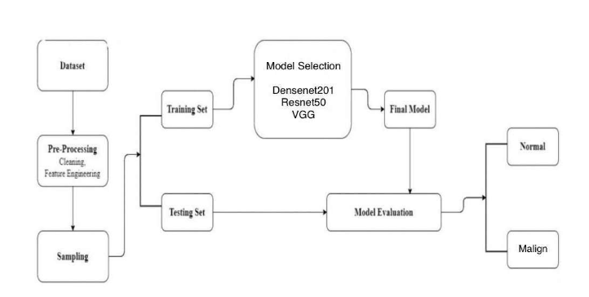
GOKARAJU RANGARAJU INSTITUTE OF ENGINEERING AND TECHNOLOGY
Department of Computer Science and Engineering
Module Integration and Testing

Slide 10
GOKARAJU RANGARAJU INSTITUTE OF ENGINEERING AND TECHNOLOGY
Department of Computer Science and Engineering
Module Integration and Testing

Slide 11
GOKARAJU RANGARAJU INSTITUTE OF ENGINEERING AND TECHNOLOGY
Department of Computer Science and Engineering

Slide 12
GOKARAJU RANGARAJU INSTITUTE OF ENGINEERING AND TECHNOLOGY
Department of Computer Science and Engineering

Slide 13
GOKARAJU RANGARAJU INSTITUTE OF ENGINEERING AND TECHNOLOGY
Department of Computer Science and Engineering

Slide 14
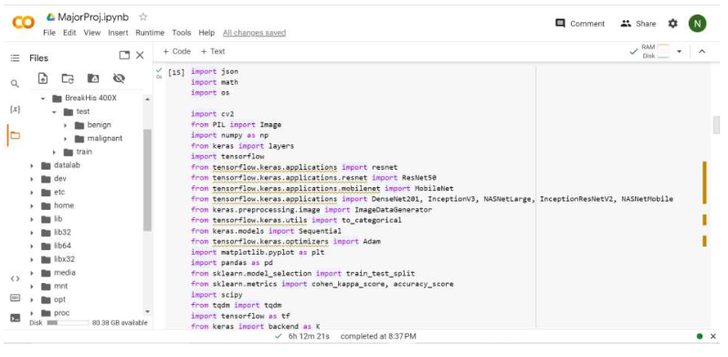
GOKARAJU RANGARAJU INSTITUTE OF ENGINEERING AND TECHNOLOGY
Department of Computer Science and Engineering
Implementation and Execution
DenseNet 201

Slide 15
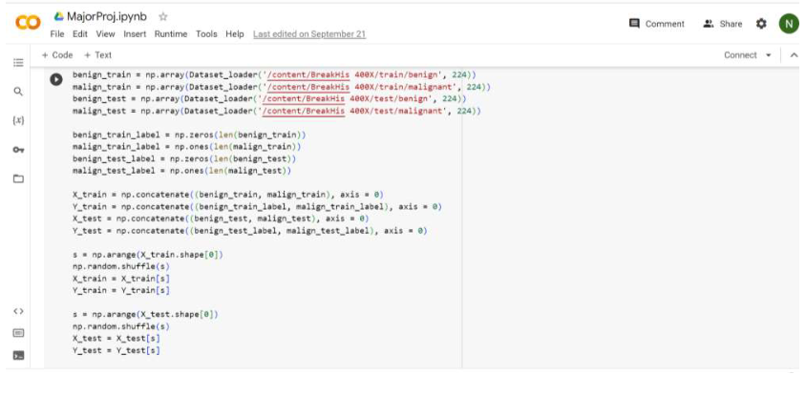
GOKARAJU RANGARAJU INSTITUTE OF ENGINEERING AND TECHNOLOGY
Department of Computer Science and Engineering

Slide 16
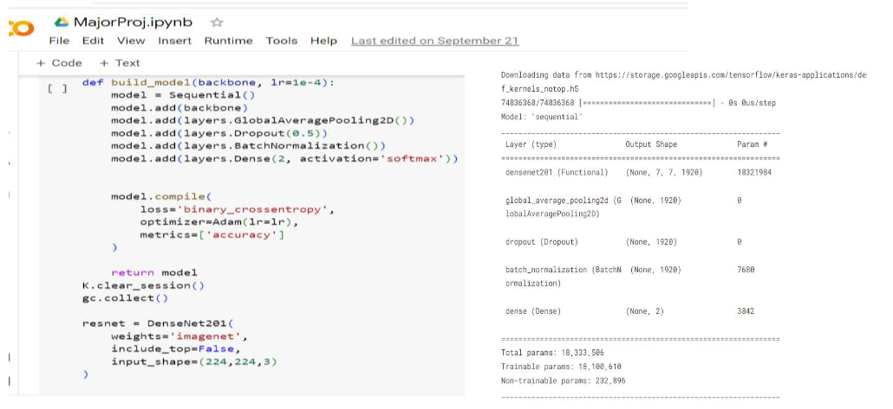
GOKARAJU RANGARAJU INSTITUTE OF ENGINEERING AND TECHNOLOGY
Department of Computer Science and Engineering

Slide 17
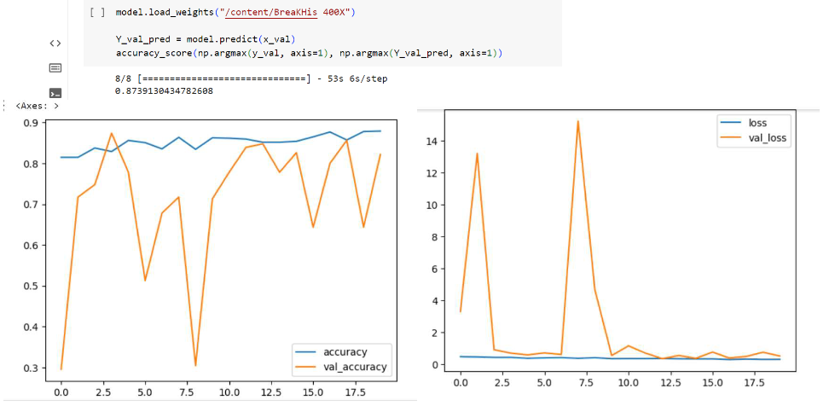
GOKARAJU RANGARAJU INSTITUTE OF ENGINEERING AND TECHNOLOGY
Department of Computer Science and Engineering

Slide 18
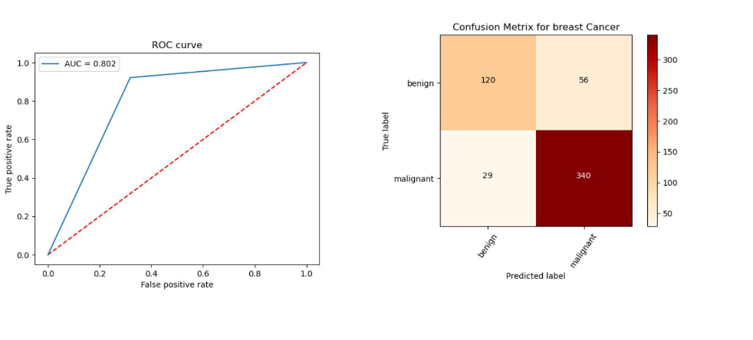
GOKARAJU RANGARAJU INSTITUTE OF ENGINEERING AND TECHNOLOGY
Department of Computer Science and Engineering

Slide 19
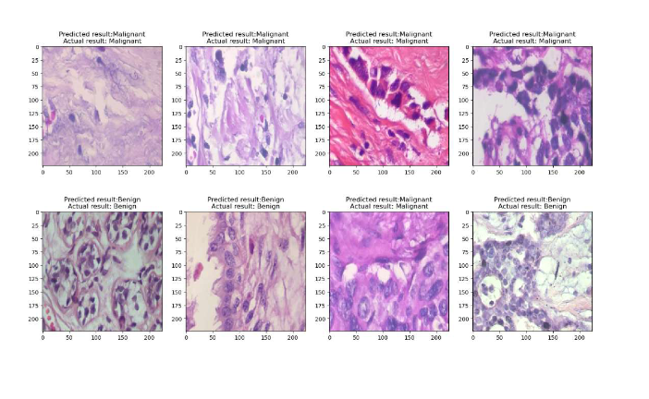
GOKARAJU RANGARAJU INSTITUTE OF ENGINEERING AND TECHNOLOGY
Department of Computer Science and Engineering

Slide 20
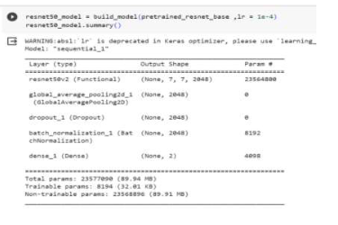
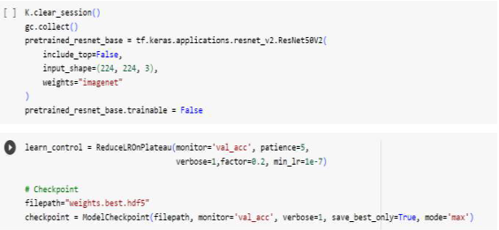
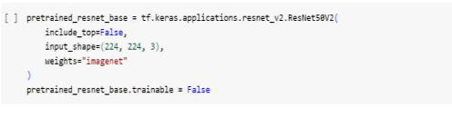

GOKARAJU RANGARAJU INSTITUTE OF ENGINEERING AND TECHNOLOGY
Department of Computer Science and Engineering
Resnet50
Accuracy:

Slide 21
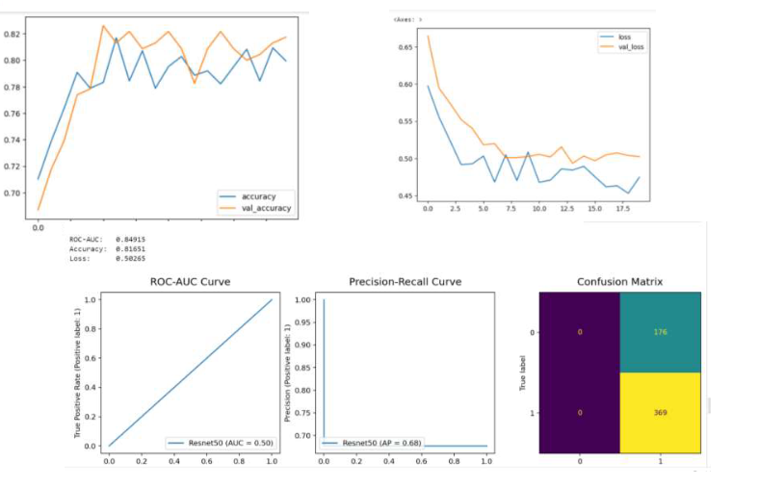
GOKARAJU RANGARAJU INSTITUTE OF ENGINEERING AND TECHNOLOGY
Department of Computer Science and Engineering

Slide 22
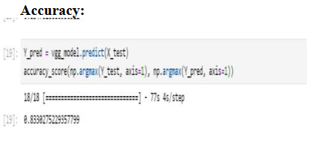
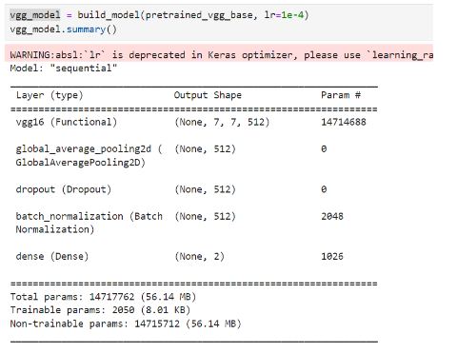
VGG16
GOKARAJU RANGARAJU INSTITUTE OF ENGINEERING AND TECHNOLOGY
Department of Computer Science and Engineering

Slide 23
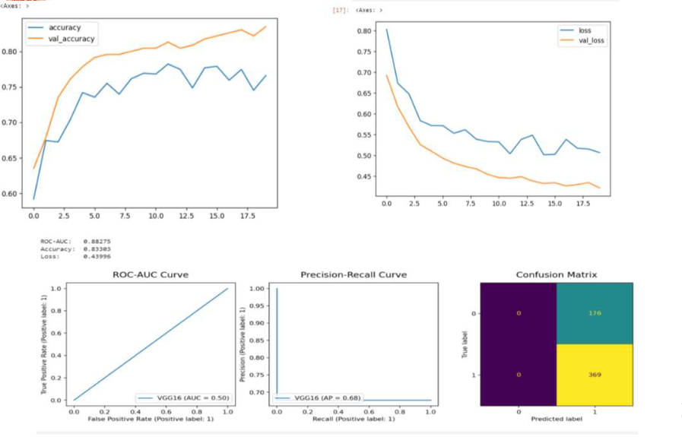
GOKARAJU RANGARAJU INSTITUTE OF ENGINEERING AND TECHNOLOGY
Department of Computer Science and Engineering

Slide 24
GOKARAJU RANGARAJU INSTITUTE OF ENGINEERING AND TECHNOLOGY
Department of Computer Science and Engineering
Scope
Data Availability and Quality: The success of machine learning models heavily relies on the quality and quantity of data. Limited access to diverse and well-annotated medical images can be a significant constraint.
Computational Resources: Training deep learning models, especially on large medical image datasets, can be computationally intensive.
Limited access to high-performance computing resources may impact the scale and speed of your project.
Ethical and Legal Considerations: Handling medical data involves strict ethical and legal considerations. Compliance with regulations such as HIPAA (Health Insurance Portability and Accountability Act) and ensuring patient privacy can impose limitations on data sharing and processing.
Real-world Generalization: Achieving a high accuracy within the training dataset doesn't always guarantee successful generalization to real-world scenarios. The model's performance on unseen data, especially from different healthcare institutions, is a challenge

Slide 25
GOKARAJU RANGARAJU INSTITUTE OF ENGINEERING AND TECHNOLOGY
Department of Computer Science and Engineering
Conclusion
There are various models present in Machine Learning which we can use for breast cancer
classification. We analysed the models and studied their characteristics. We also studied different
research papers in order to choose our model(Densenet201) or technique.We compare different
CNN models on our dataset and analyse their accuracy. The proposed project harnesses the power
of machine learning and deep learning techniques to revolutionize breast cancer detection and
diagnosis. By leveraging curated datasets of histopathology images,meticulous preprocessing,
training and testing, the project aims to create a sophisticated deep learning model capable
of accurately classifying breast cancer cases.

Slide 26
GOKARAJU RANGARAJU INSTITUTE OF ENGINEERING AND TECHNOLOGY
Department of Computer Science and Engineering
Referneces
[1] Murtaza, Ghulam, et al. "Deep learning-based breast cancer classification through medical imaging
modalities: state of the art and research challenges." Artificial Intelligence Review 53.3 (2020): 1655-1720.
[2] Amrane, Meriem, et al. "Breast cancer classification using machine learning." 2018 Electric Electronics,
Computer Science, Biomedical Engineerings' Meeting (EBBT). IEEE, 2018.
[3] Sarosa, Syam Julio A., Fitri Utaminingrum, and Fitra A. Bachtiar. "Mammogram breast cancer classification
using gray-level co-occurrence matrix and support vector machine." 2018 international conference on
sustainable information engineering and technology (SIET). IEEE, 2018.
[4] Zebari, Dilovan Asaad, et al. "Systematic review of computing approaches for breast cancer detection based
computer aided diagnosis using mammogram images." Applied Artificial Intelligence 35.15 (2021): 2157-2203.
[5] Nawaz, Majid, Adel A. Sewissy, and Taysir Hassan A. Soliman. "Multi-class breast cancer classification using
deep learning convolutional neural network." Int. J. Adv. Comput. Sci. Appl 9.6 (2018): 316-332..

Slide 27
GOKARAJU RANGARAJU INSTITUTE OF ENGINEERING AND TECHNOLOGY
Department of Computer Science and Engineering
[6] Akselrod-Ballin, Ayelet, et al. "Predicting breast cancer by applying deep learning to linked health records and mammograms." Radiology 292.2 (2019): 331-342.
[7] Krithiga, R., and P. Geetha. "Breast cancer detection, segmentation and classification on histopathology images analysis: a systematic review." Archives of Computational Methods in Engineering 28.4 (2021): 2607-2619.
[8] Hu, Chuhan, et al. "Classification of breast cancer histopathological image with deep residual learning." International Journal of Imaging Systems and Technology 31.3 (2021): 1583-1594.
[9] Sarosa, Syam Julio A., Fitri Utaminingrum, and Fitra A. Bachtiar."Mammogram breast cancer classification using gray-level co-occurrence matrix and support vector machine." (SIET). IEEE, 2018.
[10] Buda, Mateusz, et al. "A data set and deep learning algorithm for the detection of masses and architectural distortions in digital breast tomosynthesis images." JAMA network open 4.8 (2021): e2119100-e2119100.
[11] Hirra, Irum, et al. "Breast cancer classification from histopathological images using patch-based deep learning modeling." IEEE Access 9 (2021): 24273-24287.
[12] Al-Haija, Qasem Abu, and Adeola Adebanjo. "Breast cancer diagnosis in histopathological images using ResNet-50 convolutional neural network." 2020 IEEE International IOT, Electronics and Mechatronics Conference (IEMTRONICS). IEEE, 2020.

Slide 28
GOKARAJU RANGARAJU INSTITUTE OF ENGINEERING AND TECHNOLOGY
Department of Computer Science and Engineering
[13] Zebari, Dilovan Asaad, et al. "Systematic review of computing approaches for breast cancer detection based computer aided diagnosis using mammogram images." Applied Artificial Intelligence 35.15 (2021): 2157-2203.
[14] Shahidi, Faezehsadat, et al. "Breast cancer classification using deep learning approaches and histopathology image: a comparison study." IEEE Access 8 (2020): 187531-187552.
[15] Sharma, Shallu, and Rajesh Mehra. "Conventional machine learning and deep learning approach for multi-classification of breast cancer histopathology 62 images—a comparative insight." Journal of digital imaging 33.3 (2020): 632-654.
[16] Ahmad, Nouman, Sohail Asghar, and Saira Andleeb Gillani. "Transfer learning-assisted multi-resolution breast cancer histopathological images classification." The Visual Computer 38.8 (2022): 2751-2770.
[17]Nawaz, Majid, Adel A. Sewissy, and Taysir Hassan A. Soliman."Multi-class breast cancer classification using deep learning convolutional neural network." Int. J. Adv. Comput. Sci. Appl 9.6 (2018): 316-332.
[18] Hameed, Zabit, et al. "Breast cancer histopathology image classification using an ensemble of deep learning models." Sensors 20.16 (2020): 4373.
[19] Vaka, Anji Reddy, Badal Soni, and Sudheer Reddy. "Breast cancer detection by leveraging Machine Learning." ICT Express 6.4 (2020): 320-324.

Slide 29
GOKARAJU RANGARAJU INSTITUTE OF ENGINEERING AND TECHNOLOGY
Department of Computer Science and Engineering
[20] Burçak, Kadir Can, Ömer Kaan Baykan, and Harun Uğuz. "A new deep convolutional neural network model for classifying breast cancer histopathological images and the hyperparameter optimisation of the proposed model." The Journal of Supercomputing 77.1 (2021): 973-989.
[21] Obaid, O. Ibrahim, et al. "Evaluating the performance of machine learning techniques in the classification of Wisconsin Breast Cancer." International Journal of Engineering & Technology 7.4.36 (2018): 160-166.
[22] Araújo, Teresa, et al. "Classification of breast cancer histology images using convolutional neural networks." PloS one 12.6 (2017): e0177544.
[23] Bharati, Subrato, Prajoy Podder, and M. Mondal. "Artificial neural network-based breast cancer screening: a comprehensive review." arXiv preprint arXiv:2006.01767 (2020).
[24] Khourdifi, Youness, and Mohamed Bahaj. "Applying best machine learning algorithms for breast cancer prediction and classification." (ICECOCS). IEEE, 2018.
[25] Bardou, Dalal, Kun Zhang, and Sayed Mohammad Ahmad. "Classification of breast cancer based on histology images using convolutional neural networks." Ieee Access 6 (2018): 24680-24693.

Slide 30
GOKARAJU RANGARAJU INSTITUTE OF ENGINEERING AND TECHNOLOGY
Department of Computer Science and Engineering
[26] Murtaza, Ghulam, et al. "Breast cancer multi-classification through deep neural network and hierarchical classification approach." Multimedia Tools and Applications 79.21 (2020): 15481-15511.
[27] Yang, Zhanbo, et al. "EMS-Net: Ensemble of multiscale convolutional neural networks for classification of breast cancer histology images." Neurocomputing 366 (2019): 46-53.
[28] Mahmood, Tahir, et al. "Artificial intelligence-based mitosis detection in breast cancer histopathology images using faster R-CNN and deep CNNs." Journal of clinical medicine 9.3 (2020): 749.

Slide 31
GOKARAJU RANGARAJU INSTITUTE OF ENGINEERING AND TECHNOLOGY
Department of Computer Science and Engineering
Status of phase 1-Paper publication

Slide 32
GOKARAJU RANGARAJU INSTITUTE OF ENGINEERING AND TECHNOLOGY
Department of Computer Science and Engineering
THANK YOU!

