Slide 1

GOKARAJU RANGARAJU INSTITUTE OF ENGINEERING AND TECHNOLOGY
Department of Computer Science and Engineering
Major Project
Smart Platform for Breast Cancer Classification using Deep Learning Techniques
Guided by :
G.Mallikarjuna Rao
Professor

Slide 2
GOKARAJU RANGARAJU INSTITUTE OF ENGINEERING AND TECHNOLOGY
Department of Computer Science and Engineering
TEAM MEMBERS :
M.BHAVITA-20241A0591
M.SAHITHI-20241A0595
N.VARSHA-20241A0599
R.NIKITHA-20241A05B1

Slide 3
GOKARAJU RANGARAJU INSTITUTE OF ENGINEERING AND TECHNOLOGY
Department of Computer Science and Engineering
Domain name : Machine Learning
Base Paper : Deep learning-based breast cancer classification through medical imaging
modalities: state of the art and research challenges.
URL : https://www.researchgate.net/publication/333381978_Deep_learning-based_breast_cancer_classification_through_medical_imaging_modalities_state_of_the_art_and_research_challenges
Breast cancer is a prevalent disease, and early diagnosis is crucial for improving prognosis. Studies have developed automated techniques using various medical imaging modalities to predict breast cancer development. This review focuses on breast cancer classification using artificial deep neural network approaches. The review analyzed 46 journal and conference publications from eight academic repositories, revealing that mammograms and histopathologic images were the most commonly used. Pre-processing techniques like augmentation, scaling, and image normalization were employed to minimize inconsistencies in images. Convolutional neural networks were frequently used for effective classification models. The review presents 10 open research challenges for future researchers interested in developing breast cancer classification models using various imaging modalities.

Slide 4
GOKARAJU RANGARAJU INSTITUTE OF ENGINEERING AND TECHNOLOGY
Department of Computer Science and Engineering
ABSTRACT
Breast cancer is prevalent and potentially a life-threatening disease that demands early detection for effective treatment and improved patient outcomes. Machine learning and deep learning techniques aid in breast cancer prediction by algorithms on medical images, identifying specific features and classifying disease presence or absence. The project entails a multi-stage process. First, a diverse and well-curated dataset of medical images is collected , encompassing both cancerous and non-cancerous cases. Through meticulous preprocessing and data augmentation, the dataset's quality and diversity are optimized, preparing it for subsequent analysis. Various deep learning architectures , including Convolutional Neural Networks (CNNs) and possibly more specialized models for medical image analysis, are explored to extract intricate patterns and features from the images . Upon determining the optimal model, the system is deployed to classify new, unseen medical images. The model's predictions aid healthcare professionals in making informed decisions about breast cancer diagnosis and treatment planning.

Slide 5
GOKARAJU RANGARAJU INSTITUTE OF ENGINEERING AND TECHNOLOGY
Department of Computer Science and Engineering
ALGORITHMS:
The breast cancer classification project encompasses a multi-faceted approach, beginning with meticulous data preprocessing tasks such as resizing, color conversion, normalization, labeling, and overall data preparation. To address varying dataset sizes and computational resources, three distinct model architectures are selected: DenseNet201 for intricate feature capture in large datasets, ResNet50 for balanced performance in medium-sized datasets, and VGG models like VGG16 or VGG19 for simplicity in smaller or resource-constrained environments. Following model training and evaluation, heterogeneous datasets are employed to discern intricate patterns indicative of breast cancer, with various classifiers utilized to differentiate between benign and malignant instances. Subsequently, the project extends to classify the stage of breast cancer and provide tailored recommendations and precautions, including medication suggestions for mitigating the condition. A user-friendly online interface is developed for easy access to analysis results, albeit strictly for informational purposes, with users advised to consult medical professionals for optimal guidance and treatment. Through this comprehensive approach, the project endeavors to enhance breast cancer detection, understanding, and management.

Slide 6
GOKARAJU RANGARAJU INSTITUTE OF ENGINEERING AND TECHNOLOGY
Department of Computer Science and Engineering
ALGORITHMS:
•Decision Tree
Decision Tree is a Supervised learning technique that can be used for both classification and Regression problems, but mostly it is preferred for solving Classification problems. It is a tree-structured classifier, where internal nodes represent the features of a dataset, branches represent the decision rules and each leaf node represents the outcome. Decision Tree is employed to classify stage of cancer

Slide 7
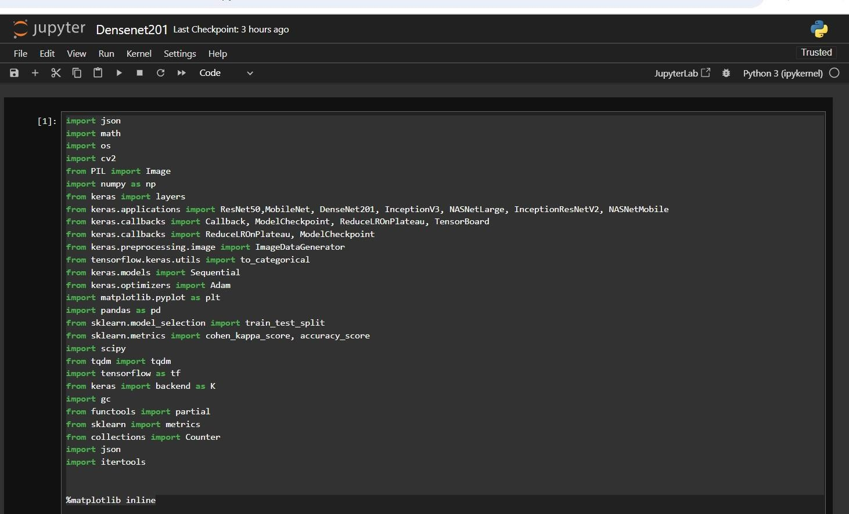
GOKARAJU RANGARAJU INSTITUTE OF ENGINEERING AND TECHNOLOGY
Department of Computer Science and Engineering
Implementation and Execution
importing libraries:

Slide 8
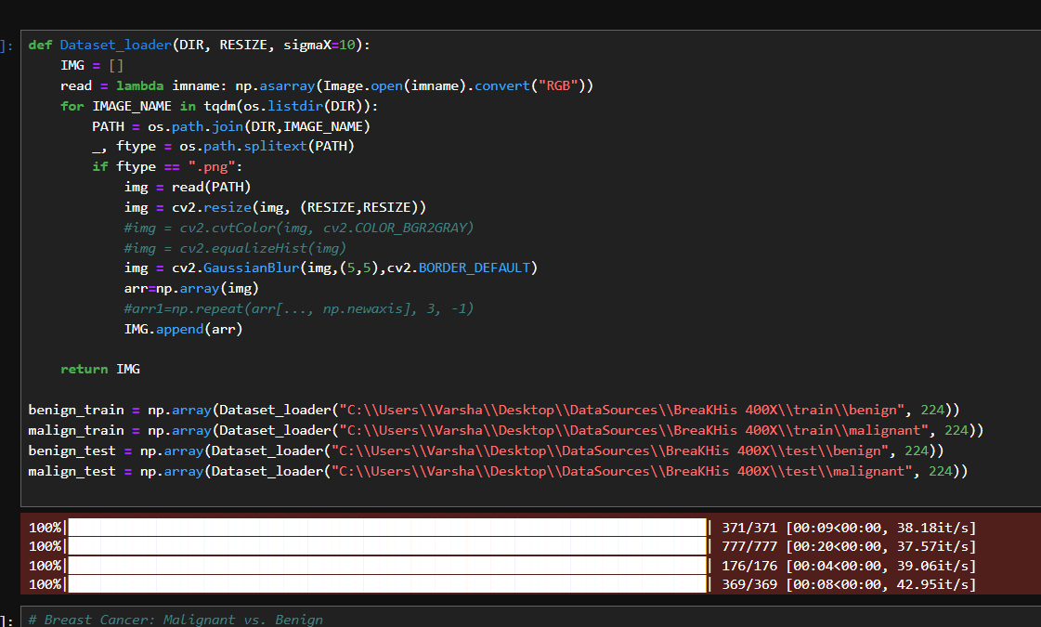
GOKARAJU RANGARAJU INSTITUTE OF ENGINEERING AND TECHNOLOGY
Department of Computer Science and Engineering
Dividing into training and testing Data:

Slide 9
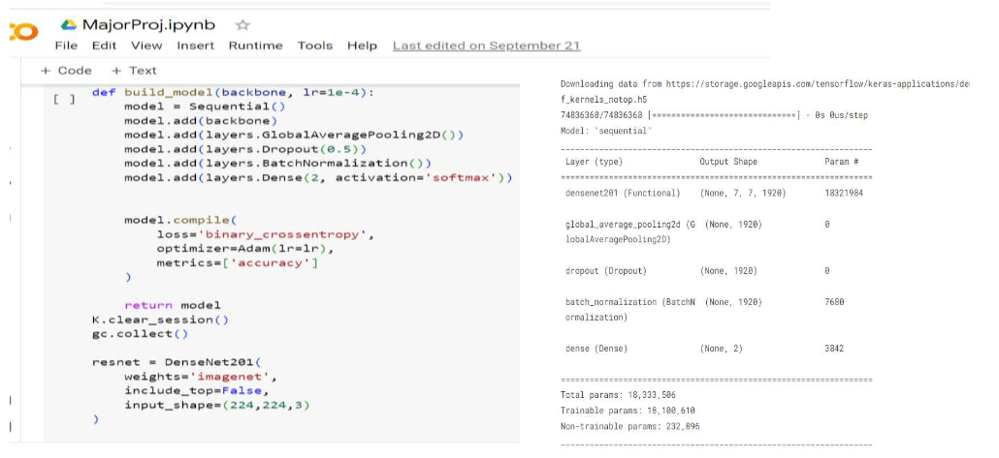
GOKARAJU RANGARAJU INSTITUTE OF ENGINEERING AND TECHNOLOGY
Department of Computer Science and Engineering
Building densenet Model:

Slide 10
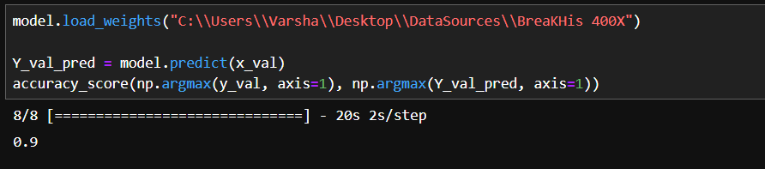
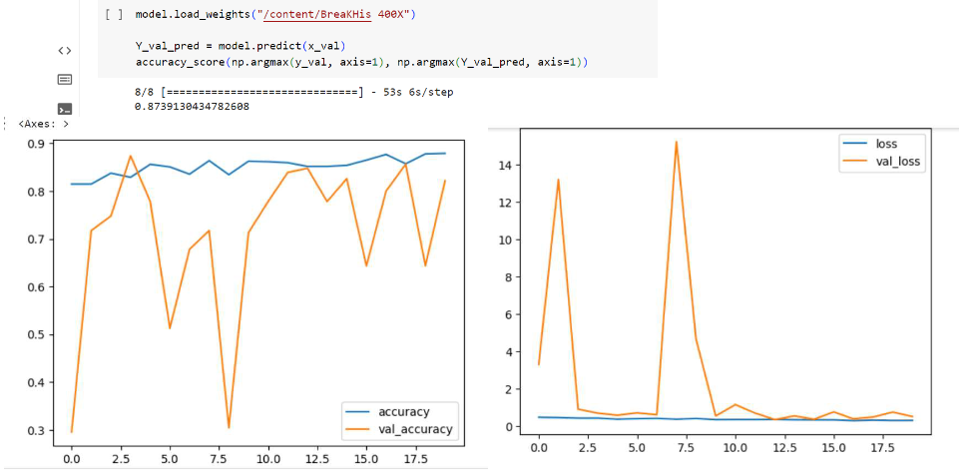
GOKARAJU RANGARAJU INSTITUTE OF ENGINEERING AND TECHNOLOGY
Department of Computer Science and Engineering

Slide 11
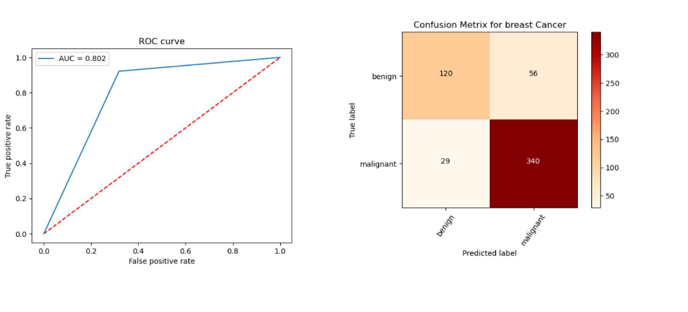
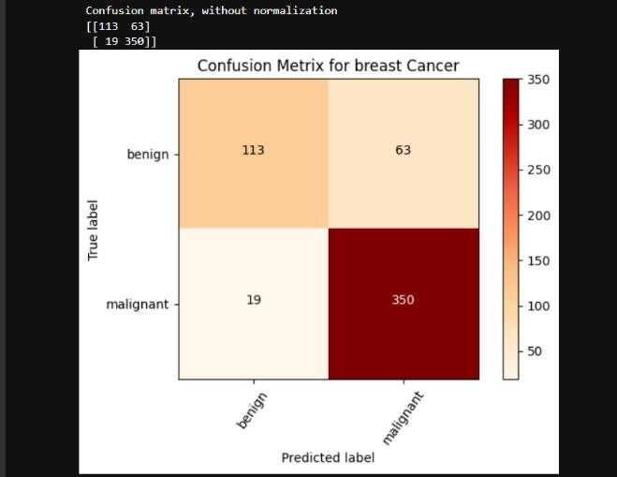
GOKARAJU RANGARAJU INSTITUTE OF ENGINEERING AND TECHNOLOGY
Department of Computer Science and Engineering

Slide 12
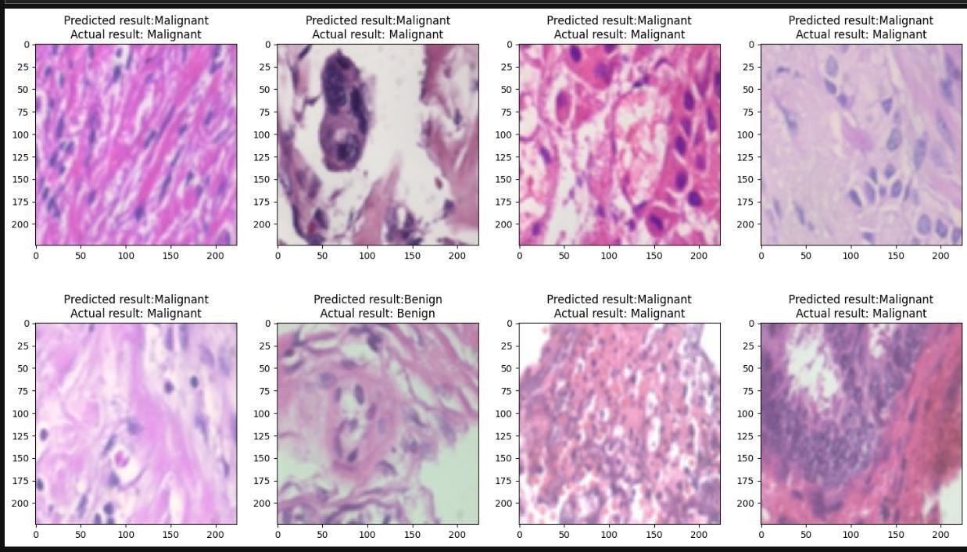
GOKARAJU RANGARAJU INSTITUTE OF ENGINEERING AND TECHNOLOGY
Department of Computer Science and Engineering

Slide 13
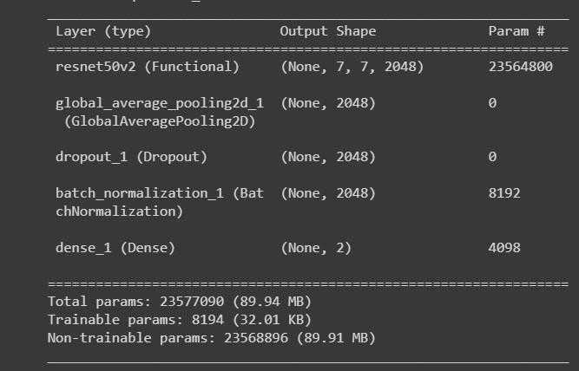
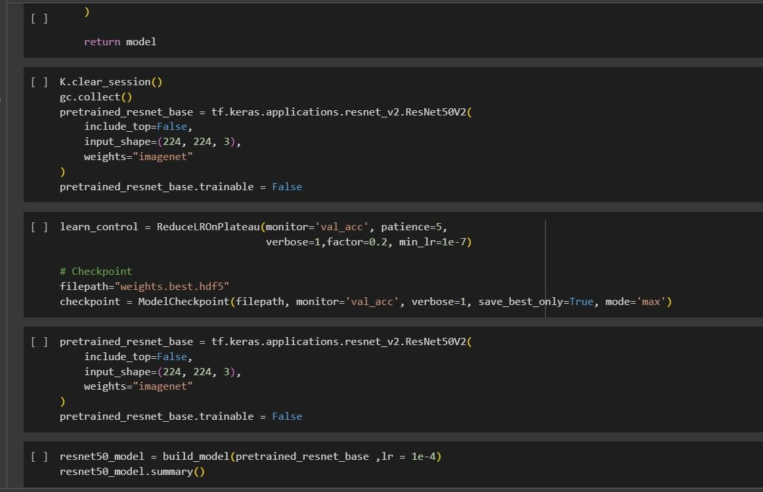
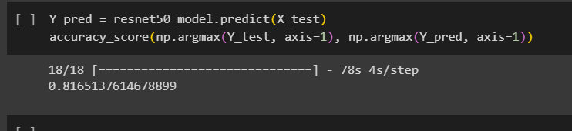
GOKARAJU RANGARAJU INSTITUTE OF ENGINEERING AND TECHNOLOGY
Department of Computer Science and Engineering
Resnet50
Accuracy:

Slide 14
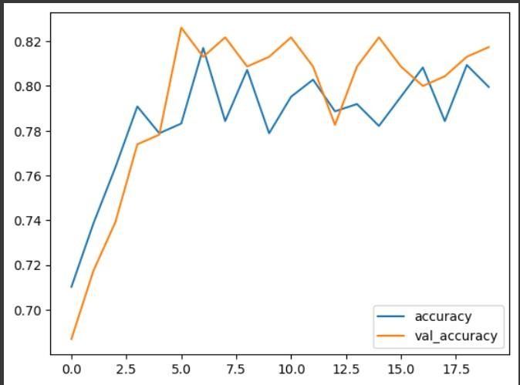
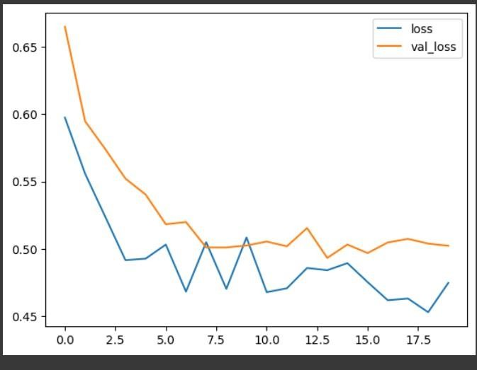
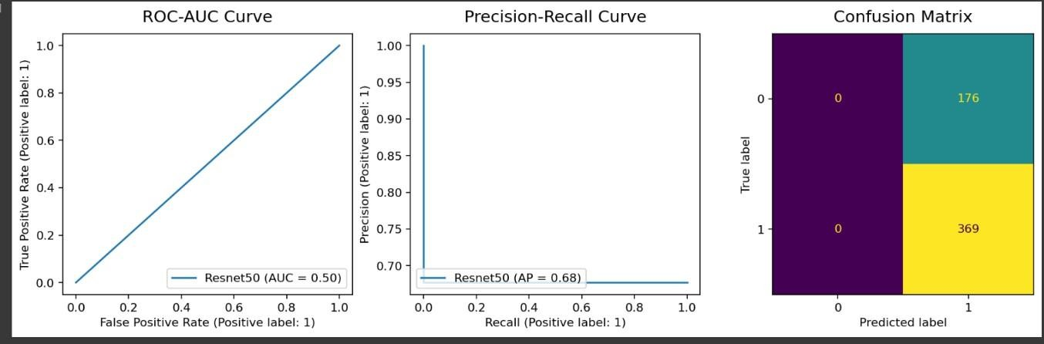
GOKARAJU RANGARAJU INSTITUTE OF ENGINEERING AND TECHNOLOGY
Department of Computer Science and Engineering

Slide 15
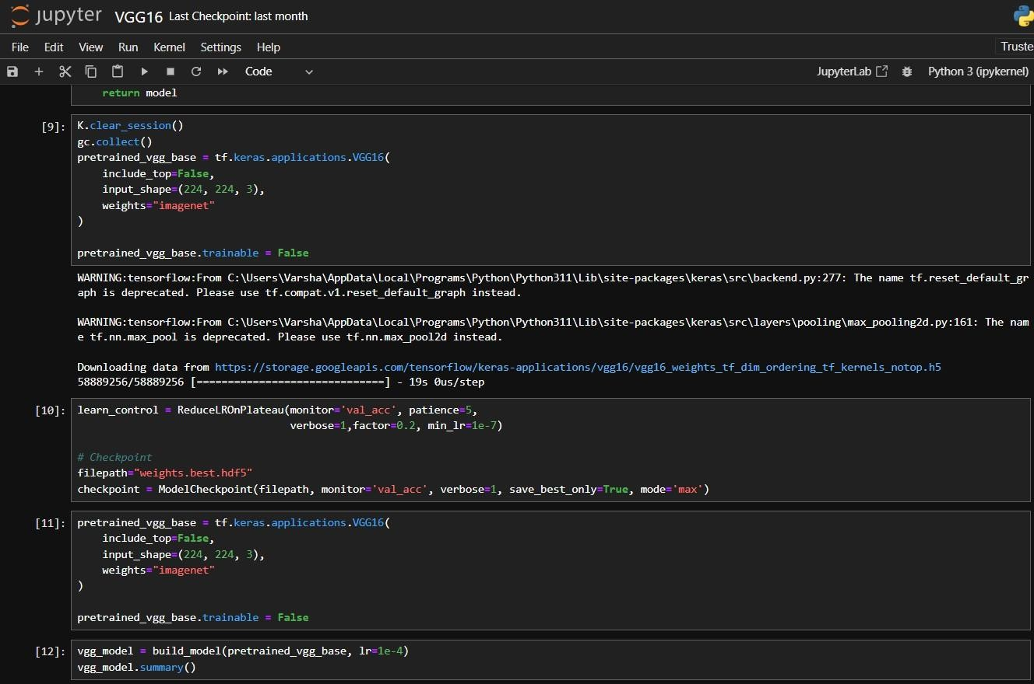
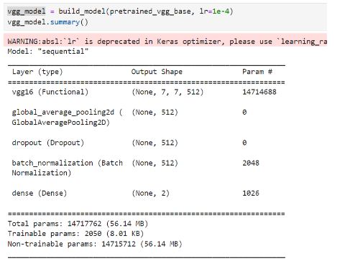
VGG16
GOKARAJU RANGARAJU INSTITUTE OF ENGINEERING AND TECHNOLOGY
Department of Computer Science and Engineering

Slide 16
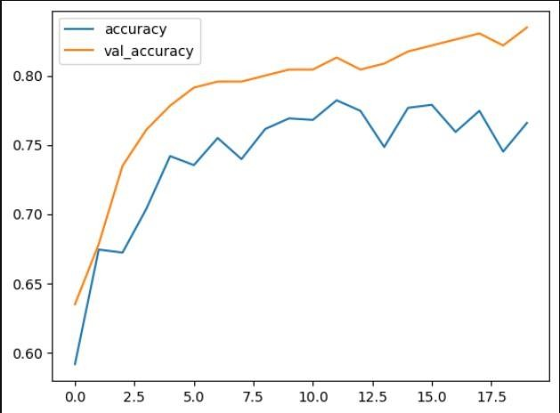
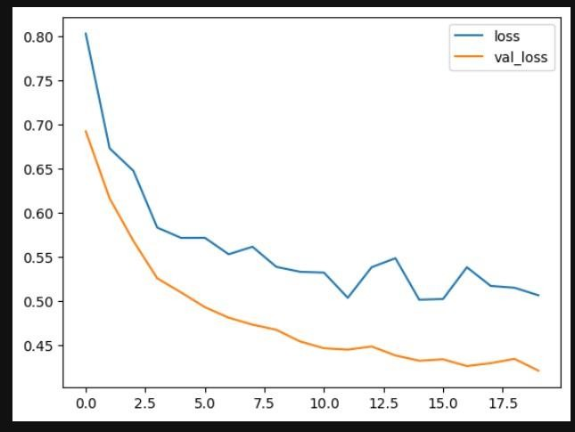
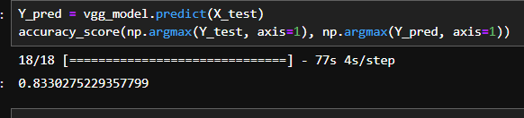
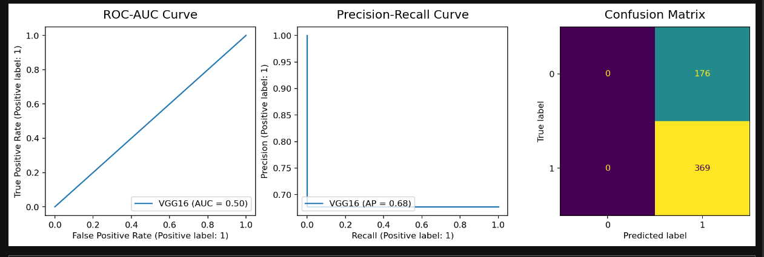
GOKARAJU RANGARAJU INSTITUTE OF ENGINEERING AND TECHNOLOGY
Department of Computer Science and Engineering
Accuracy:

Slide 17
GOKARAJU RANGARAJU INSTITUTE OF ENGINEERING AND TECHNOLOGY
Department of Computer Science and Engineering
Output:
Densenet
Resnet
VGG
1
2
3

Slide 18
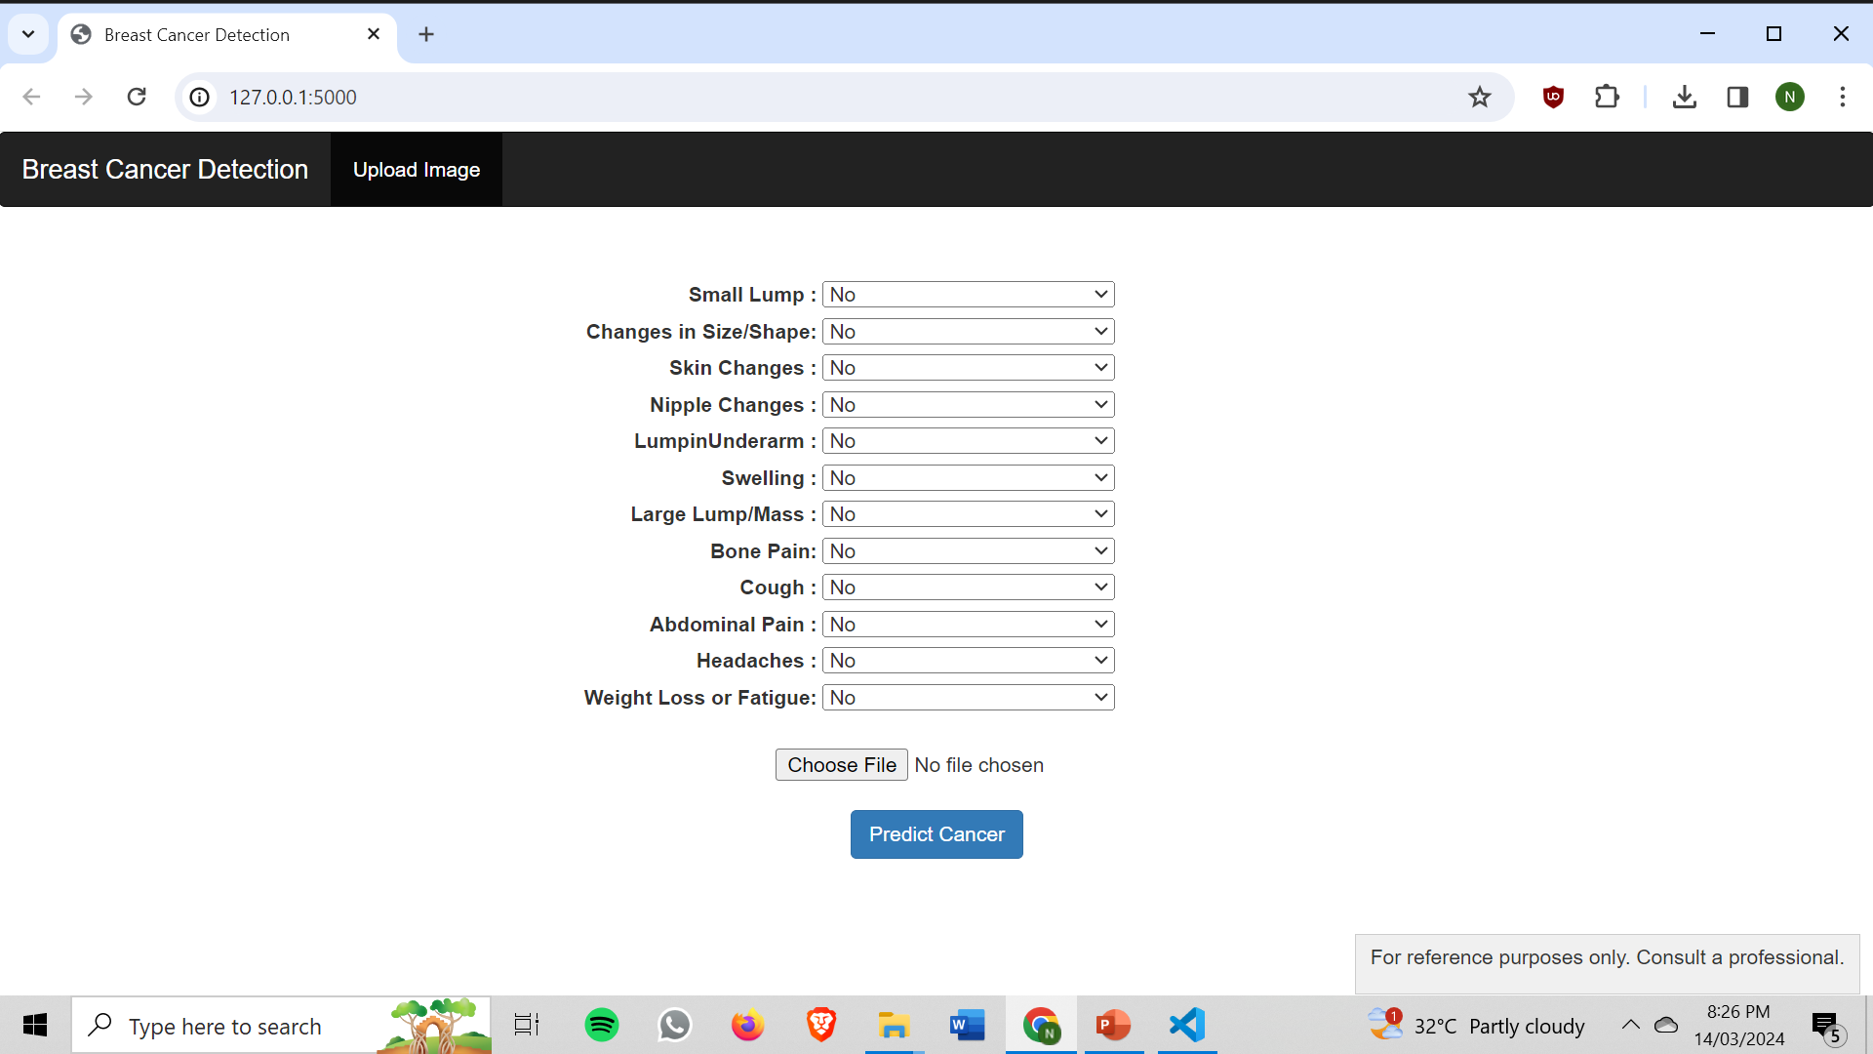
GOKARAJU RANGARAJU INSTITUTE OF ENGINEERING AND TECHNOLOGY
Department of Computer Science and Engineering
Output:
User Interface of the project:

Slide 19
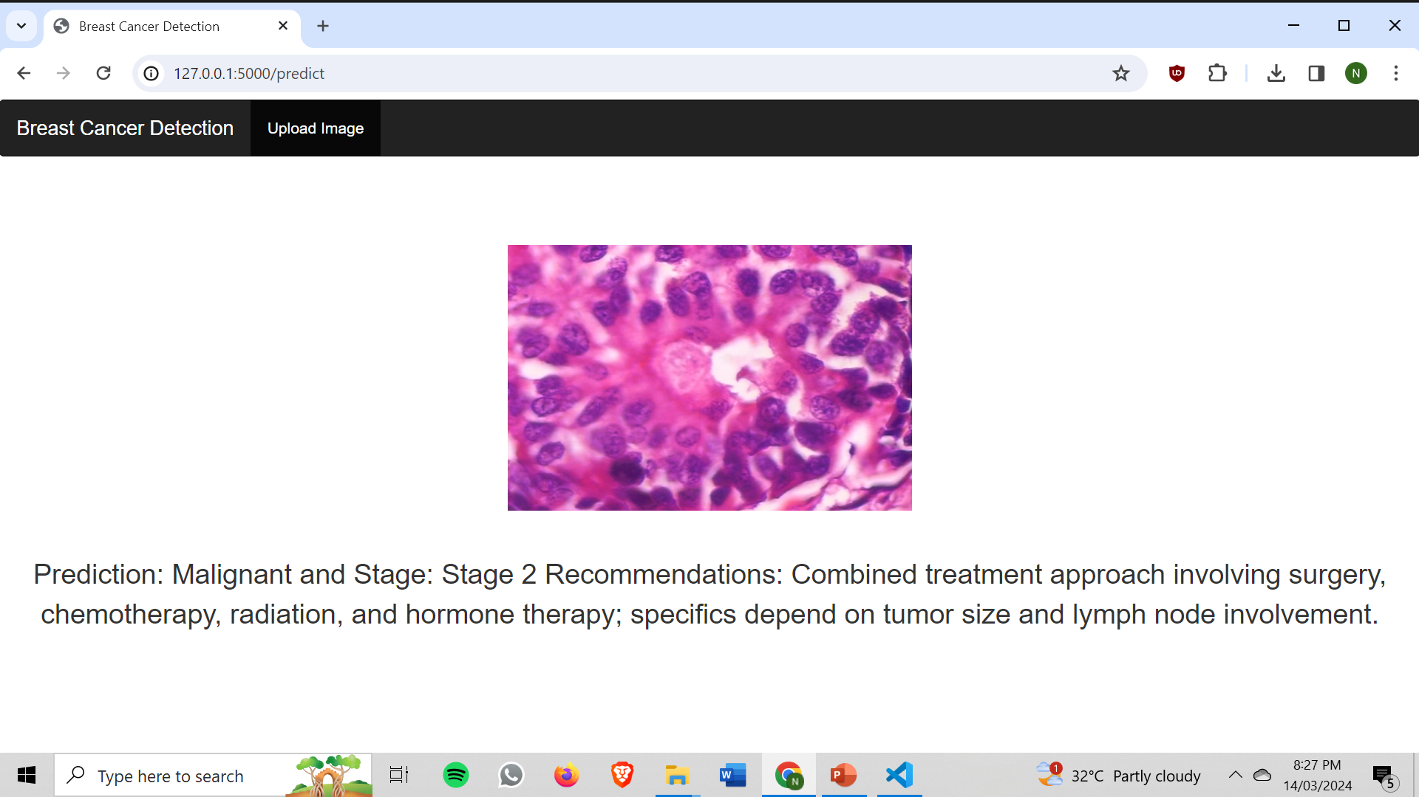
GOKARAJU RANGARAJU INSTITUTE OF ENGINEERING AND TECHNOLOGY
Department of Computer Science and Engineering
Output:
User Interface of the project:

Slide 20

GOKARAJU RANGARAJU INSTITUTE OF ENGINEERING AND TECHNOLOGY
Department of Computer Science and Engineering
Output:
User Interface of the project:

Slide 21
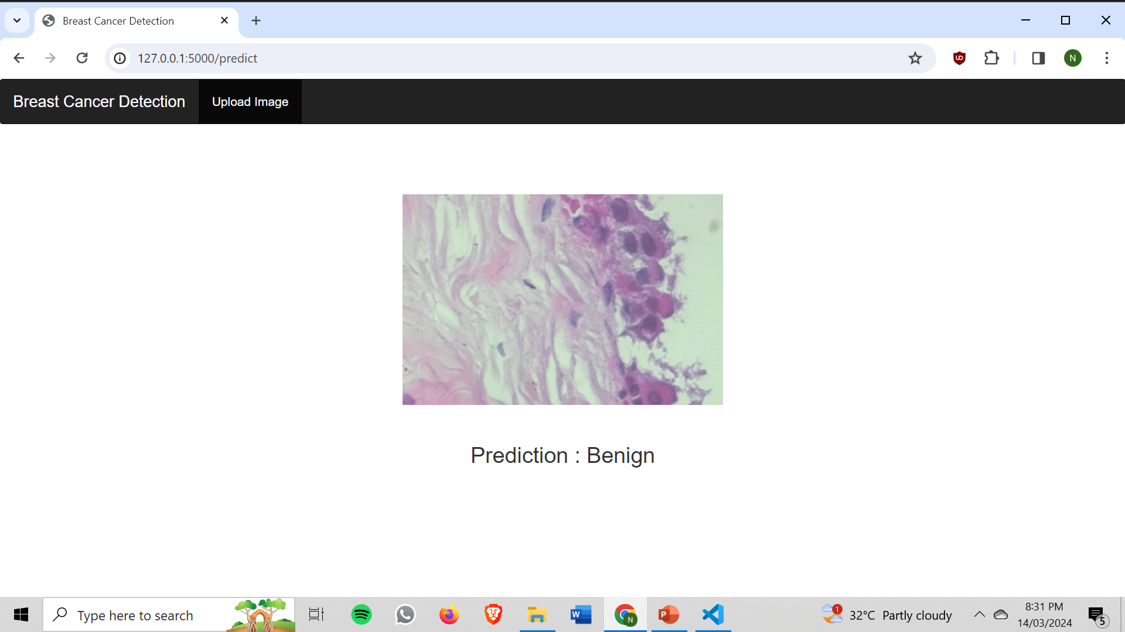
GOKARAJU RANGARAJU INSTITUTE OF ENGINEERING AND TECHNOLOGY
Department of Computer Science and Engineering
Output:
User Interface of the project:

Slide 22
GOKARAJU RANGARAJU INSTITUTE OF ENGINEERING AND TECHNOLOGY
Department of Computer Science and Engineering
Conclusion:
In conclusion, our project on breast cancer classification utilizing deep learning methodologies marks a significant advancement in the realm of medical imaging and machine learning. Through the integration of diverse datasets encompassing biopsy images, mammograms, and mri data, alongside the development of sophisticated deep learning models to achieve optimal performance . The culmination of our efforts is manifested in a user-friendly interface empowering clinicians and patients to leverage insights for informed decision-making and proactive health management. The suggested model accurately predicts whether a given sample of image has cancer or is normal using a number of convolutional layers. This is extremely useful in the medical field for detecting Cancer in patients early and accurately. Early diagnosis is critical for saving a person’s life by ensuring that the patient receives effective and timely treatment. Detection of Cancer phase/stage using Decision Tree also helps in the diagnosis and treatment effectively.

Slide 23
GOKARAJU RANGARAJU INSTITUTE OF ENGINEERING AND TECHNOLOGY
Department of Computer Science and Engineering
THANK YOU!

