Slide 1

GOKARAJU RANGARAJU INSTITUTE OF ENGINEERING AND TECHNOLOGY
Department of Computer Science and Engineering
Major Project Phase-II
Final Review
Smart Platform for Breast Cancer Classification using Deep Learning Techniques
- Guide : G.Mallikarjuna Rao,Professor
M.BHAVITA-20241A0591
M.SAHITHI-20241A0595
N.VARSHA-20241A0599
R.NIKITHA-20241A05B1

Slide 2
GOKARAJU RANGARAJU INSTITUTE OF ENGINEERING AND TECHNOLOGY
Department of Computer Science and Engineering
ABSTRACT
Breast cancer is prevalent and potentially a life-threatening disease that demands early detection for effective treatment and improved patient outcomes. Machine learning and deep learning techniques aid in breast cancer prediction by algorithms on medical images, identifying specific features and classifying disease presence or absence. The project entails a multi-stage process. First, a diverse and well-curated dataset of medical images is collected , encompassing both cancerous and non-cancerous cases. Through meticulous preprocessing and data augmentation, the dataset's quality and diversity are optimized, preparing it for subsequent analysis. Various deep learning architectures , including Convolutional Neural Networks (CNNs) and possibly more specialized models for medical image analysis, are explored to extract intricate patterns and features from the images . Upon determining the optimal model, the system is deployed to classify new, unseen medical images. The model's predictions aid healthcare professionals in making informed decisions about breast cancer diagnosis and treatment planning.

Slide 3
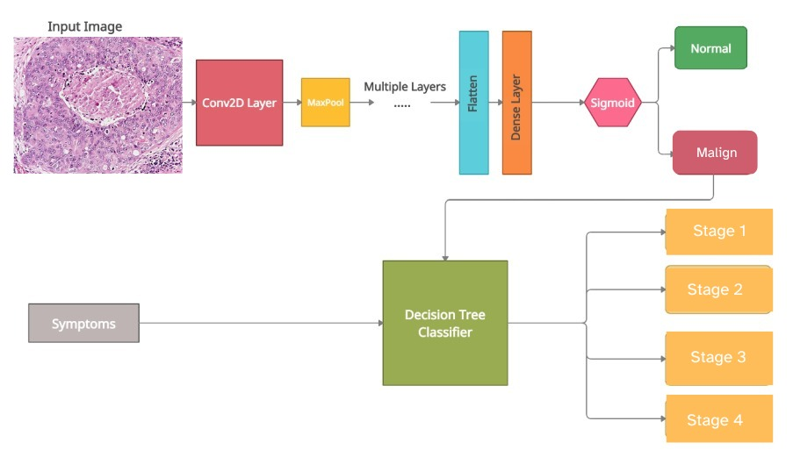
GOKARAJU RANGARAJU INSTITUTE OF ENGINEERING AND TECHNOLOGY
Department of Computer Science and Engineering
Proposed Architecture:

Slide 4
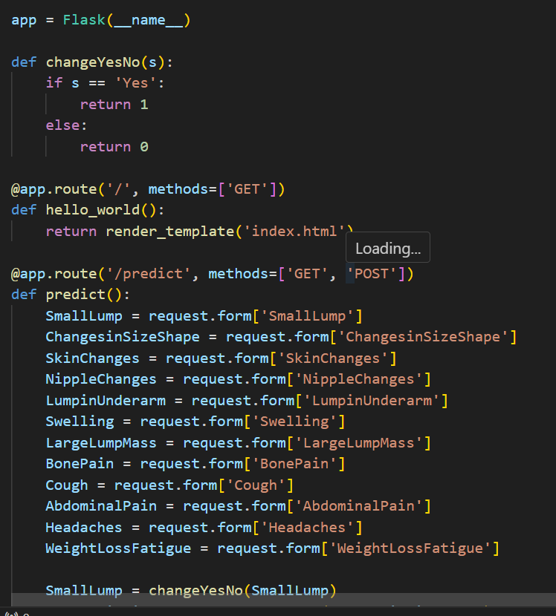
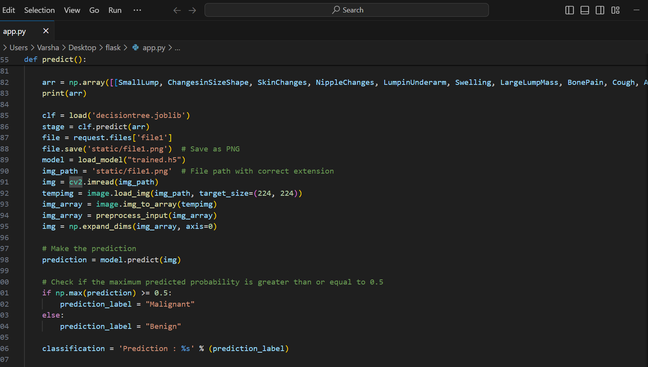
GOKARAJU RANGARAJU INSTITUTE OF ENGINEERING AND TECHNOLOGY
Department of Computer Science and Engineering
GUI:

Slide 5
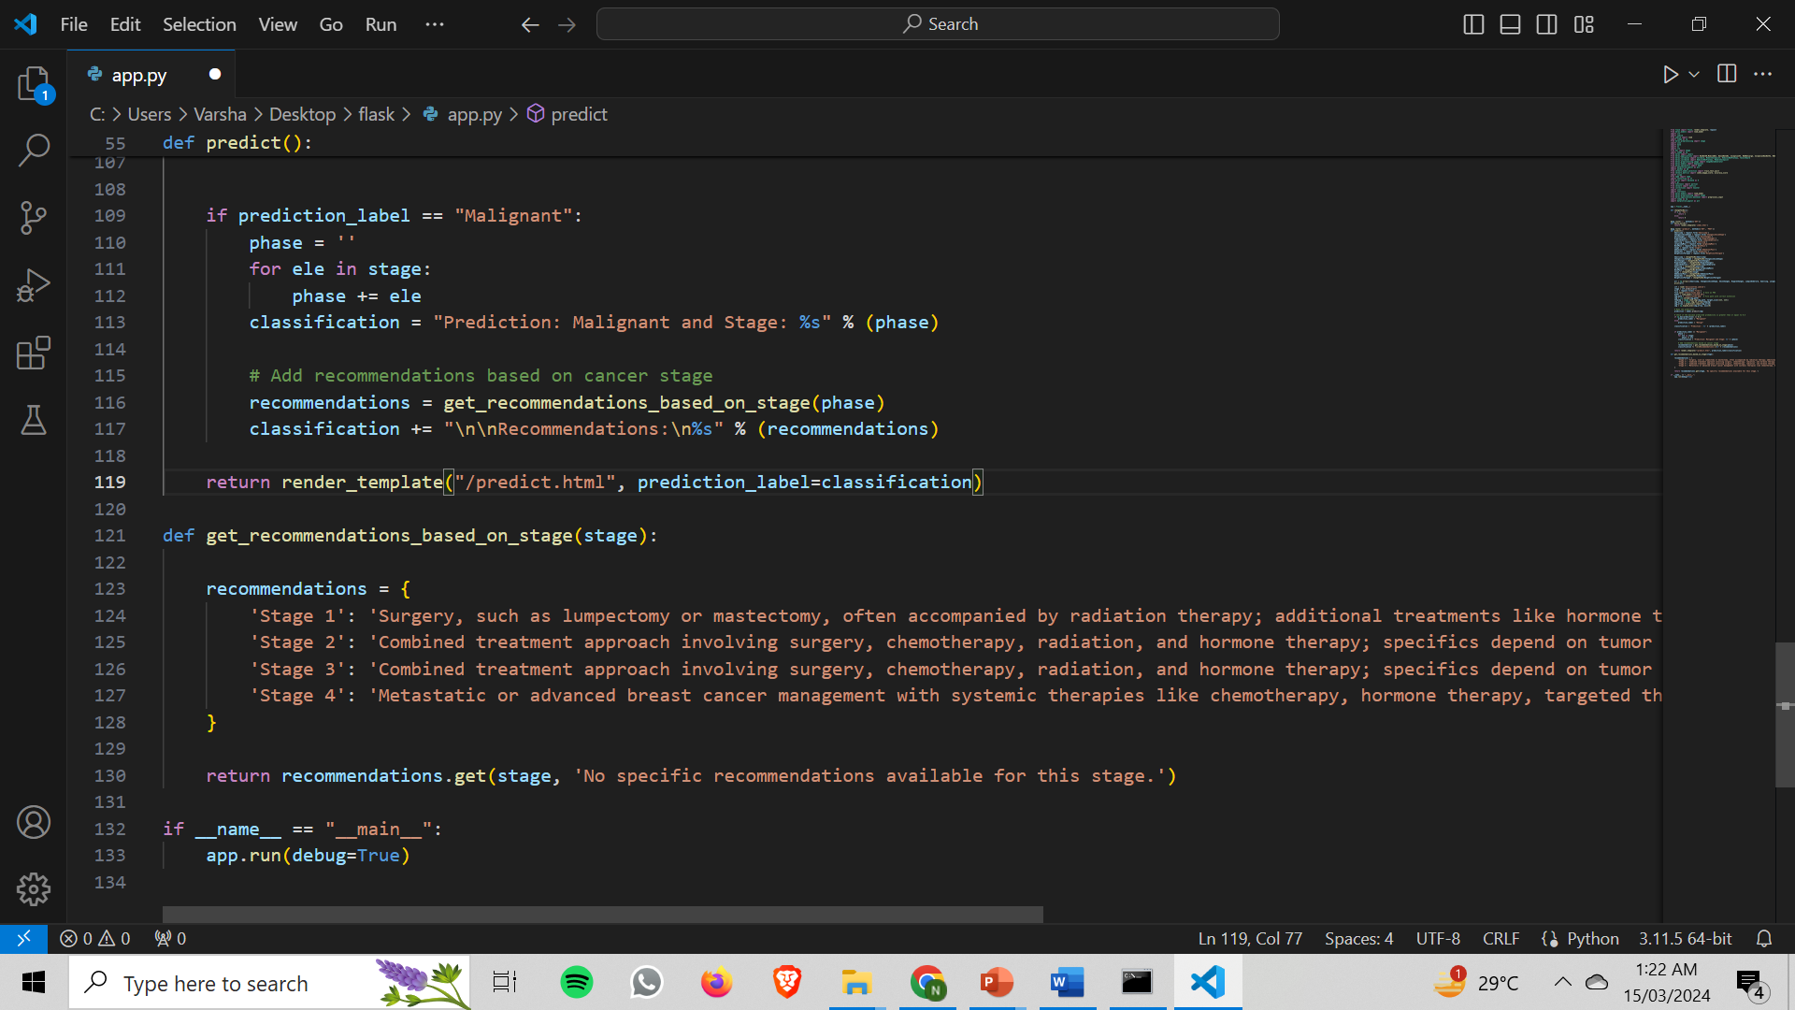
GOKARAJU RANGARAJU INSTITUTE OF ENGINEERING AND TECHNOLOGY
Department of Computer Science and Engineering
User Interface:

Slide 6
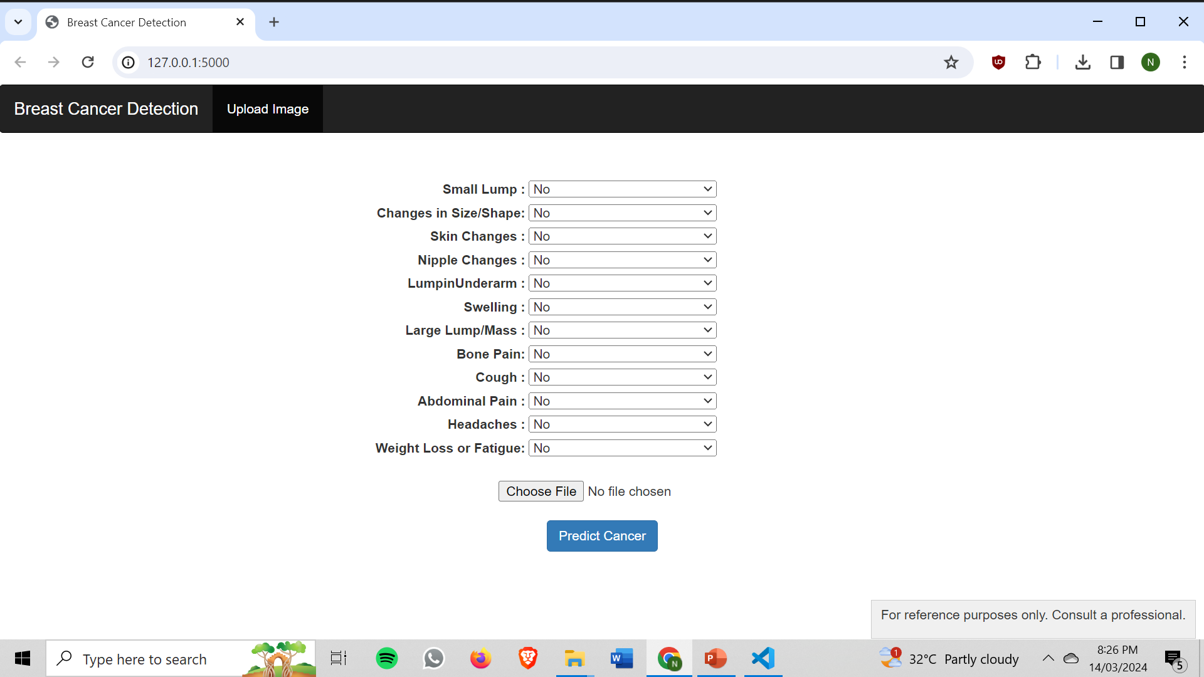
GOKARAJU RANGARAJU INSTITUTE OF ENGINEERING AND TECHNOLOGY
Department of Computer Science and Engineering
GUI:

Slide 7
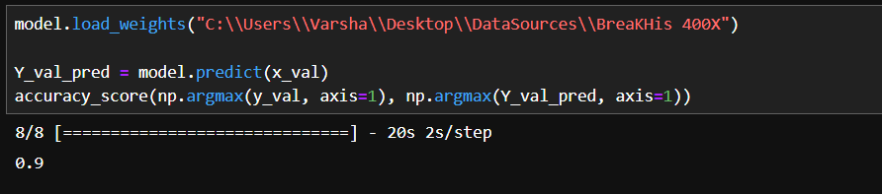
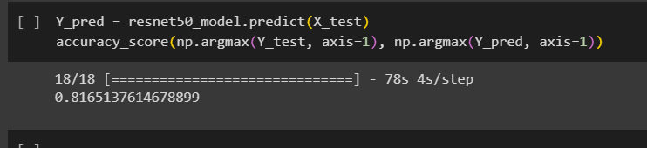
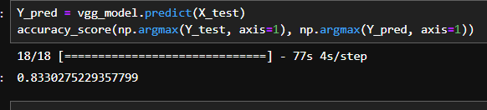
GOKARAJU RANGARAJU INSTITUTE OF ENGINEERING AND TECHNOLOGY
Department of Computer Science and Engineering
Result Analysis:
Densenet
Resnet
VGG
1
2
3

Slide 8

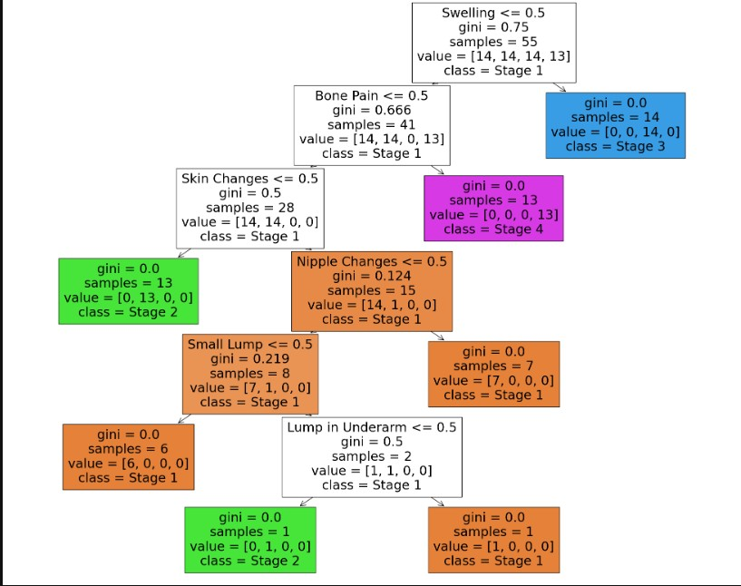
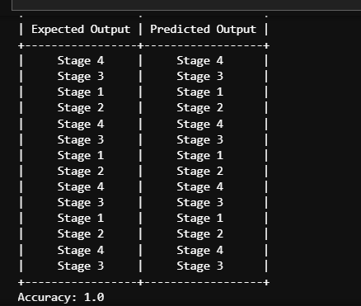
GOKARAJU RANGARAJU INSTITUTE OF ENGINEERING AND TECHNOLOGY
Department of Computer Science and Engineering
Results for DecisonTreeClassifier:

Slide 9
GOKARAJU RANGARAJU INSTITUTE OF ENGINEERING AND TECHNOLOGY
Department of Computer Science and Engineering
Result Analysis:
Integration of Heterogeneous Data Sets:
Heterogeneous data sources, including mammograms and mri images, were integrated by standardizing formats, addressing missing values, and normalizing data for consistency. Feature extraction techniques such as texture analysis and edge detection were employed across modalities, followed by fusion methods to create a unified representation. Challenges included aligning disparate data formats, selecting relevant features, and ensuring consistent normalization.
Stage Detection and Classification:
Stages 0-IV indicate the severity of cancer progression based on symptoms, crucial for determining appropriate interventions like surgery, chemotherapy, or radiation therapy. Understanding cancer stages aids in prognosis and treatment efficacy assessment.
User Interface Development:
The user-friendly interface allowed users to upload mammograms and ultrasound images, select classification models, and visualize results including predicted cancer stages and feature importance.
Patient Education:
Integrated educational resources provided patients with information on cancer stages, treatment options, and preventive measures, empowering informed decision-making for their healthcare journey.

Slide 10
Publication Status
Conference Name :5th IEEE India Council International Subsections Conference 2024
Track Name:Track 4 : Artificial Intelligence and Data Science
Paper ID:1743
Paper Title
Advancing Breast Cancer Diagnosis: An In-depth Examination of Deep Learning-based Classification Methods
Submission Files
IEEE_Advancing_Breast_Cancer_Diagnosis_An_In-depth_Examination_of_Deep_Learningbased_Classifica.doc (3.4 Mb, 4/13/2024, 2:00:34 PM)

Slide 11
GOKARAJU RANGARAJU INSTITUTE OF ENGINEERING AND TECHNOLOGY
Department of Computer Science and Engineering
Conclusion:
In conclusion, our project on breast cancer classification utilizing deep learning methodologies marks a significant advancement in the realm of medical imaging and machine learning. Through the integration of diverse datasets encompassing biopsy images, mammograms, and mri data, alongside the development of sophisticated deep learning models to achieve optimal performance . The culmination of our efforts is manifested in a user-friendly interface empowering clinicians and patients to leverage insights for informed decision-making and proactive health management. The suggested model accurately predicts whether a given sample of image has cancer or is normal using a number of convolutional layers. This is extremely useful in the medical field for detecting Cancer in patients early and accurately. Early diagnosis is critical for saving a person’s life by ensuring that the patient receives effective and timely treatment. Detection of Cancer phase/stage using Decision Tree also helps in the diagnosis and treatment effectively.

Slide 12
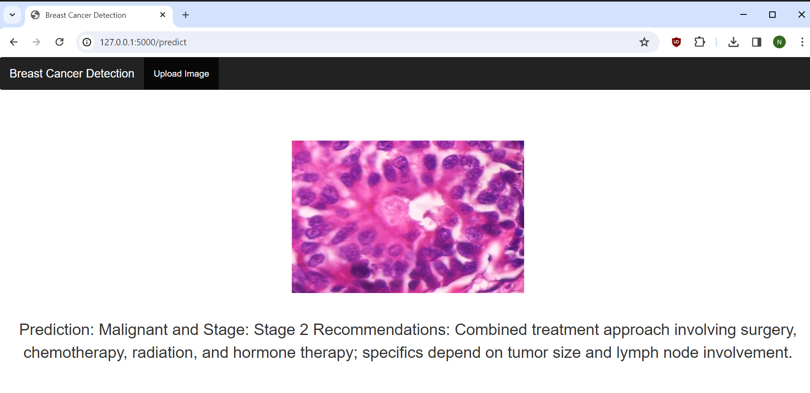
GOKARAJU RANGARAJU INSTITUTE OF ENGINEERING AND TECHNOLOGY
Department of Computer Science and Engineering
Snapshots:
User Interface:
Fig. Sample Output showing Malign and its stage as Prediction with recommendations.

Slide 13

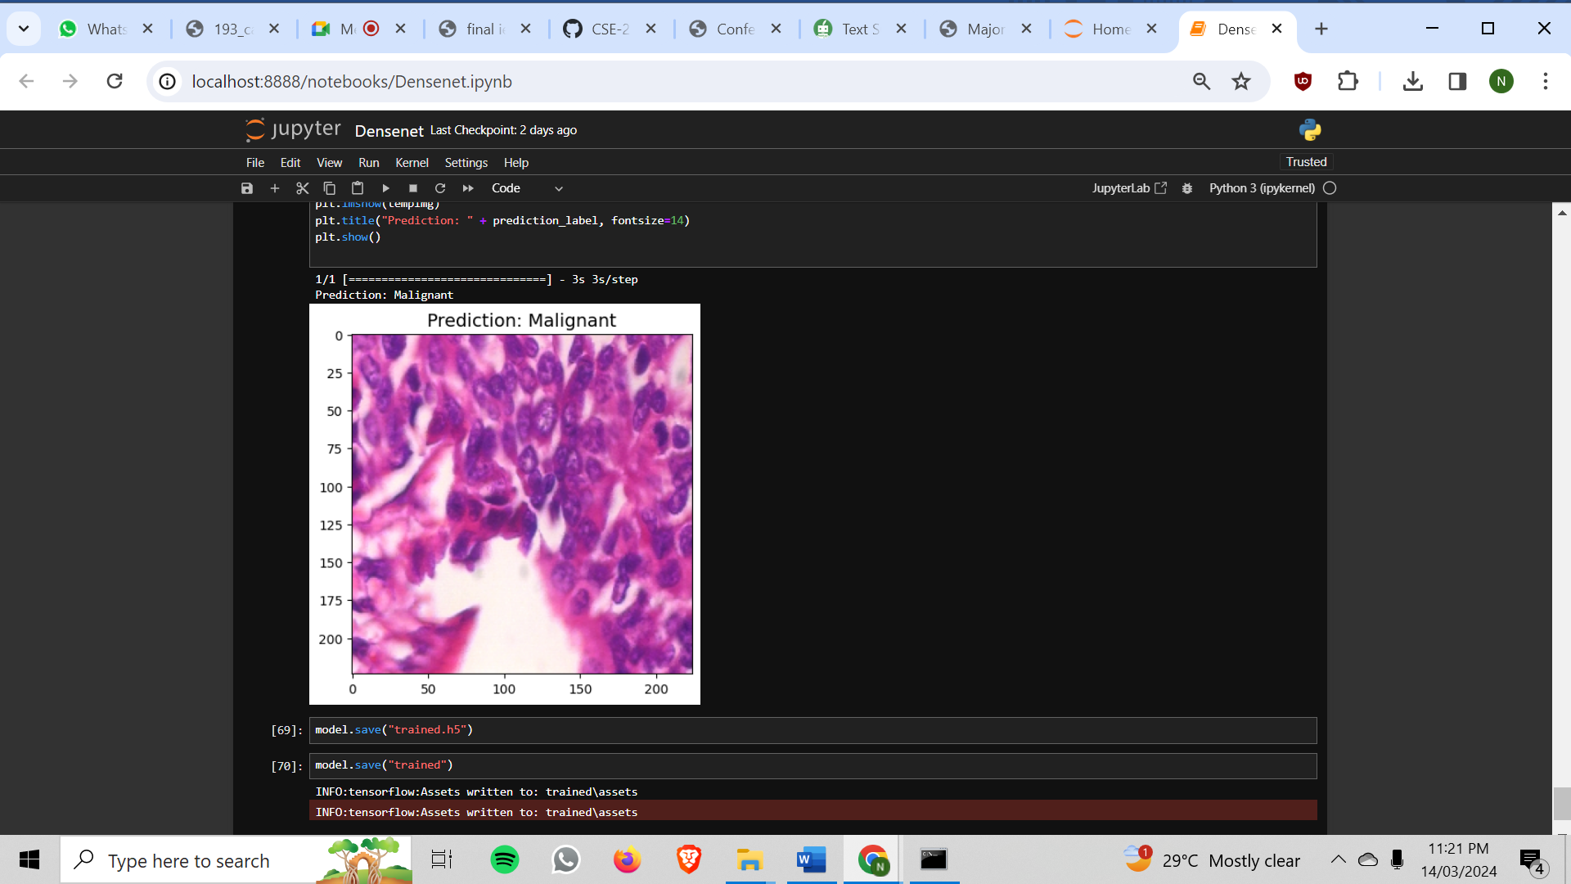
GOKARAJU RANGARAJU INSTITUTE OF ENGINEERING AND TECHNOLOGY
Department of Computer Science and Engineering
Snapshots:
User Interface:
Fig. Sample Output showing Malign and its stage as Prediction with recommendations.

Slide 14
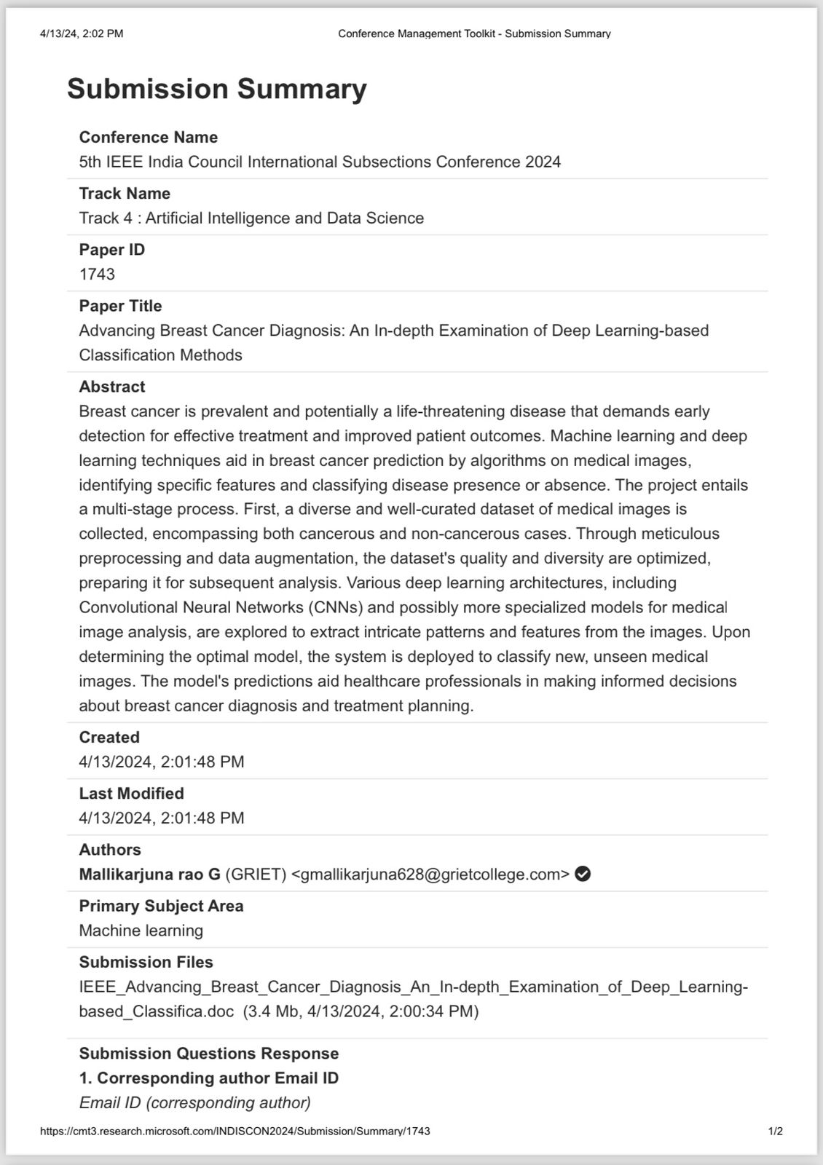
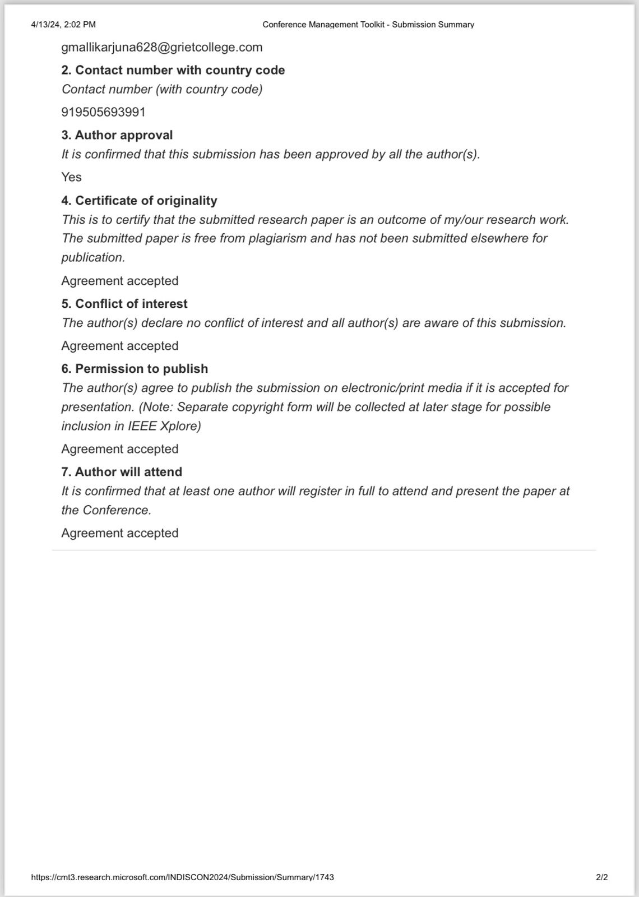
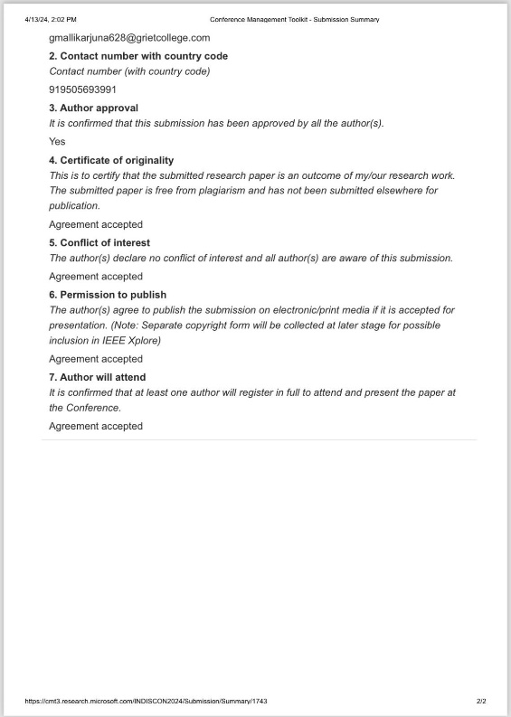
Proof of Publication

Slide 15
GOKARAJU RANGARAJU INSTITUTE OF ENGINEERING AND TECHNOLOGY
Department of Computer Science and Engineering
THANK YOU!

