Slide 1

Smart Framework for Identification of Food Adulteration using IoT -Mr.G Mallikarjuna Rao, Professor
GOKARAJU RANGARAJU INSTITUTE OF ENGINEERING AND TECHNOLOGY
Department of Computer Science and Engineering
MINI Project Review-2
Bhavita M-20241A0591
Varsha Naidu-20241A0599
Sahithi Meesala-20241A0595
Nikitha R-20241A05B1

Slide 2
ABSTRACT Existing: . https://journals.resaim.com/ijresm/article/view/245/226 . Proposed: . Food adulteration refers to the practice of deliberately adding substances to food to increase its volume, weight or to improve its appearance, texture or flavour, it is a significant issue that affects the health and safety of consumers. With the increasing demand for food, the risk of contamination and intentional addition of harmful substances has increased. There are several existing methods for detecting food adulteration, including Chemical analysis, Microscopy, Sensory analysis etc. While these methods are useful, they can be timeconsuming, labour-intensive, and may not provide real-time results. The use of Internet of Things (IoT), Machine Learning (ML) can greatly enhance the ability to identify food adulteration. In this project, we propose a solution to detect food adulteration using IoT and machine learning. The system consists of IoT sensors and devices that can be used to gather data on various parameters such as temperature, pH, colour etc. The collected data is fed into machine learning algorithms for pre-processing, analysis, and testing and any anomalies or deviations from the normal patterns are flagged for further investigation.ML algorithms can continuously learn from the data collected, allowing them to continually improve their accuracy and effectiveness over time. By implementing this system, we aim to create a real-time, datadriven approach to detecting food adulteration, ensuring food safety and quality for consumers by creating a warning system.
GOKARAJU RANGARAJU INSTITUTE OF ENGINEERING AND TECHNOLOGY
Department of Computer Science and Engineering
MINI Project Review-2

Slide 3
GOKARAJU RANGARAJU INSTITUTE OF ENGINEERING AND TECHNOLOGY
Department of Computer Science and Engineering
MINI Project Review-2
Overall Architecture of the project and its components :

Slide 4
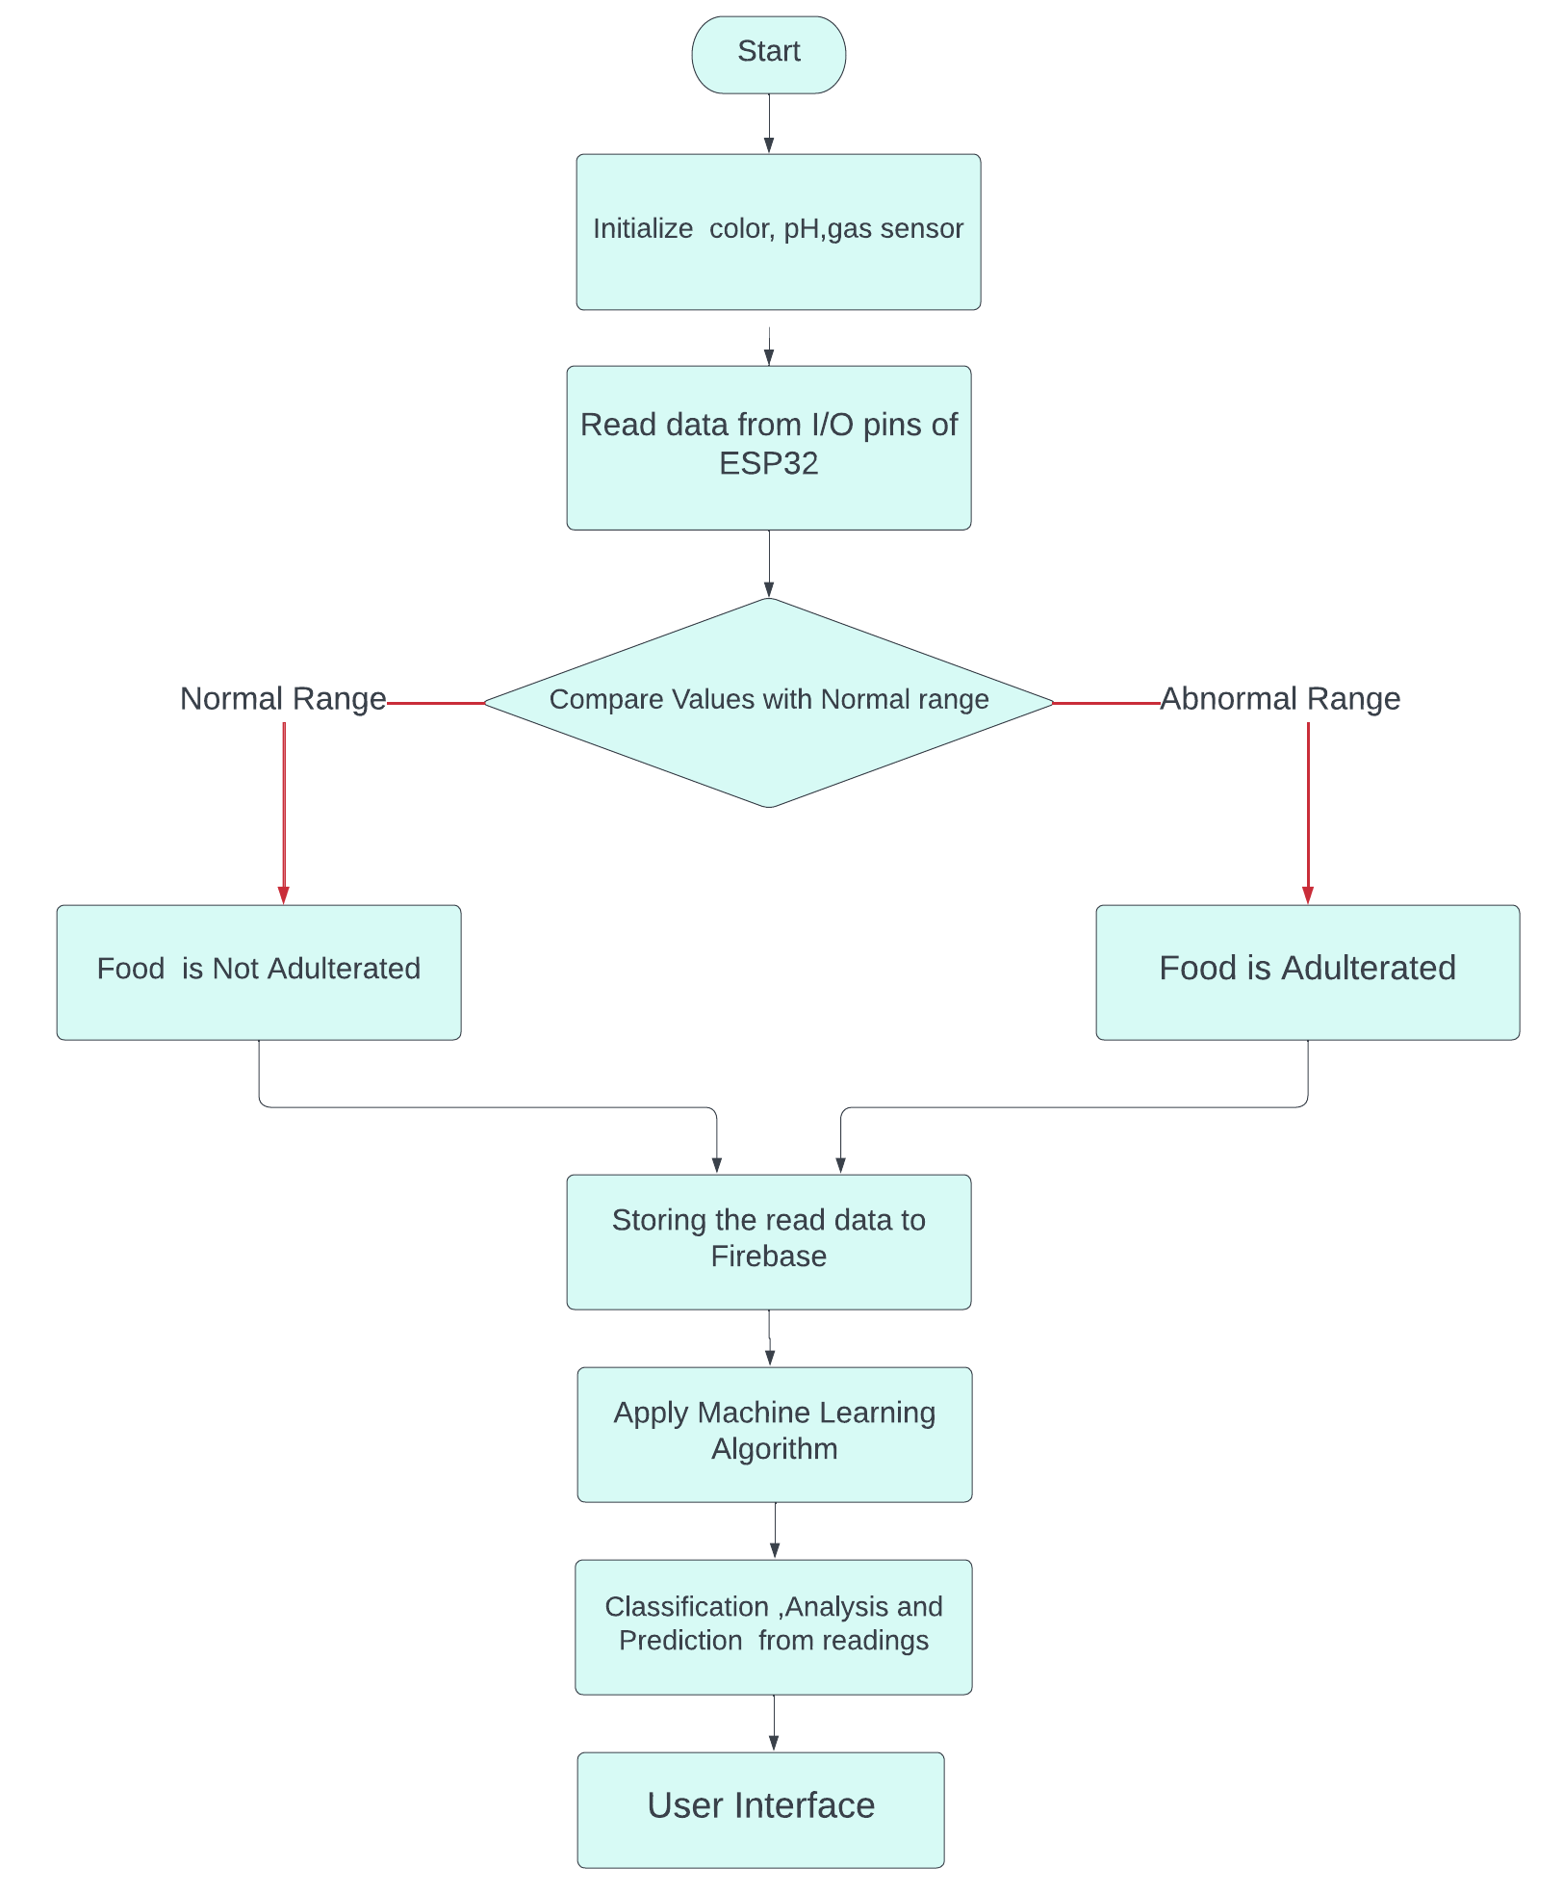
GOKARAJU RANGARAJU INSTITUTE OF ENGINEERING AND TECHNOLOGY
Department of Computer Science and Engineering
MINI Project Review-2

Slide 5
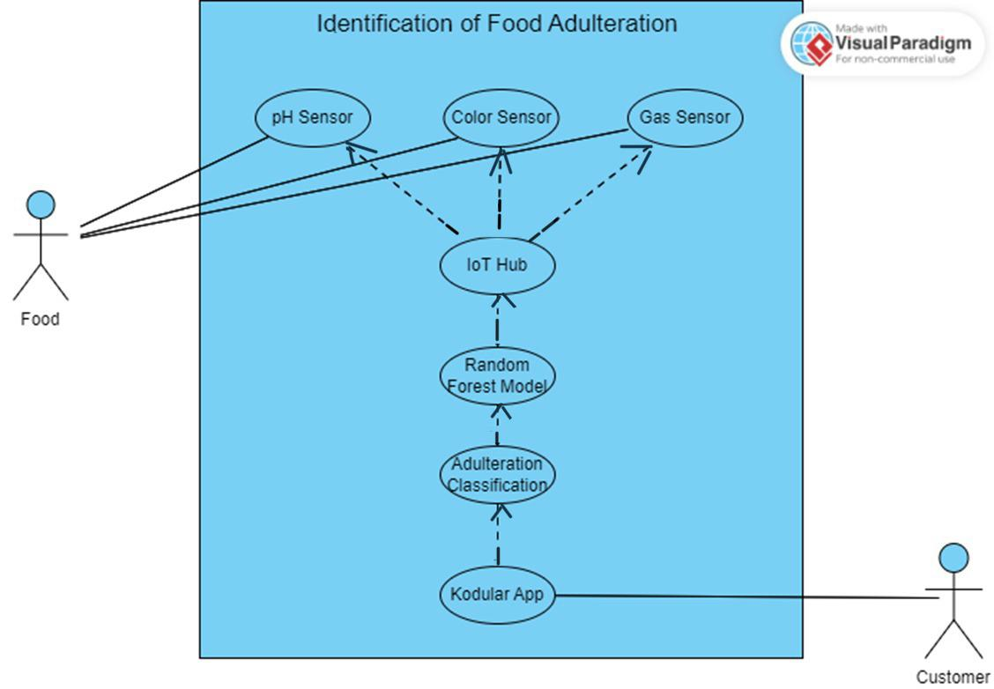
GOKARAJU RANGARAJU INSTITUTE OF ENGINEERING AND TECHNOLOGY
Department of Computer Science and Engineering
MINI Project Review-2
Usecase Diagram:
Using UML :

Slide 6
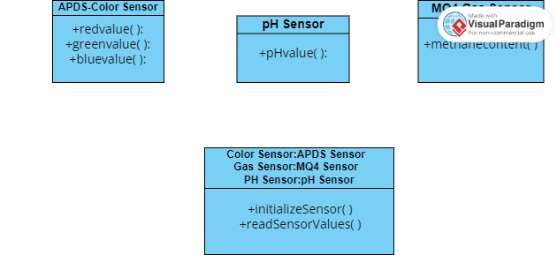
Each Module in the project (module with UML)
GOKARAJU RANGARAJU INSTITUTE OF ENGINEERING AND TECHNOLOGY
Department of Computer Science and Engineering
MINI Project Review-2
Database
Gas Sensor(MQ4)
+readValues( )
+storeValues( )
+methanecontent( ):
RandomForest Model
+trainValues( )
+testValues( )
+classifyValues( )
Application
API
+getValues( )
+showResults( )

Slide 7
GOKARAJU RANGARAJU INSTITUTE OF ENGINEERING AND TECHNOLOGY
Department of Computer Science and Engineering
MINI Project Review-2
Actual algorithm used in this project for each module:
Sensors- Data is collected through sensors using Arduino IDE.
MQ-4:(gas)
The MQ-4 sensor module usually has four pins: VCC, GND, AOUT, and DOUT.
The VCC and GND pins should be connected to the 3.3V and GND pins on the ESP32, respectively.
The AOUT pin should be connected to an analog input pin on the ESP32, such as pin 36.
The DOUT pin can be left unconnected if you don't plan to use it.
APDS9960: (colour )
Connect the VCC pin of the APDS9960 sensor to the 3.3V pin of the ESP32.
Connect the GND pin of the APDS9960 sensor to the GND pin of the ESP32.
Connect the SDA pin of the APDS9960 sensor to the SDA pin of the ESP32. The SDA pin is usually GPIO21 on the ESP32.
Connect the SCL pin of the APDS9960 sensor to the SCL pin of the ESP32. The SCL pin is usually GPIO22 on the ESP32

Slide 8
GOKARAJU RANGARAJU INSTITUTE OF ENGINEERING AND TECHNOLOGY
Department of Computer Science and Engineering
MINI Project Review-2
pH sensor:
Connect the BNC connector of the pH sensor to the ADC module.
Connect the ground wire of the ADC module to the ground pin of the ESP32.
Connect the power supply wire of the ADC module to the 3.3V pin of the ESP32.
Connect the analog output pin of the ADC module to any of the analog input pins of the ESP32 (for example, pin A0).
Upload the appropriate code to read the pH sensor data from the analog input pin of the ESP32 and display it on the serial monitor or send it to a web server or database.
Firebase :
Upload the data from sensors to Firebase server.
Machine Learning Algorithm:
With the use of Random Forest Algorithm , SVM we can classify our data and build predictive models.
User Interface:
We can build an interactive application using kodular app to get information about whether the tested food is adulterated or not.

Slide 9
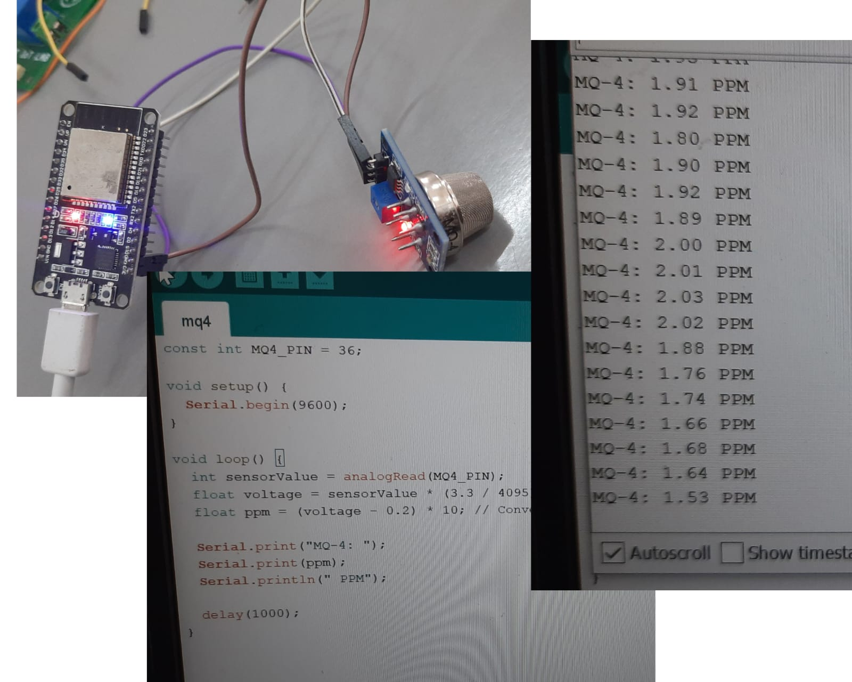
GOKARAJU RANGARAJU INSTITUTE OF ENGINEERING AND TECHNOLOGY
Department of Computer Science and Engineering
MINI Project Review-2
MQ-4:
Project Implementation and Execution:
const int MQ4_PIN = 36;
void setup() {
Serial.begin(9600);
}void loop() {
int sensorValue = analogRead(MQ4_PIN);
float voltage = sensorValue * (3.3 / 4095); // Convert ADC value to voltage
float ppm = (voltage - 0.2) * 10; // Convert voltage to PPM (parts per million)
Serial.print("MQ-4: ");
Serial.print(ppm);
Serial.println(" PPM");
delay(1000);
}

Slide 10
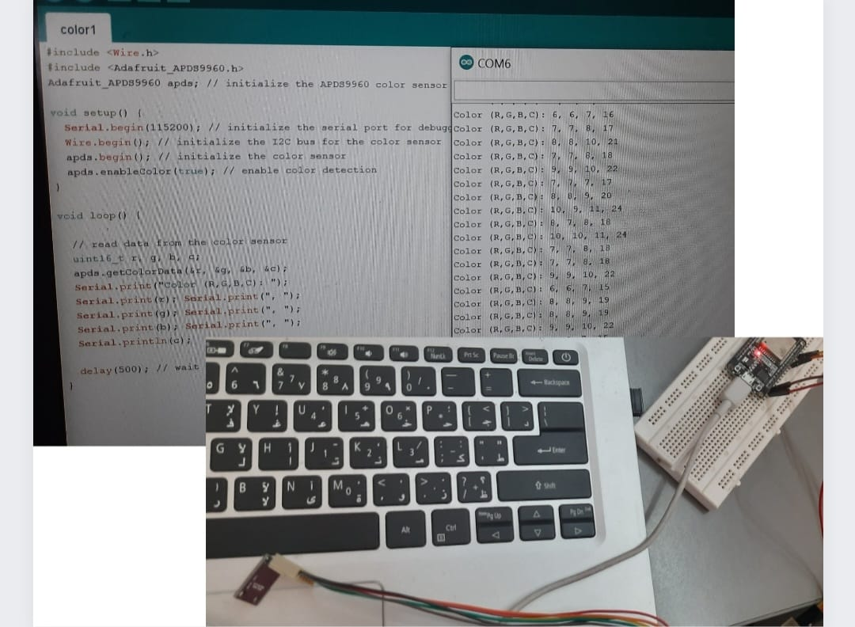
GOKARAJU RANGARAJU INSTITUTE OF ENGINEERING AND TECHNOLOGY
Department of Computer Science and Engineering
MINI Project Review-2
#include <Wire.h> APDS9960:
#include <Adafruit_APDS9960.h>
Adafruit_APDS9960 apds; // initialize the APDS9960 color sensor
void setup() {
Serial.begin(115200); // initialize the serial port for debugging
Wire.begin(); // initialize the I2C bus for the color sensor
apds.begin(); // initialize the color sensor
apds.enableColor(true); // enable color detection
}
void loop() { // read data from the color sensor
uint16_t r, g, b, c;
apds.getColorData(&r, &g, &b, &c);
Serial.print("Color (R,G,B,C): ");
Serial.print(r); Serial.print(", ");
Serial.print(g); Serial.print(", ");
Serial.print(b); Serial.print(", ");
Serial.println(c);
delay(500); // wait for a short time before taking the next sensor reading
}

Slide 11
GOKARAJU RANGARAJU INSTITUTE OF ENGINEERING AND TECHNOLOGY
Department of Computer Science and Engineering
MINI Project Review-2
EXECUTION:

Slide 12
GOKARAJU RANGARAJU INSTITUTE OF ENGINEERING AND TECHNOLOGY
Department of Computer Science and Engineering
MINI Project Review-2
Thank you!
Any Queries?

