Slide 1



Therapeutic Warming Beans
Helps alleviate pain and inflammation with various size warming beans to contour your body
This Photo by Unknown Author is licensed under CC BY-NC-ND

Slide 2
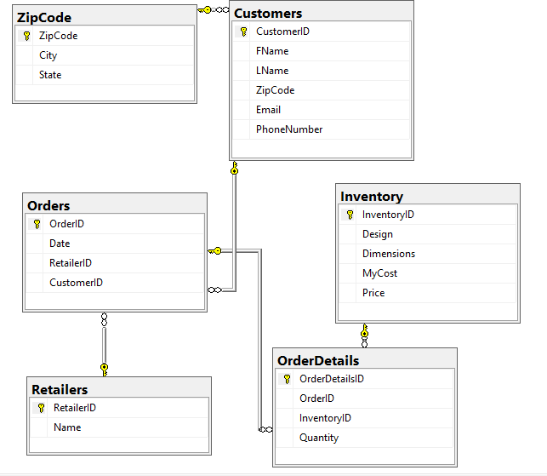
Database Diagram

Slide 3
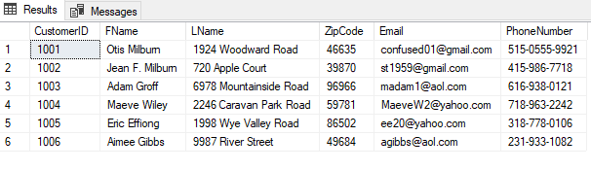
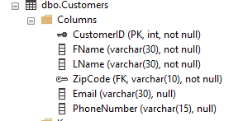
Customers Table

Slide 4
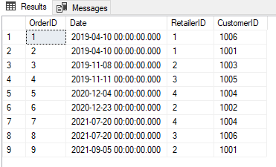
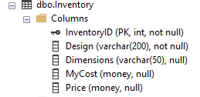
Inventory

Slide 5
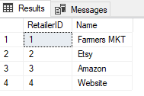

Retailers

Slide 6
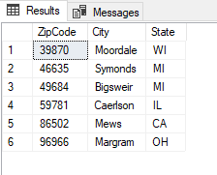

ZipCode

Slide 7
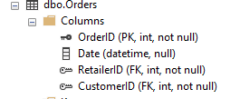
Orders

Slide 8
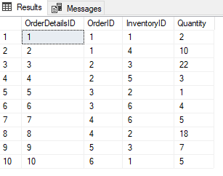
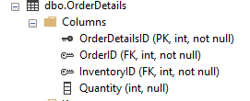
Order Details

Slide 9
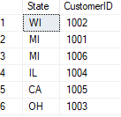

Summary Query #1

Slide 10
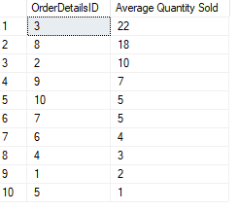
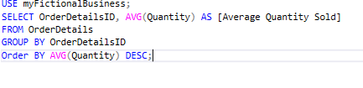
Summary Query #2

Slide 11
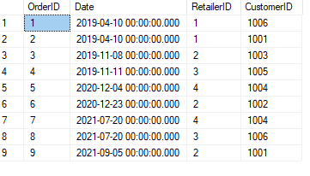
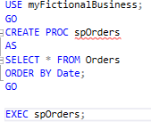
Stored Procedure #1

Slide 12
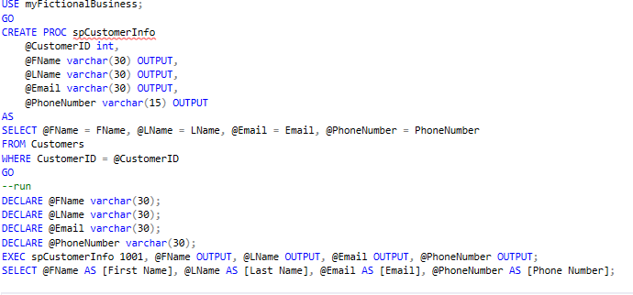

Stored Procedure #2

Slide 13
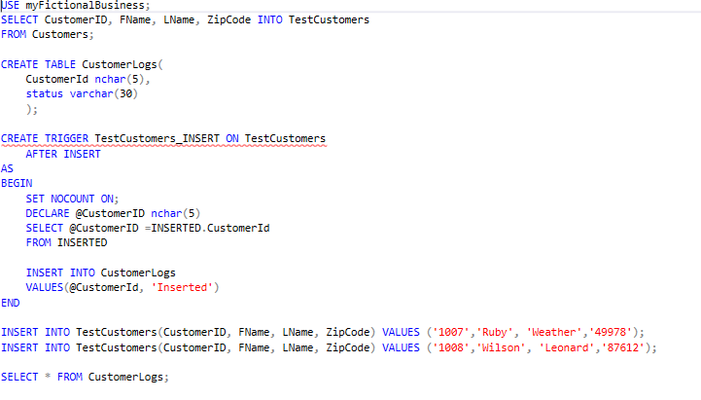

Trigger #1
This SQL code was designed to trigger an ‘insert’ when new customers are input into the CustomerLogs table. After a new customer is added, the message ‘Inserted’ appears in the table.

Slide 14
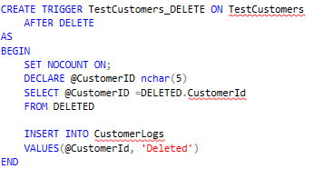
Trigger #2
This SQL code was created to delete the Customer from the system after the trigger is initiated.

Slide 15
What went well……
I enjoyed working on this project. I created myFictionalBusiness to showcase a potential business of therapeutic warming beans in the future. I have been making them myself for years, as well as making them for friends and family. Setting the business was probably the easy part since I already had an idea. I enjoyed developing different SQL code to go along with my business to showcase what I have learned so far.

Slide 16
What I had problems with…..
Creating SQL code for myFictionalBusiness was challenging at times. I did struggle with sub queries and triggers. Sub queries were a hard concept to initially grasp for me. I didn’t fully understand why I would develop it and what the use was for it. It took a few tries, but I believe I understand it better. Triggers were also hard to understand. I understood why you would develop a trigger, but the construction of one is tedious. I developed over 5 triggers, and every time I would get to adding information and it would throw an error, and I would have to start all over. I will definitely need more practice with triggers in the future.

Slide 17
What I learned…..
Coming into this class, I had a brief introduction with SQL For a few weeks in CIT100. In this project I have learned how to construct basic queries, select statements, UPDATE, CREATE, EXECUTE, joins, views, sub queries, functions, and triggers. I have learned so much throughout this class and this project. It has given me the basic understanding of SQL to apply it to future endeavors.

Slide 18
What I would like to include in future releases…..
In the future, I would like to add to myFictionalBusiness more tables and more specific queries to break down the information for marketing purposes. I would like to see what type of audience would be purchasing the product so I could expand more options for purchases. I would also like to add a query to look at the purchases and see which products sell the most and what makes the most profit. I could develop a trigger to store that information into a table called profit.

