Slide 1



Therapeutic Warming Beans
Helps alleviate pain and inflammation with various size warming beans to contour your body
This Photo by Unknown Author is licensed under CC BY-NC-ND

Slide 2
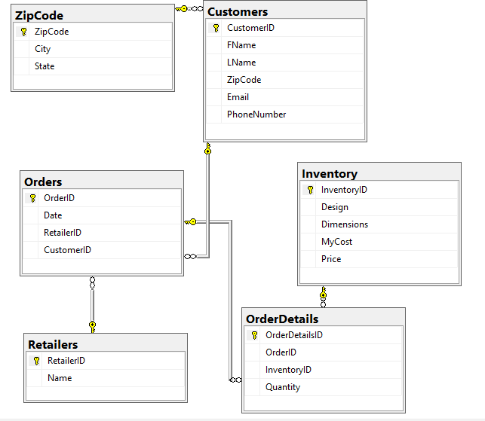
Database Diagram

Slide 3
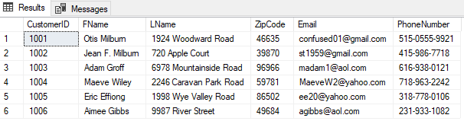
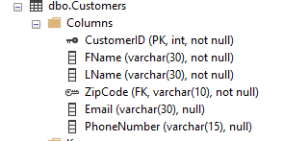
Customers Table

Slide 4
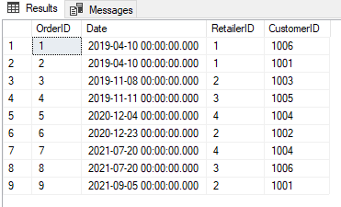
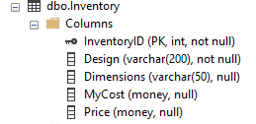
Inventory

Slide 5
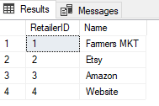

Retailers

Slide 6
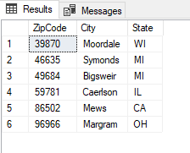

ZipCode

Slide 7
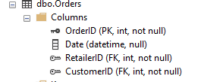
Orders

Slide 8
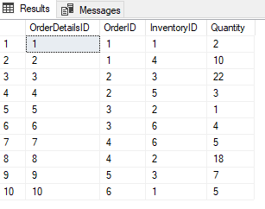
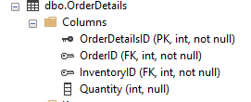
Order Details

Slide 9
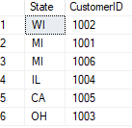

Summary Query #1

Slide 10
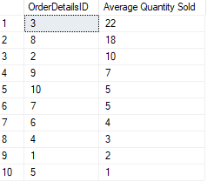
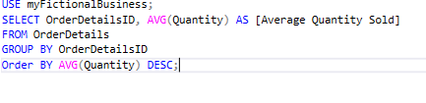
Summary Query #2

Slide 11
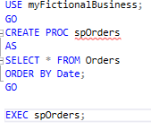
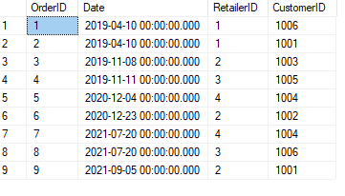
Stored Procedure #1
In this procedure spOrders is being created and the data is displayed by date.

Slide 12
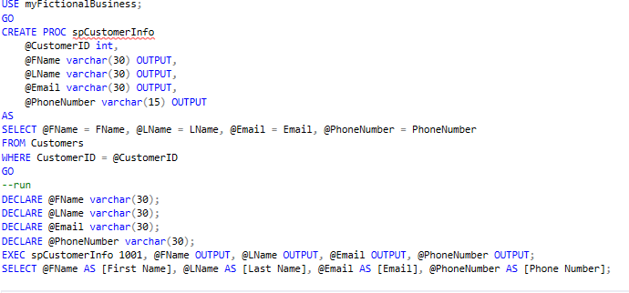

Stored Procedure #2
In this procedure spCustomerInfo we are identifying customer 1001 and it is including First Name, Last Name, Email, and phone number.

Slide 13
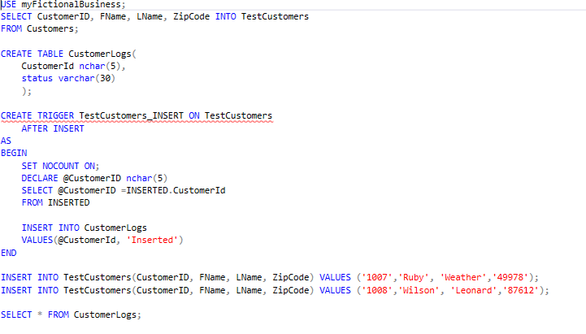

Trigger #1
This SQL code was designed to trigger an ‘insert’ when new customers are input into the CustomerLogs table. After a new customer is added, the message ‘Inserted’ appears in the table.

Slide 14
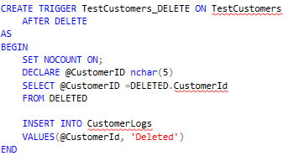
Trigger #2
This SQL code was created to delete the Customer from the system after the trigger is initiated.

Slide 15
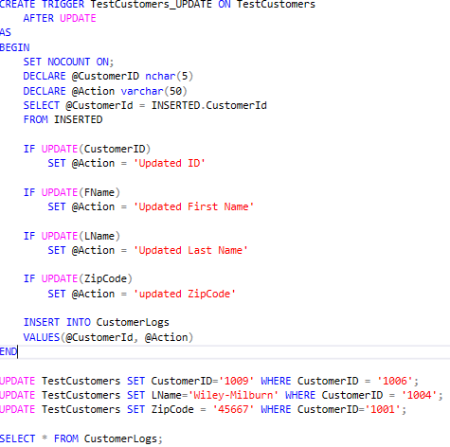
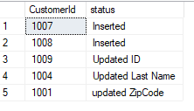
Update Trigger
In this trigger it is updating information for CustomeId 1006 to 1009, changing the last name of customer 1004 to Wiley-Milburn, and updating the Zipcode for customer 1001.

Slide 16
What went well……
I enjoyed working on this project. I created myFictionalBusiness to showcase a potential business of therapeutic warming beans in the future. I have been making them myself for years, as well as making them for friends and family. Setting the business was probably the easy part since I already had an idea. I enjoyed developing different SQL code to go along with my business to showcase what I have learned so far.

Slide 17
What I had problems with…..
Creating SQL code for myFictionalBusiness was challenging at times. I did struggle with sub queries and triggers. Sub queries were a hard concept to initially grasp for me. I didn’t fully understand why I would develop it and what the use was for it. It took a few tries, but I believe I understand it better. Triggers were also hard to understand. I understood why you would develop a trigger, but the construction of one is tedious. I developed over 5 triggers, and every time I would get to adding information and it would throw an error, and I would have to start all over. I will definitely need more practice with triggers in the future.

Slide 18
What I learned…..
Coming into this class, I had a brief introduction with SQL For a few weeks in CIT100. In this project I have learned how to construct basic queries, select statements, UPDATE, CREATE, EXECUTE, joins, views, sub queries, functions, and triggers. I have learned so much throughout this class and this project. It has given me the basic understanding of SQL to apply it to future endeavors.

Slide 19
What I would like to include in future releases…..
In the future, I would like to add to myFictionalBusiness more tables and more specific queries to break down the information for marketing purposes. I would like to see what type of audience would be purchasing the product so I could expand more options for purchases. I would also like to add a query to look at the purchases and see which products sell the most and what makes the most profit. I could develop a trigger to store that information into a table called profit.

